Slide 1
PowerPoint® Lecture Slide Presentation by Robert J. Sullivan, Marist College
Human Biology
CHAPTER 10
RESPIRATORY SYSTEM: EXCHANGE OF GASES
Copyright © 2003 Pearson Education, Inc. publishing as Benjamin Cummings.

Slide 2
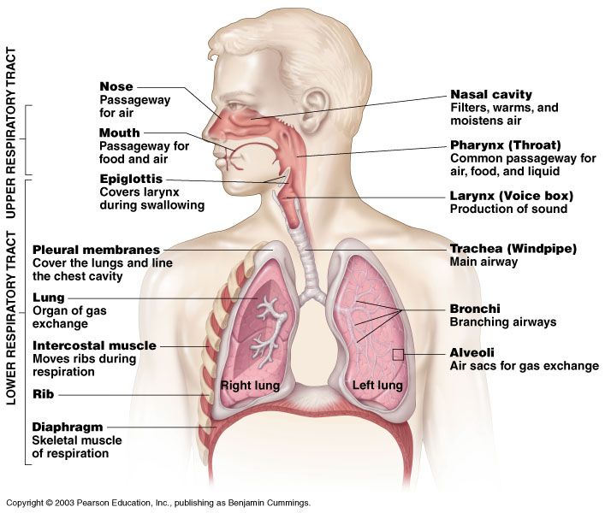
Human Respiratory System
Figure 10.1

Slide 3
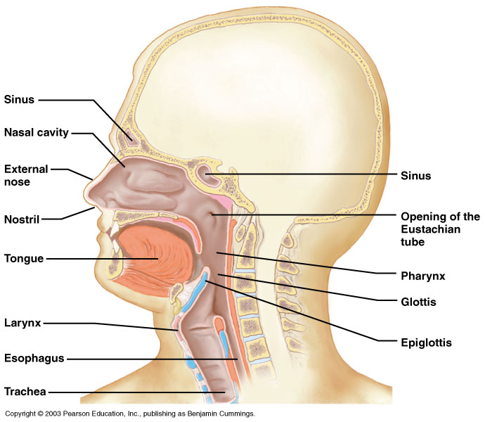
Components of the Upper Respiratory Tract
Figure 10.2

Slide 4
Upper Respiratory Tract Functions
Passageway for respiration
Receptors for smell
Filters incoming air to filter larger foreign material
Moistens and warms incoming air
Resonating chambers for voice

Slide 5
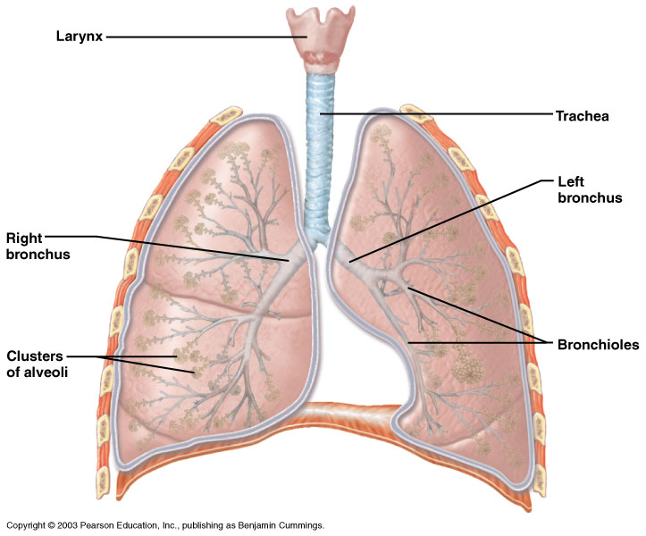
Components of the Lower Respiratory Tract
Figure 10.3

Slide 6
Lower Respiratory Tract
Functions:
  Larynx: maintains an open airway, routes food and air appropriately, assists in sound production
  Trachea: transports air to and from lungs
  Bronchi: branch into lungs
  Lungs: transport air to alveoli for gas exchange

Slide 7
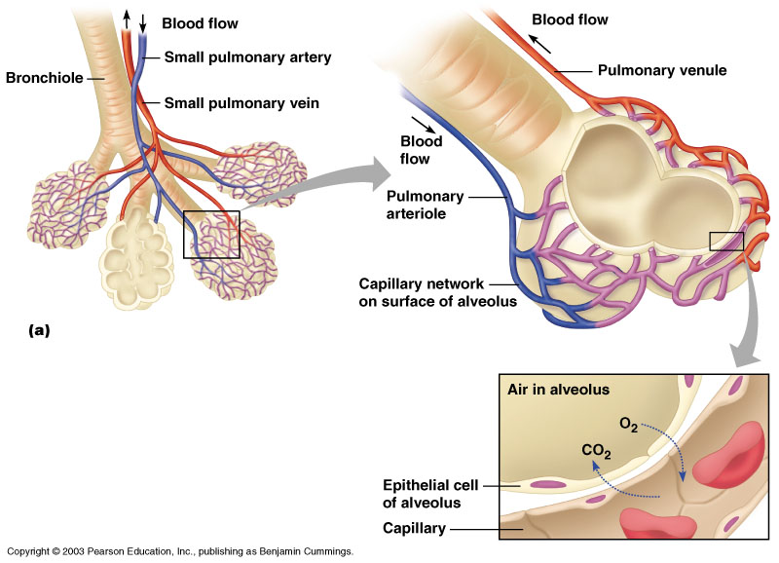
Gas Exchange Between the Blood and Alveoli
Figure 10.8A

Slide 8
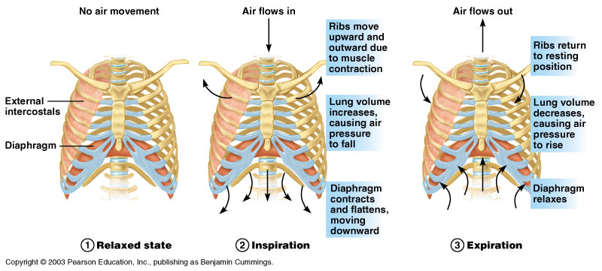
Respiratory Cycle
Figure 10.9

Slide 9
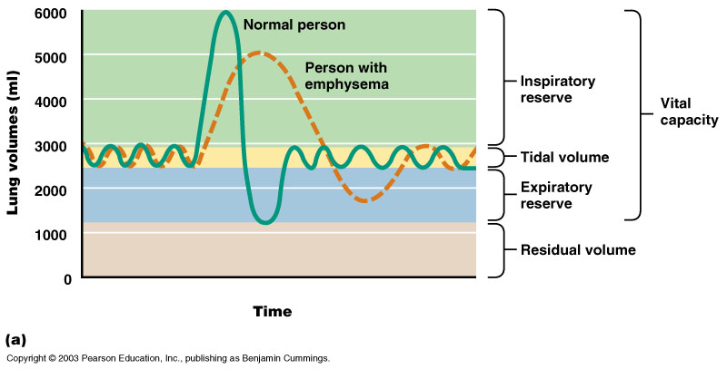
Measurement of Lung Capacity
Figure 10.10A

Slide 10
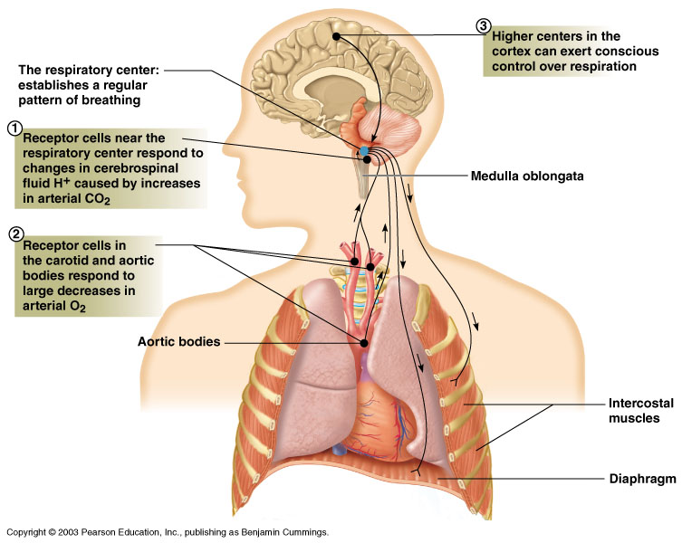
Regulation of Breathing
Figure 10.13

Slide 11
Regulation of Breathing:
Nervous System Involvement
Carotid and aortic bodies: sensitive to carbon dioxide, pH, and oxygen levels
Conscious control: resides in higher brain centers; ability to modify breath is limited

Slide 12
Disorders of Respiratory System
Reduced air flow: asthma, emphysema, bronchitis
Infections: pneumonia, tuberculosis, botulism
Lung cancer
Congestive heart failure
Cystic fibrosis

Slide 13
Breathing disorders
One breathing disorder:
Asthma or
Bronchitis
One possible cause
Prevention
Treatment

Slide 14
Process of Breathing: Pressure Gradient
Inspiration/Expiration: air in/air out
Cycle:
  Relaxed state: diaphragm and intercostal muscles relaxed
  Inspiration: diaphragm contracts, pulling muscle down, intercostal muscles contract elevating chest wall and expanding volume of chest, lowering pressure in lungs, pulling in air
  Expiration: muscles relax, diaphragm resumes dome shape, intercostal muscles allow chest to lower resulting in increase of pressure in chest and expulsion of air

Slide 15
Measurement of Lung Function
Lung volumes and vital capacity
  Tidal volume: volume of air inhaled and exhaled in a single breath
  Dead space volume: the air that remains in the airways and does not participate in gas exchange
  Vital capacity: the maximal volume that can be exhaled after maximal inhalation
  Inspiratory reserve volume: the amount of air that can be inhaled beyond the tidal volume

Slide 16
Measurement of Lung Function (cont.)
Lung volumes and vital capacity (continued)
  Expiratory reserve volume: the amount of air that can be forcibly exhaled beyond the tidal volume
  Residual volume: the amount of air remaining in the lungs, even after a forceful maximal expiration
Measurement: spirometer

Slide 17
Gas Exchange & Transport:
A Passive Process
Gases diffuse according to their partial pressures
  External respiration: gases exchanged between air and blood
  Internal respiration: gases exchanged with tissue fluids
  Oxygen transport: bound to hemoglobin in red blood cells or dissolved in blood plasma
  Carbon dioxide transport: dissolved in blood plasma, bound to hemoglobin, or in the form of plasma bicarbonate

Slide 18
Regulation of Breathing:
Nervous System Involvement
Respiratory center in the medulla oblongata: establishes basic breathing pattern
Chemical receptors: monitor carbon dioxide, hydrogen ions, and oxygen levels
Medulla: sensitive to hydrogen ions in cerebrospinal fluid resulting from carbon dioxide in blood

Slide 19
Four Respiration Processes
Breathing (ventilation): air in to and out of lungs
External respiration: gas exchange between air and blood
Internal respiration: gas exchange between blood and tissues
Cellular respiration: oxygen use to produce ATP, carbon dioxide as waste

