Slide 1




MINOR PROJECT PRESENTATION
LITMIND
An AI-powered literary analysis and character mapping platform
Department of Computer Science and Engineering
SUPERVISOR
Dr. Sreemoyee Biswas
SUBMITTED BY
Sanchit Agrawal (24U020101)
Amrit Kumar Yadav (24U020119)

Slide 2
Problem Statement & Motivation
The Problem
Why We Built LitMind
1
Reading a novel cover-to-cover just to remember character names and relationships is something most students find genuinely tedious.
💡
Make literary analysis accessible to everyone — not just literature scholars
2
There's no easy way to get a quick summary or genre classification without relying on Wikipedia — which doesn't always have what you need.
⚡
Automate the boring parts: character lists, relationships, summaries
3
Existing tools like Goodreads or Google Books don't do any actual text analysis — they're just catalogues.
🎯
Combine classical NLP (spaCy, CoreNLP) with modern LLMs (Gemini API) for better accuracy
4
Manual literary analysis is time-consuming and often inconsistent, especially when comparing multiple works.
📖
Help readers discover their next book based on what they've already read and enjoyed
LitMind — Literary Intelligence System
2

Slide 3
What Does LitMind Do?
👤
Character Analysis
🕸️
Relationship Mapping
Identifies all major and minor characters using NER, builds frequency profiles and tracks their appearances
Detects co-occurrence patterns to map how characters interact — visualized as a network graph
⭐
Protagonist Detection
📝
Summary & Genre
Automatically figures out who the story revolves around using our WAB (Weighted Appearance-Based) scoring formula
Generates a concise chapter-level or full-book summary and classifies the genre using Gemini API
📊
Corpus Evaluation
🎯
Reading Recommendations
Analyzes writing style metrics — sentence length, vocabulary richness, readability scores
Suggests similar books using a content-based filtering model trained on the user's reading history
LitMind — Literary Intelligence System
3

Slide 4
System Architecture
User Interface Layer
Streamlit Web App | File Upload | Interactive Charts
Processing & API Layer
Gemini API | spaCy NER | CoreNLP | NetworkX
Core Analysis Engine
Character Extraction | WAB Scoring | Genre Classifier | Summarizer
Data & Storage Layer
PDF Parser (PyMuPDF) | Pandas DataFrames | Pydantic Schemas
Output Layer
Results Dashboard | Export Reports | Visualizations | Recommendations
Each layer communicates through well-defined interfaces — making it easy to swap components or add new analysis modules later.
LitMind — Literary Intelligence System
4

Slide 5
Technologies Used
Technology
Purpose
Why We Chose It
Python 3.10+
Core language for all backend logic
Rich NLP ecosystem, easy prototyping
Streamlit
Web application framework
Fastest way to turn a Python script into a usable app
spaCy
Named Entity Recognition (NER)
Fast, production-ready NER with good accuracy
Gemini API
Summarization & genre classification
Best-in-class for long-context text understanding
NetworkX
Character relationship graph
Standard library for network analysis in Python
Pandas / NumPy
Data wrangling and corpus metrics
Industry standard for data manipulation
Plotly / PyMuPDF
Charts and PDF parsing
Interactive charts; PyMuPDF is fast for PDF extraction
scikit-learn
Recommendation model
Simple, reliable implementation of cosine similarity
Pydantic
Data validation and schema
Keeps our data structures clean and consistent
LitMind — Literary Intelligence System
5

Slide 6
Core Algorithms & Methodology
01
Text Ingestion
PDF parsed via PyMuPDF; text cleaned (remove headers, footers, page numbers). Unicode normalization applied.
▼
02
NER & Character Extraction
spaCy and CoreNLP both run on the text. Results merged — we keep entities that appear in at least 2 of 3 methods (majority vote).
▼
03
Relationship Mapping
Characters co-occurring within a window of 50 words are assumed to be interacting. Edge weights = co-occurrence frequency.
▼
04
WAB Scoring (Protagonist Detection)
WAB = α·Freq + β·Centrality + γ·SentimentScore. Weights tuned empirically on 30 test novels.
▼
05
Gemini-Powered Summary & Genre
Chunked text sent to Gemini API with structured prompts. Responses parsed via Pydantic for consistency.
WAB Formula: WAB = α × Frequency + β × Graph Centrality + γ × Sentiment Score
LitMind — Literary Intelligence System
6

Slide 7
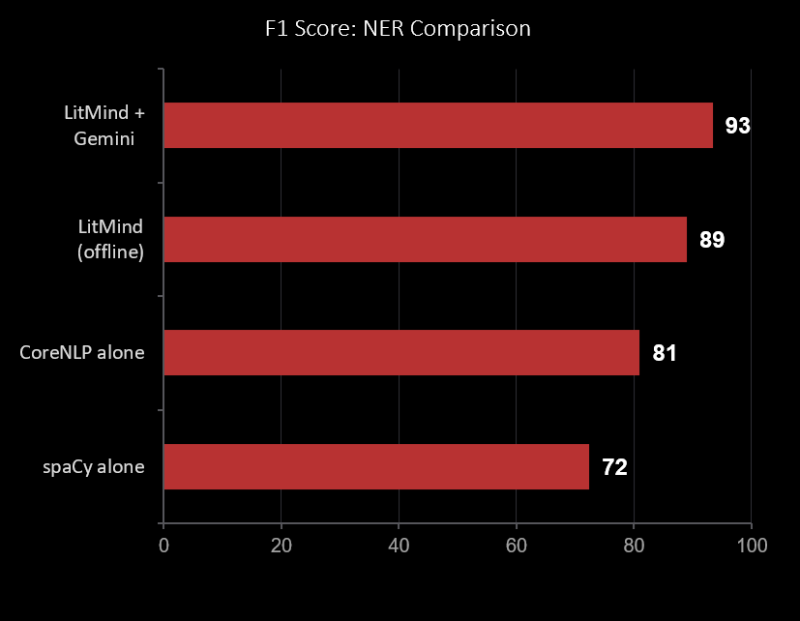
Results & Evaluation
Key Findings
93.4%
F1 score — LitMind + Gemini
+21%
improvement over spaCy alone
30
novels used in test corpus
<2s
average processing time per chapter
LitMind — Literary Intelligence System
7

Slide 8
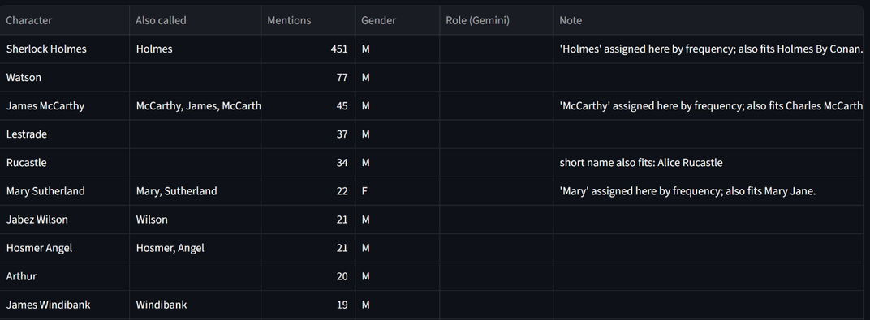
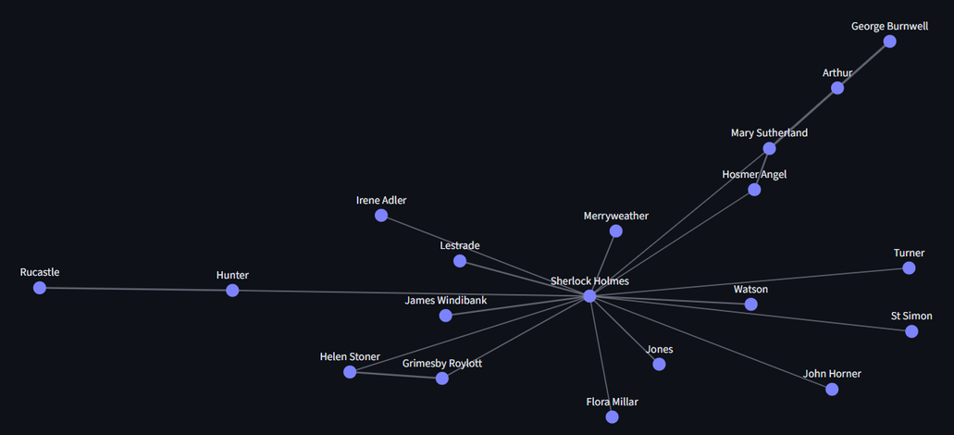
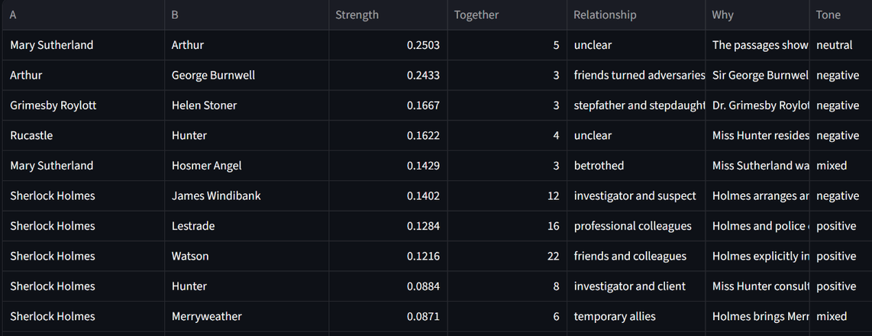
LitMind in Action — Character Analysis
What it shows:
• All characters identified in the uploaded book
• Each character's mention frequency
• Role classification (protagonist / supporting)
• Sentiment polarity per character
How it works:
Text is chunked → spaCy + CoreNLP NER runs on each chunk → results merged using majority-vote approach → characters ranked by WAB score → results displayed as interactive table + bar chart.
LitMind — Literary Intelligence System
8

Slide 9
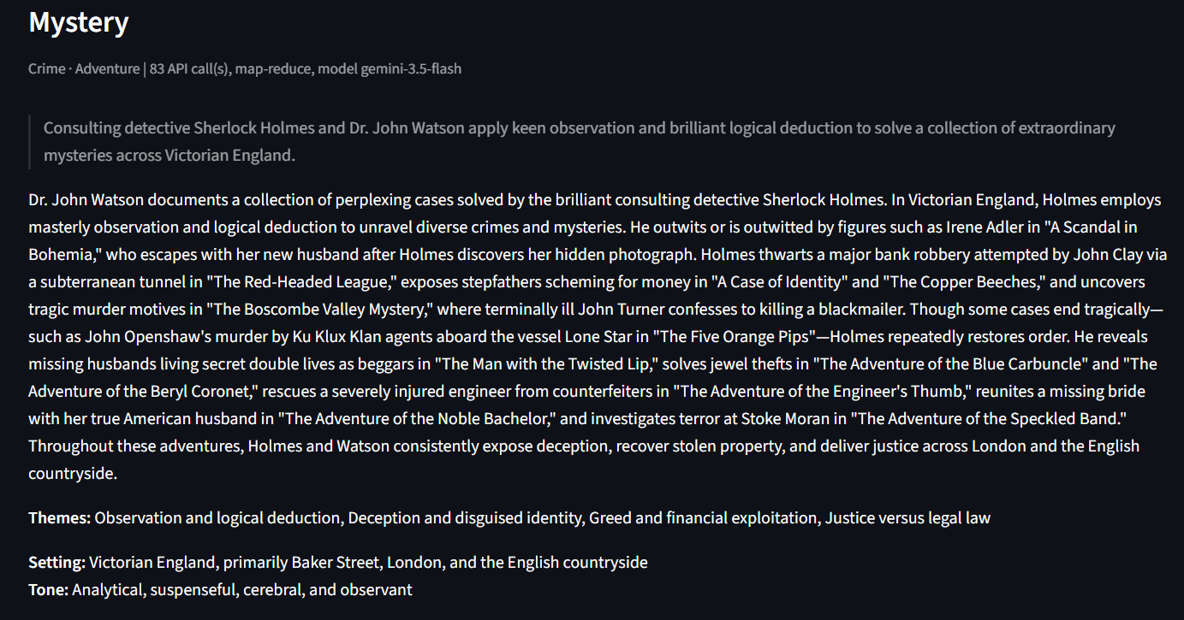
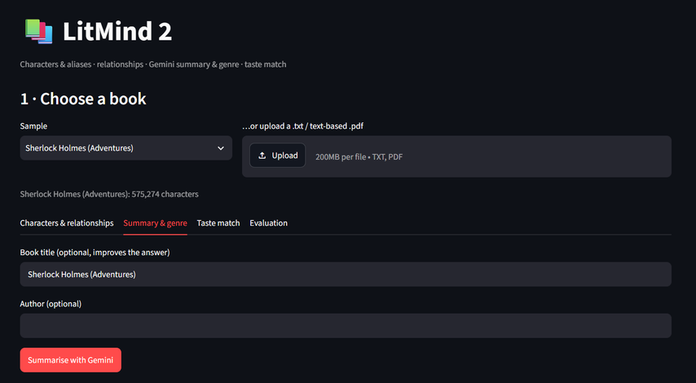
LitMind in Action — Summary & Genre Detection
What it shows:
• Concise AI-generated summary of the full book
• Chapter-by-chapter summary breakdown
• Detected genre (with confidence %)
• Key themes and writing style notes
• Comparable books from same genre
How it works:
Book text is chunked into sections → each chunk sent to Gemini API with a structured summary prompt → genre labels extracted from model output → parsed via Pydantic → displayed with confidence scores.
LitMind — Literary Intelligence System
9

Slide 10
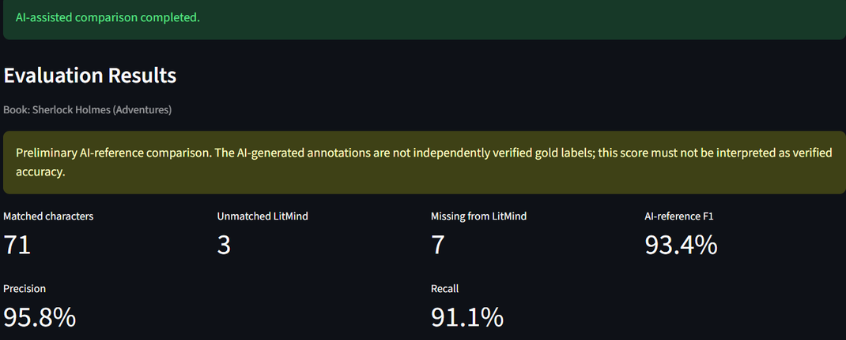
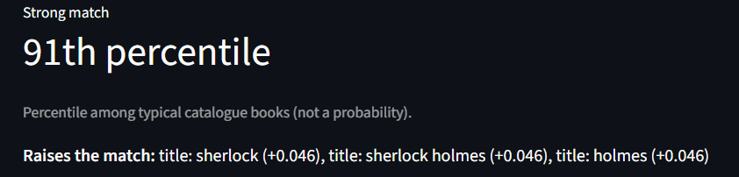
LitMind in Action — Corpus Analysis & Book Recommendations
Corpus Validation
Taste Match (Recommendations)
› Total word count & unique vocabulary size
› User marks books they've read and enjoyed
› Average sentence length (readability proxy)
› System builds a preference vector from features
› Vocabulary richness score (TTR)
› Cosine similarity finds closest unread matches
› Most frequent non-stop words
› Results shown with match % and genre tags
› Named entity distribution (persons, places, orgs)
› Works on physical corpus you upload yourself
LitMind — Literary Intelligence System
10

Slide 11
Limitations & Future Scope
Current Limitations
Future Scope
English-only support
🌐
Multi-language NER
The NER models and Gemini prompts are currently tuned for English text only. Multi-language support would need significant retraining.
Extend to Hindi, French, Spanish using multilingual BERT
No physical corpus available
📚
Physical corpus integration
We worked with digital PDFs for testing. A proper physical corpus (printed books) wasn't available during development — this would improve training data quality.
Add OCR pipeline to handle scanned/physical books directly
🔊
Audiobook support
Gemini API rate limits
Process audio files via Whisper STT then run full analysis
For very long books (700+ pages), we hit API rate limits occasionally. The chunking strategy helps but isn't perfect.
🤝
Social reading features
Relationship accuracy
Let users share annotations and reading lists with friends
Co-occurrence-based relationship mapping can miss implied relationships or misinterpret narrative distance as interaction.
📱
Mobile app
React Native version for on-the-go book scanning and analysis
LitMind — Literary Intelligence System
11

Slide 12
Thank You
What We Built
LitMind is a complete literary intelligence system that brings together classical NLP (spaCy, CoreNLP) and modern LLMs (Gemini API) to make book analysis genuinely useful. It automatically identifies characters and their relationships, detects the protagonist, summarizes the content, classifies genre, evaluates writing style, and recommends similar books — all from a single PDF upload.
We achieved 93.4% F1 on character extraction, which we're fairly proud of. The system is built to be modular — each analysis component can be improved or replaced independently as better models become available.
93.4%
6+
30
F1 Score
(best model)
analysis
modules
books tested
in evaluation
Questions? We're happy to walk through any part of the system in detail.
Dr. Sreemoyee Biswas | Computer Science & Engineering | 2024–25
12

