Slide 1
Genetics Working Group
RStudio and QTL2 Part 1
April 7, 2022

Slide 2
Genetics Working Group Organization
Teams/Genetics Working Group/Data Science and Computing 101 Meeting Material
Schedule
PowerPoint presentations
Code
GitHub, https://github.com/bytesizesci/GeneticsWorkingGroup

Slide 3
Today’s Goals
Knowledge
Basic introduction to RStudio and critical functions to memorize
Understand generally what quantitative trait loci (QTL) mapping is
Understand generally the R/qtl2 workflow and data structure
Review the Diversity Outbred mouse model
Exercise
QTL focus: Run GWG_M1_220407.Rmd

Slide 4
Comprehensive R Resources
R for Data Science (online book), https://r4ds.had.co.nz/index.html
Carpentries (tutorials and workshops)
Data Carpentry - https://datacarpentry.org/lessons/
Software Carpentry - https://software-carpentry.org/lessons/
R - https://swcarpentry.github.io/r-novice-gapminder/
RStudio Cheat Sheets, https://www.rstudio.com/resources/cheatsheets/
Google → Stack exchange, r-bloggers, university sites
Teams/General/LearningResources

Slide 5
RStudio Highlights (*Open RStudio)
Panels (console, environment, file pane, and code pane)
RProject (File → New Project → New Directory)
Grounds your working directory
Script (.R) versus Markdown (.rmd)
Script – short code; does something like writes a function or runs a process
Markdown – good for analysis; can create rendered output that is good for report sharing
How to install packages
CRAN – network of servers that host packages; strict policies to reposit code; install.packages()
Bioconductor - network of servers that host packages; strict policies to reposit code; have to install the BiocManager which allows you to then install packages hosted on Bioconductor; https://bioconductor.org/install/
GitHub – the wild west but still helpful; we will learn about this another day
How to learn about functions
?function_name; ex: ?mean, ?dplyr::subset

Slide 6
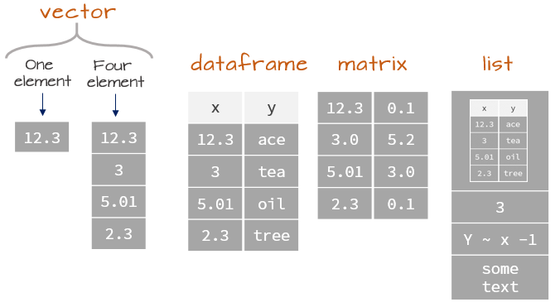
Vector, Data Frame, List
Can access parts of dataframes and lists with “$”
Dataframe$column
List$dataframe$column
Important for R/qtl2
Image source: https://mgimond.github.io/ES218/Week02a.html#Core_data_types

Slide 7
Comprehensive R/qtl2 Resources
Tutorials
https://smcclatchy.github.io/mapping/
https://kbroman.org/qtl2/assets/vignettes/user_guide.html
Literature
Google scholar → Karl Broman
In-House Pipeline
https://github.com/exsquire/DO_pipe

Slide 8
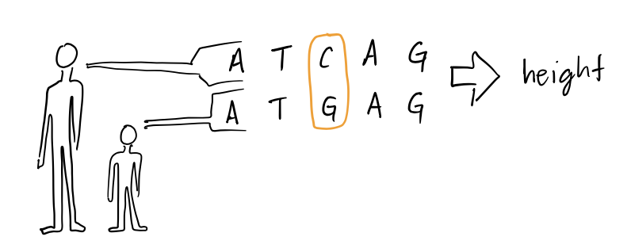
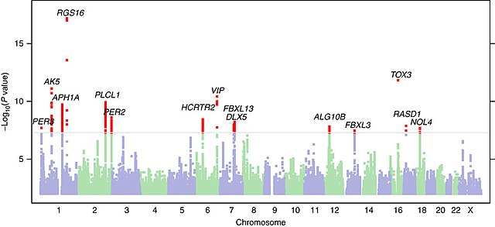
Quantitative Trait Loci Mapping
Like human Genome Wide Association Studies (GWAS)
Associating phenotypes with genotypes using statistics
What genes or genetic structures (e.g., SNPs, long non-coding RNA, microRNA) are associated with a given trait (e.g., height)?
This generates a testable hypothesis that the gene regulates the trait
Image: http://www.nature.com/ncomms/2016/160202/ncomms10448/full/ncomms10448.html

Slide 9
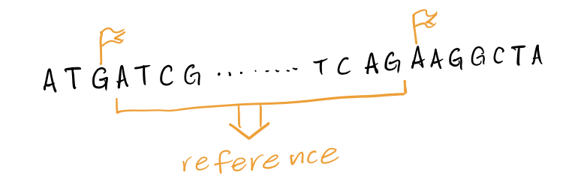
SNP Based
Giga-Mouse Universal Genotyping Array (GigaMuga, GM)
143,000 SNPs from 159 inbred lines
Average spacing between SNPs is ~22.5 kb
Takes advantage of linkage disequilibrium
We measure SNPs and impute/assume the DNA between the measured nucleotides based on reference genomes

Slide 10
QTL Mapping in R with R/qtl2
Well supported software package that allows us to perform QTL analysis in R
Requires specific file structure
Required files:
Reference genotypes (GigaMuga, GM)
Genotypes of your samples (finalreport.txt or parsed into individual Chr files; large file(s)!)
Phenotype file (pheno.csv)
Covariate file (covar.csv)

Slide 11
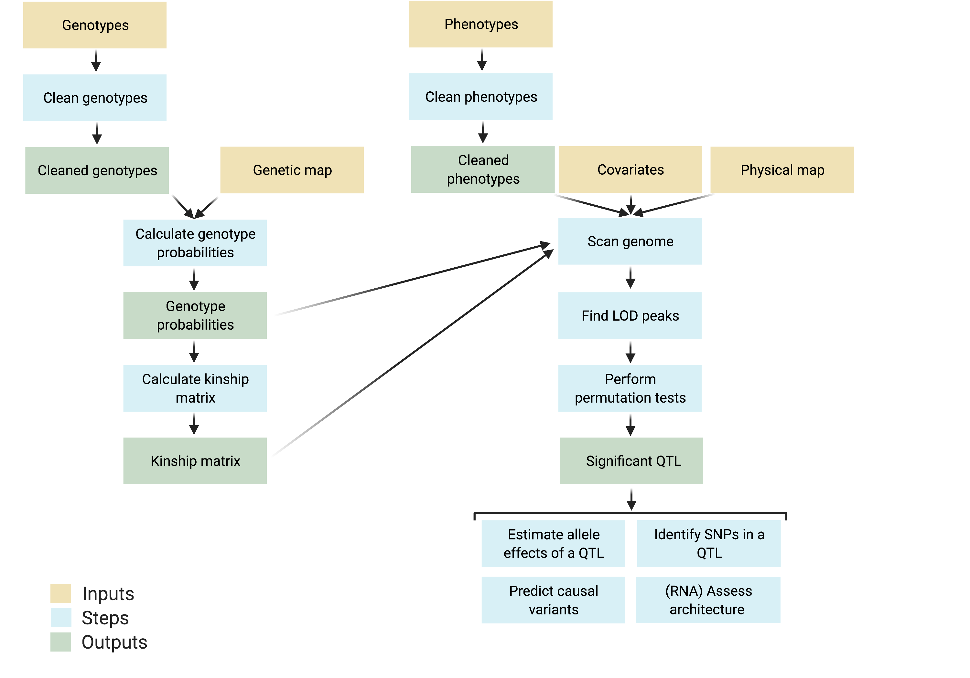
Pipeline - DOPipe
Adapted from McClatchy tutorial

Slide 12
Code
Create a new R project named “Genetics_Working_Group_Local”
In the Genetics_Working_Group_Local directory, create a folder named “qtl2”.
Download files from Teams and put in “qtl2”:
GWG_M1_220407_qtl2.Rmd
GM directory
GenotypesProcessed directory
Phenotype file
Covariate file
Begin running code

Slide 13
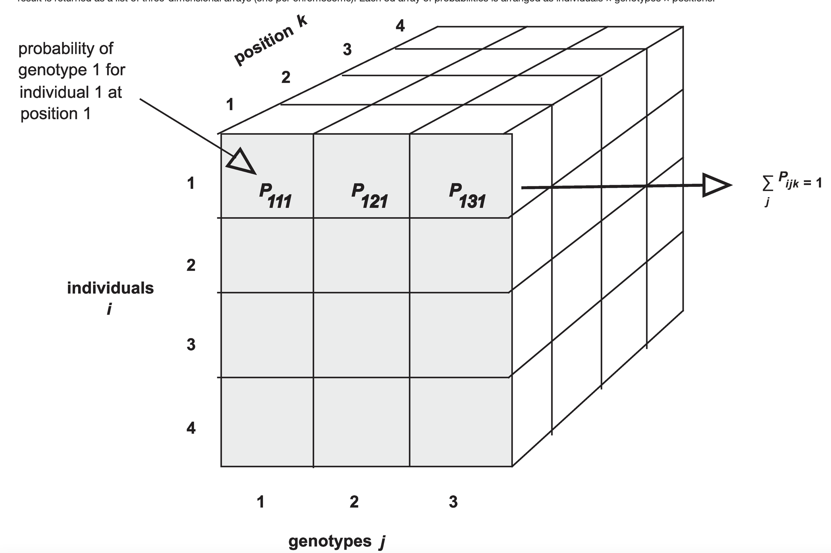
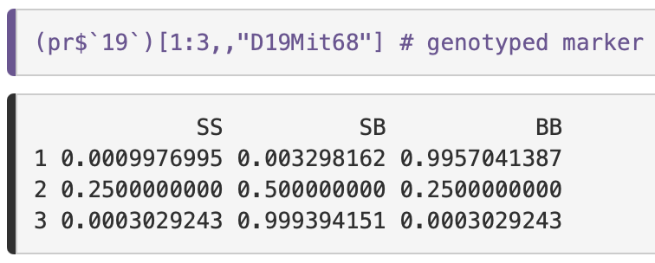
Genome Probabilities
Calculates the probability of a genotype (A, B, H) at every marker for every mouse
Uses a Hidden Markov model (which is shmancy and incorporates conditional probabilities and you/we can get into it some other time, https://academic.oup.com/g3journal/article/12/2/jkab396/6429279?login=true)
Computationally and memory intense
List of lists
Image from McClatchy tutorial

Slide 14
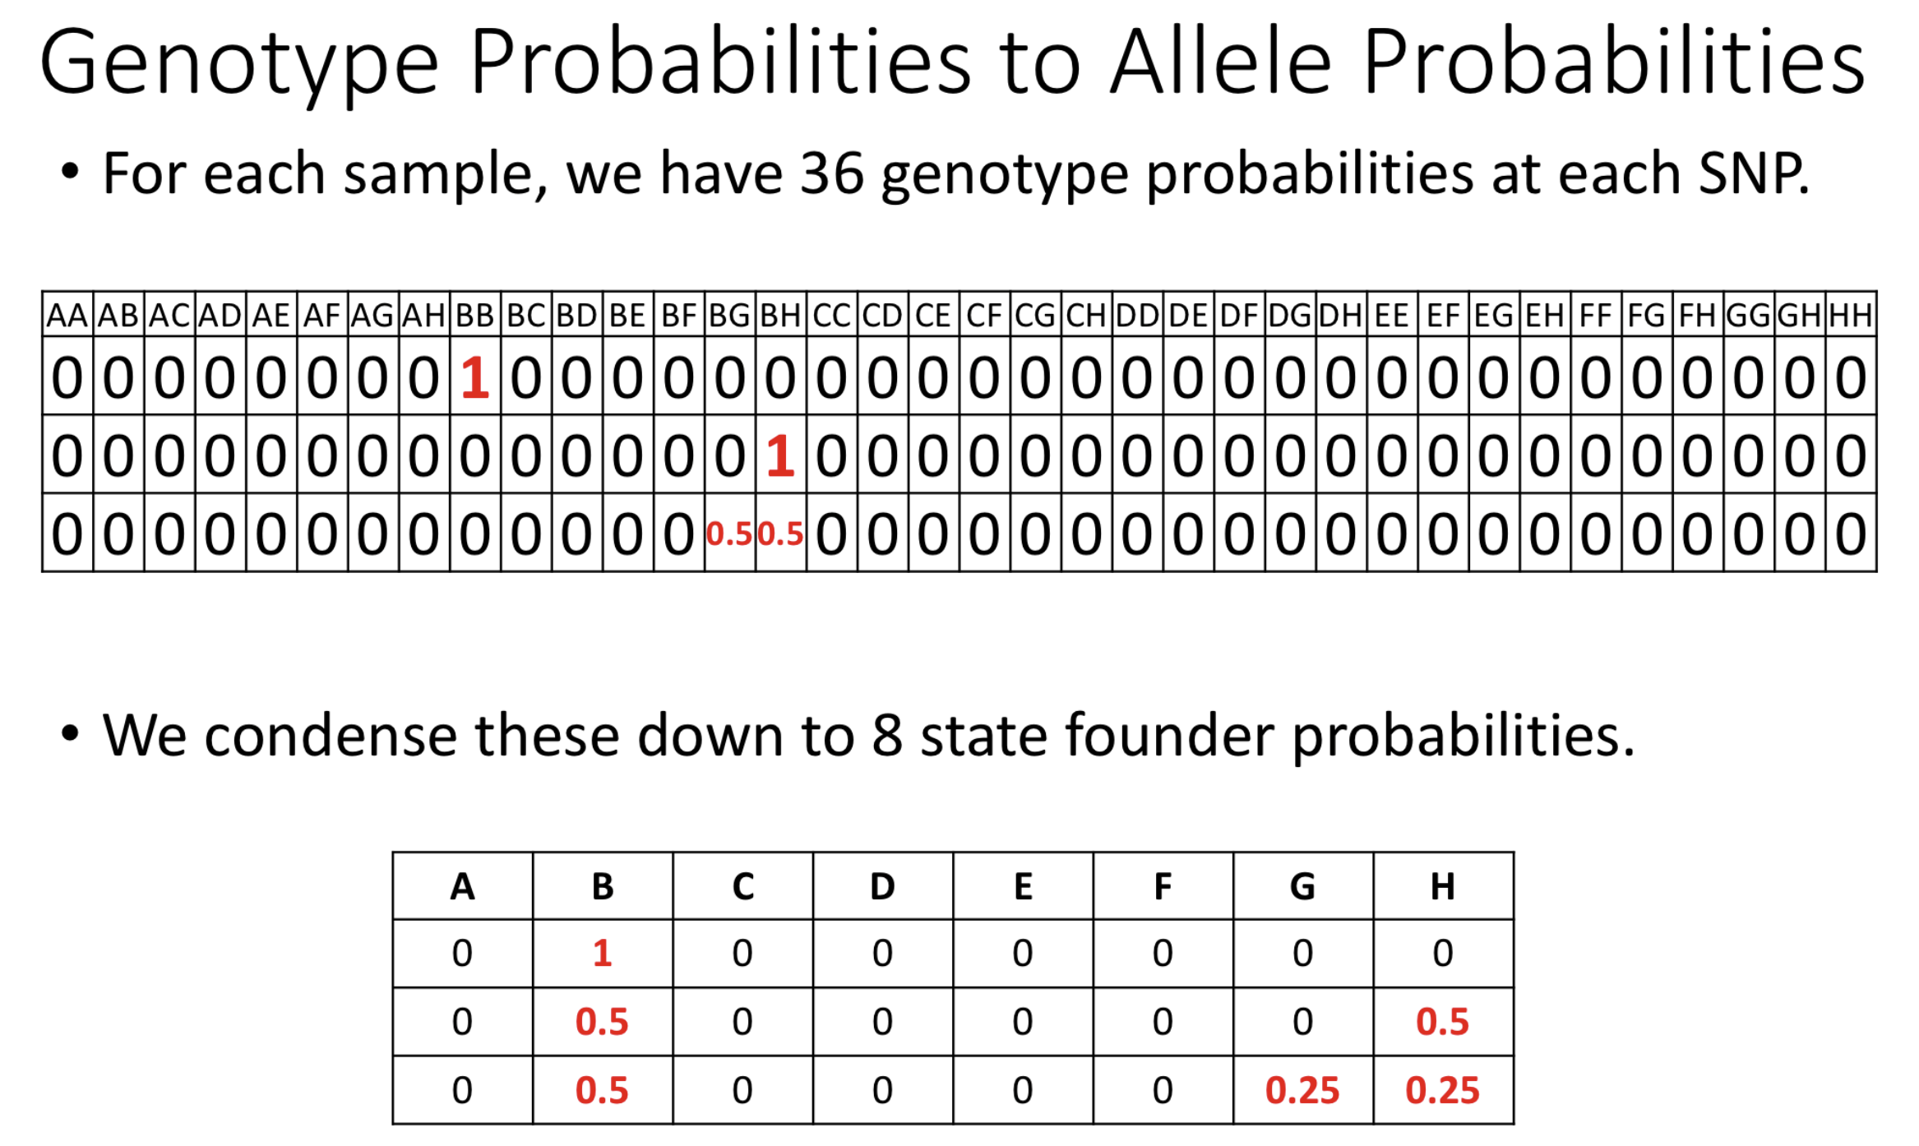
Allele Probabilities
Mice are diploid (one allele from each parent)
Allele probabilities take up less memory
Mouse 1 at SNP 1
Mouse 2 at SNP 1
Mouse 3 at SNP 1
Mouse 1 at SNP 1
Mouse 2 at SNP 1
Mouse 3 at SNP 1
Image from McClatchy tutorial

Slide 15
Kinship
Mice are related to each other
Related mice share more genes
Related mice are more likely to
Need to control for in statistics otherwise might have inflated/false results
Matrix with samples as rows and columns and degree of identical DNA in cells

Slide 16
Covariates
What might affect the phenotypes?
Sex → Xcovar
DO generation
Diet
Make sure to dummy code factors (0 and 1) otherwise the linear model will thing there is an additive effect
If the variable has more than 2 levels then you need to add additional columns
Ngen=42,43,44
Ngen_42; 0=no,1=yes
Ngen_43; 0=no,1=yes
Ngen_44; 0=no,1=yes

Slide 17
Scan1 – linear mixed model
NEXT TIME ☺

Slide 18
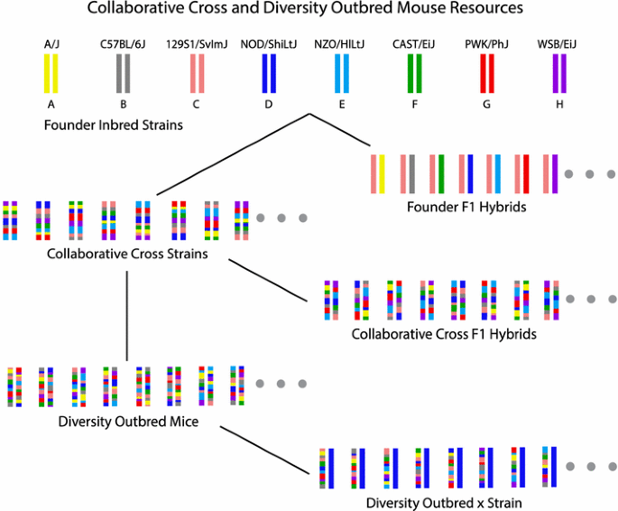
Advanced Genetic Models and the Diversity Outbred Mouse
https://link.springer.com/article/10.1007/s00335-015-9595-6

