Slide 1
CANTOP Tour System
2015-4

Slide 2

Business flow
Confirmation
Agency
Request
Input
Invoice

Slide 3
System Deployment
OP
Server
Local Tour System
Database
OP
Access by browser

Slide 4
System Architecture
OP Interface
Agent Interface
Public Website
Tour
Voucher
Invoice
Agency?
Route/Plan/Product
Hotel
Restaurant
Admission
Database

Slide 5
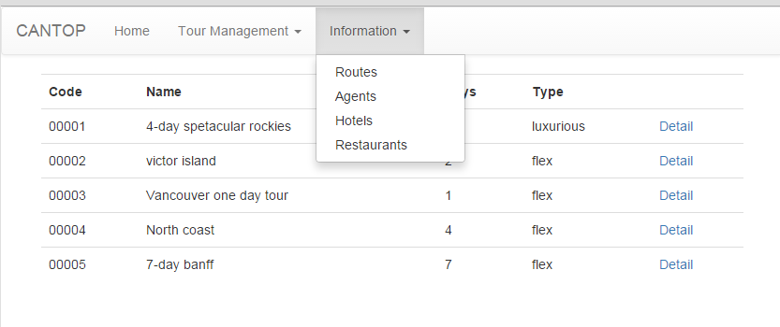
Layout

Slide 6
Data Models
Tour? (including multiple vouchers)
Voucher
Invoice
Plan/route/product
Agent
Hotel
Restaurant
Admission

Slide 7
Schedule
Deadline :
  1st week : UI
  2nd week : Information Input
  3rd to 4^{th:} week : Voucher Logic
  5th week: deploy and fix

