Slide 1
CANTOP Tour System
2015-4
Sun
www.amsun.me

Slide 2

Business flow
Agency
booking
Request
New Tour
Schedule List
Confirmation
Invoice
Name List

Slide 3
System Deployment
OP
Server
Local Tour System
Database
OP
Access by browser

Slide 4
System Architecture
OP Interface
Agent Interface
Public Website
Tour
Confirmation
Invoice
Agency/Bus Com.
Route/Plan/Product
Hotel
Restaurant
Admission
NO-SQL Database

Slide 5
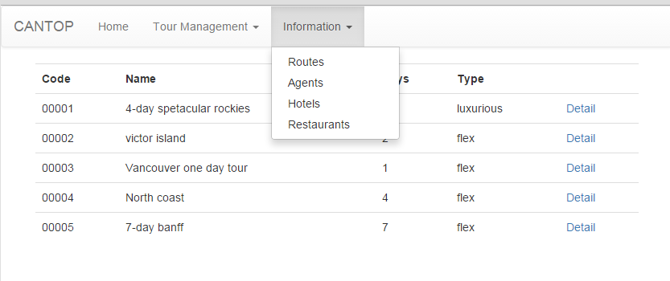
Layout

Slide 6
Data Models
Tour? (including multiple vouchers)
Voucher
Invoice
Plan/route/product
Agent
Hotel
Restaurant
Admission

Slide 7
Schedule
Deadline :
  1st week : UI
  2nd week : Information Input
  3rd to 4^{th:} week : Confirmation and Invoice Logic
  5th week: deploy and fix

