Slide 1
SenHAT: Sentinel-2 Super-Resolution
A simple two-phase approach to accurate and sharp maps
Aayush Kharbanda | Meeting with Dr. Mishra

Slide 2
What problem are we solving?
Sentinel-2 gives useful data, but some bands are lower resolution (20 m) than others (10 m).
We want one sharp 10 m map that keeps correct colours and vegetation signals.
If the model invents fake edges or wrong band relationships, the map is not scientifically usable.

Slide 3
What is SenHAT?
SenHAT combines sharp 10 m geometry with richer 20 m spectral information.
A transformer backbone looks at larger context (fields, rivers, roads) — not just tiny patches.
Output: an 8-band super-resolved image that matches real Sentinel/VENµS structure.

Slide 4
Why train in two phases?
Phase 1 — Fidelity first: teach the model to get the right pixels, bands, and vegetation index.
Phase 2 — Sharpness second: add perceptual sharpening only after the base map is trustworthy.
This order reduces hallucination: we sharpen real structure, not invent fake detail.

Slide 5
Phase 1: Fidelity Foundation
Current Narval run (no adversarial training yet)
Losses: pixel (L1), content (VGG), artifact map (LDL), vegetation index (NDI).
Discriminator is off — we are not chasing “pretty” textures yet.
Success looks like: stable training, correct band mixing, boundaries that do not bleed.

Slide 6
Phase 2: Controlled Sharpening
After fidelity weights are extracted
Turn on adversarial + MS-SSIM to recover fine edges (roads, tree lines, field boundaries).
Keep NDVI and spectral constraints active so sharpening does not break physics.
Same SenHAT model — only the training objective changes.

Slide 7
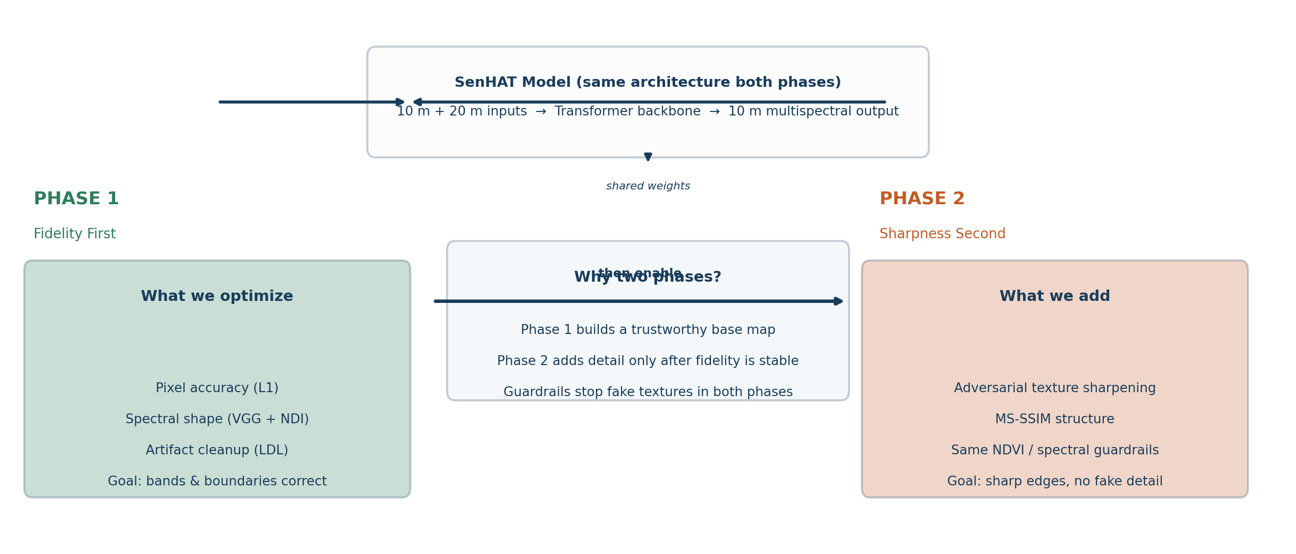
Two-Phase Training Pipeline

Slide 8
Where we are now
Phase 1 fidelity training is running on Narval (A100, staged data on node SSD).
Early signs: model learning structure; SSIM around 0.71 in initial checks.
Next: pick best Phase 1 checkpoint → run Phase 2 sharpening → compare baselines for paper.

