Slide 1
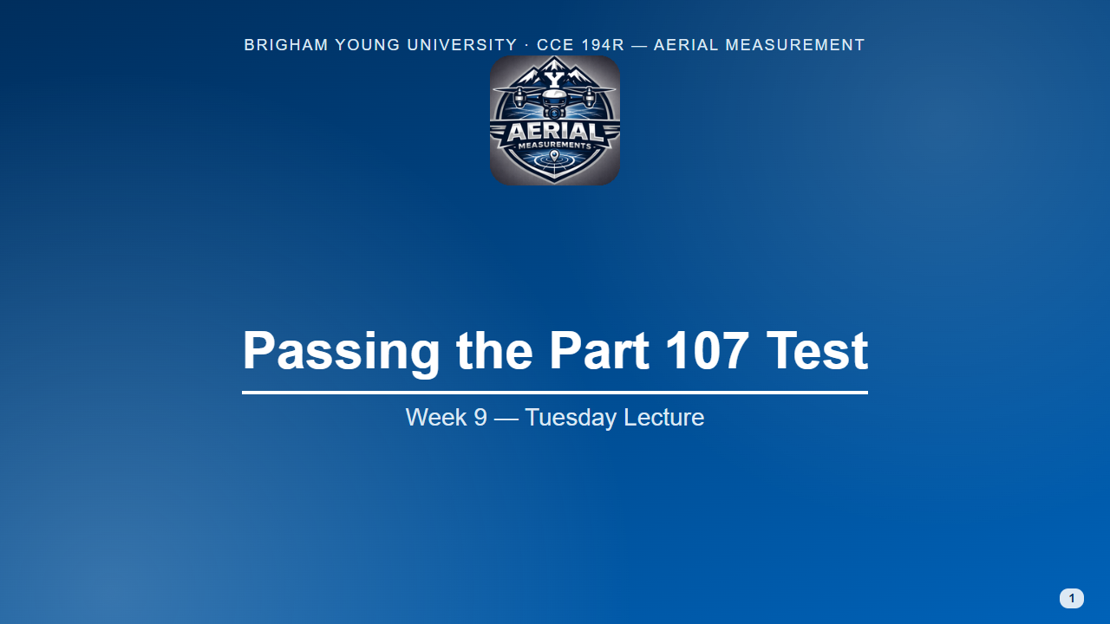
Notes:
Format for every question slide today: groups of 2–3, then one group answers and the class discusses. Questions marked "FAA sample" are adapted from the FAA's published UAG sample question set (public domain), keeping its answer choices; the others are written for this course in the same style.
Slides tagged "Seen in Week 3" are review.

Slide 2
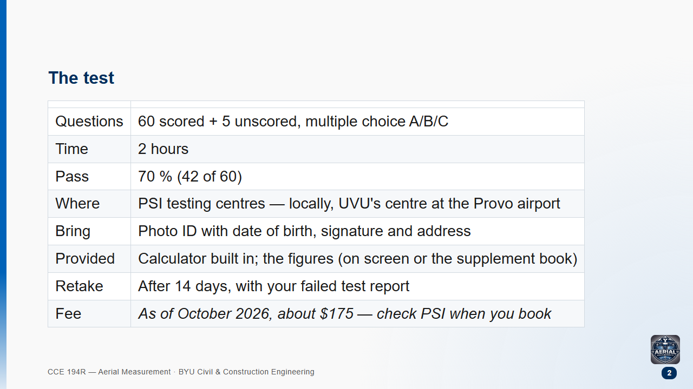

Slide 3
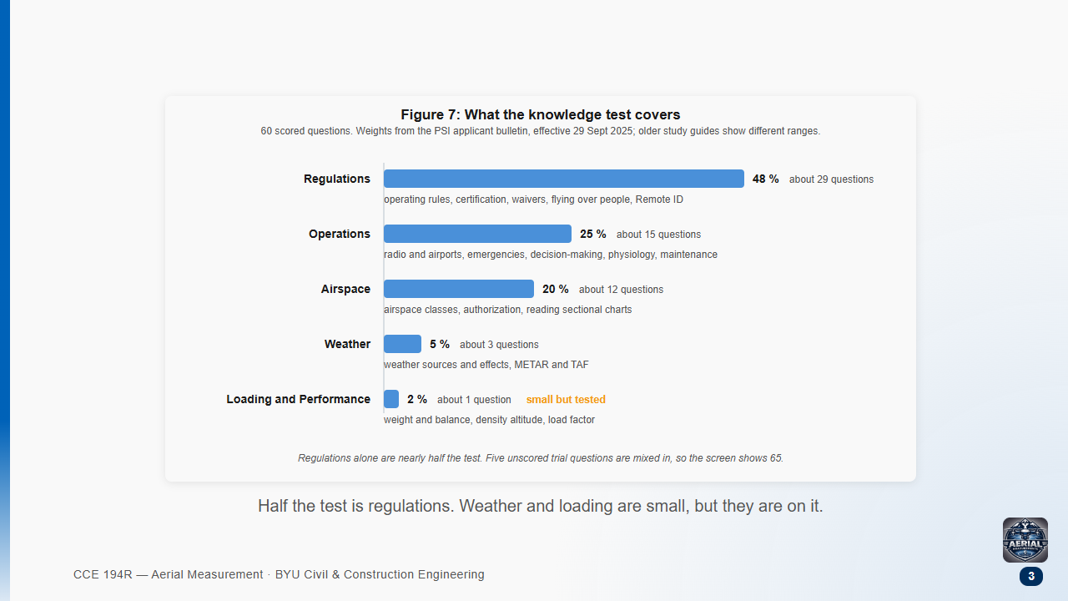
Notes:
Weights from PSI's applicant bulletin, effective 29 September 2025. Older study guides still show the previous ranges.

Slide 4
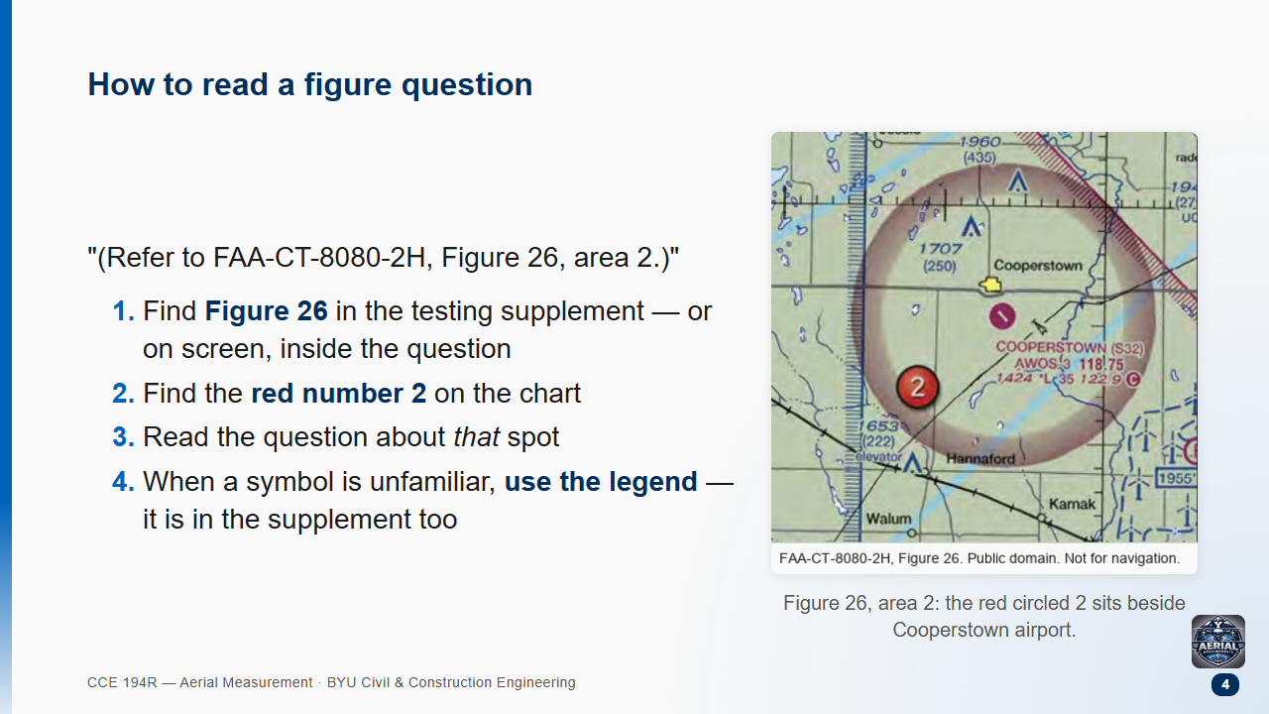
Notes:
Point at the red 2, then at the airport symbol and its label block (elevation, runway length, CTAF with the C in a circle). Every chart question on the test starts this way.

Slide 5
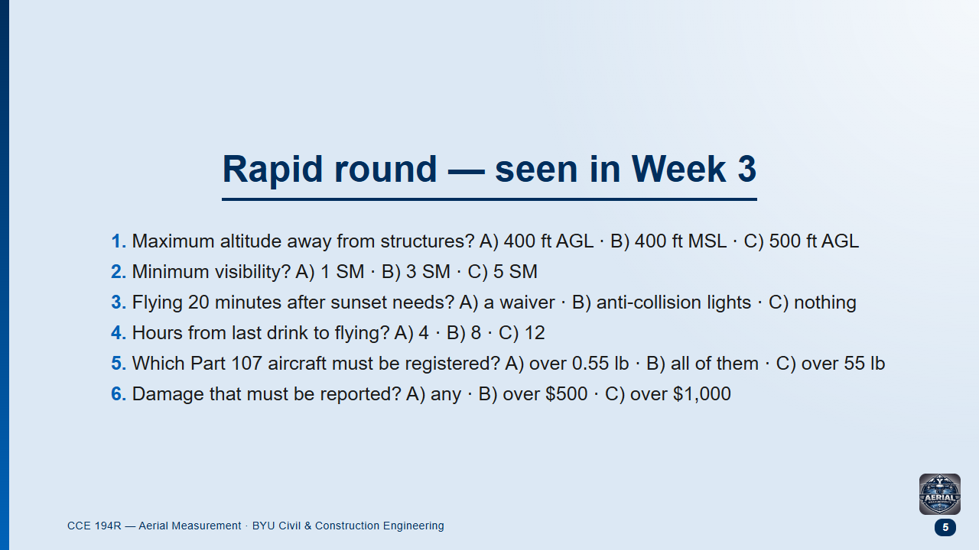
Notes:
Groups, 3 minutes for all six. Then read out answers fast.

Slide 6
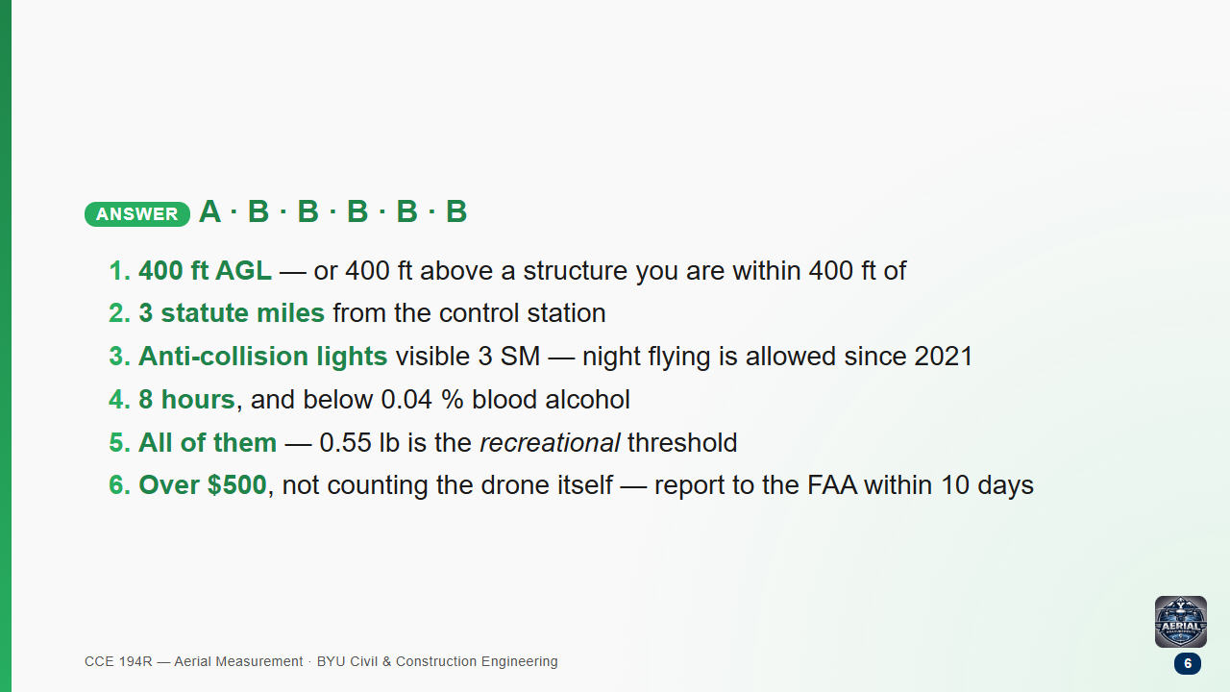

Slide 7
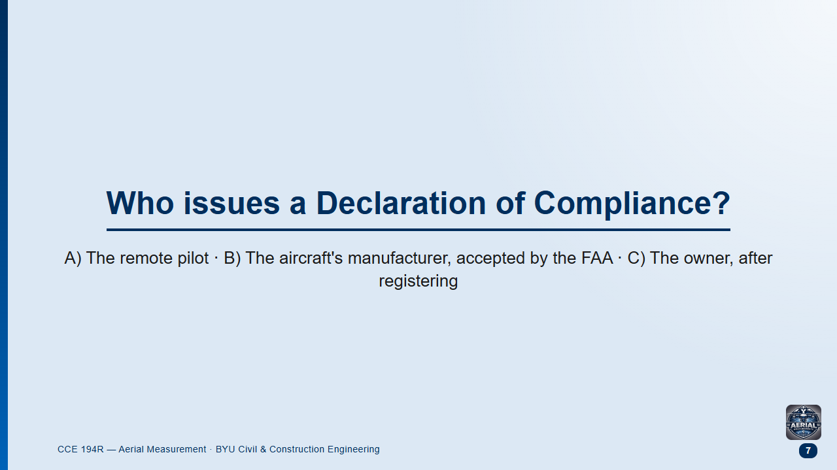
Notes:
Groups 1 min, then class. Seen in Week 3.
This is the most-missed item on the real test — about three in four people get it wrong.

Slide 8
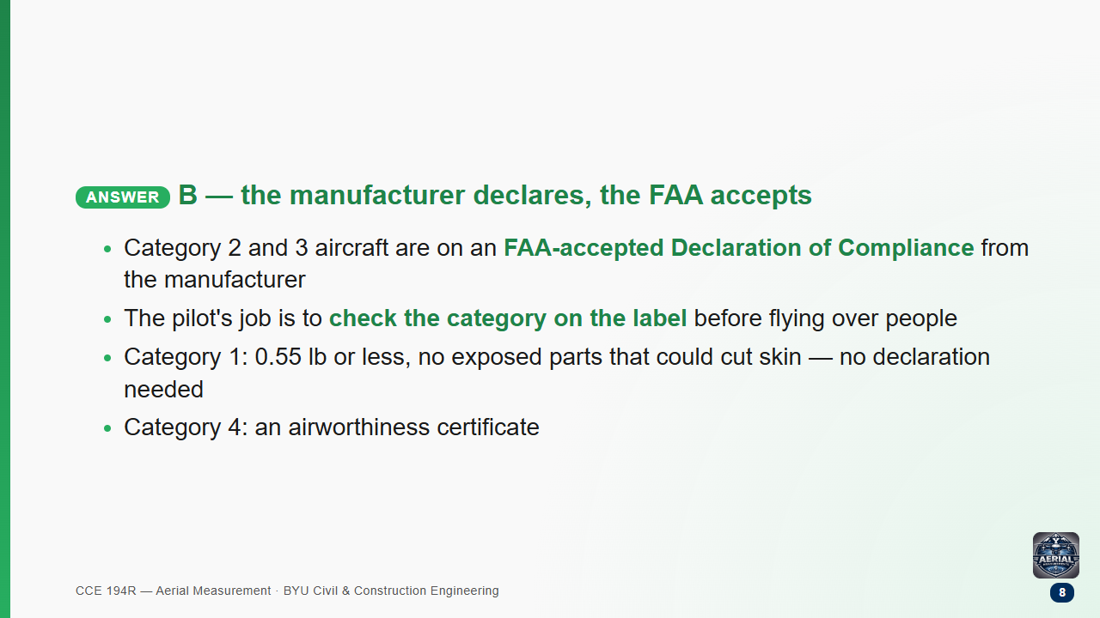

Slide 9
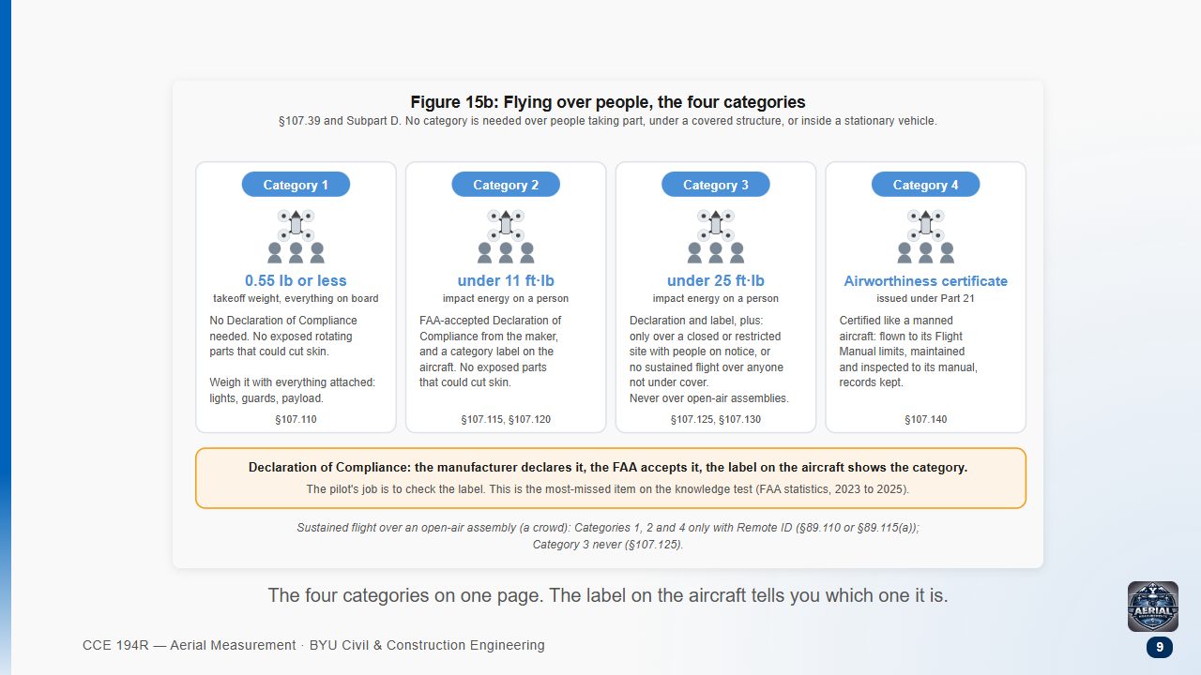
Notes:
Seen in Week 3. Walk the four cards left to right, then the amber strip: the manufacturer declares, the FAA accepts, the pilot checks the label.

Slide 10
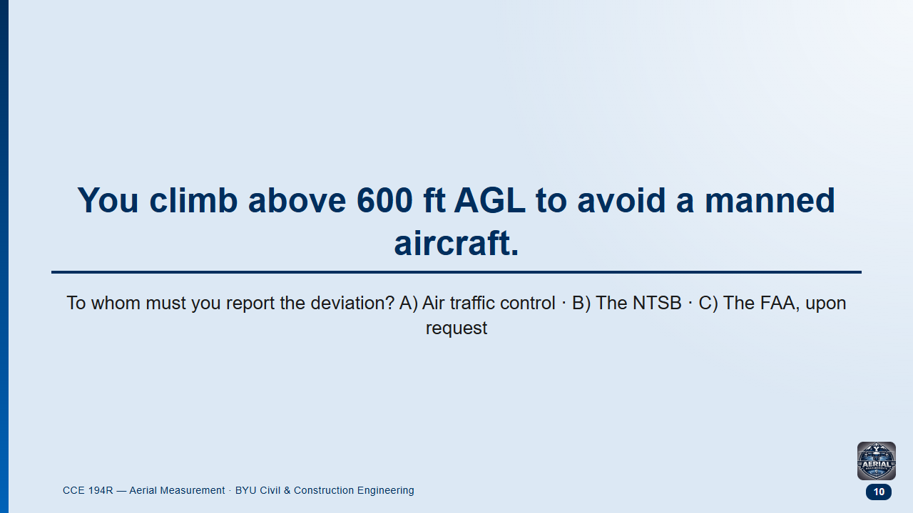
Notes:
FAA sample question, adapted. Groups 1 min.
Likely answer: B.

Slide 11
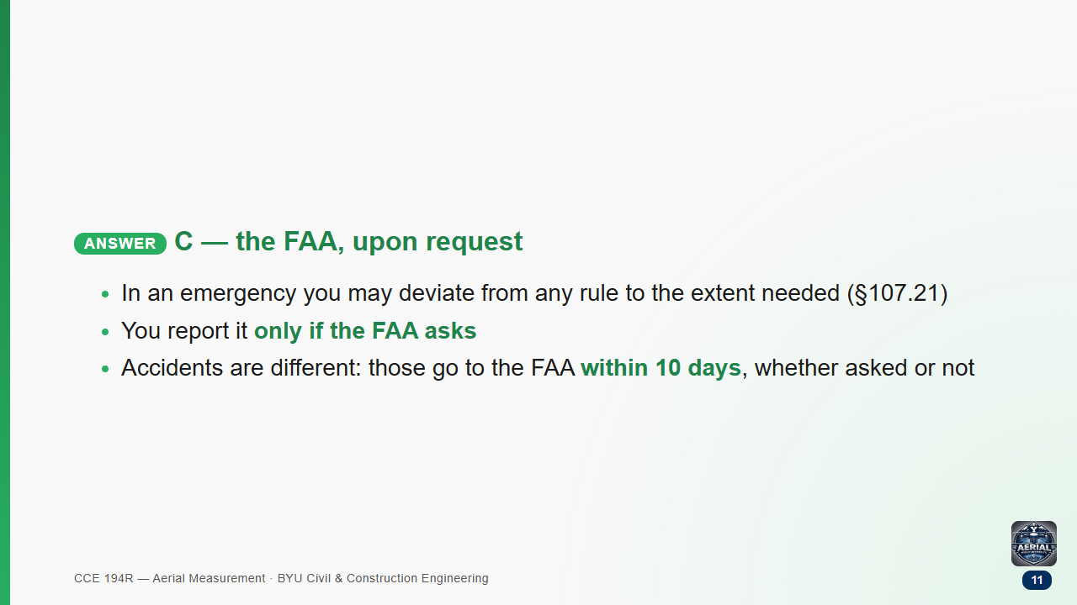

Slide 12
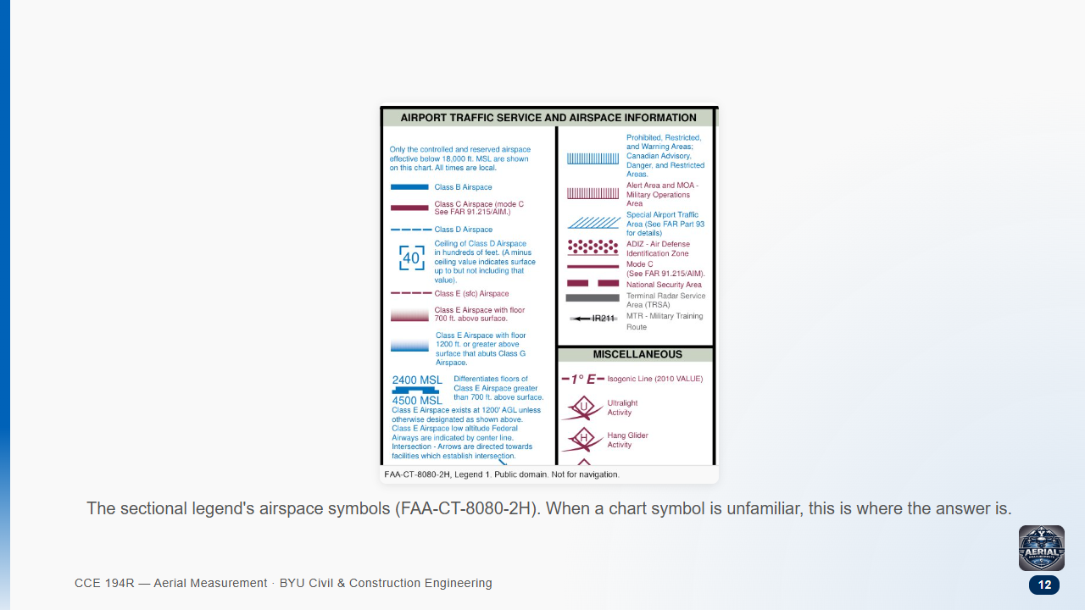

Slide 13
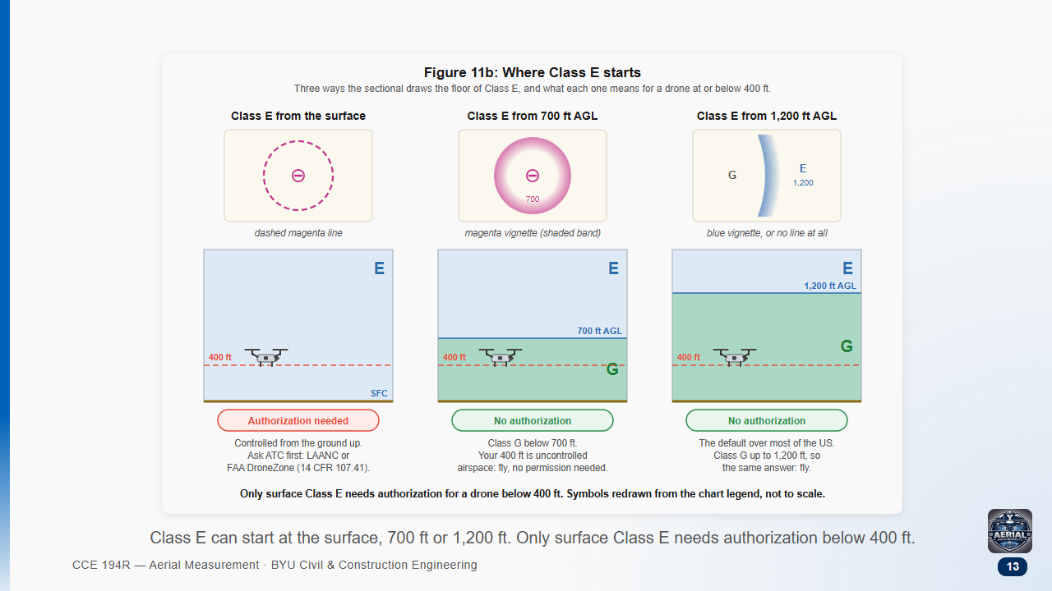

Slide 14
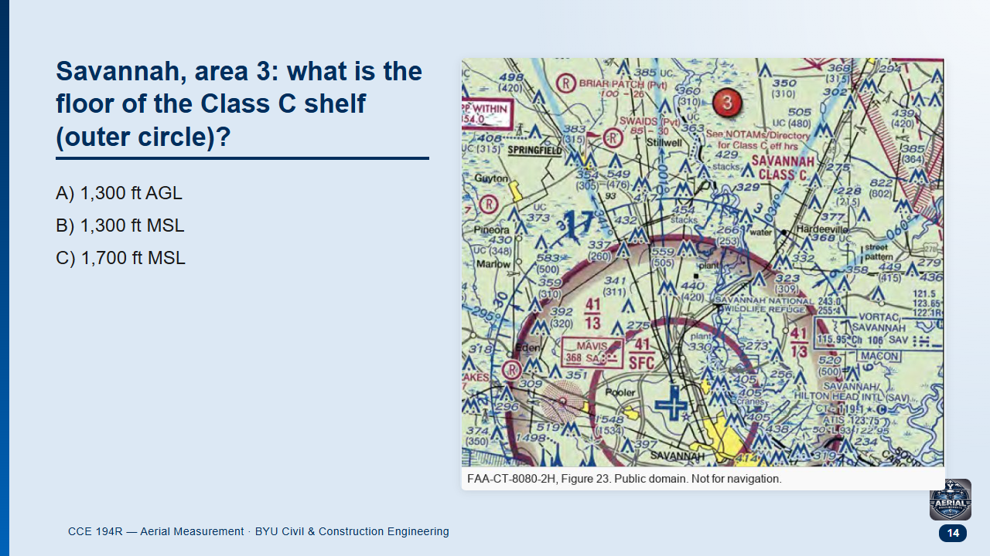
Notes:
FAA sample question, adapted (Figure 23, area 3). Groups 1.5 min.
Likely answer: A — students forget chart altitudes are MSL.

Slide 15
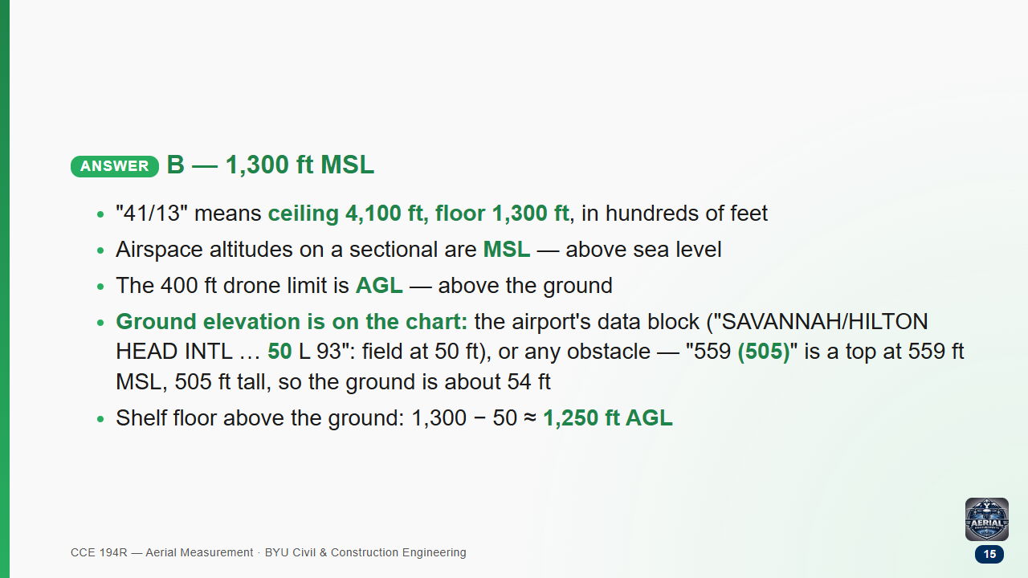
Notes:
Point at the airport data block in the lower right of the crop, then at an obstacle near the shelf. Obstacle numbers: bold = top in MSL, (brackets) = height above ground. Top minus height = ground elevation. Contour tints and spot elevations also give ground height, but on the test the airport block and obstacles are quickest.

Slide 16
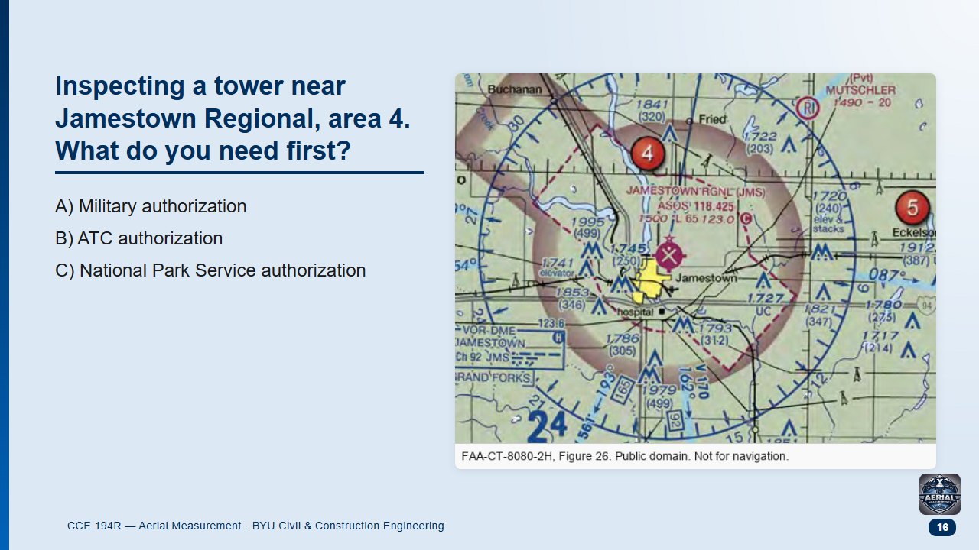
Notes:
FAA sample question, adapted (Figure 26, area 4). Groups 1.5 min.
Likely answer: "nothing" — students who miss the dashed magenta line think it is uncontrolled.

Slide 17
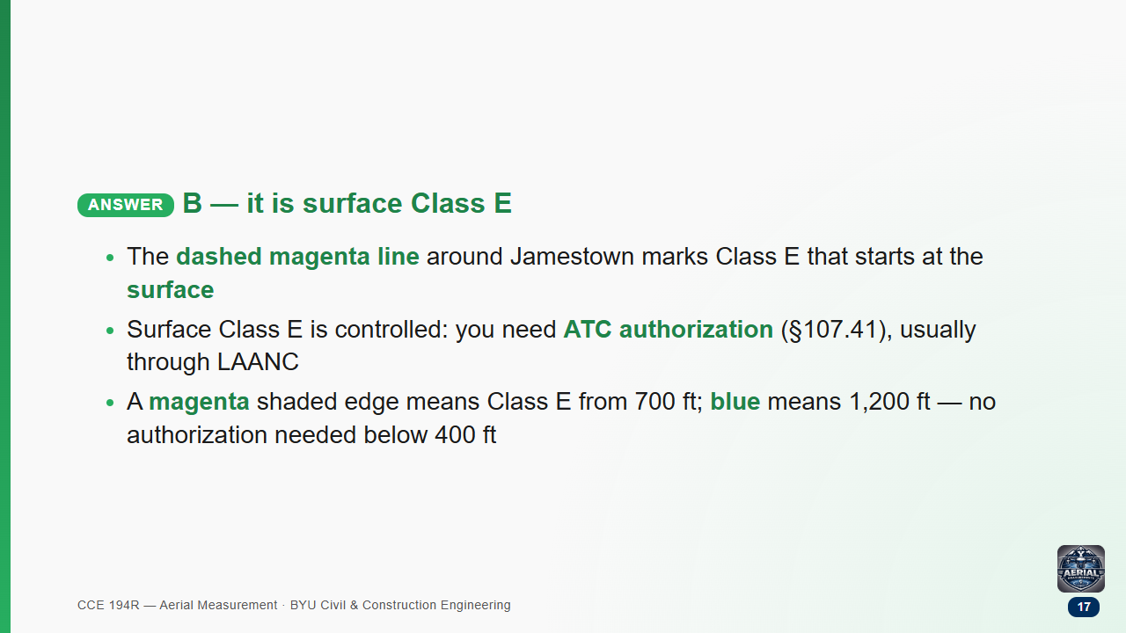

Slide 18
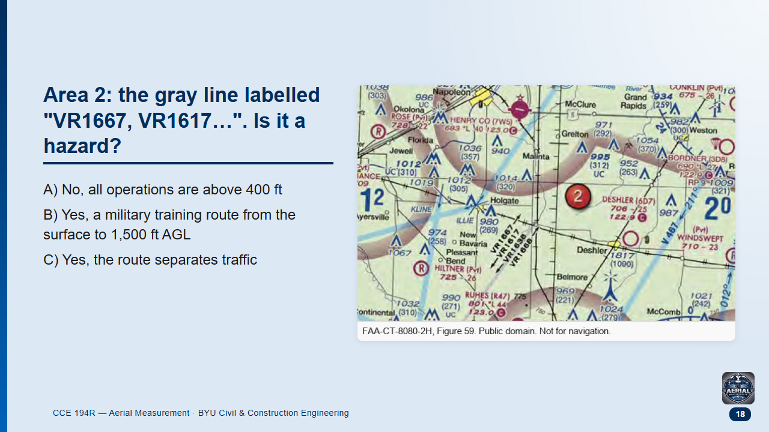
Notes:
FAA sample question, adapted (Figure 59, area 2). Groups 1 min.

Slide 19
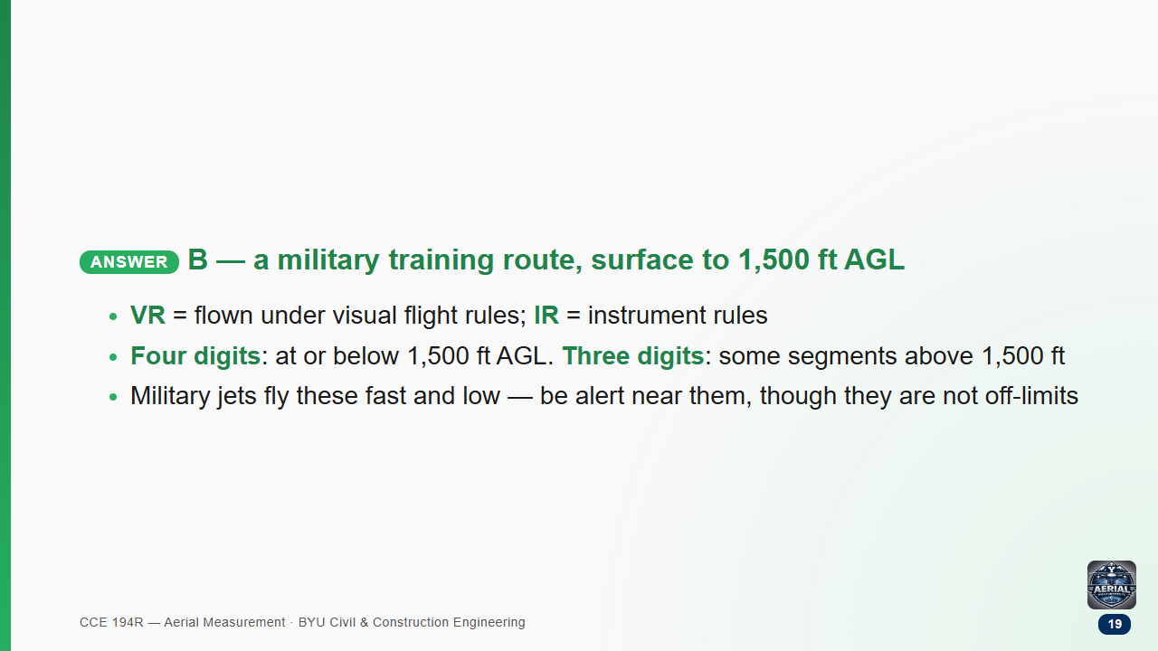

Slide 20
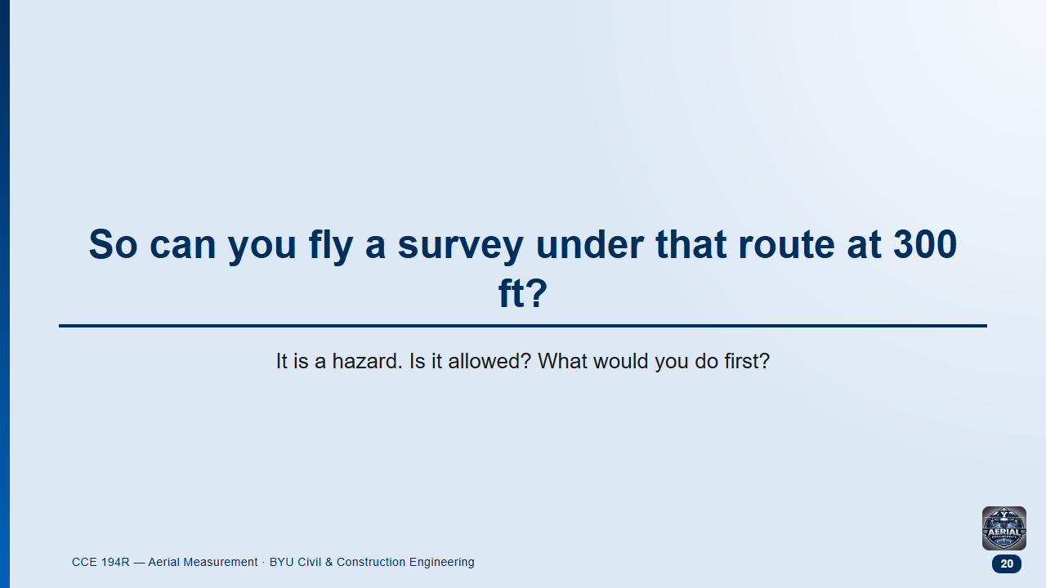
Notes:
Groups 2 min, then class. Follow-on discussion, not an FAA sample question.
Likely answers: "No, it's military airspace" or "Yes, we're below 400 ft so we're fine."
Both miss the point: legal, but you must manage the risk.

Slide 21
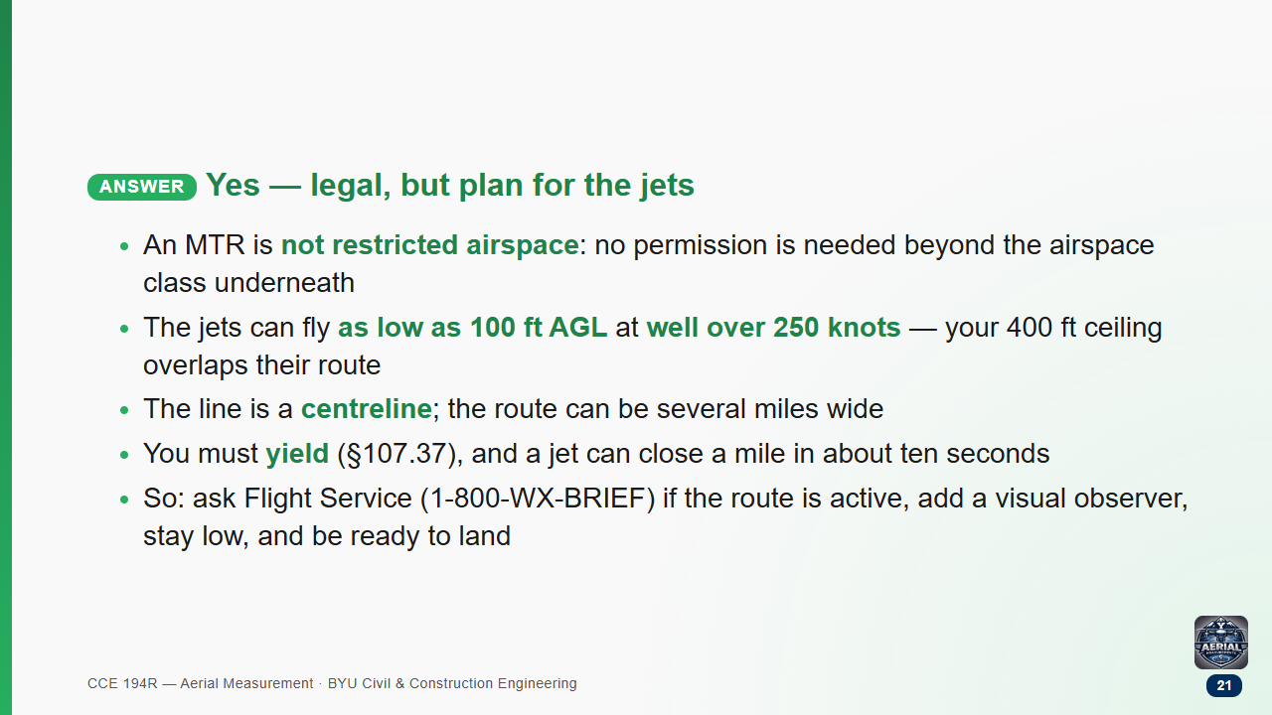

Slide 22
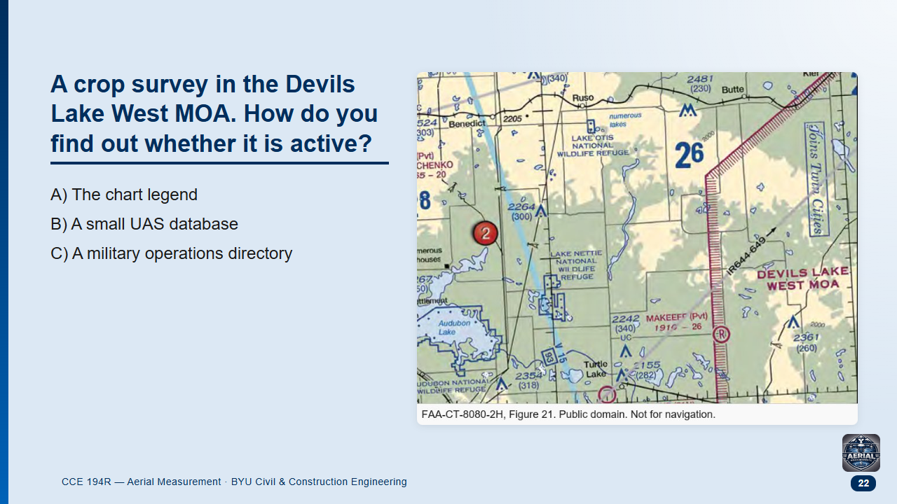
Notes:
FAA sample question, adapted (Figure 21). Groups 1 min.

Slide 23
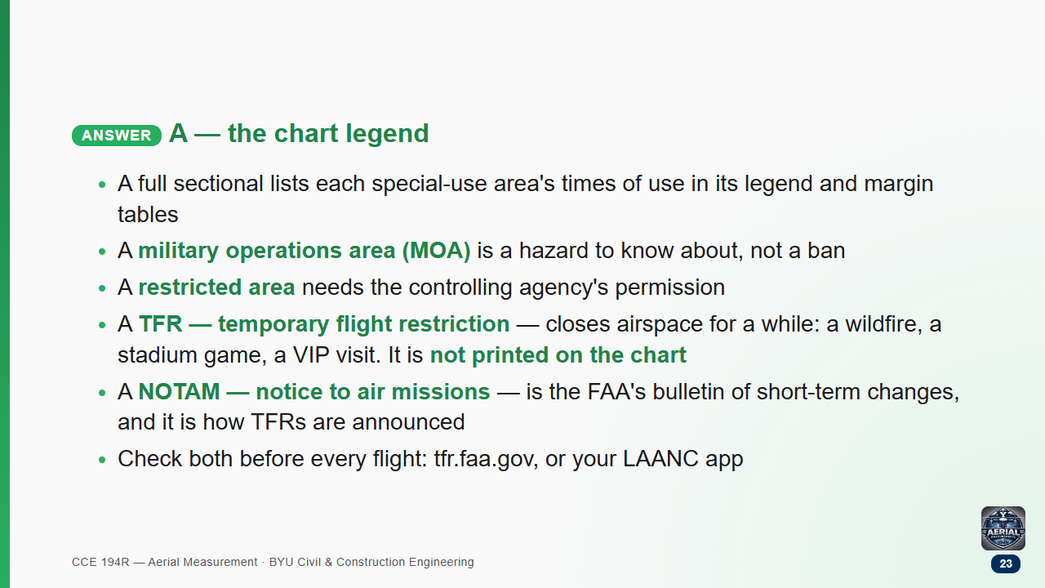
Notes:
Beginners have never seen either word. A TFR is the restriction; a NOTAM is the message that announces it (and other temporary changes, like a closed runway or a crane near an airport).

Slide 24
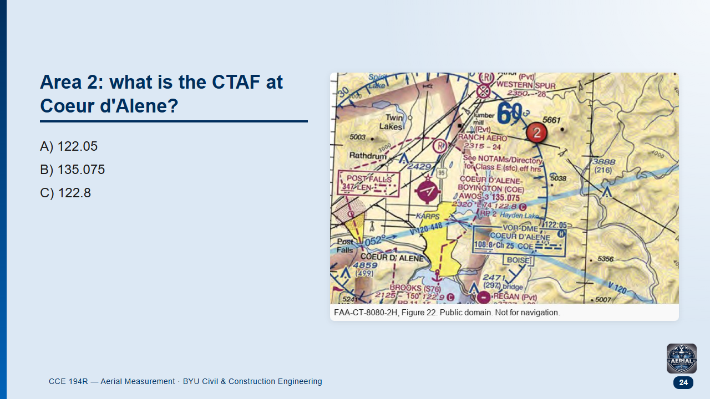
Notes:
FAA sample question, adapted (Figure 22, area 2). Groups 1 min.

Slide 25
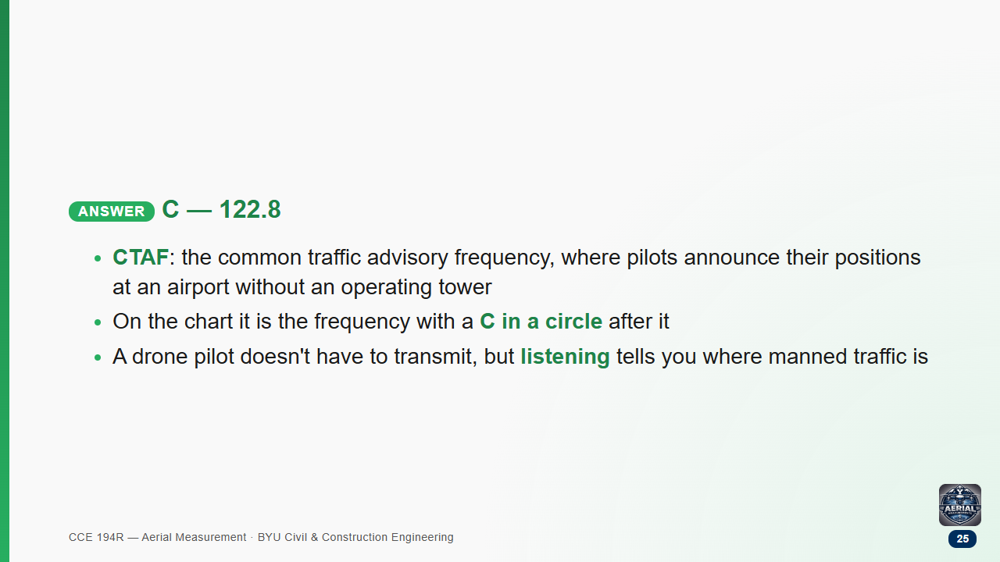

Slide 26
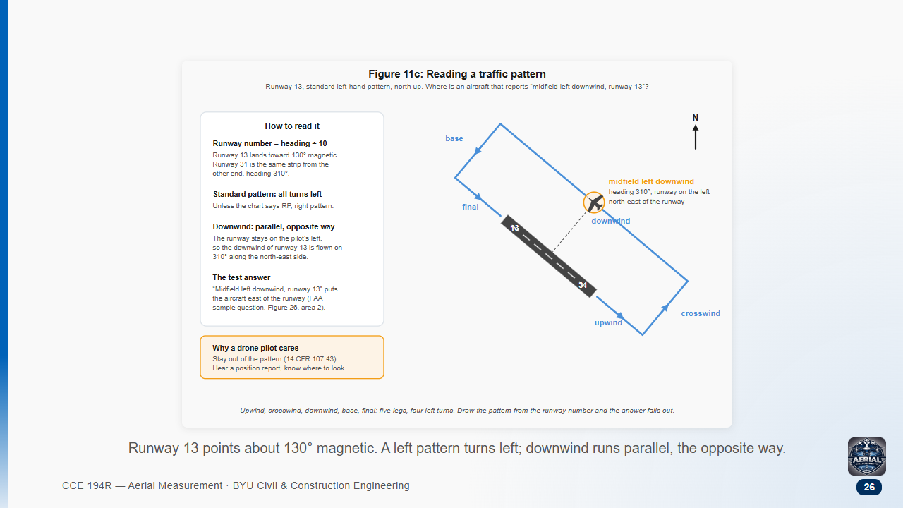

Slide 27
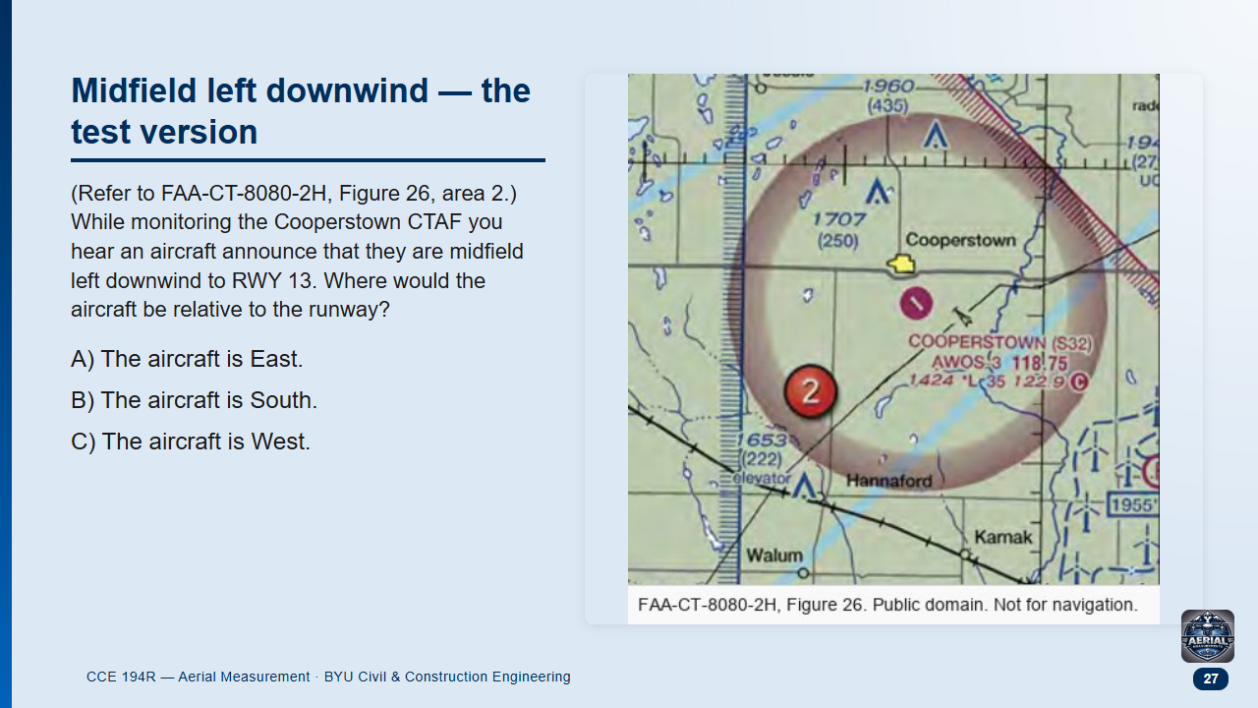
Notes:
FAA sample question 18, word for word (UAG sample set, public domain; ACS code UA.V.A.K3). Pairs 2 min: find the runway on the chart, draw the landing direction toward 130 degrees, turn left four times. The previous slide (Figure 11c) is the worked picture; ask them to apply it to this chart without looking back.

Slide 28
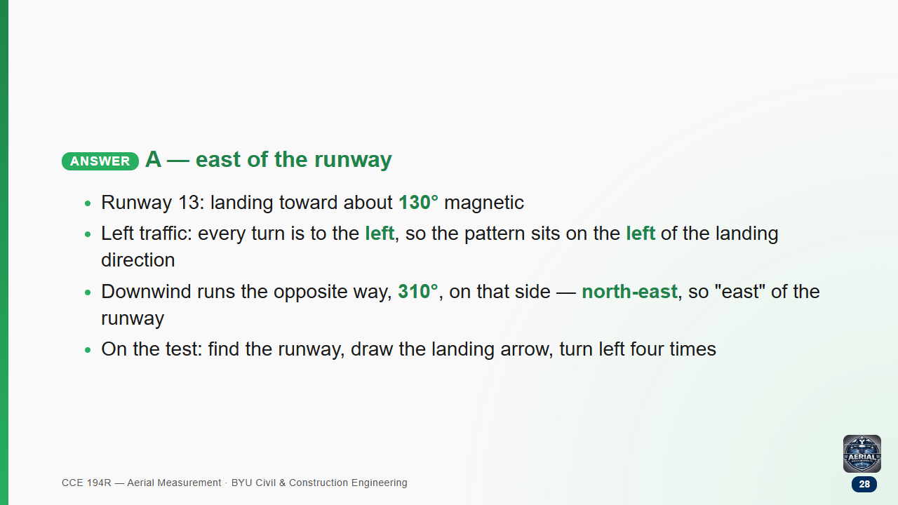

Slide 29
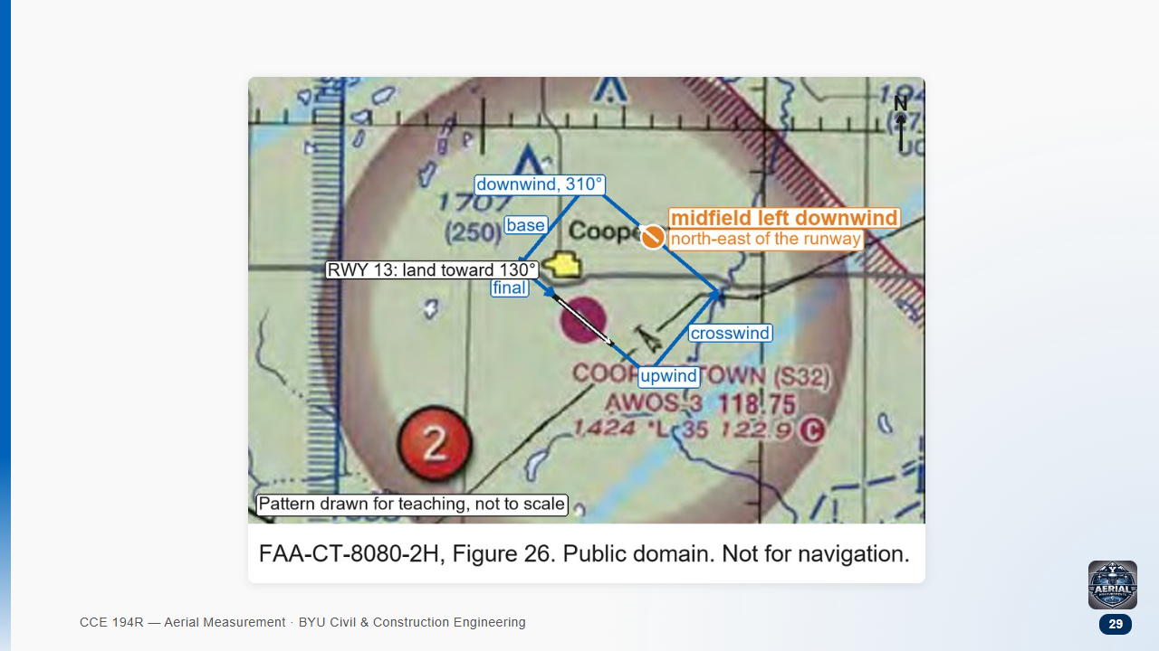
Notes:
The same Figure 26 crop as the question, with the left-hand pattern for runway 13 sketched on it (not to scale). Trace it with the class: land toward 130, upwind, turn left onto crosswind, left onto downwind heading 310 (the north-east side), then base and final.

Slide 30
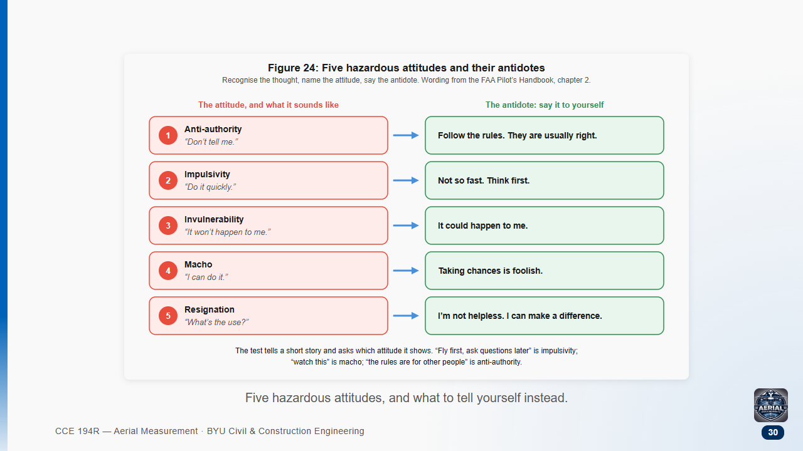

Slide 31
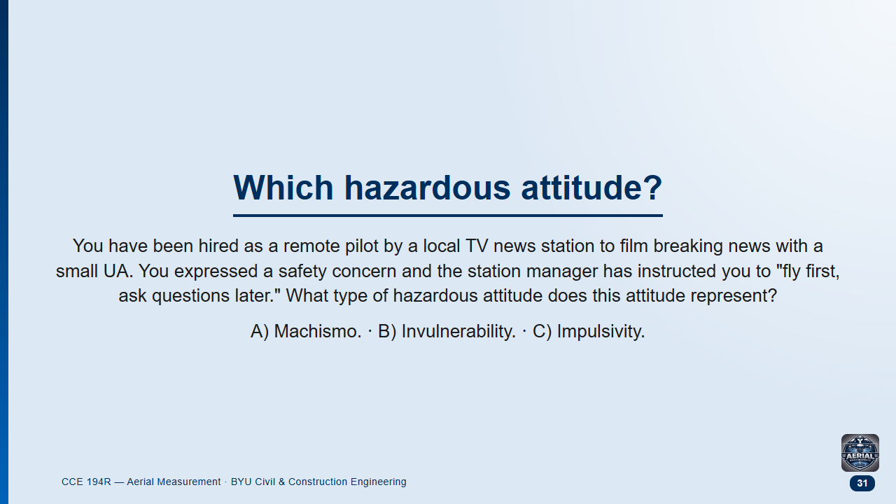
Notes:
FAA sample question 16, word for word (UAG sample set, public domain; ACS code UA.V.D.K4). Groups 1 min.

Slide 32
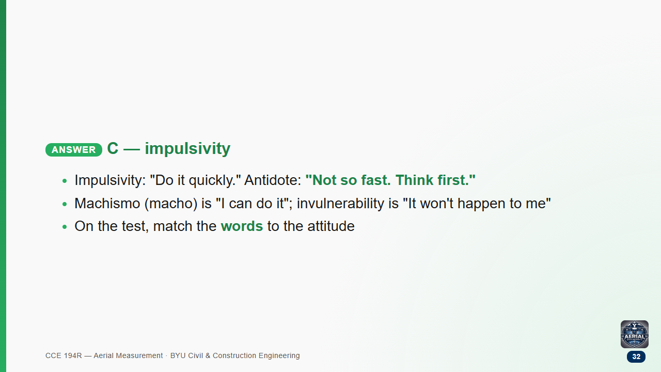

Slide 33
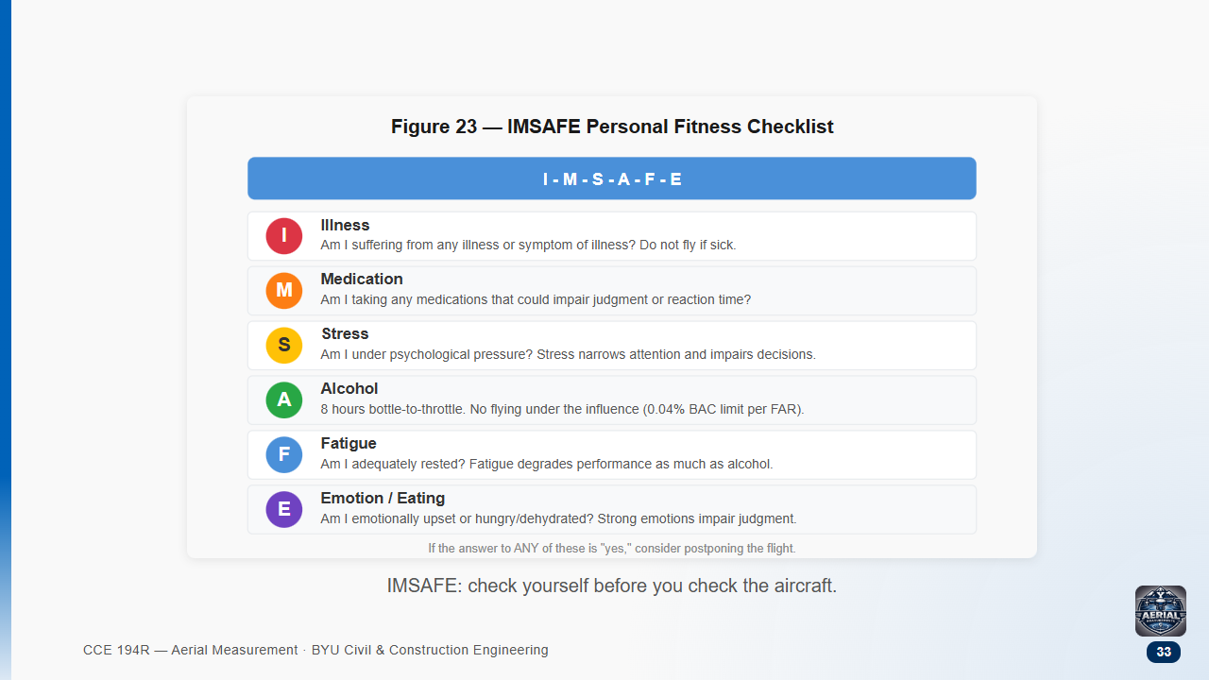

Slide 34
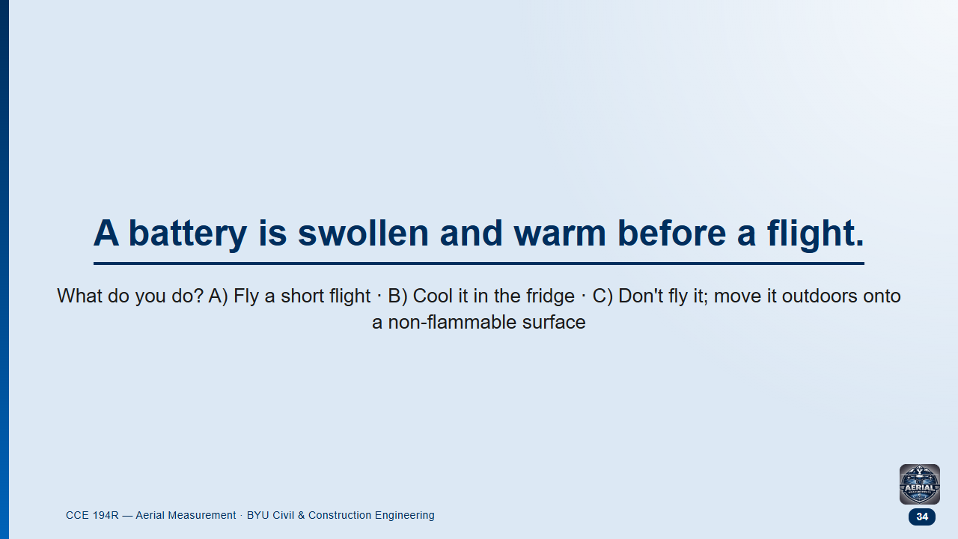
Notes:
Course question. Groups 1 min.

Slide 35
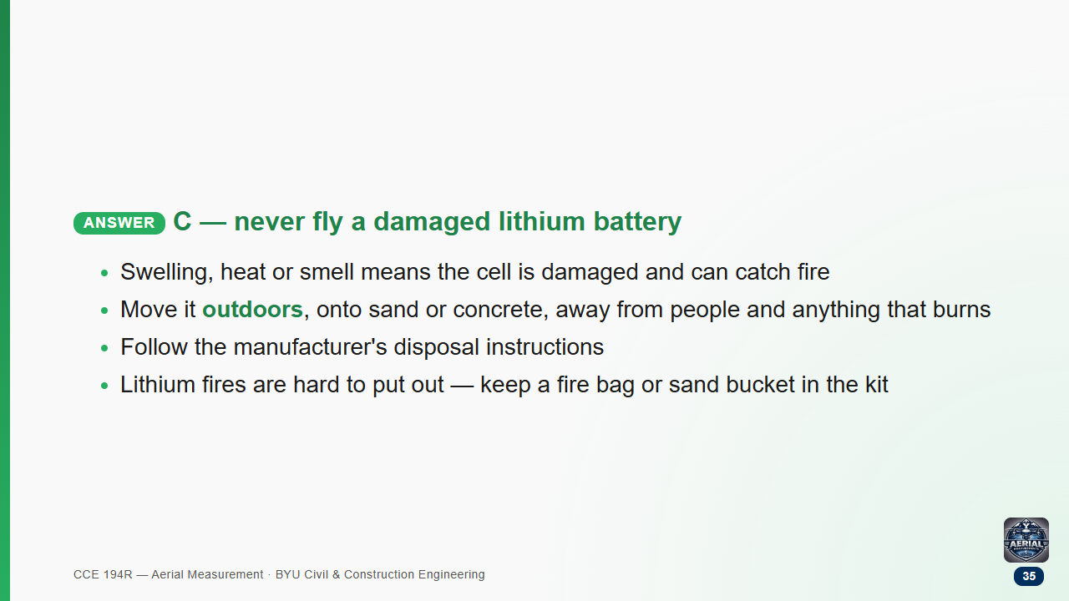

Slide 36
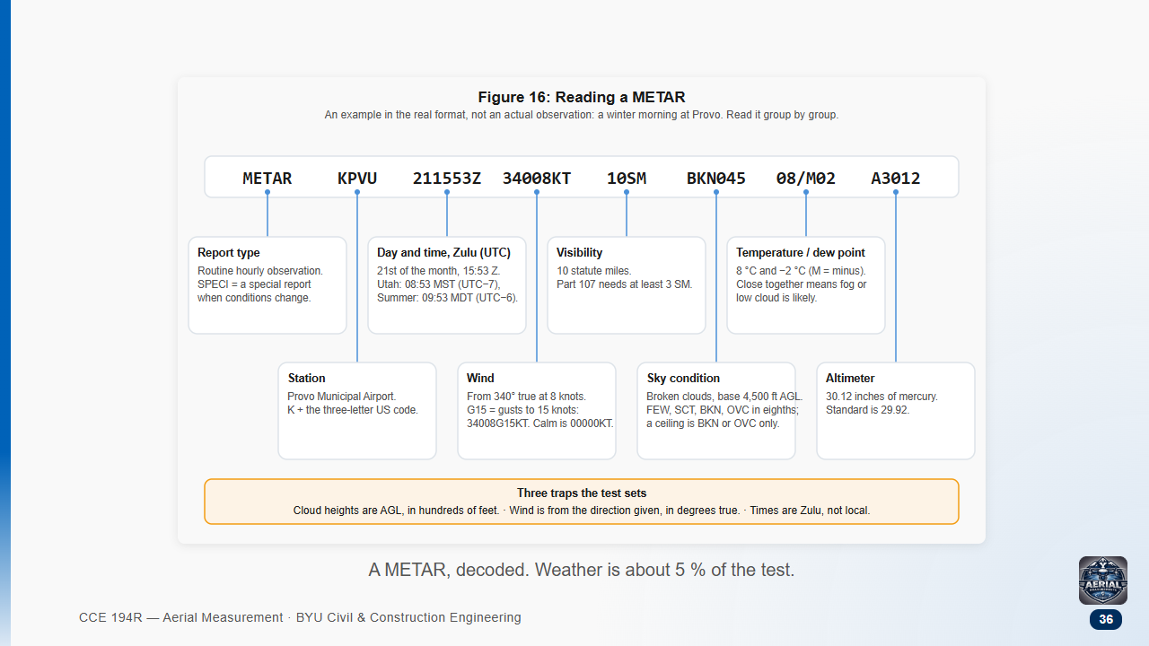

Slide 37
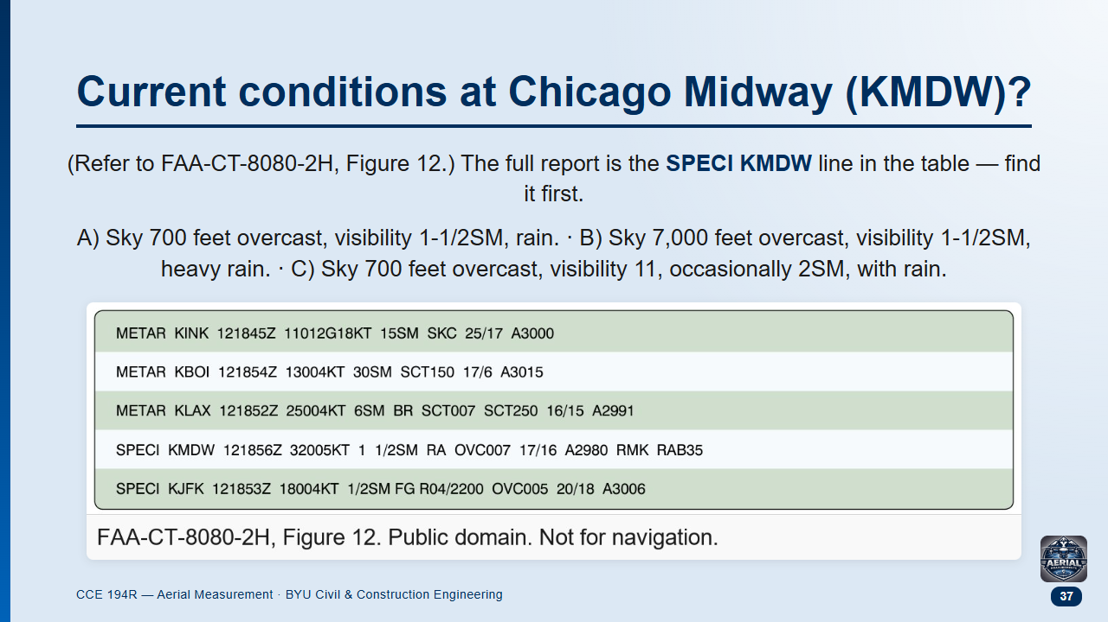
Notes:
FAA sample question 25, word for word (UAG sample set, public domain). Groups 1.5 min.
The first skill is finding the right line: five reports, one for Midway. Then read it left to right.

Slide 38
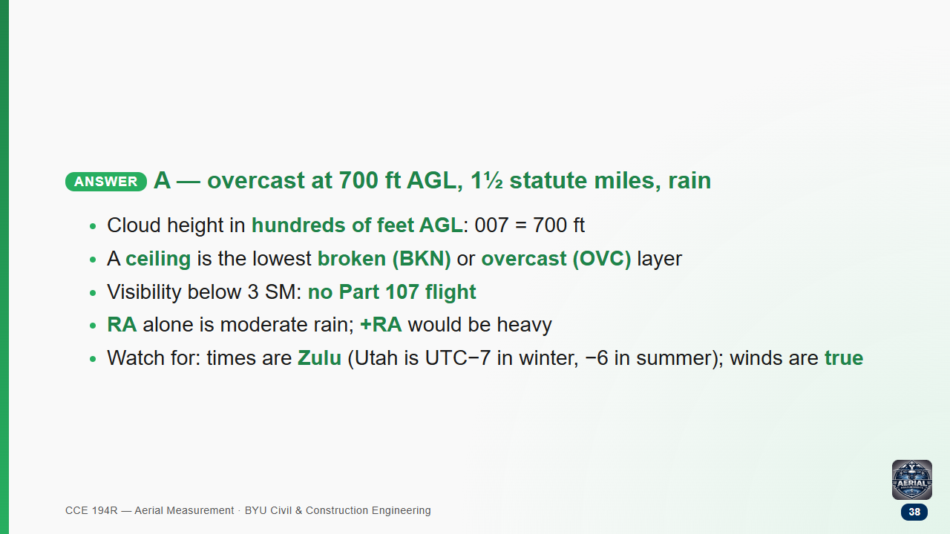

Slide 39
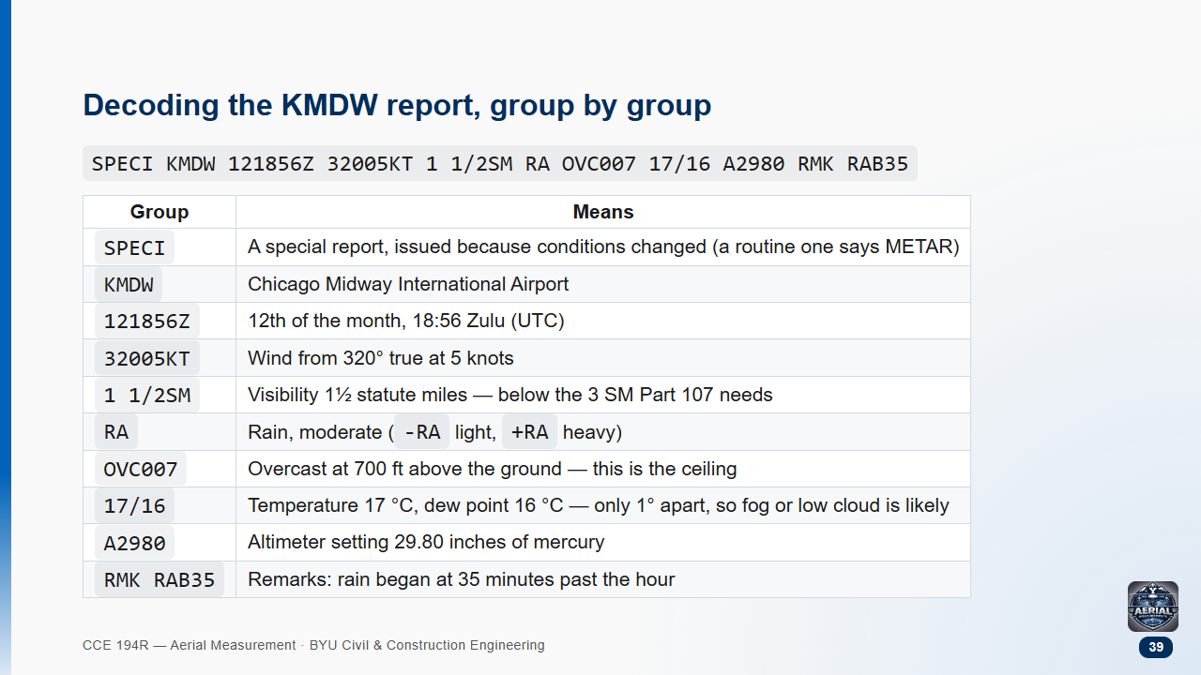

Slide 40
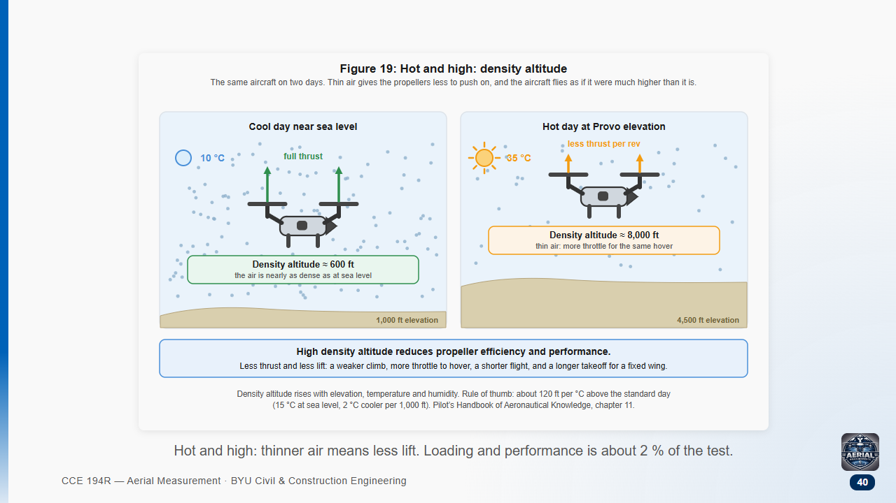

Slide 41
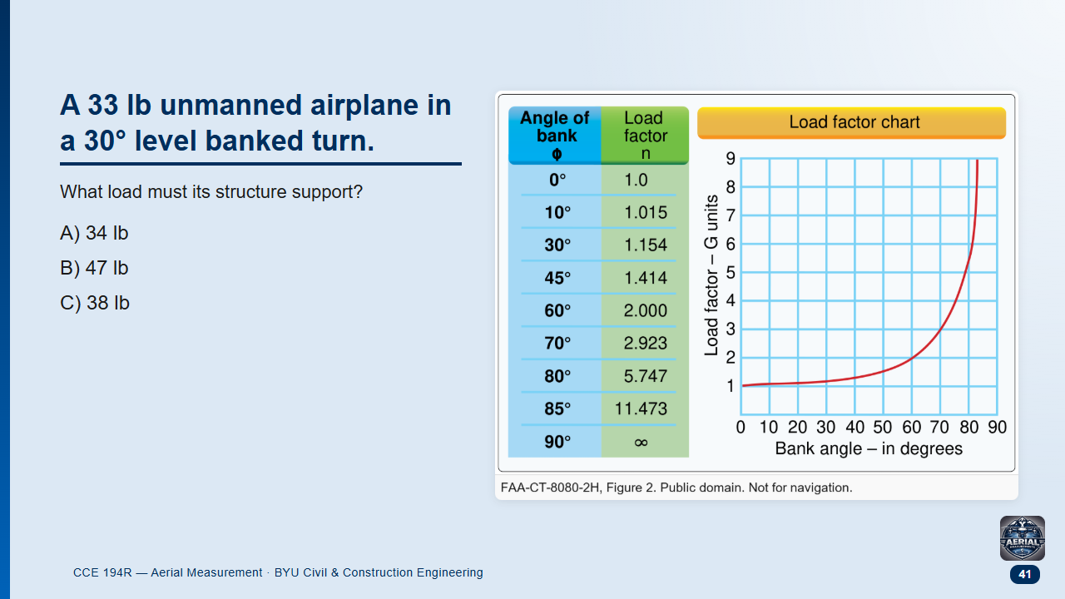
Notes:
FAA sample question, adapted (Figure 2). Pairs 2 min. Calculator allowed.

Slide 42
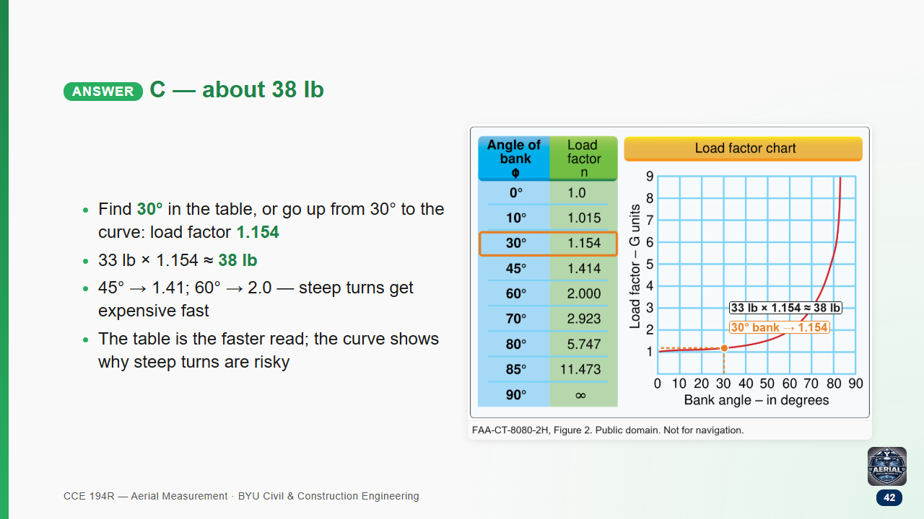

Slide 43
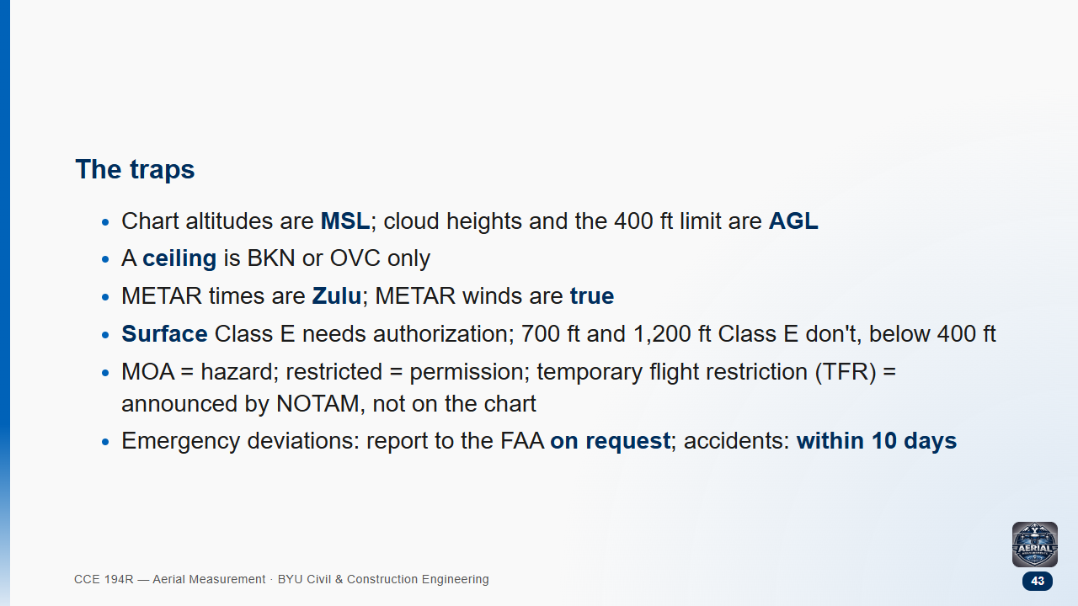

Slide 44
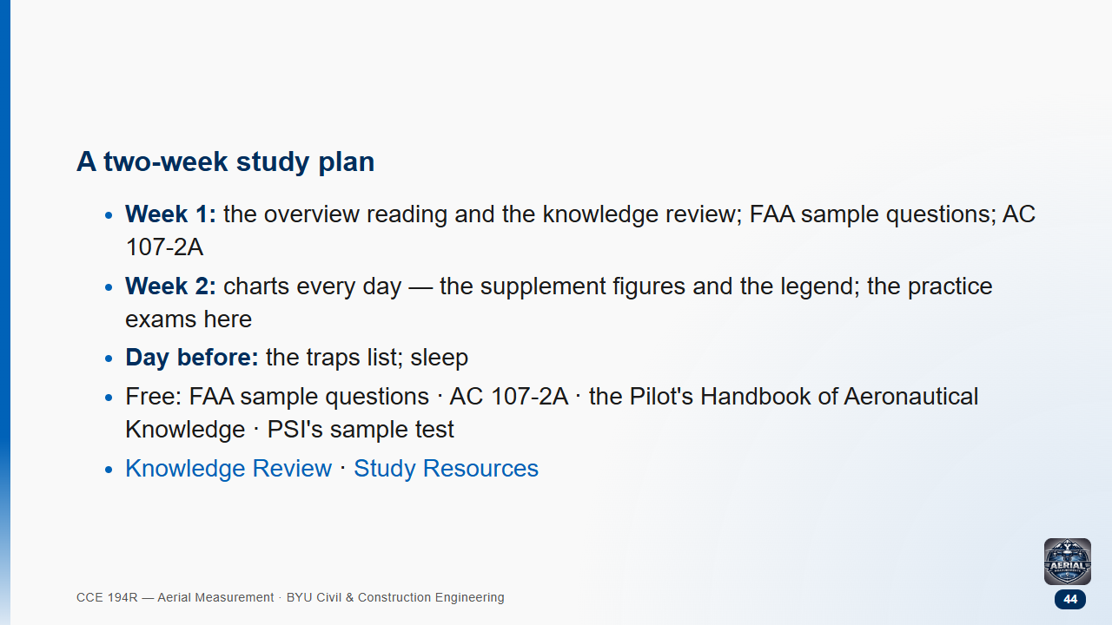

Slide 45


