Slide 1

Notes:
Introduces the project on Tue Nov 3. Every rule here is on the Final Project pages of the site; point students there for details. Leave the last 10 minutes for forming groups.

Slide 2
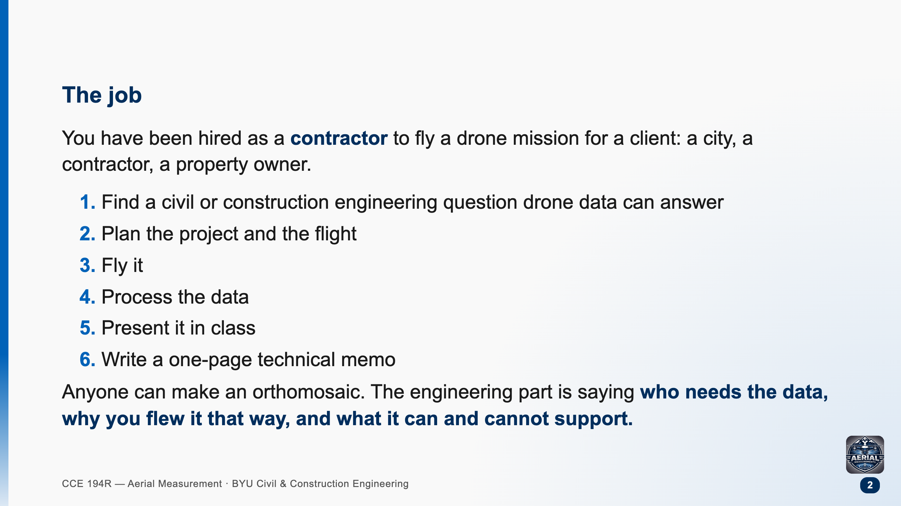

Slide 3
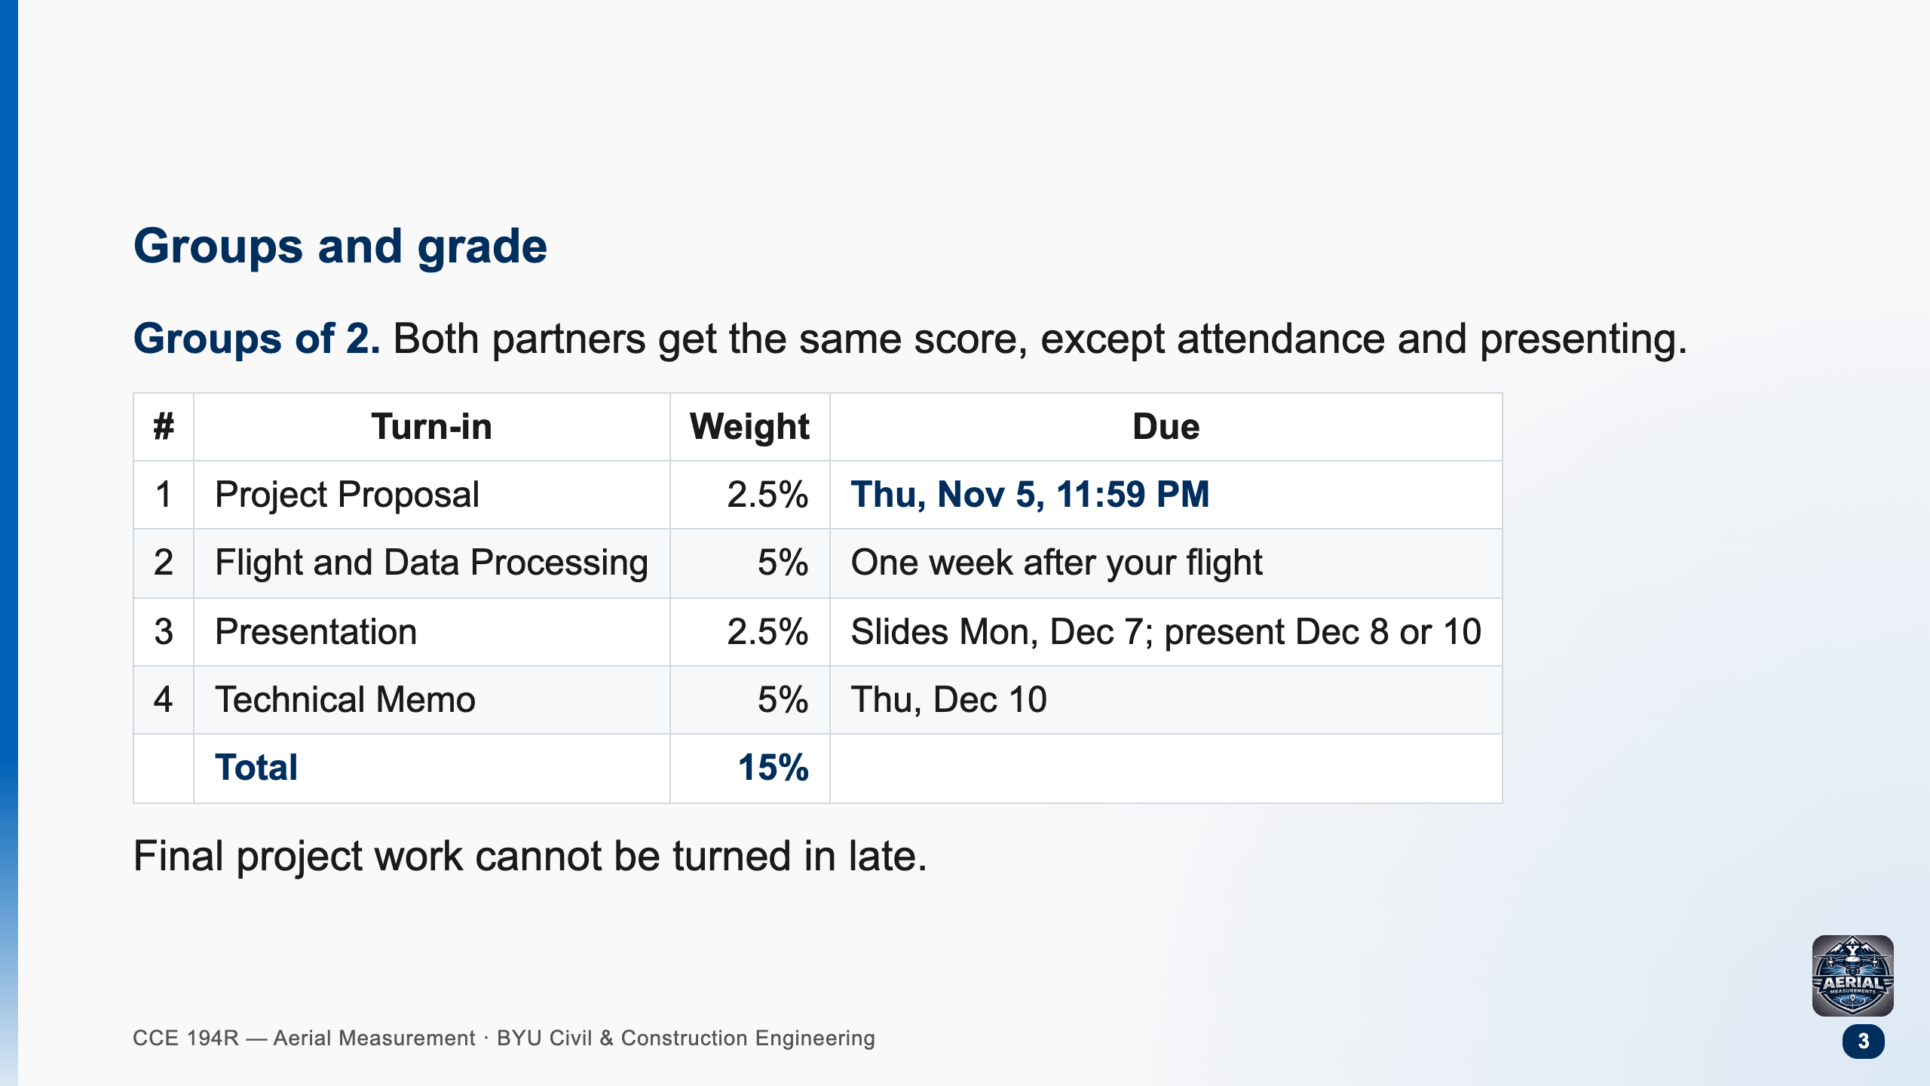

Slide 4
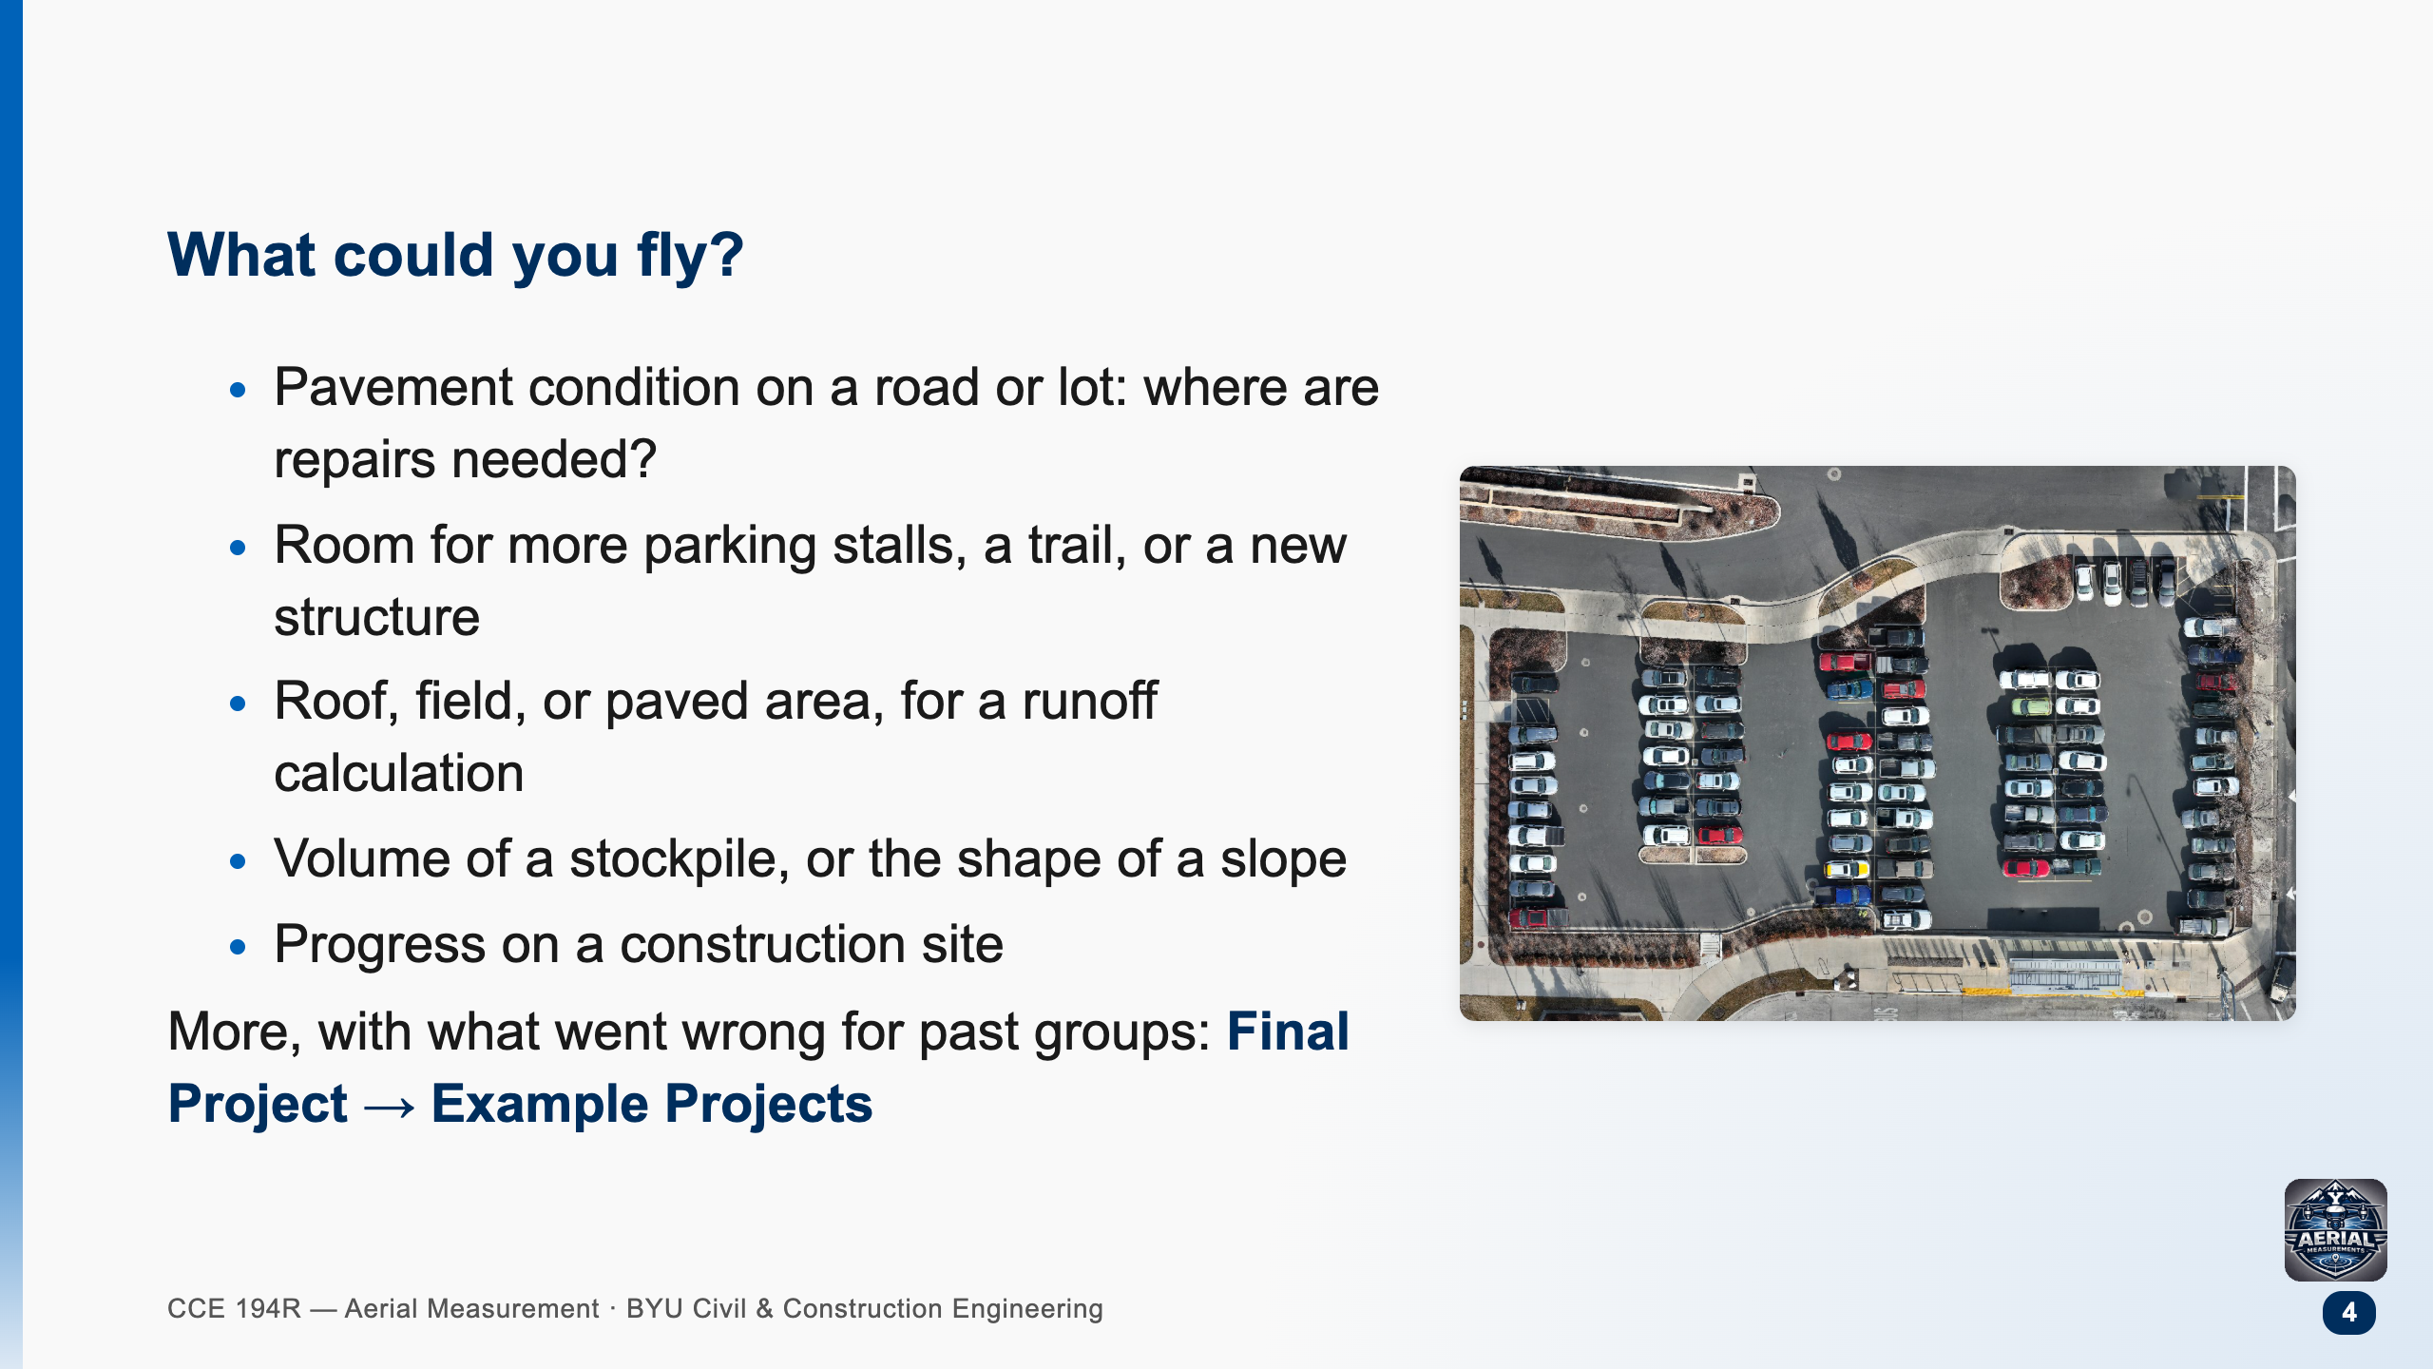
Notes:
Push them toward a question with a client attached, not "we want to map the duck pond". Sites within walking distance of the EB make the 50-minute trip much easier.

Slide 5
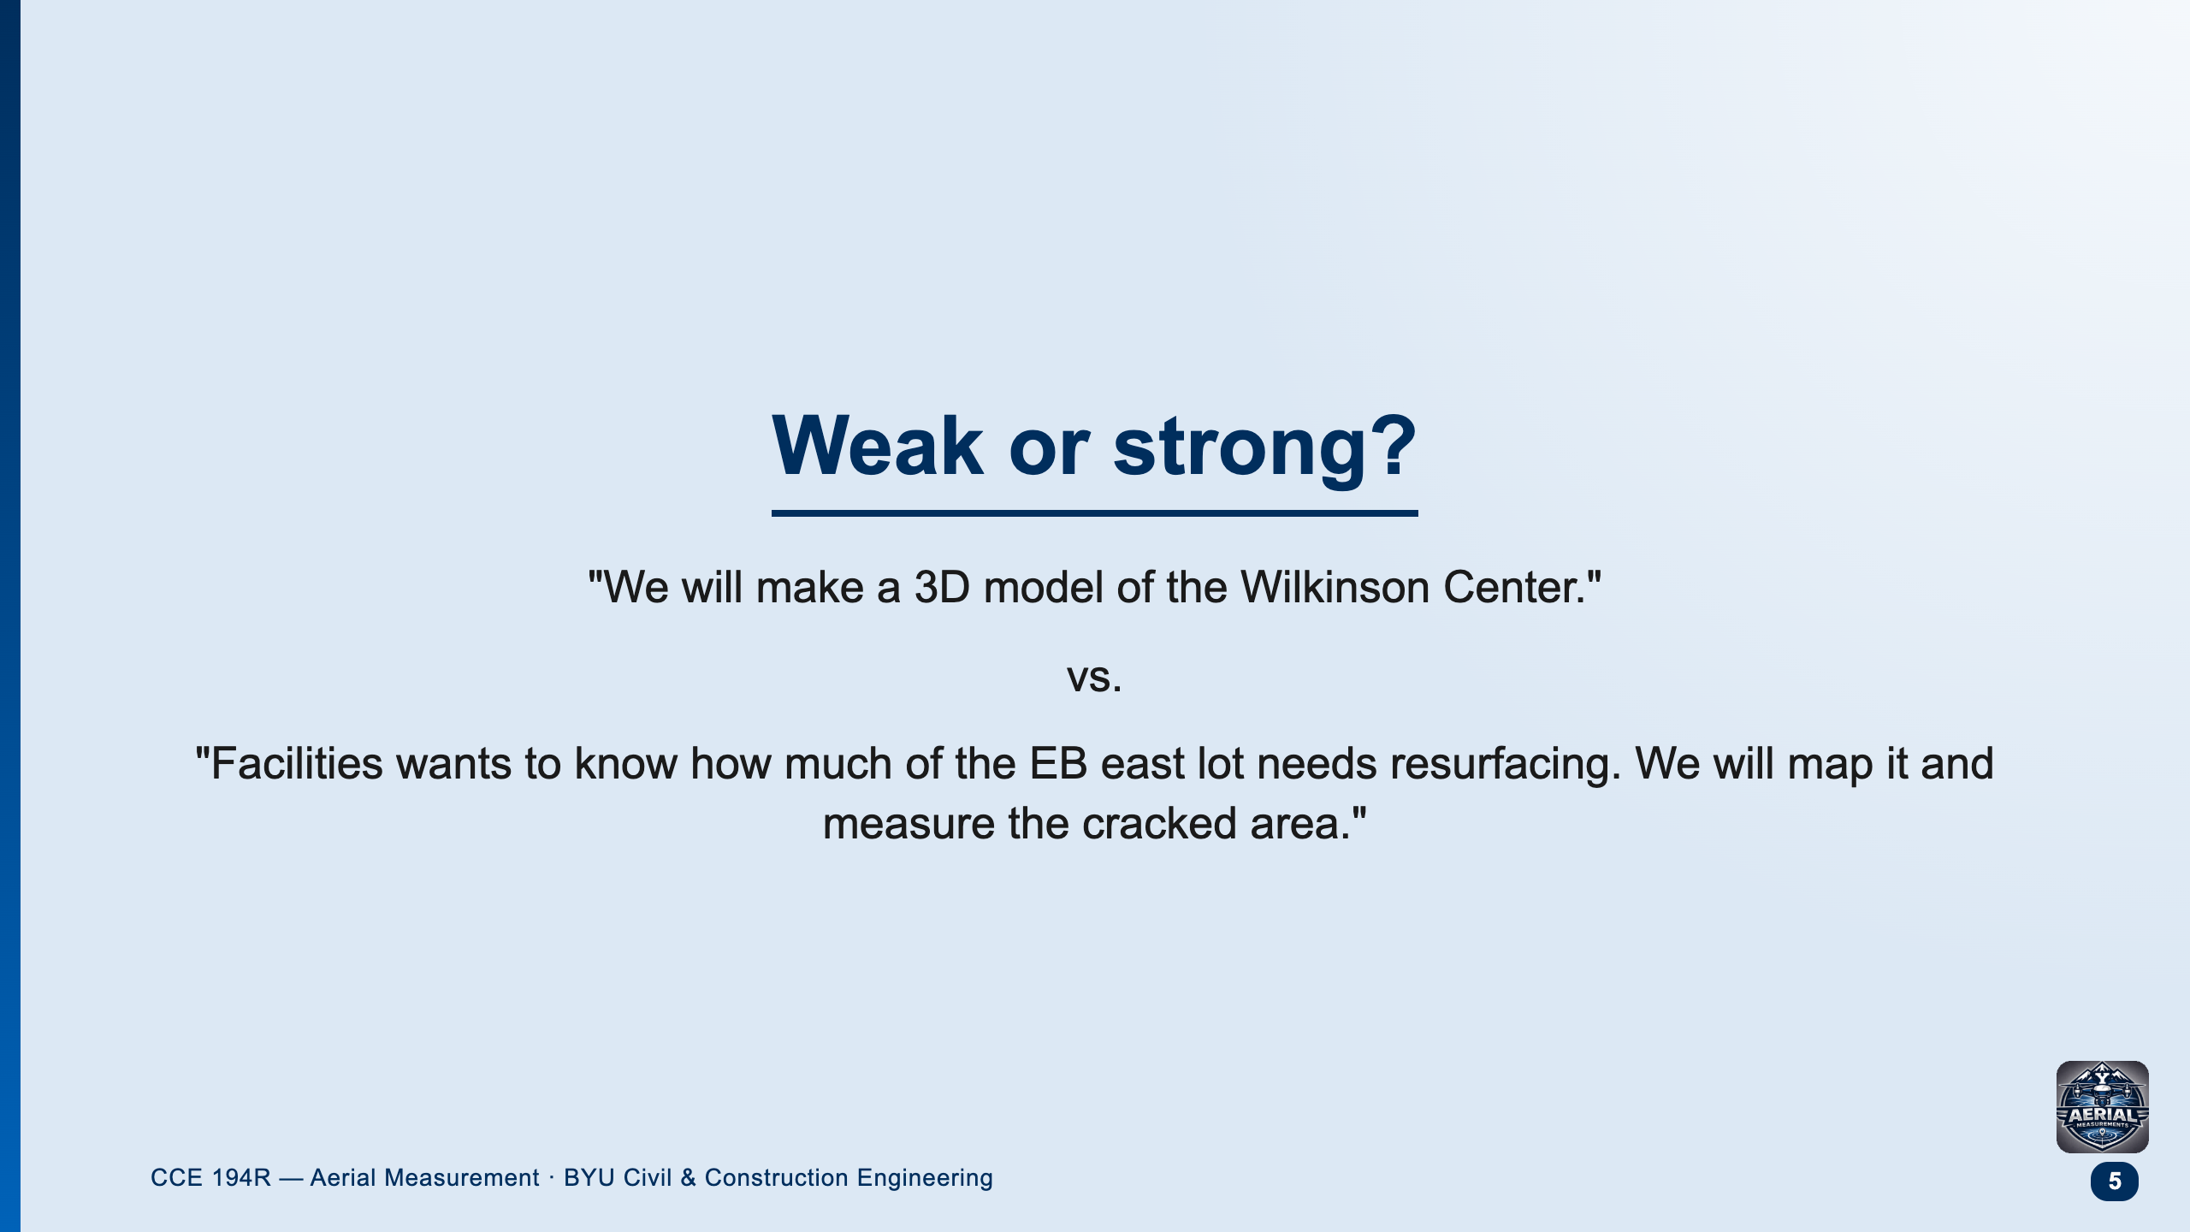
Notes:
The first is a product. The second has a client, a decision, and a measurement. Ask: who would pay for the first one?

Slide 6
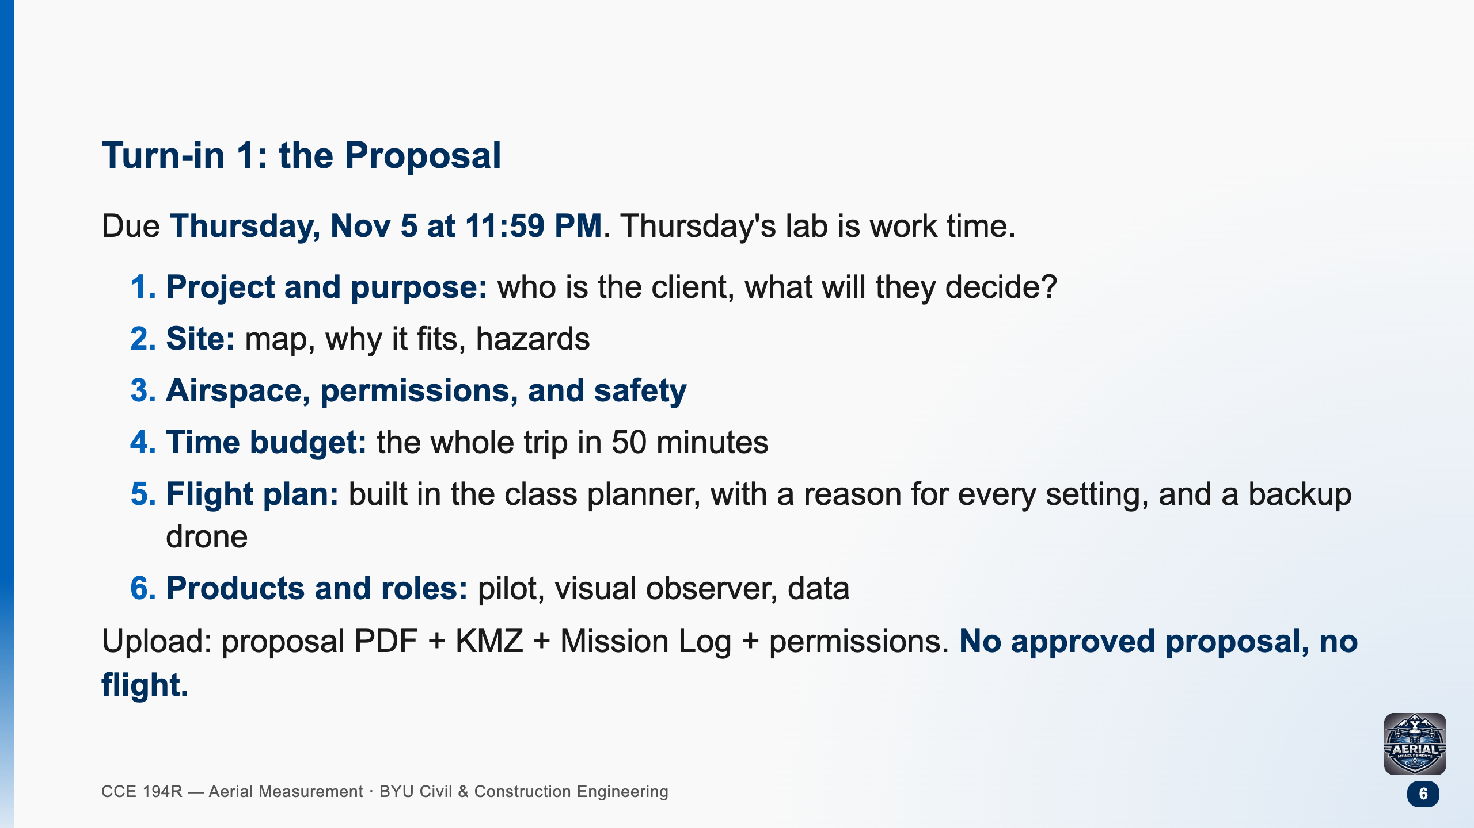

Slide 7
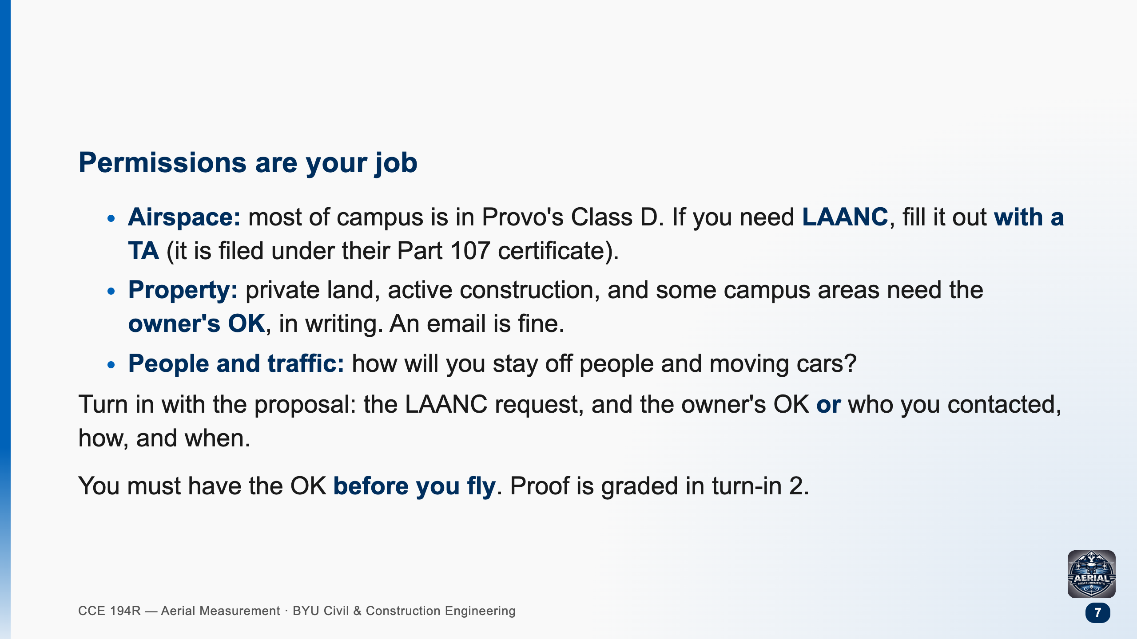

Slide 8
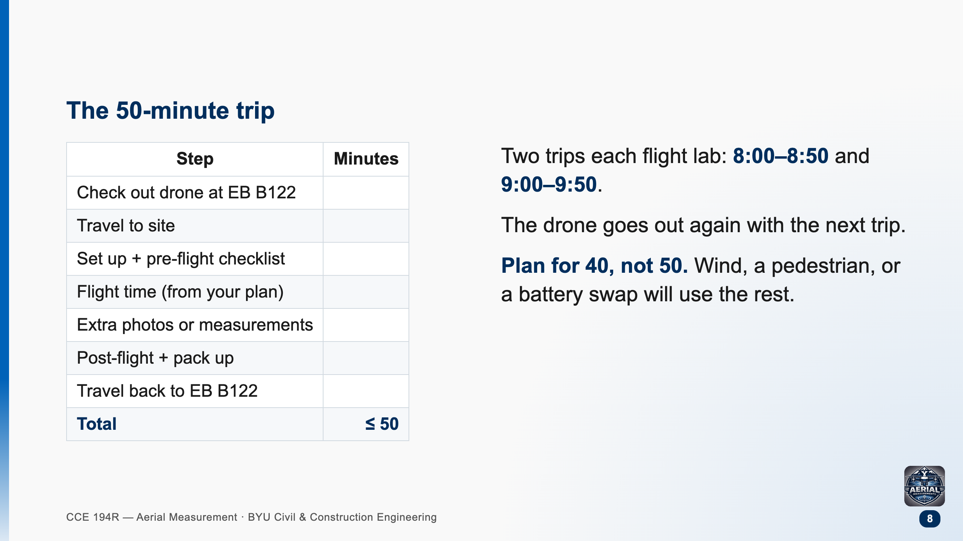

Slide 9
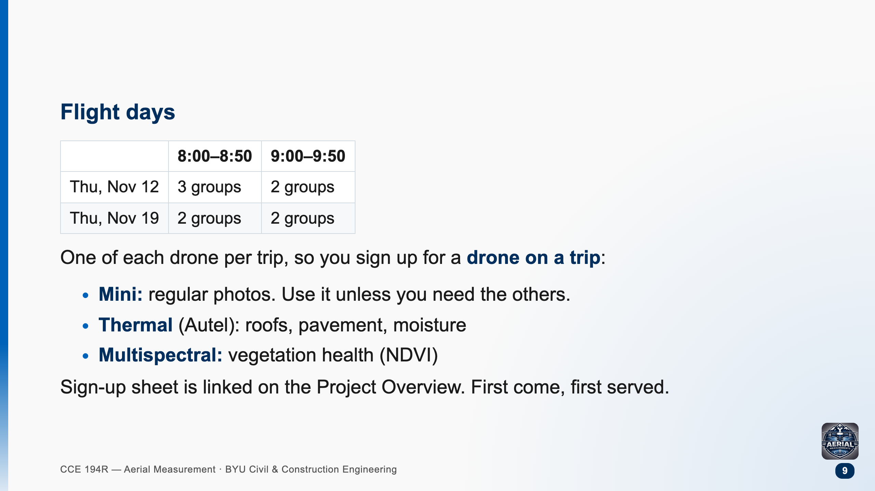

Slide 10
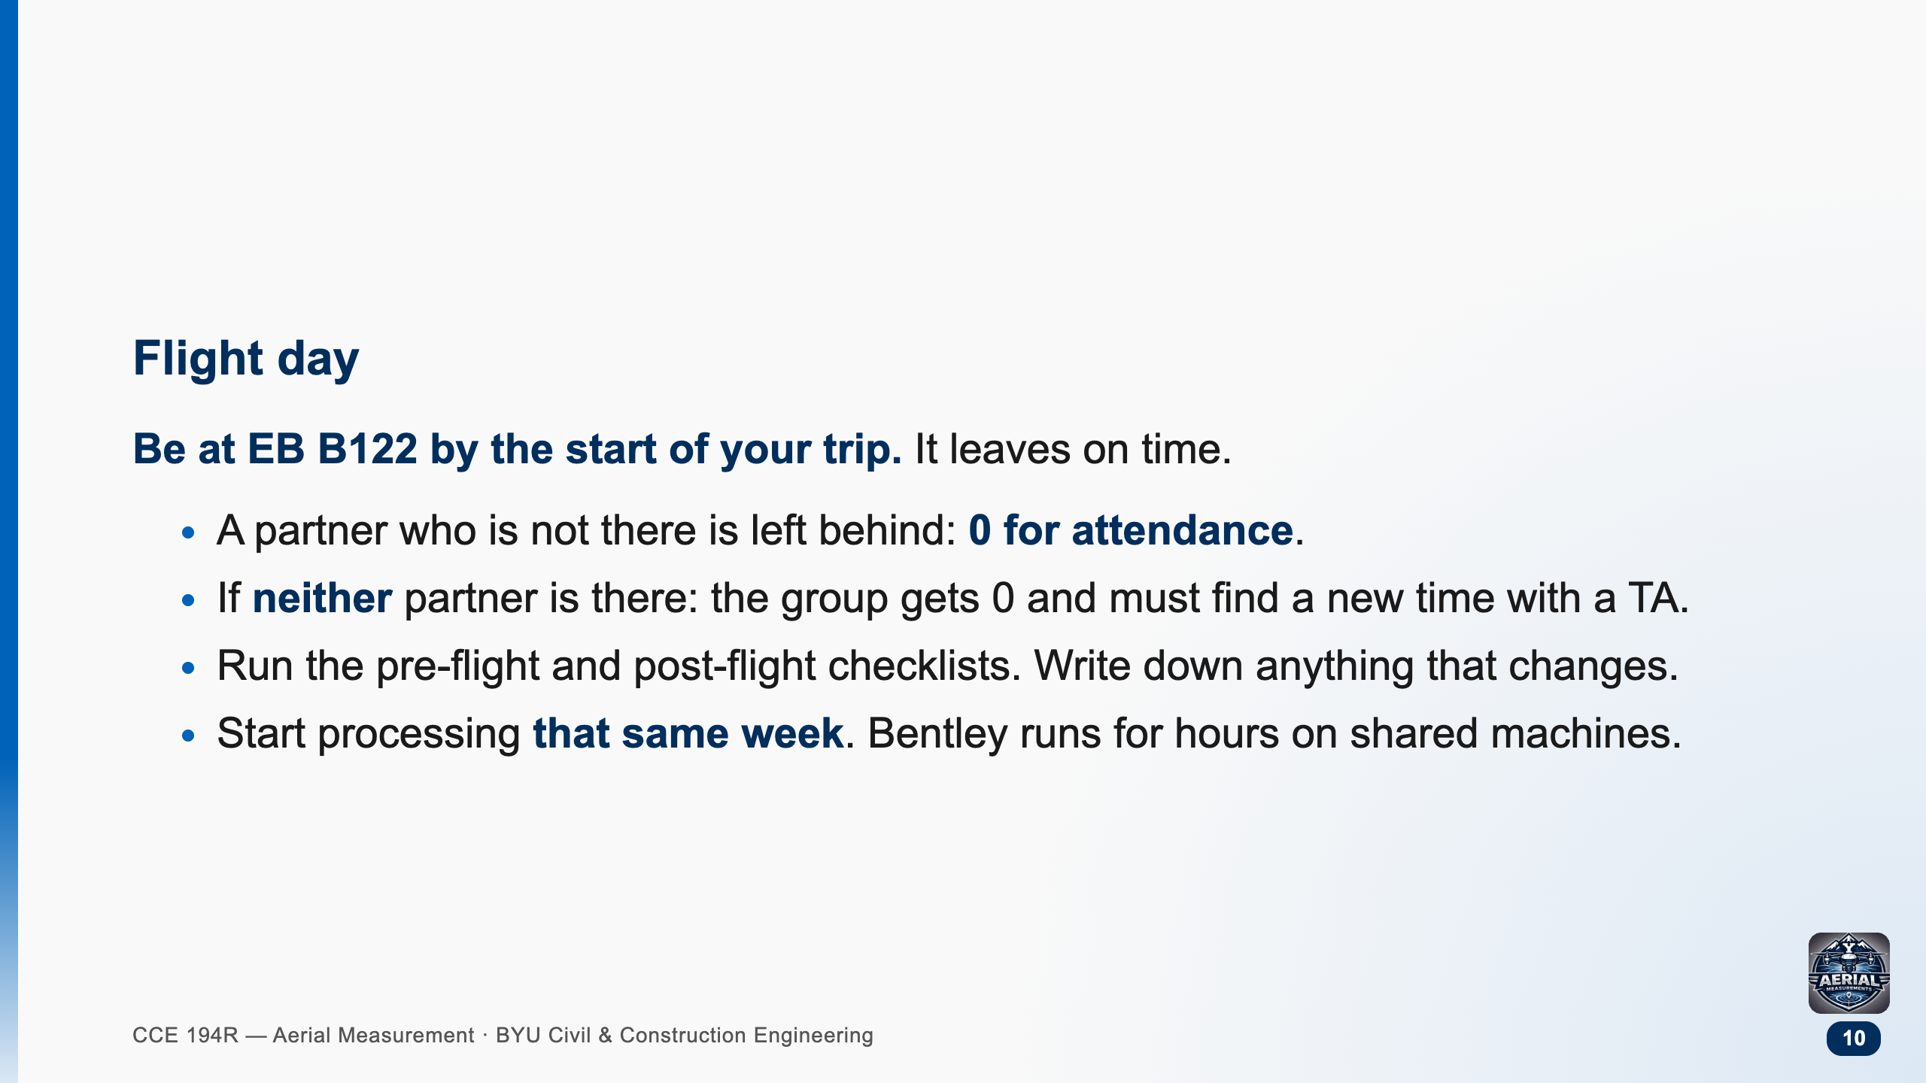

Slide 11
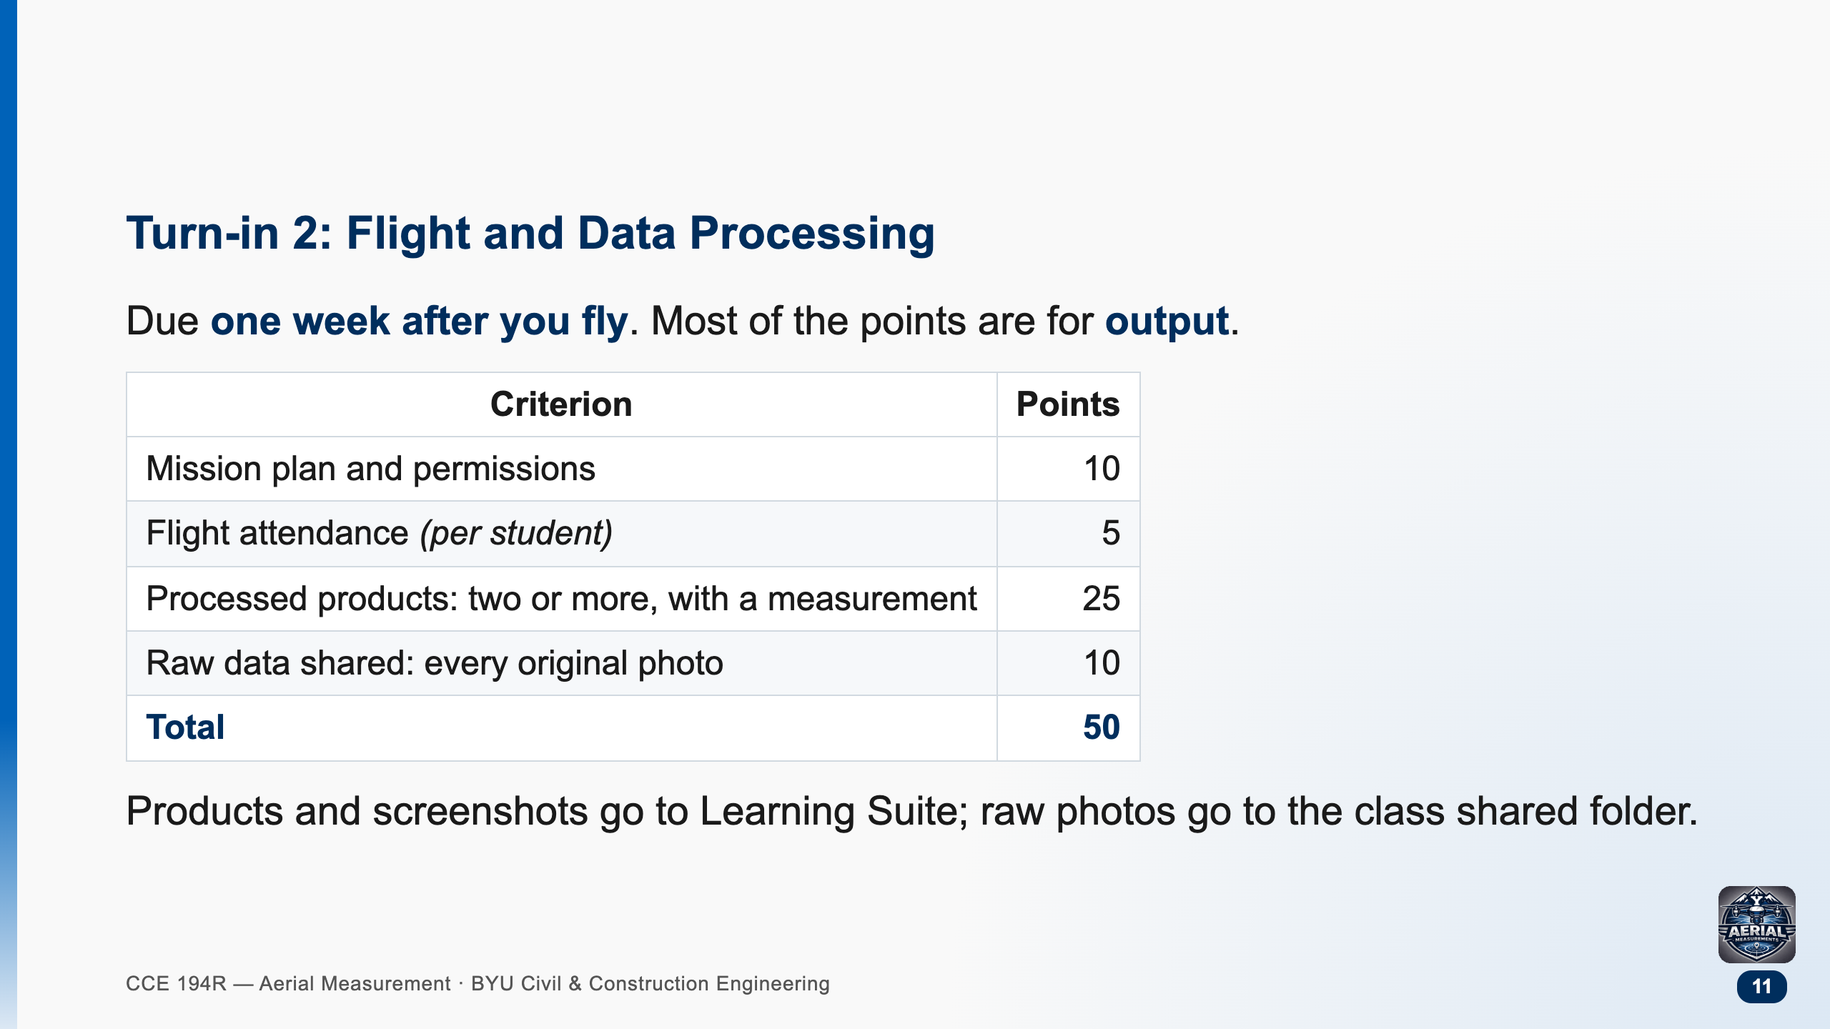

Slide 12
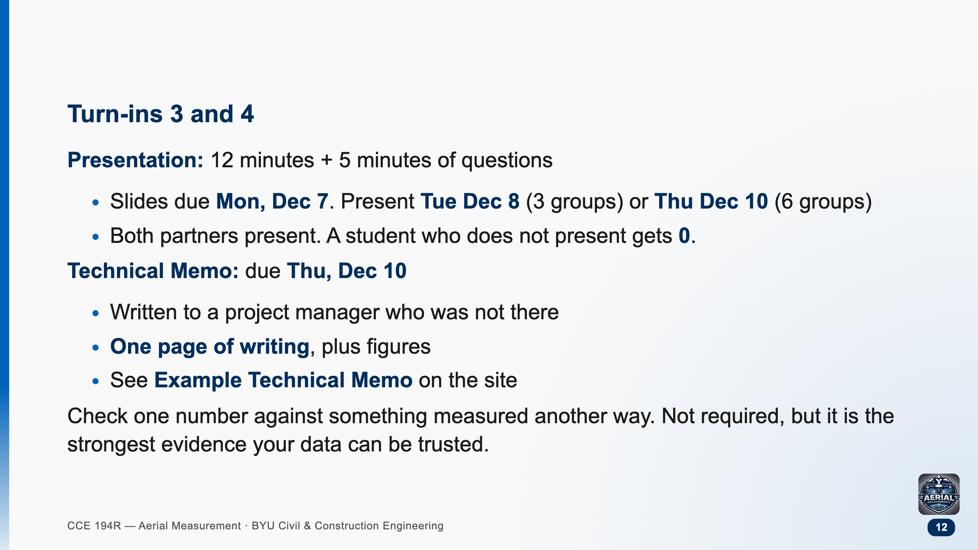

Slide 13
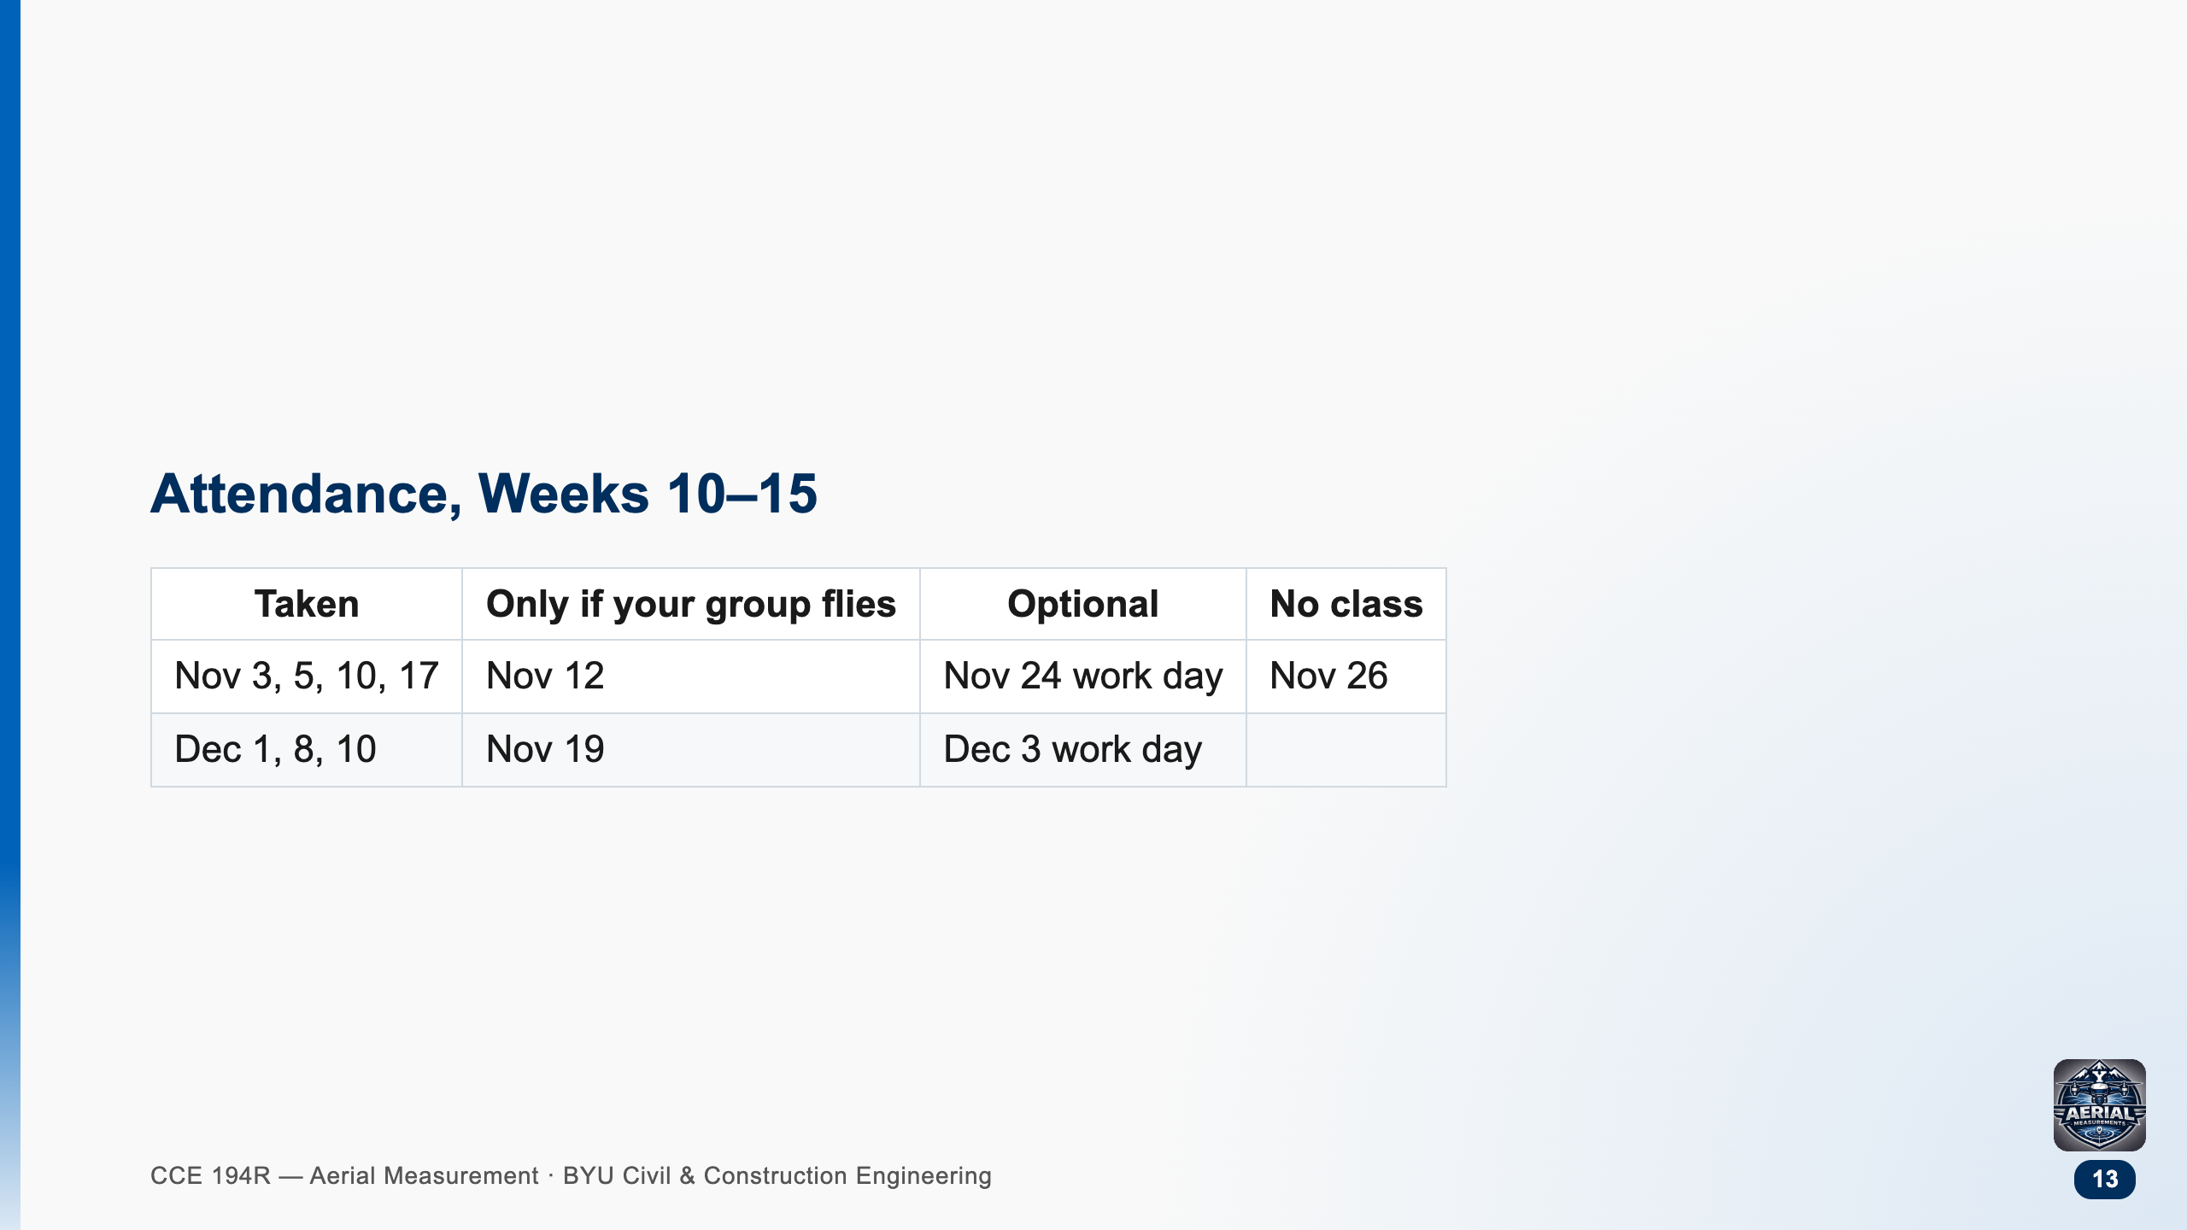

Slide 14
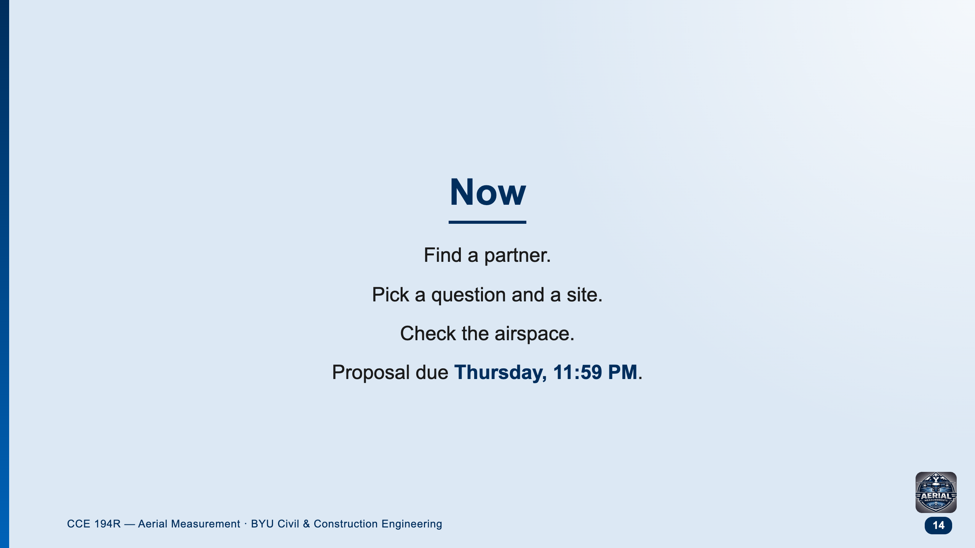
Notes:
Have groups write their names and a one-line idea on the board or in Teams before they leave. Thursday's lab: TAs check sites and file LAANC requests.

