Slide 1

Notes:
Format for every question slide today: groups of 2–3 talk for the time given, then one group answers and the class discusses. Not a quiz. Reveal on the next slide.
Regulations are 48 % of the Part 107 knowledge test, so today is exam preparation too. Week 9 reviews it.

Slide 2
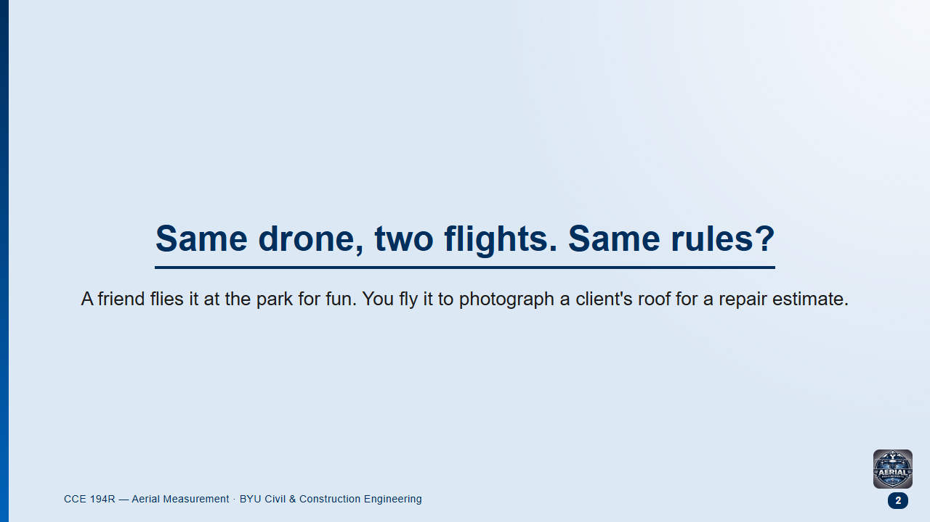
Notes:
Groups 1.5 min, then class.
Likely answer: "Yes, a drone is a drone."
Follow-up: "What changes if nobody pays you, but it is for a class project?"

Slide 3
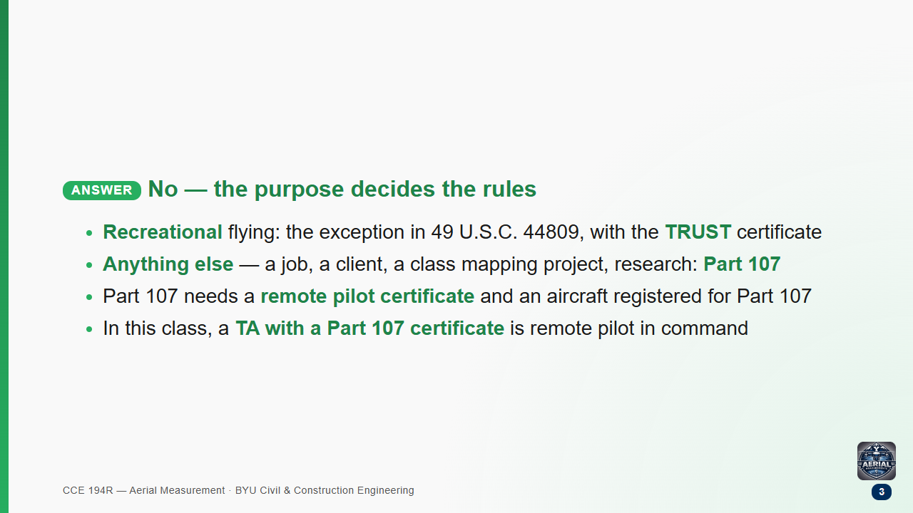

Slide 4
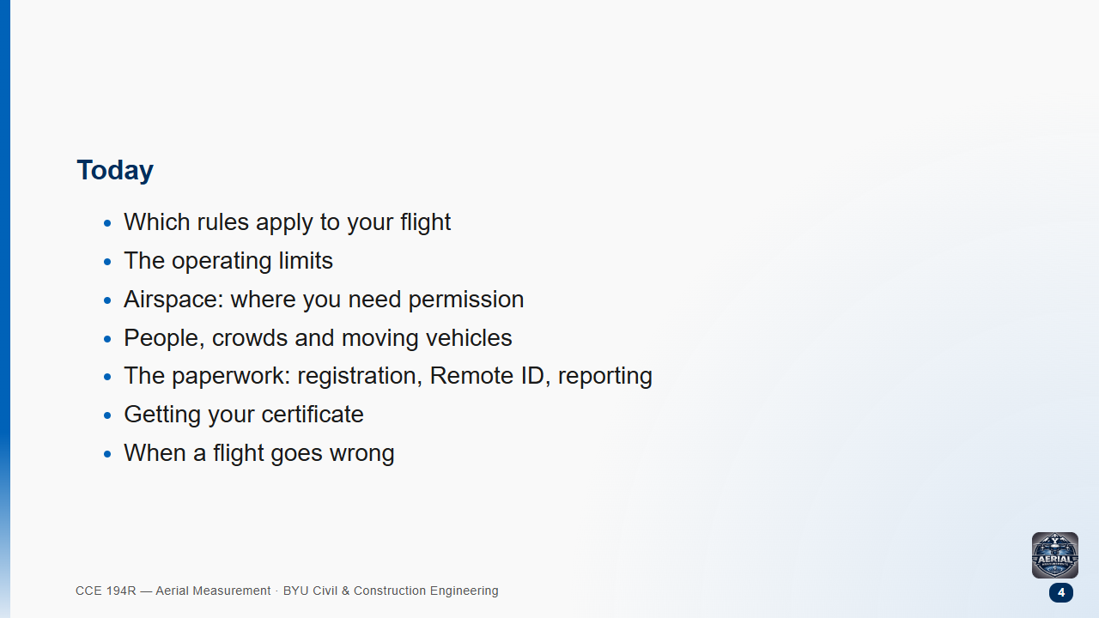

Slide 5
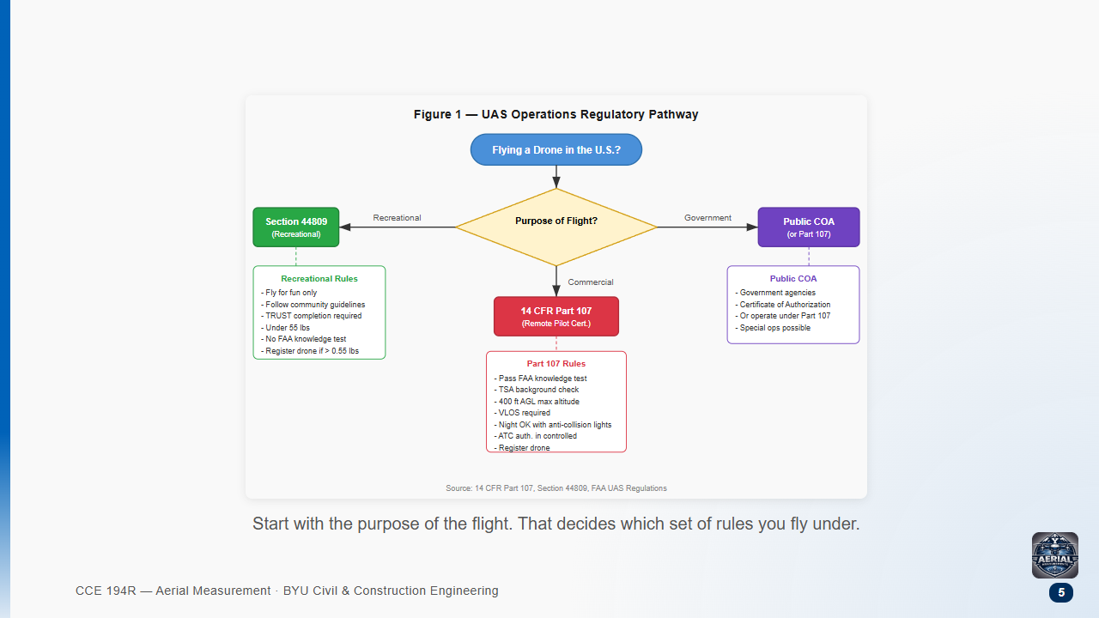

Slide 6
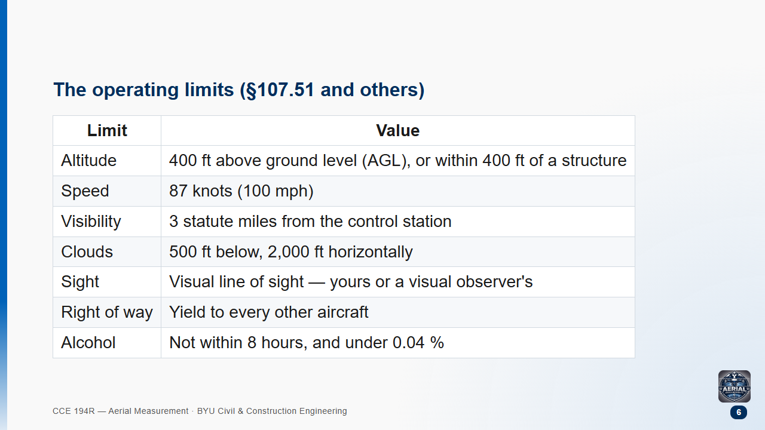

Slide 7
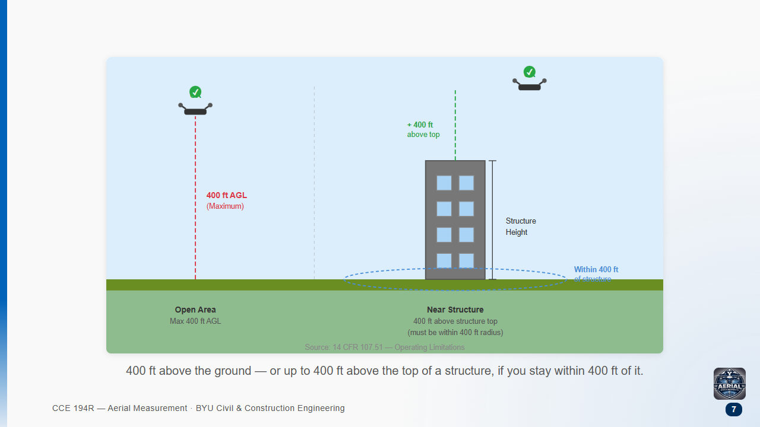

Slide 8
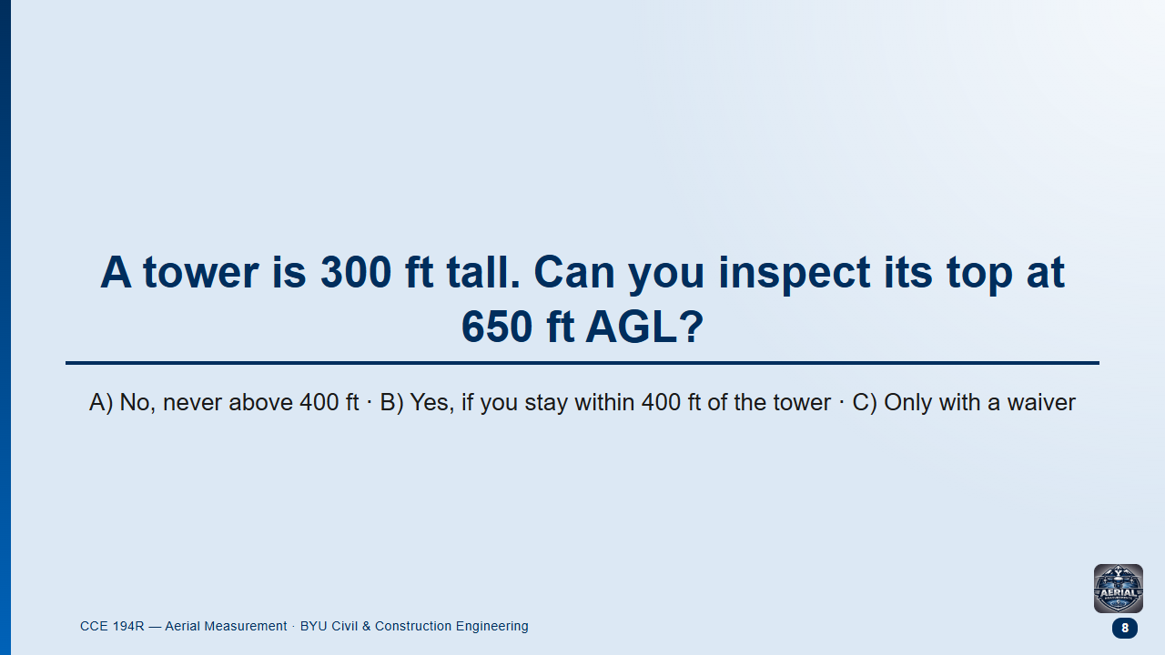
Notes:
Groups 1 min, then class.
Likely answer: A.
Follow-up: "How high could you go over a 1,000 ft tower?"

Slide 9
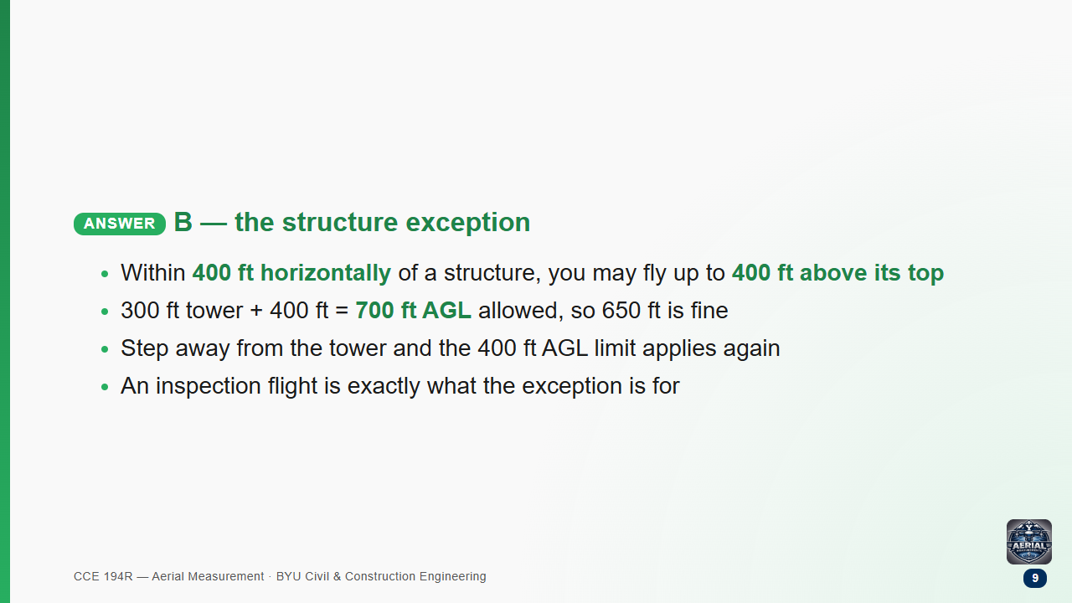

Slide 10
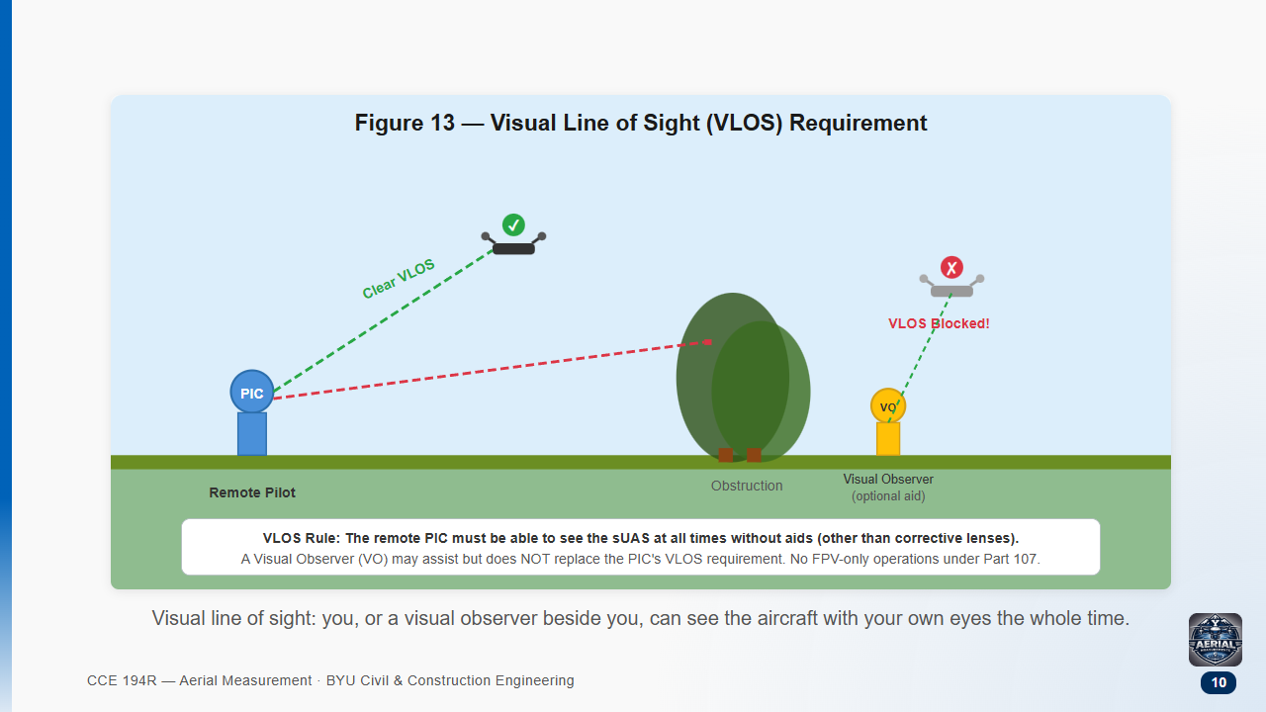

Slide 11
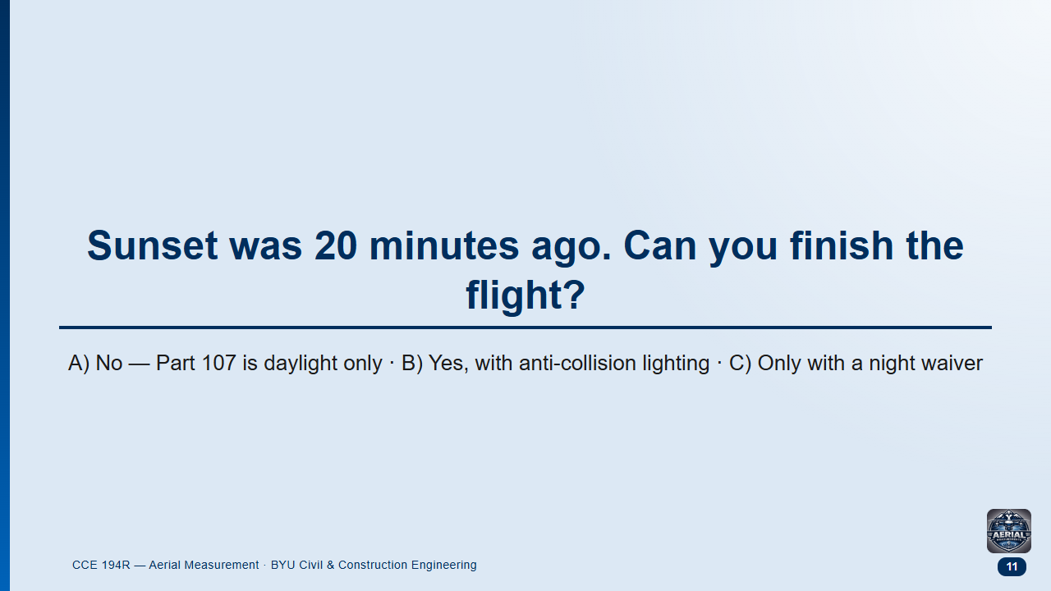
Notes:
Groups 1 min, then class.
Likely answer: A or C. Many study guides still say daylight only; the rule changed in 2021.

Slide 12
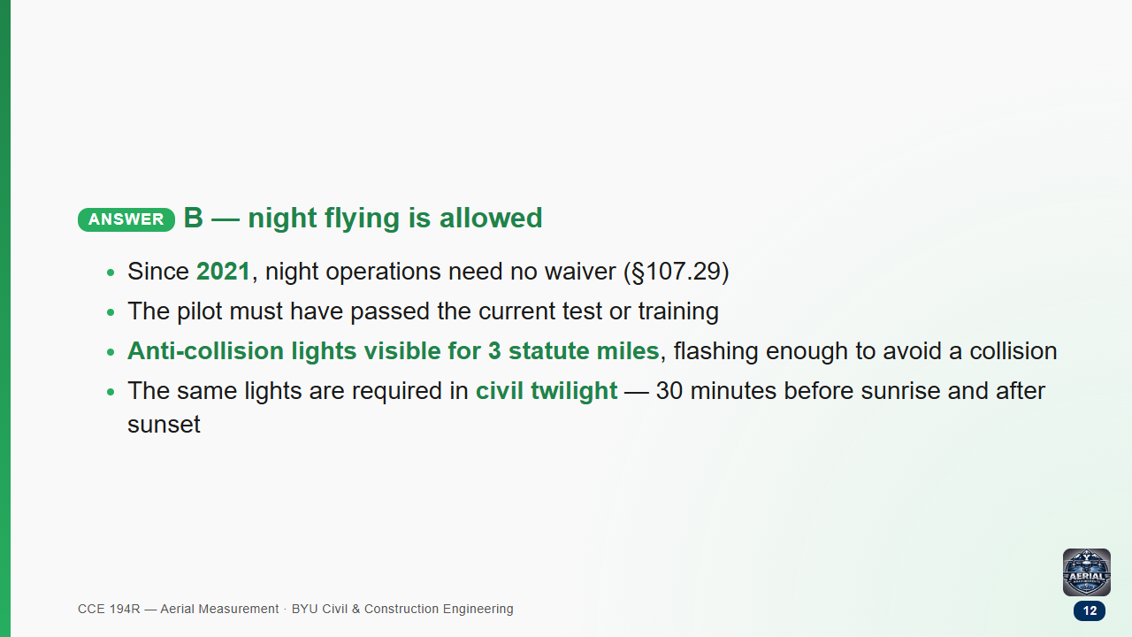

Slide 13
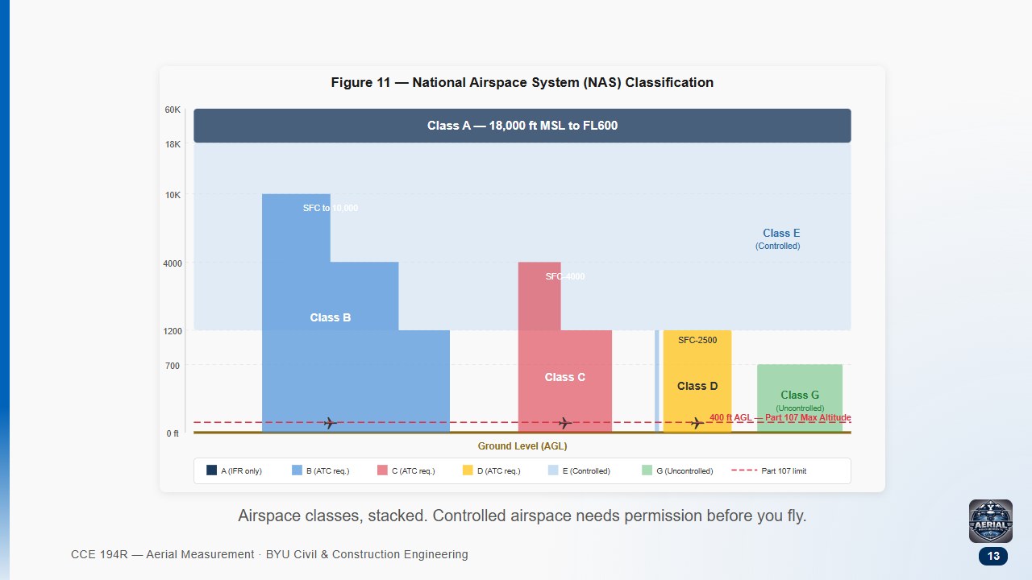

Slide 14
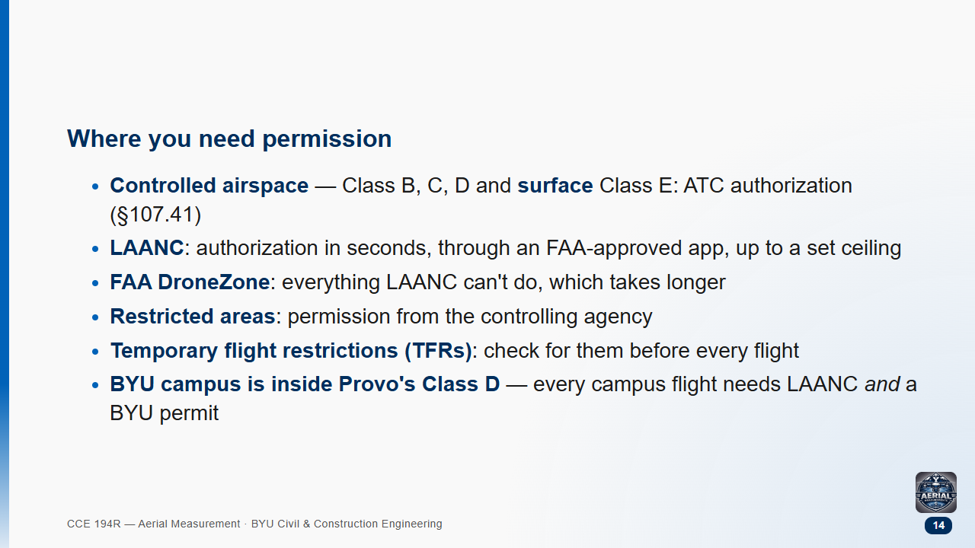

Slide 15
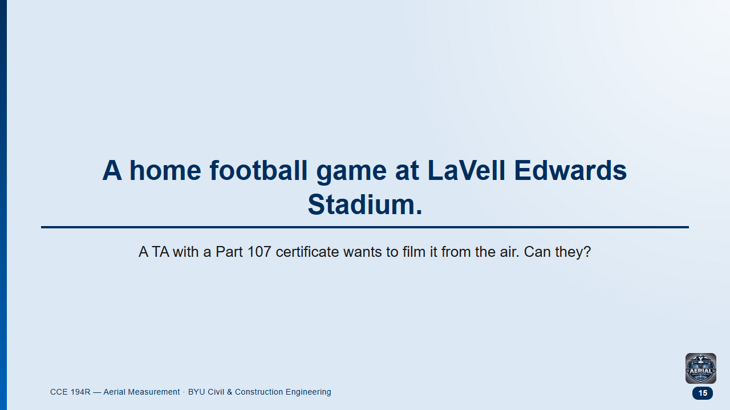
Notes:
Groups 2 min, then class.
Likely answer: "Yes, with LAANC" — campus is Class D, so students who listened will reach for LAANC.
Follow-up: "What if the game ended two hours ago?"

Slide 16
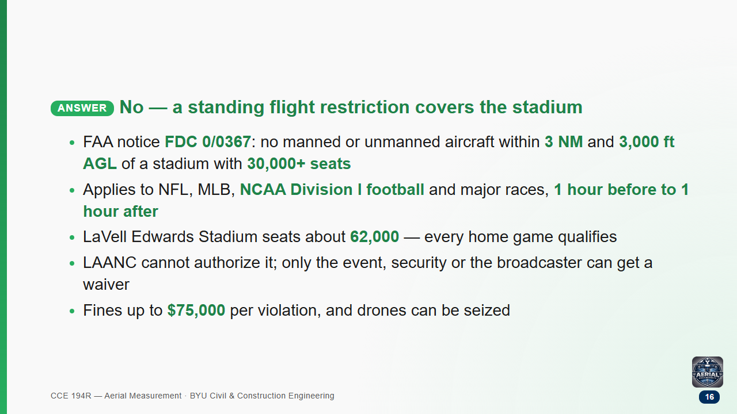

Slide 17
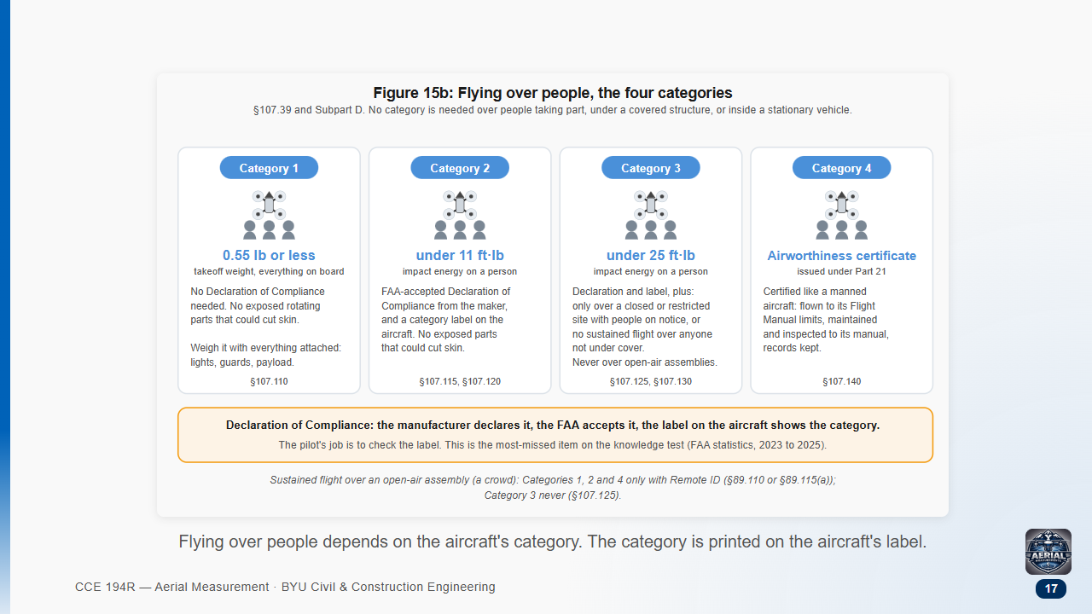

Slide 18
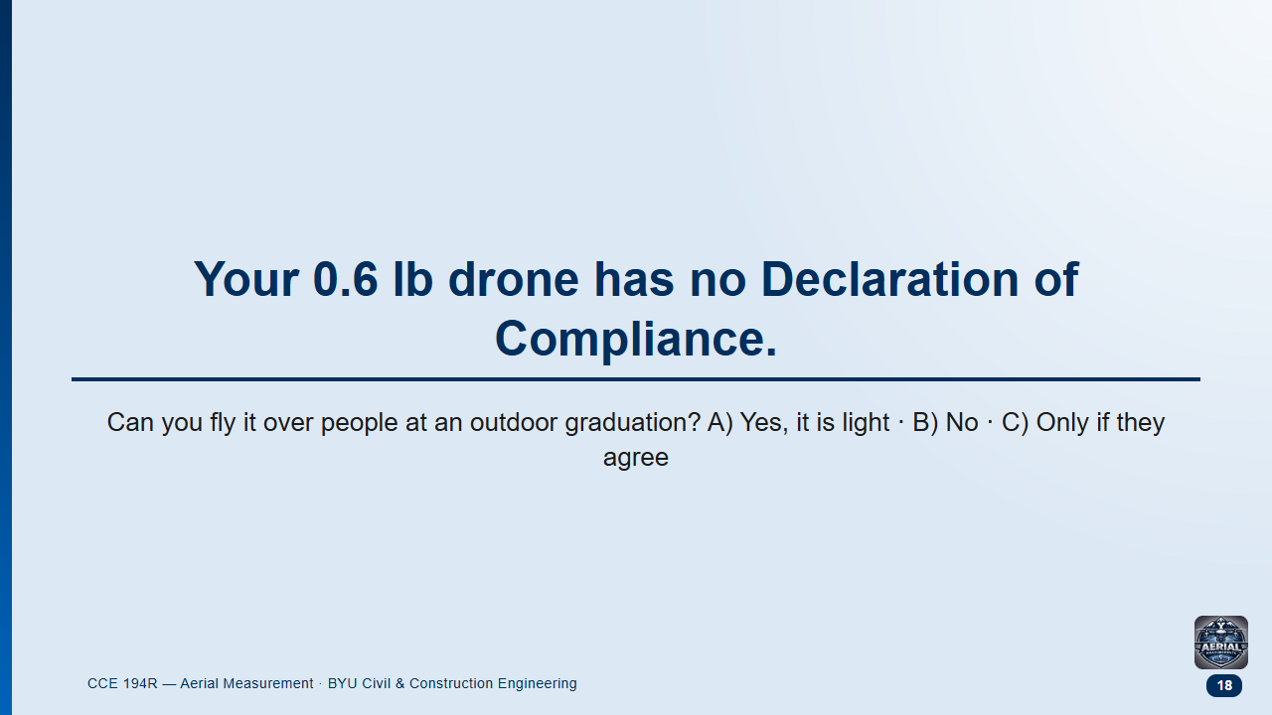
Notes:
Groups 1.5 min, then class.
Likely answer: A.
This is the most-missed topic on the real test — about three in four people get it wrong.

Slide 19
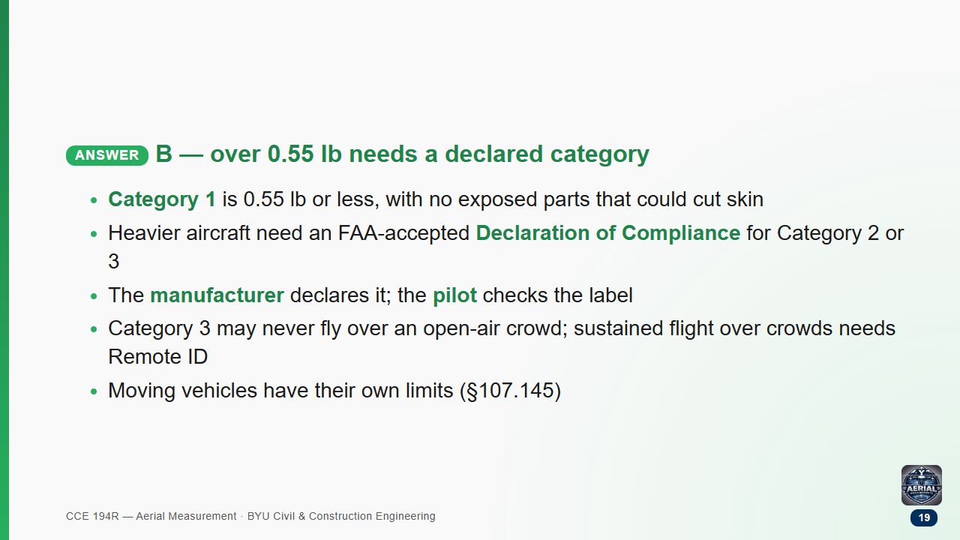

Slide 20
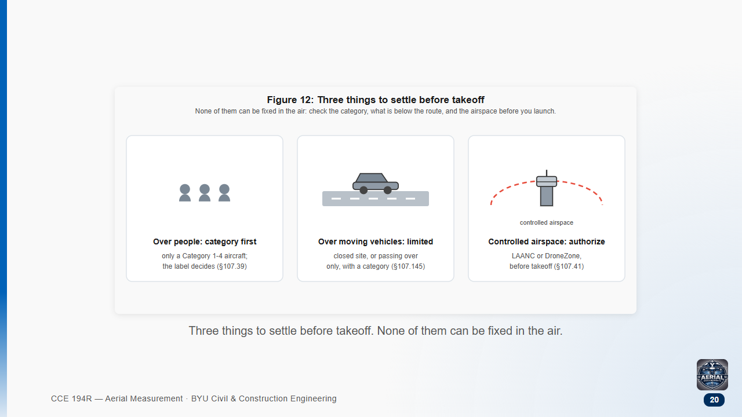

Slide 21
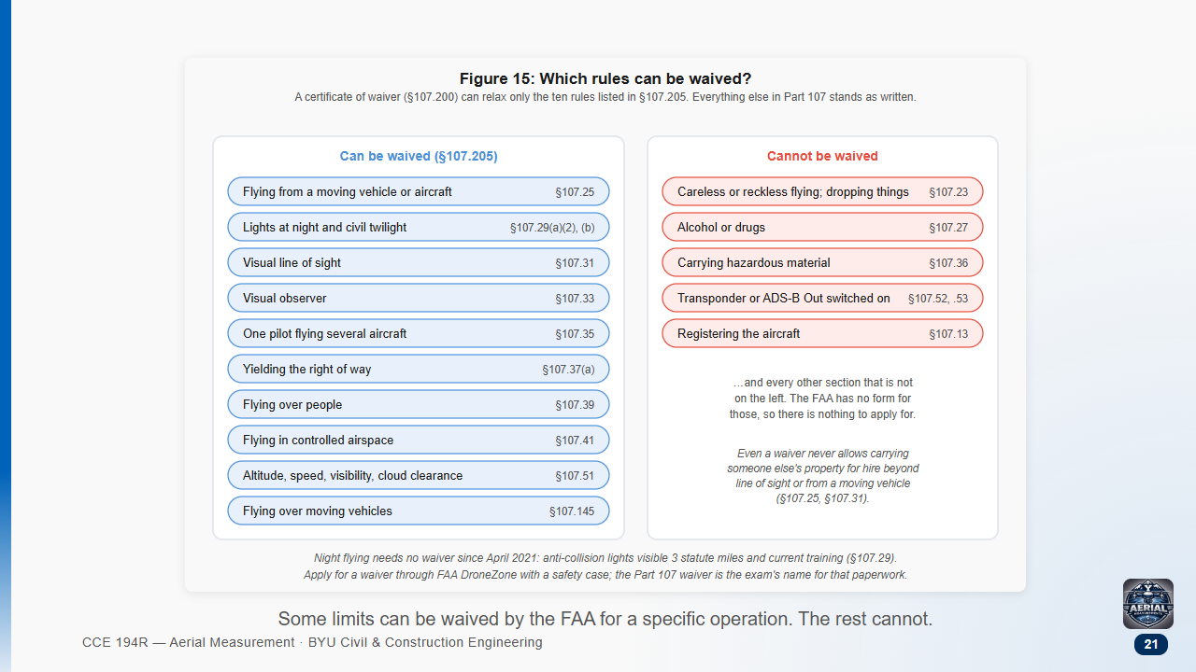

Slide 22
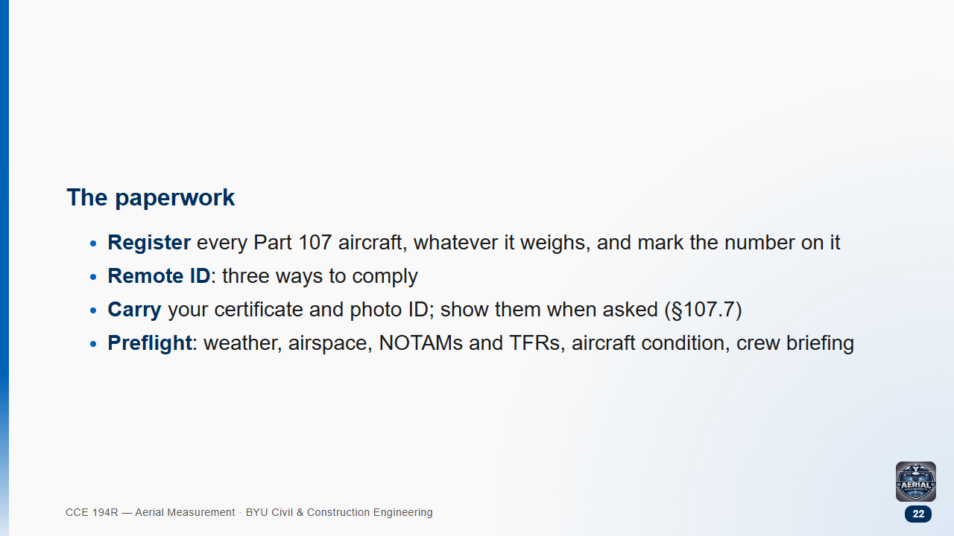

Slide 23
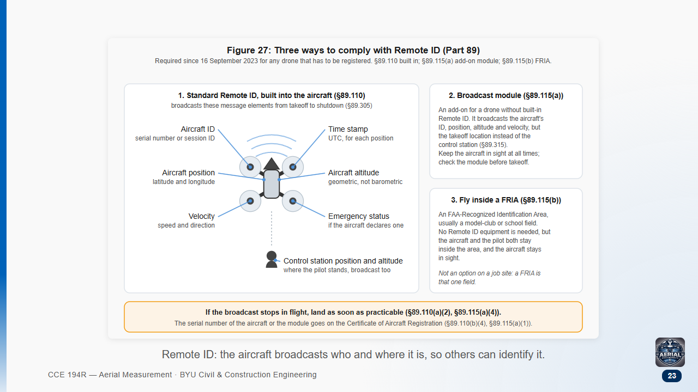

Slide 24
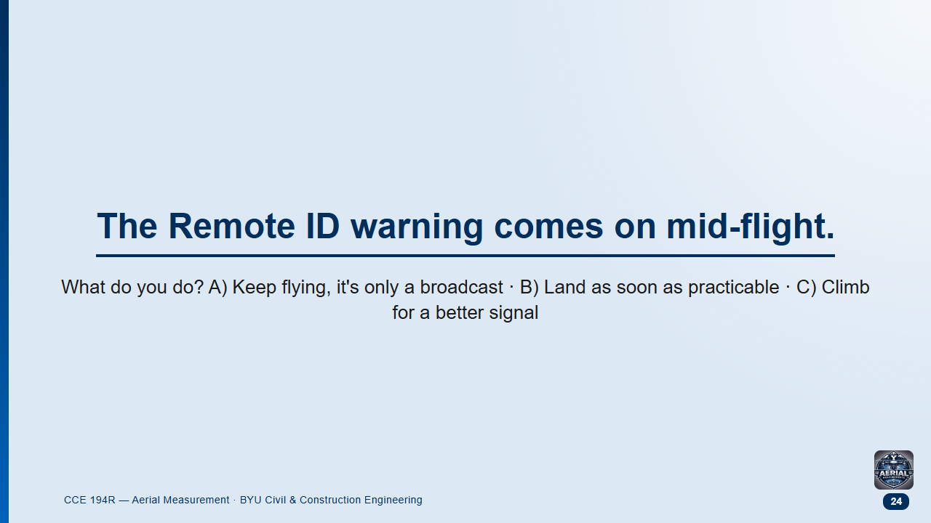
Notes:
Groups 1 min, then class.
Likely answer: A.

Slide 25
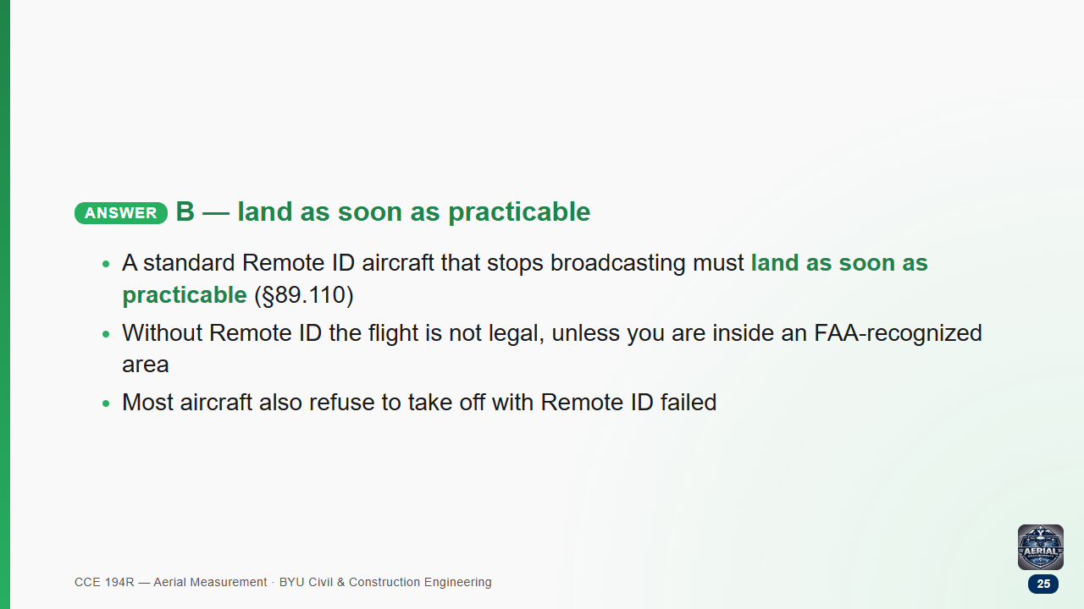

Slide 26
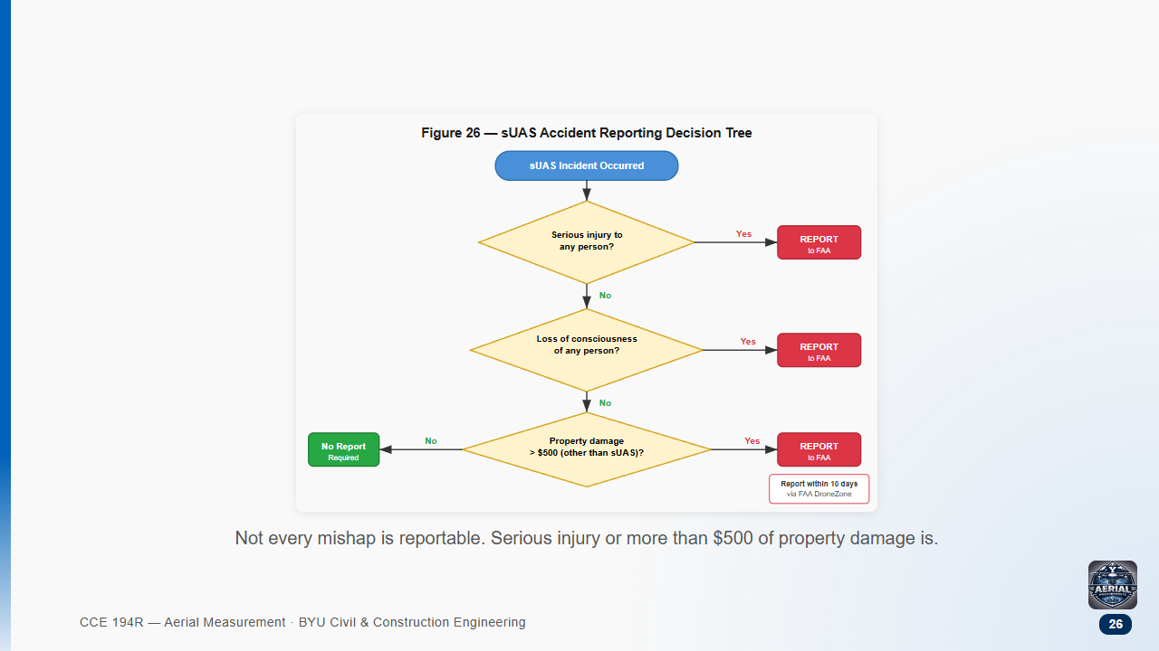

Slide 27
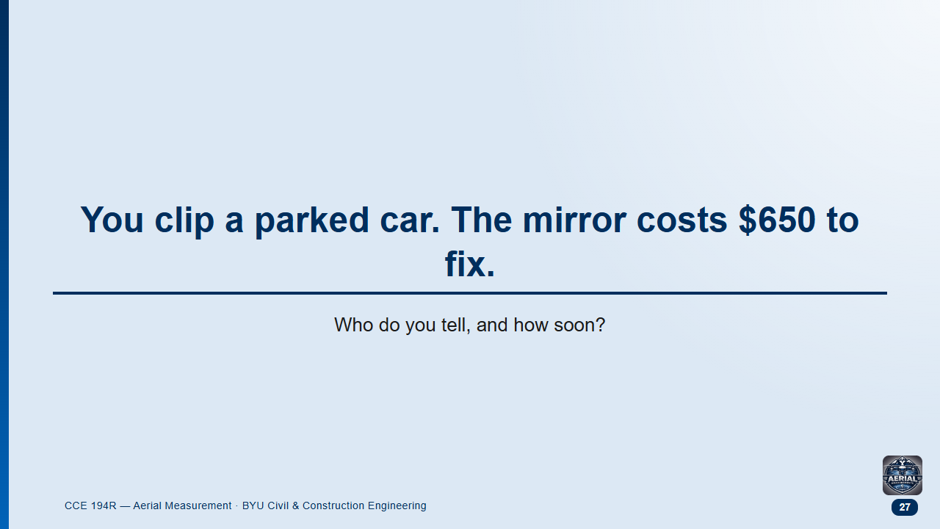
Notes:
Groups 1.5 min, then class.
Likely answers: "nobody", "the police", or "the NTSB".

Slide 28
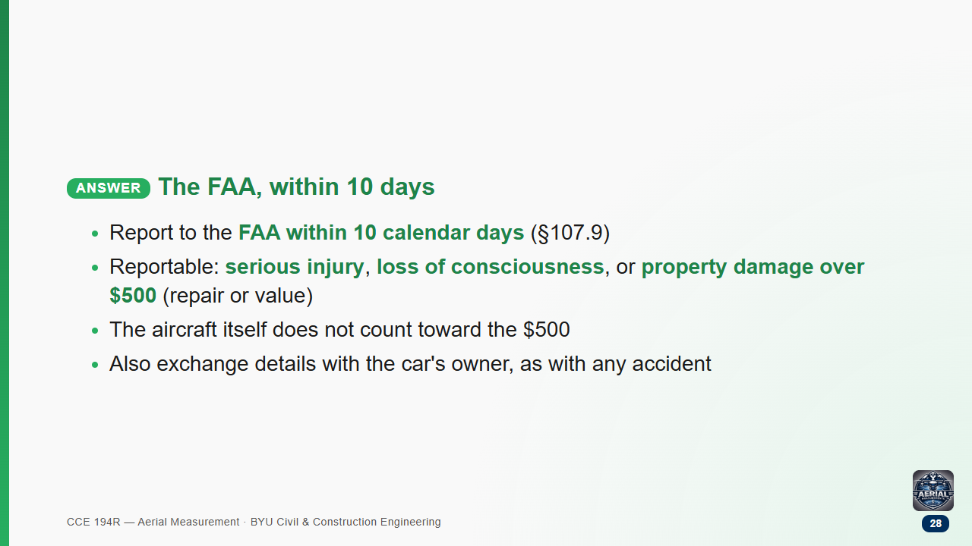

Slide 29
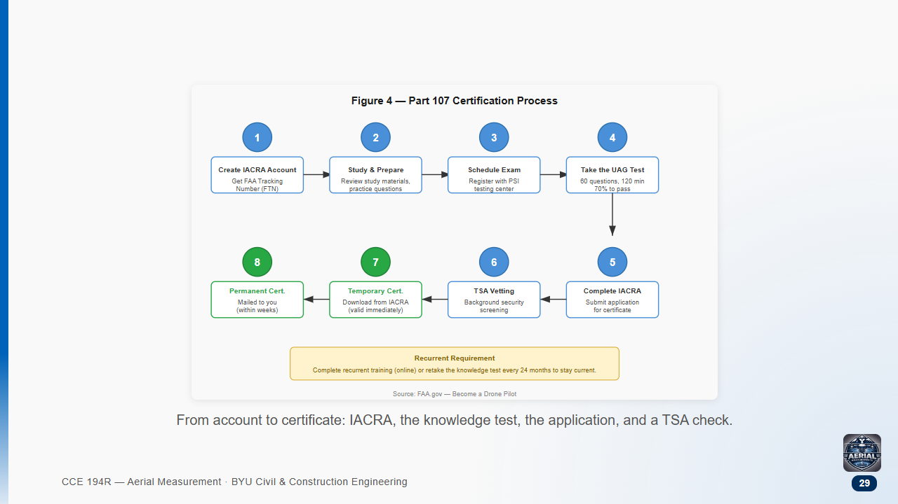

Slide 30
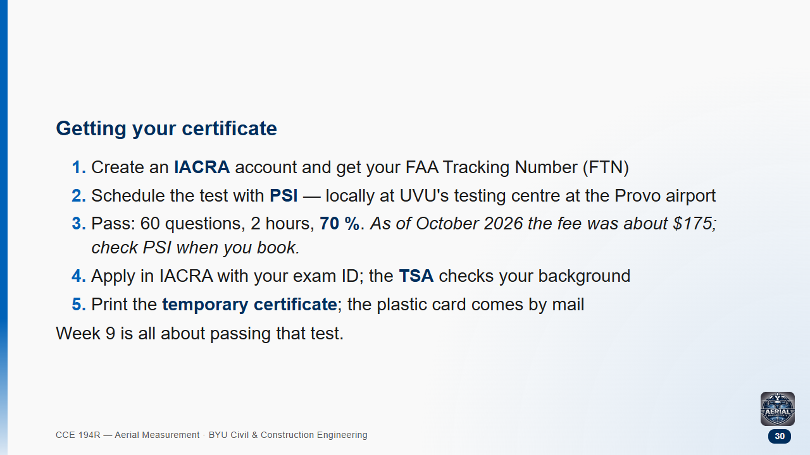

Slide 31
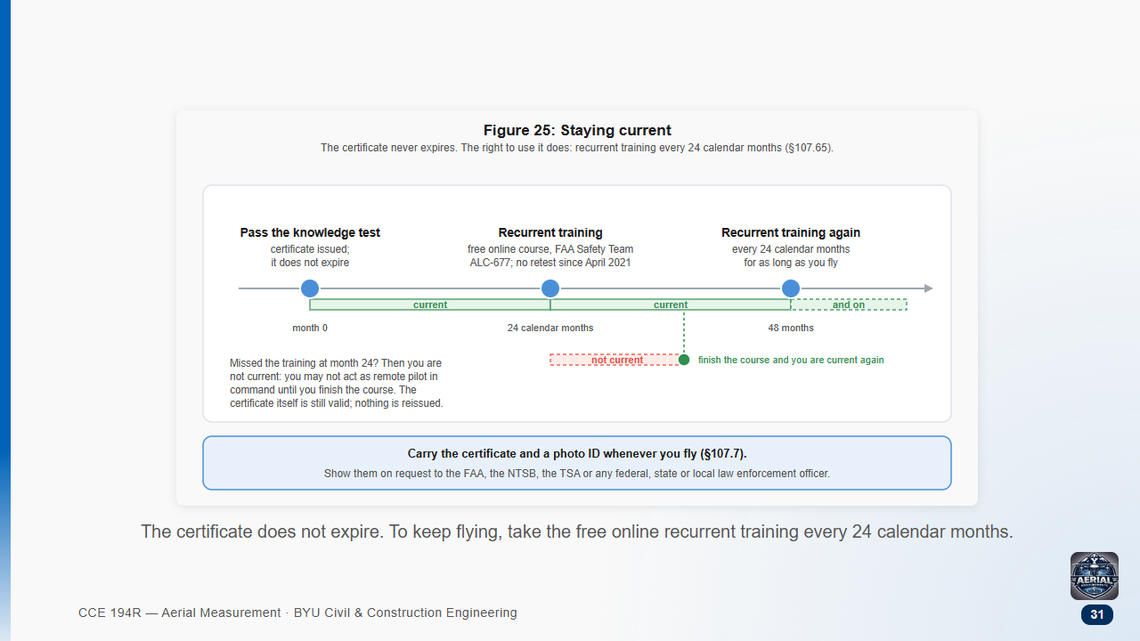

Slide 32
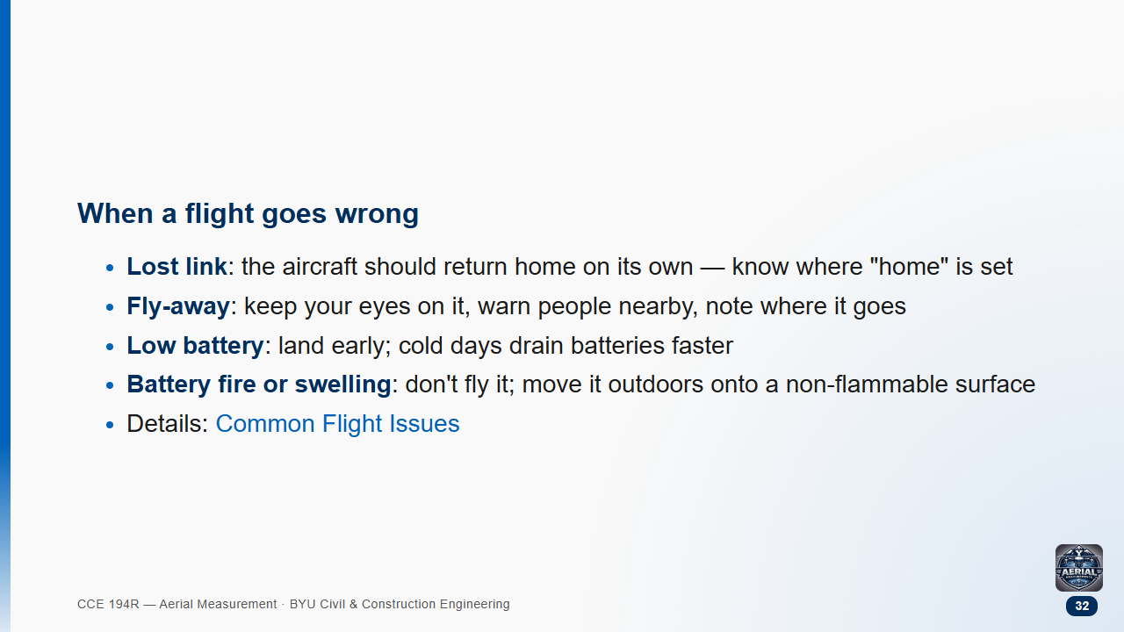

Slide 33
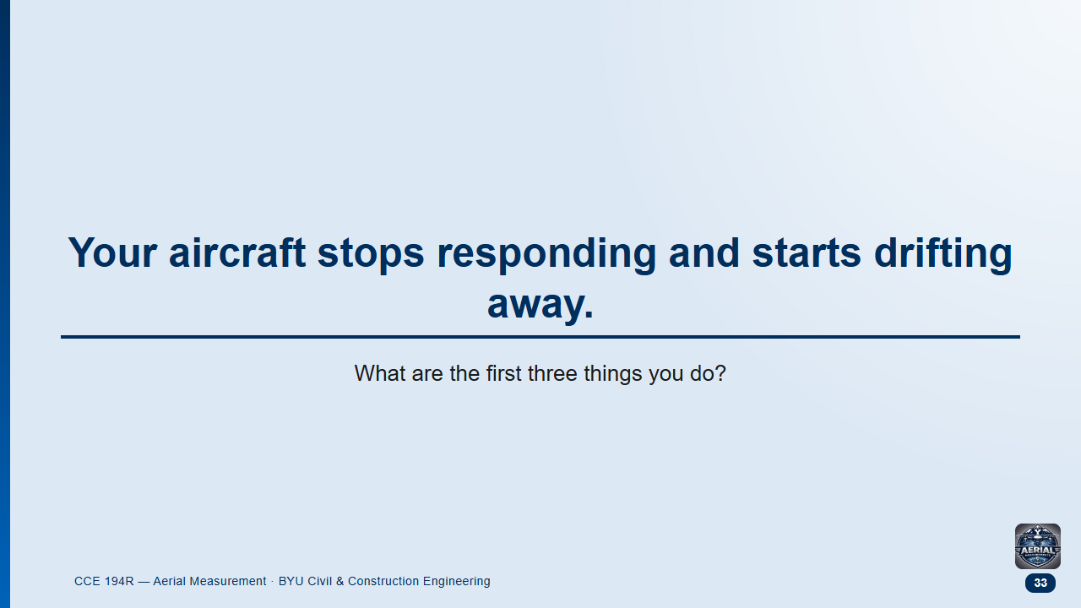
Notes:
Groups 2 min, then class.
Likely answer: "Chase it." Running after a drone while looking up is how people get hurt.

Slide 34
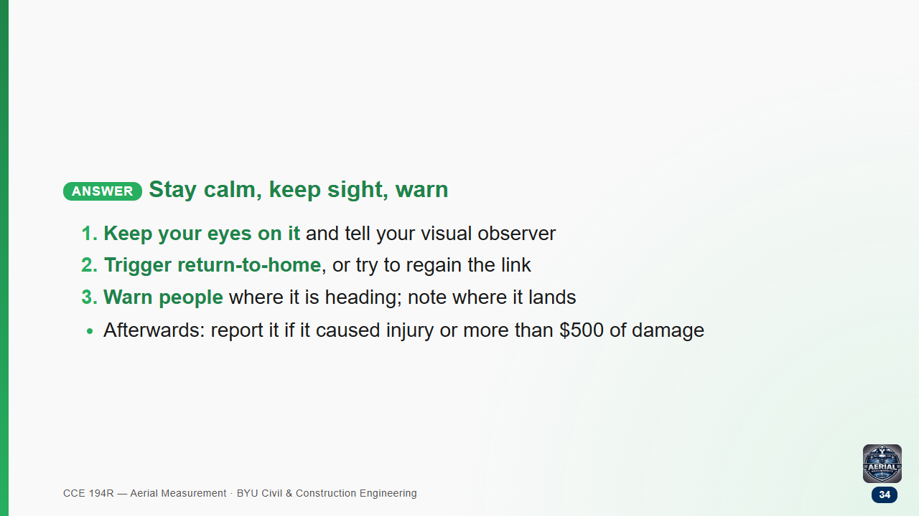

Slide 35
