Slide 1

Notes:
Format for every question slide today: groups of 2–3 talk for the time given, then one group answers and the class discusses. Not a quiz. Reveal on the next slide.

Slide 2
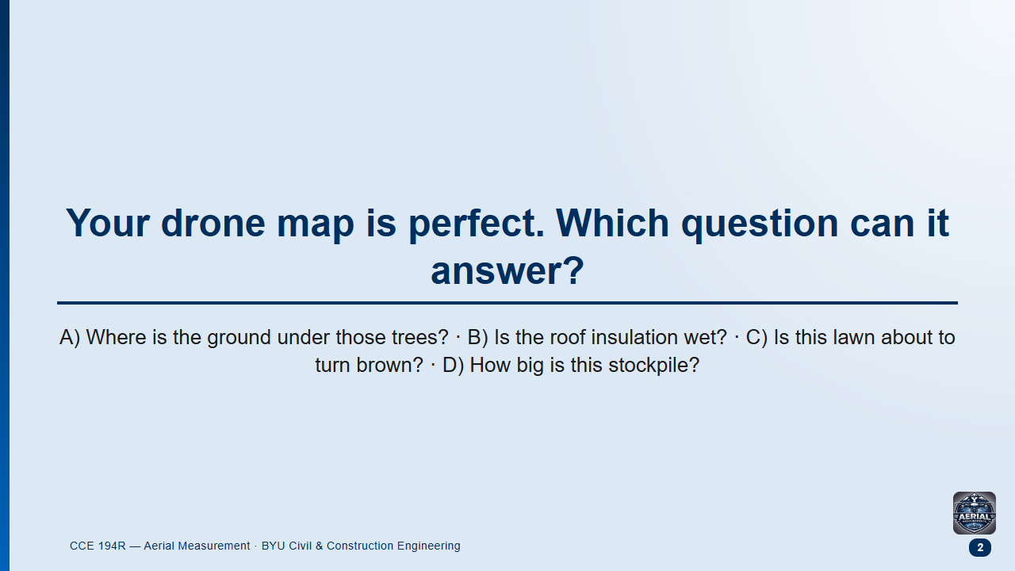
Notes:
Groups 1.5 min, then class.
Likely answer: A, because Week 7 showed DTMs and students assume software can strip trees anywhere.
Follow-up: "What would you need to see the ground under a tree?"

Slide 3
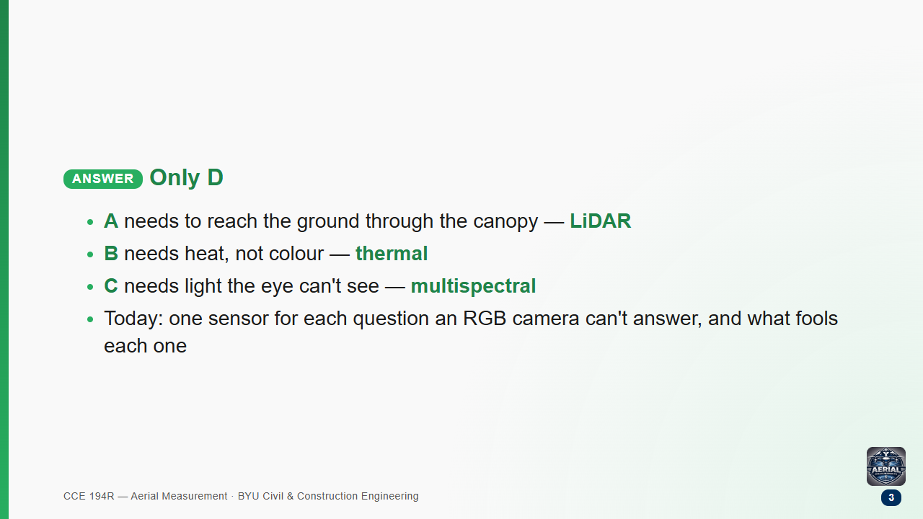

Slide 4
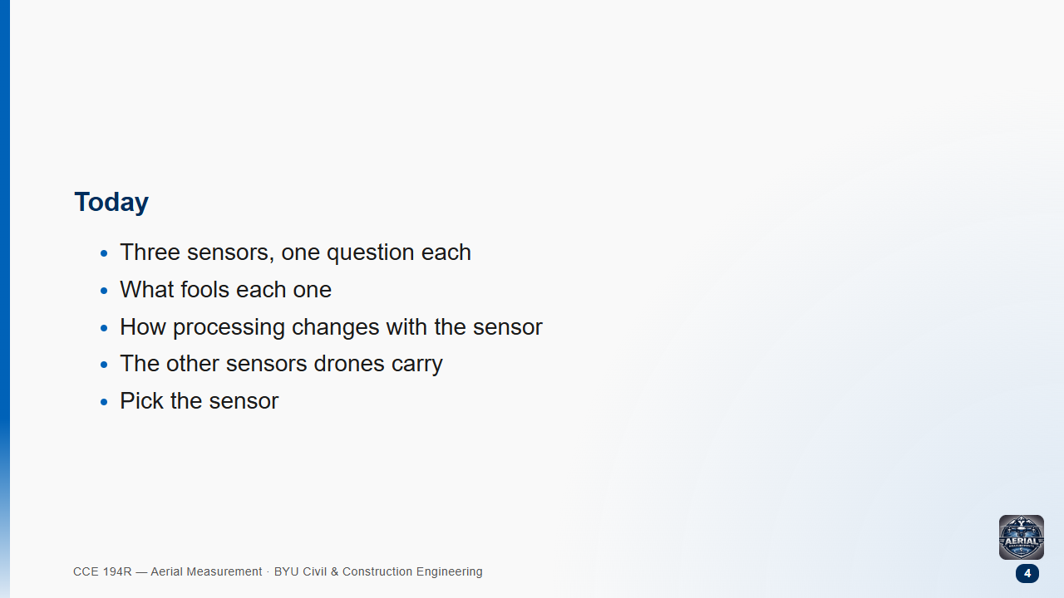

Slide 5
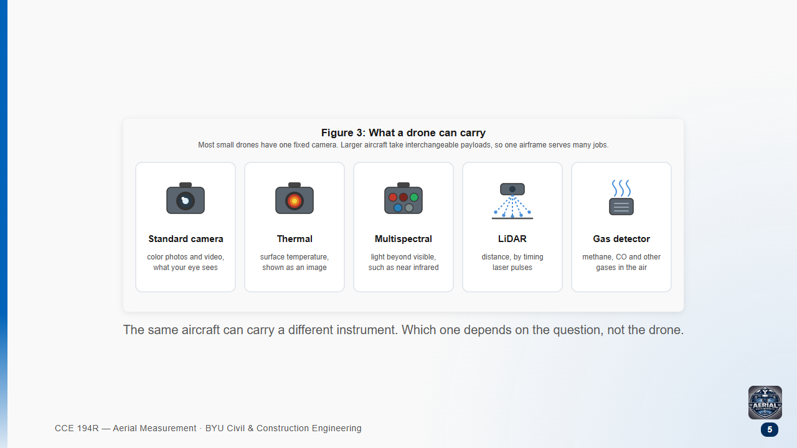
Notes:
Mention the gas detector here: methane at landfills, wastewater plants and pipelines. More on the "other sensors" slide later.

Slide 6
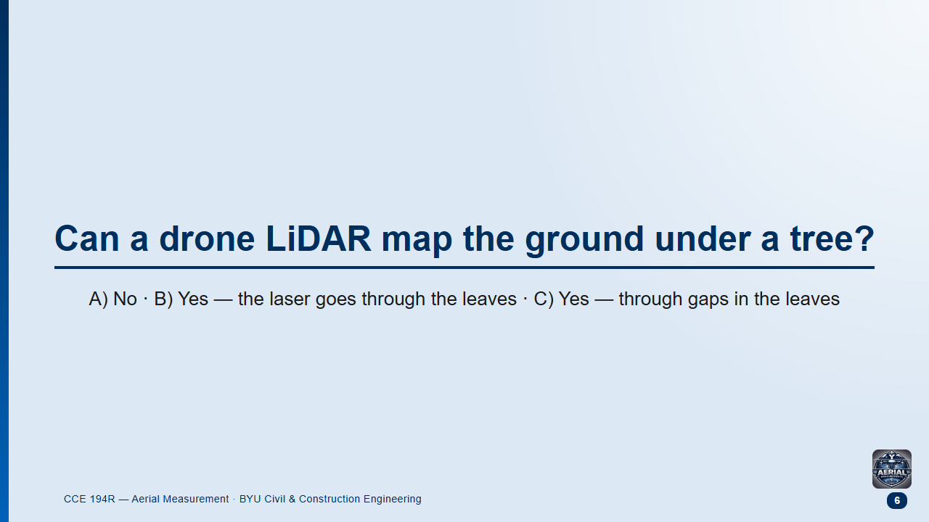
Notes:
Groups 1 min, then class.
Likely answer: B. "Lasers penetrate" sounds right.
Follow-up: "Then why do winter flights work better?"

Slide 7
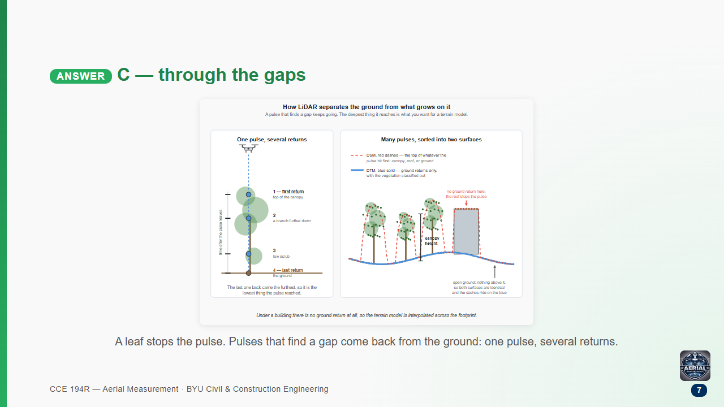

Slide 8
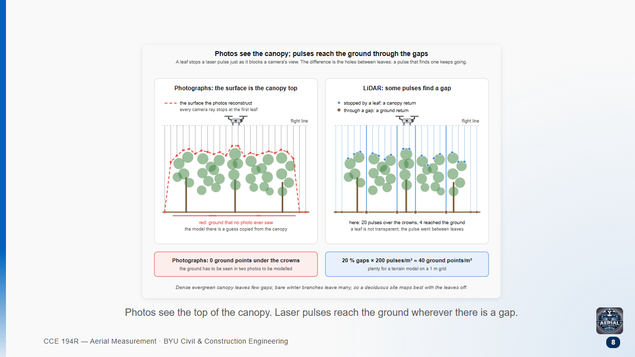

Slide 9
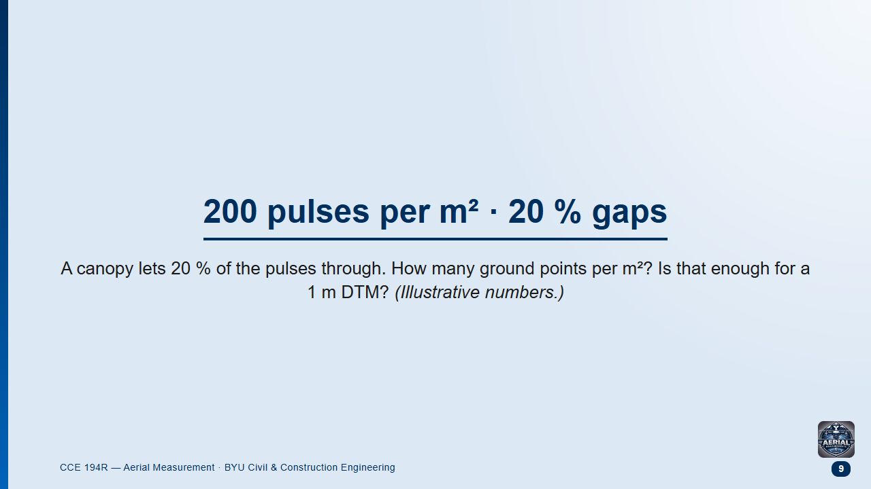
Notes:
Pairs 2 min, then class.
Likely answers: 0 ("leaves block lasers") or 200 ("LiDAR sees through").
Follow-up: "What if it's a dense evergreen with 2 % gaps?"

Slide 10
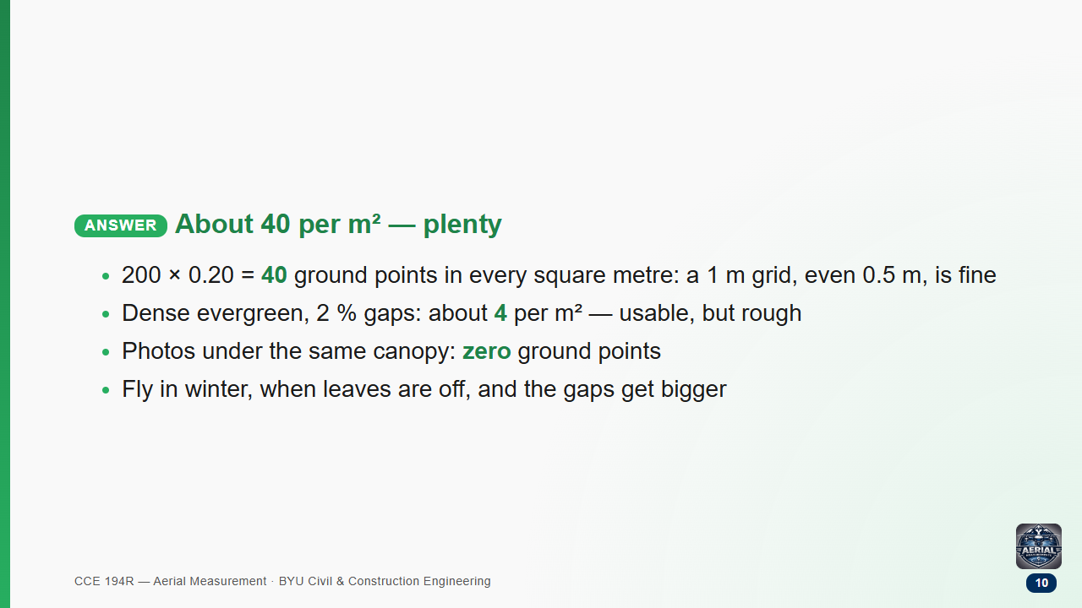

Slide 11
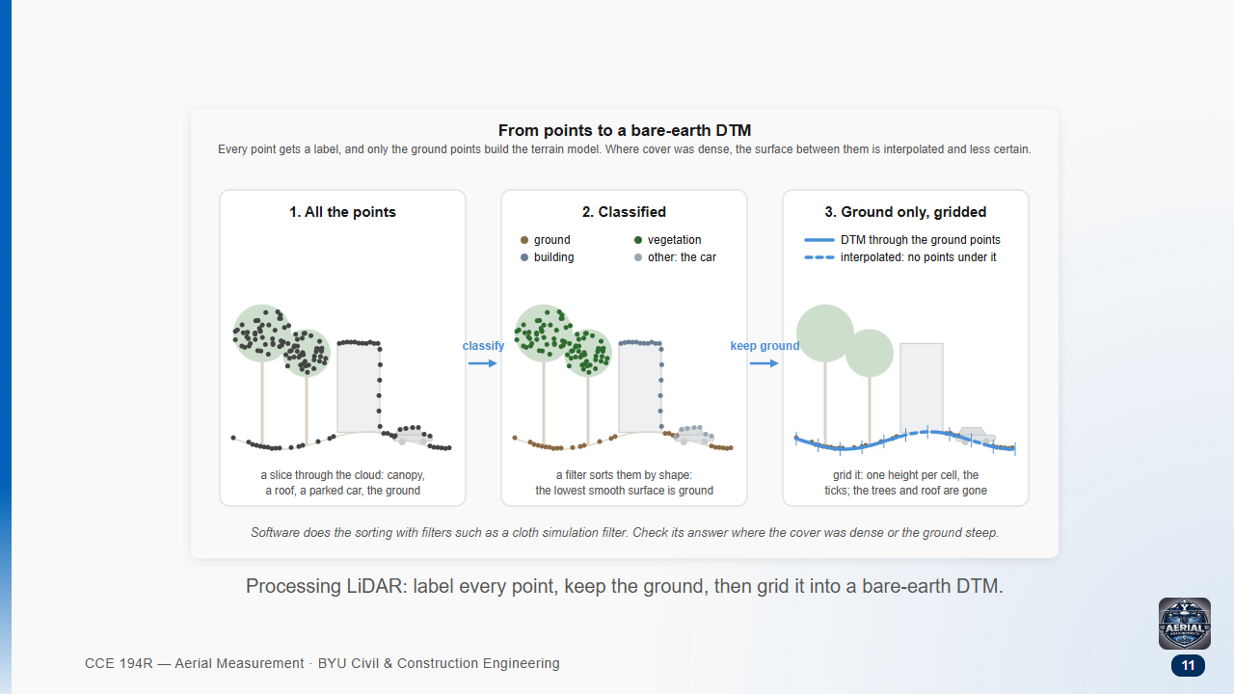

Slide 12
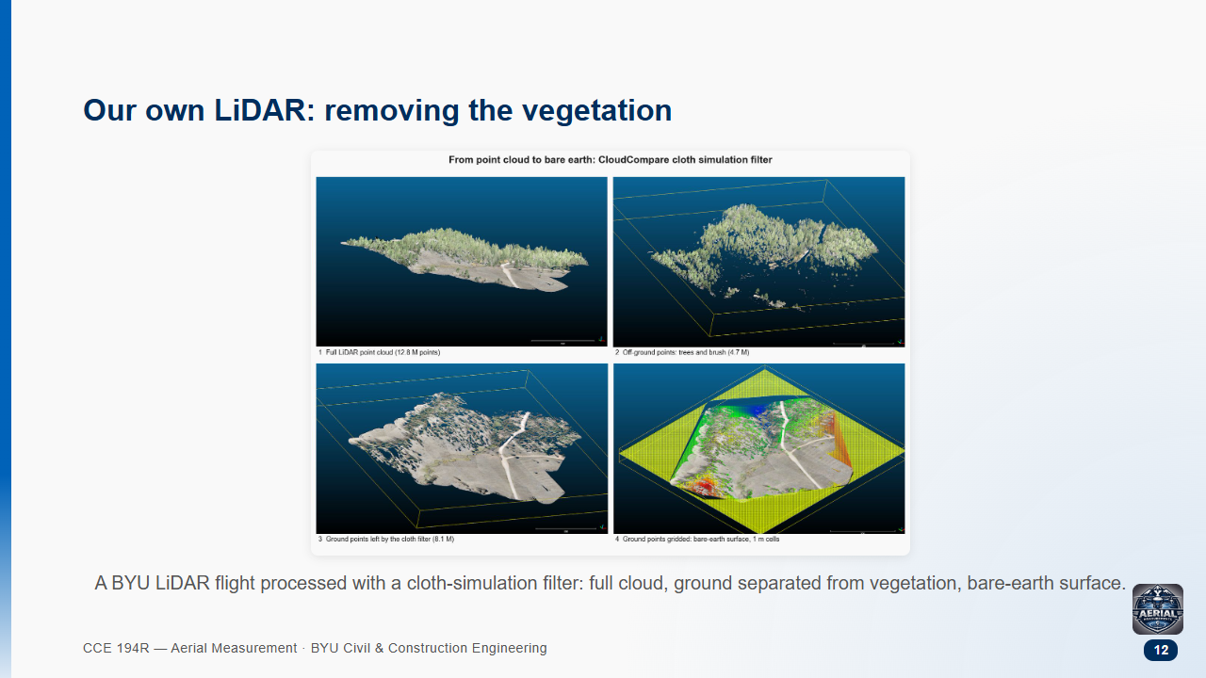

Slide 13
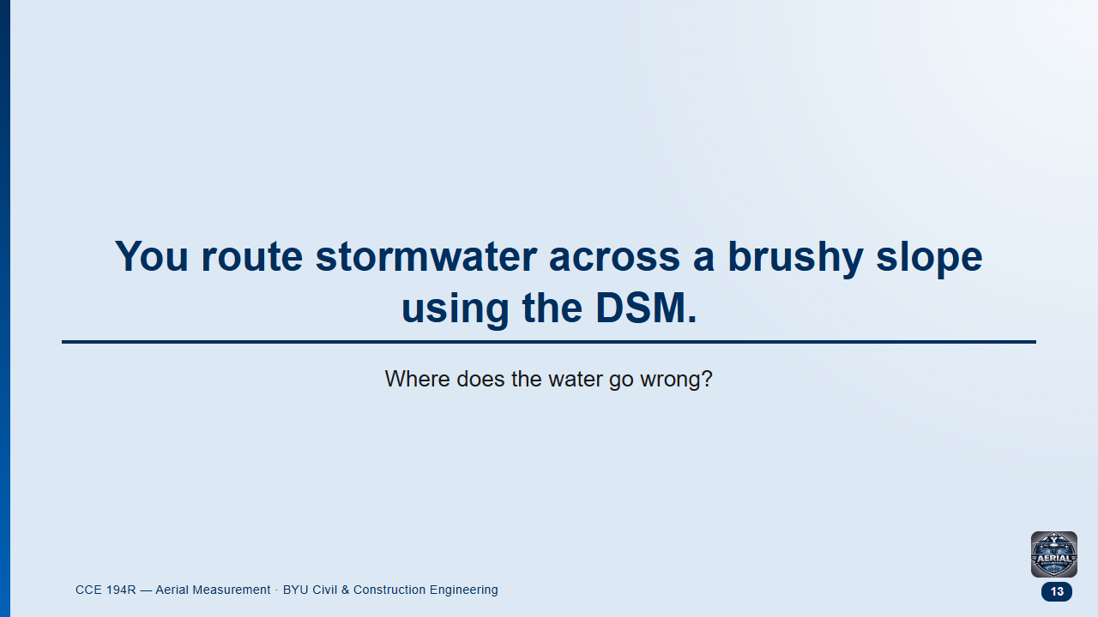
Notes:
Groups 2 min, then class.
Likely answer: "Hardly anywhere — bushes are small."
This is the drainage activity at the end of the LiDAR reading.

Slide 14
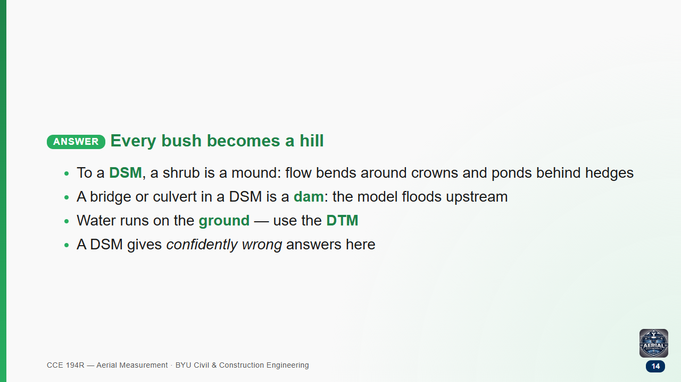

Slide 15
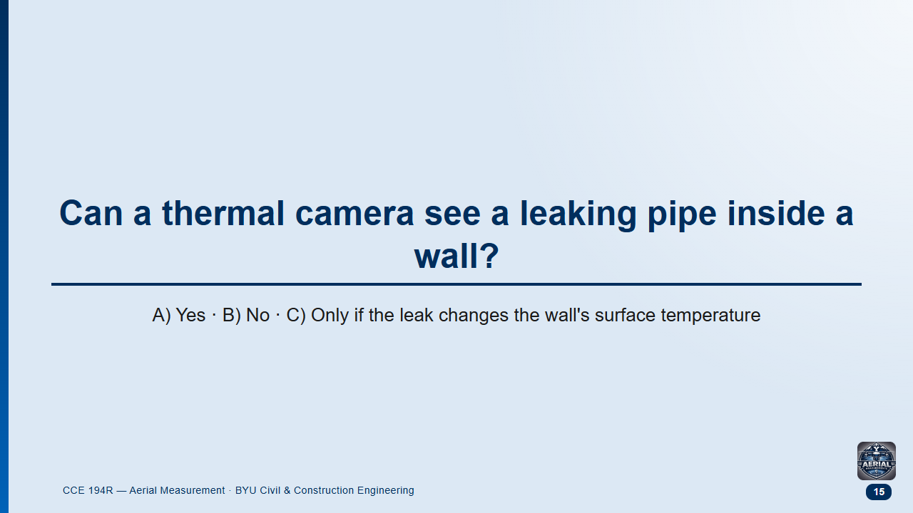
Notes:
Groups 1 min, then class.
Likely answer: A, from movies.
Follow-up: "So what would the leak look like on the wall's surface?"

Slide 16
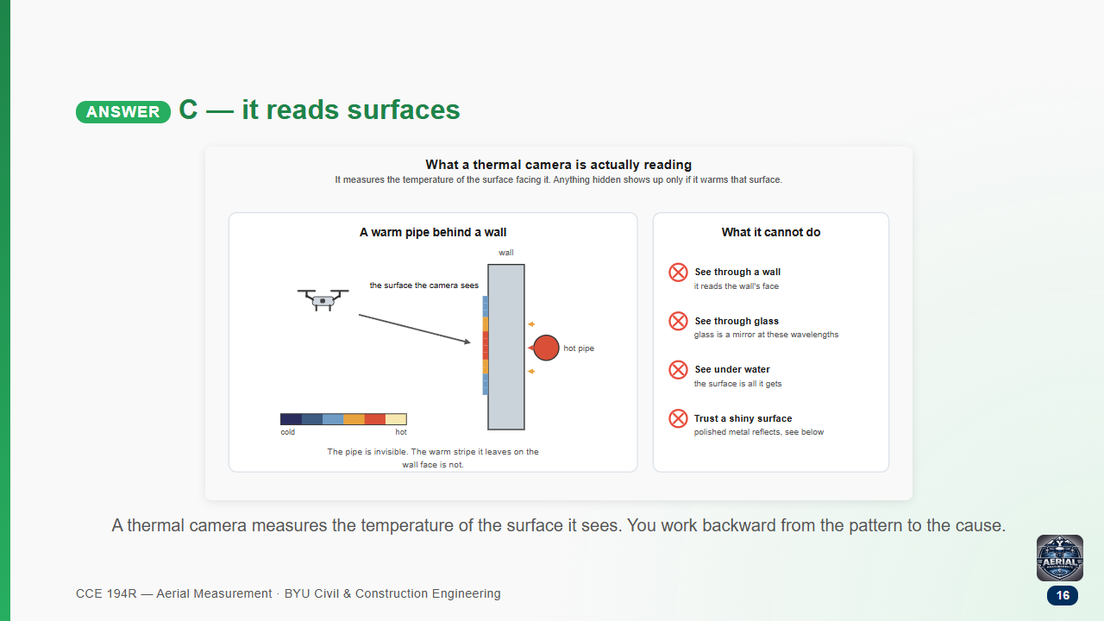

Slide 17
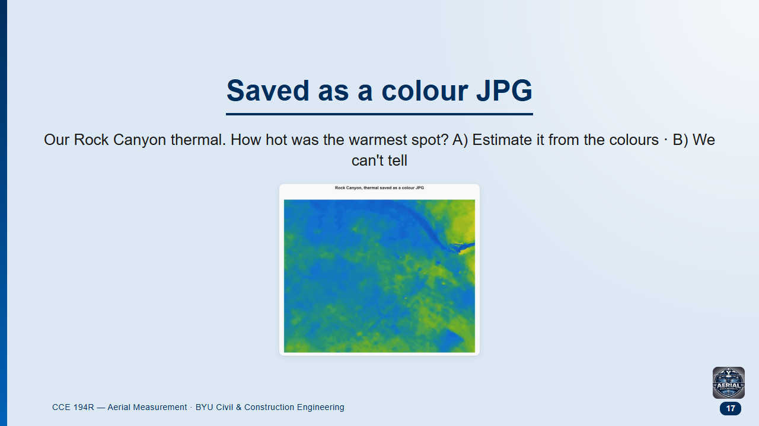
Notes:
Groups 1.5 min, then class.
Likely answer: A.
Follow-up: "What would you check on the camera before takeoff?"

Slide 18
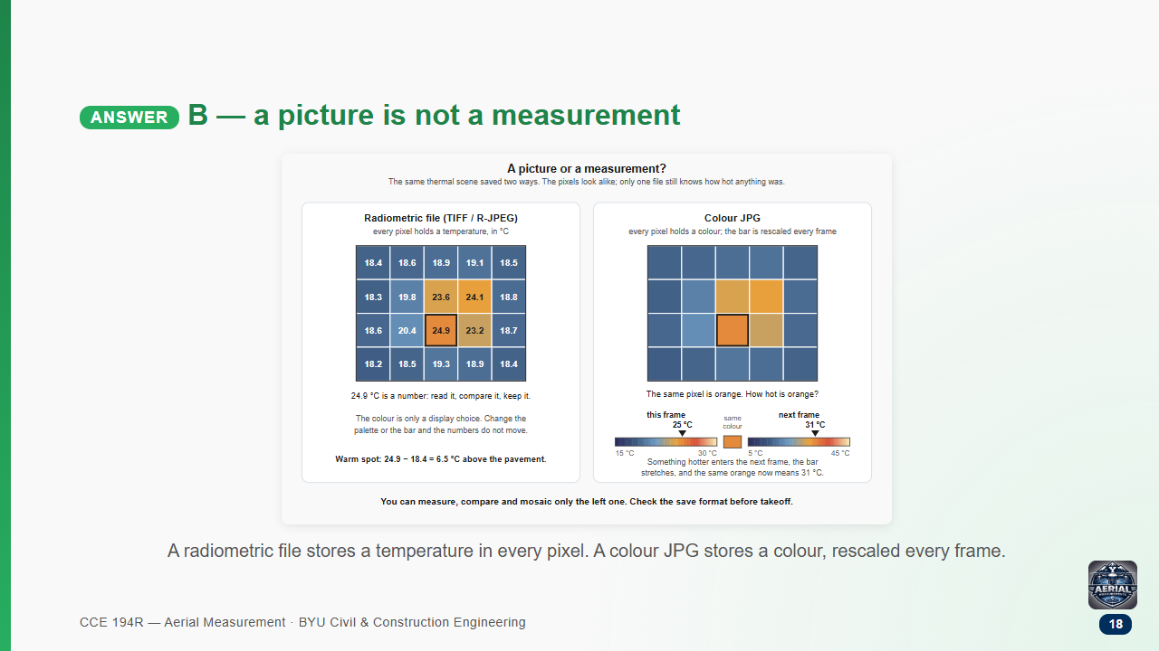
Notes:
Check the save format before takeoff, the same way you check the gimbal.

Slide 19
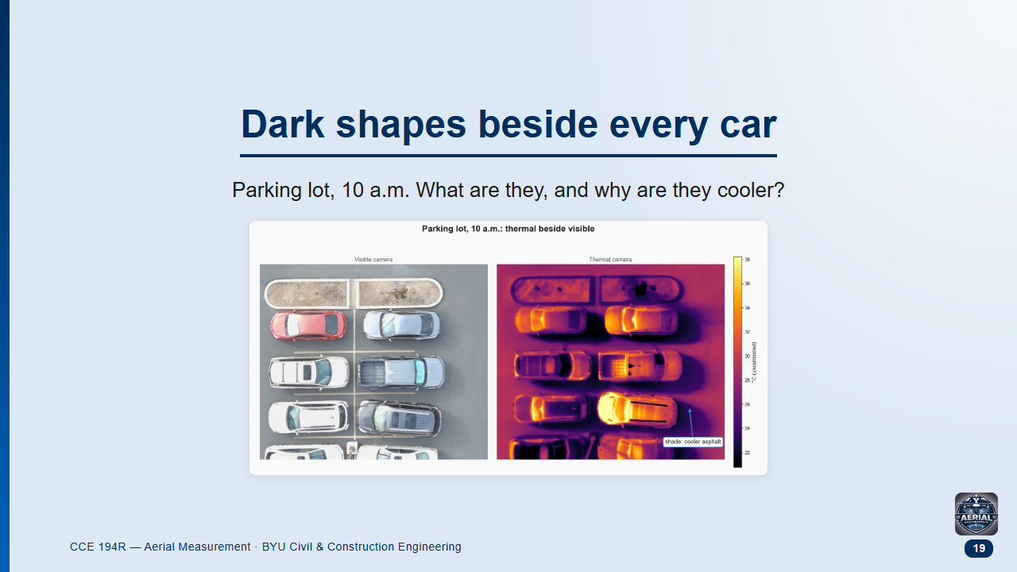
Notes:
Groups 2 min, then class.
Likely answers: puddles, a glitch, "cold cars".
Follow-up: "What would they look like an hour later, once the sun has moved?"

Slide 20
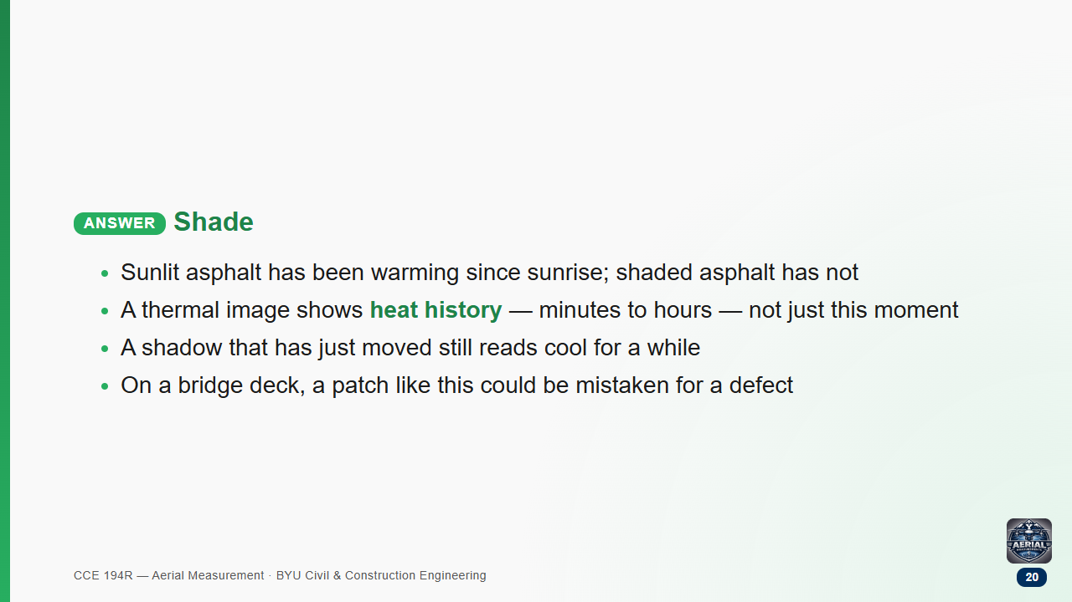

Slide 21
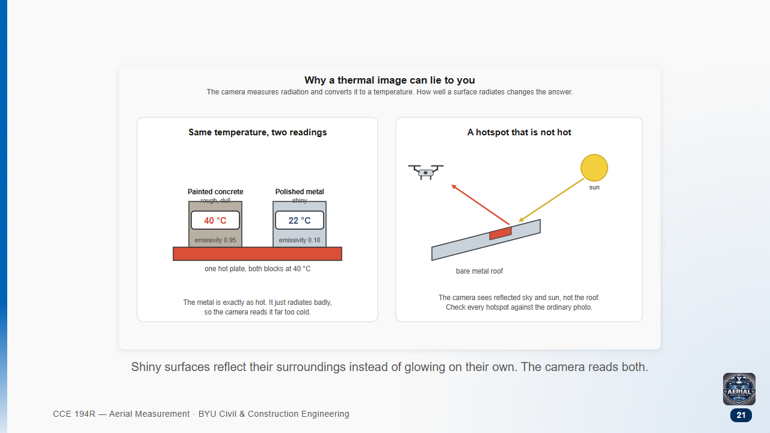

Slide 22
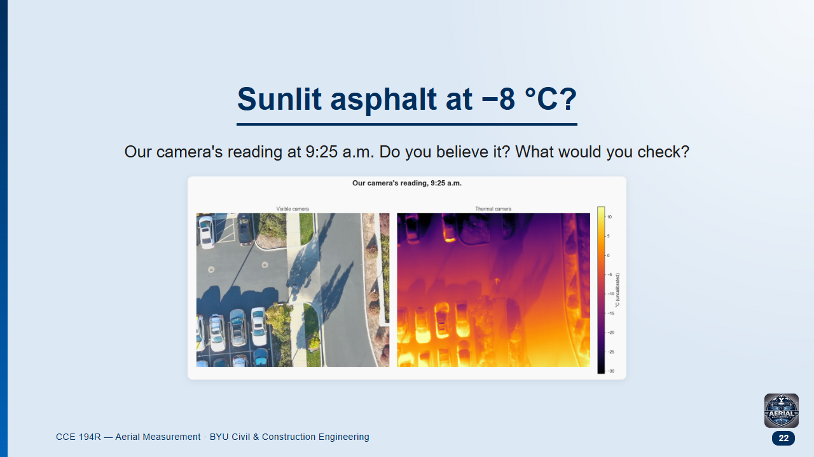
Notes:
Groups 2 min, then class.
Likely answers: "Trust it, it's the instrument" or "the camera is broken."
This is our own data. We are checking the conversion in a separate project; use the doubt itself as the lesson.

Slide 23
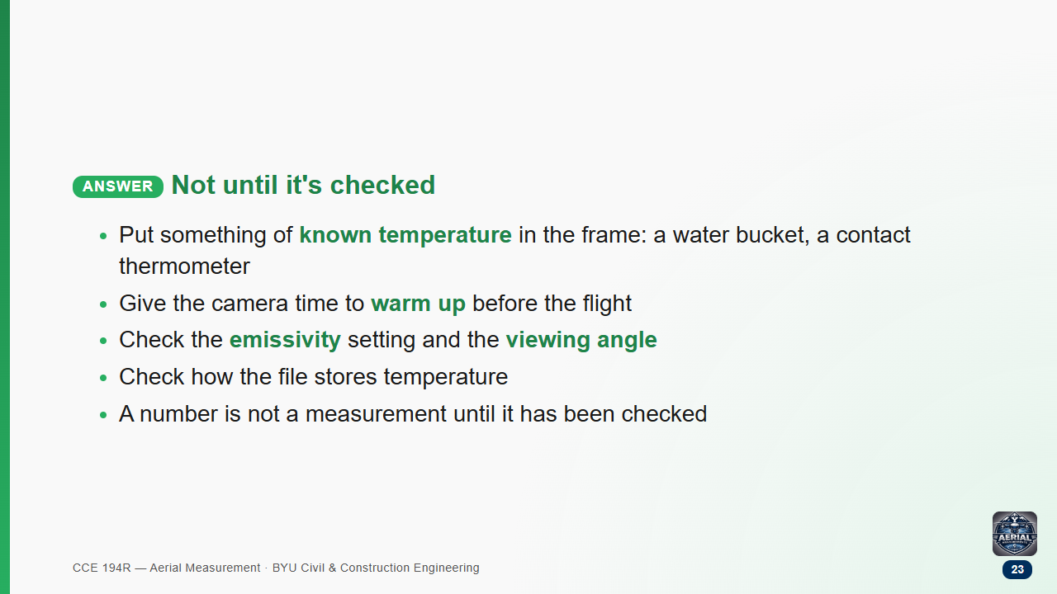

Slide 24
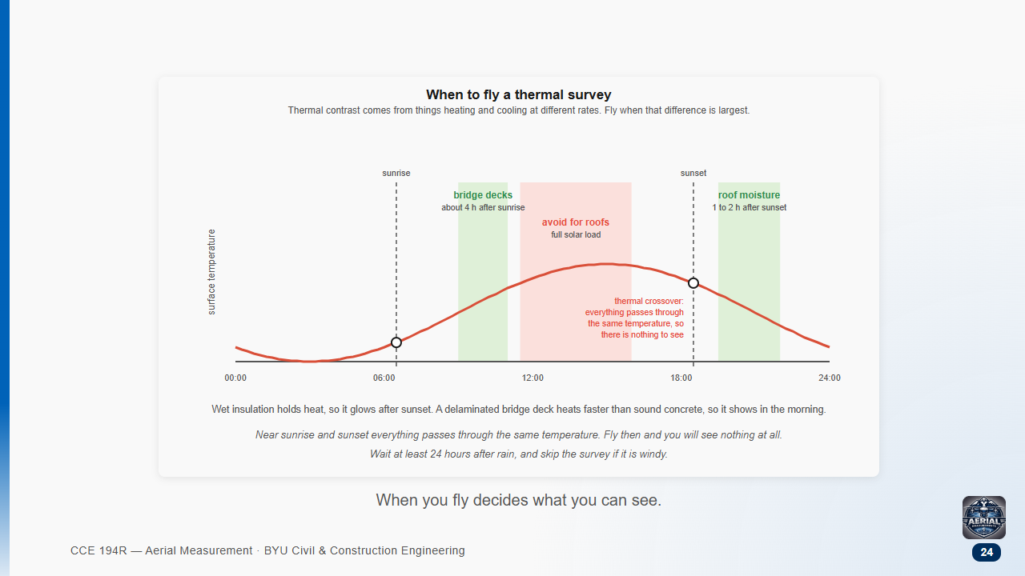

Slide 25
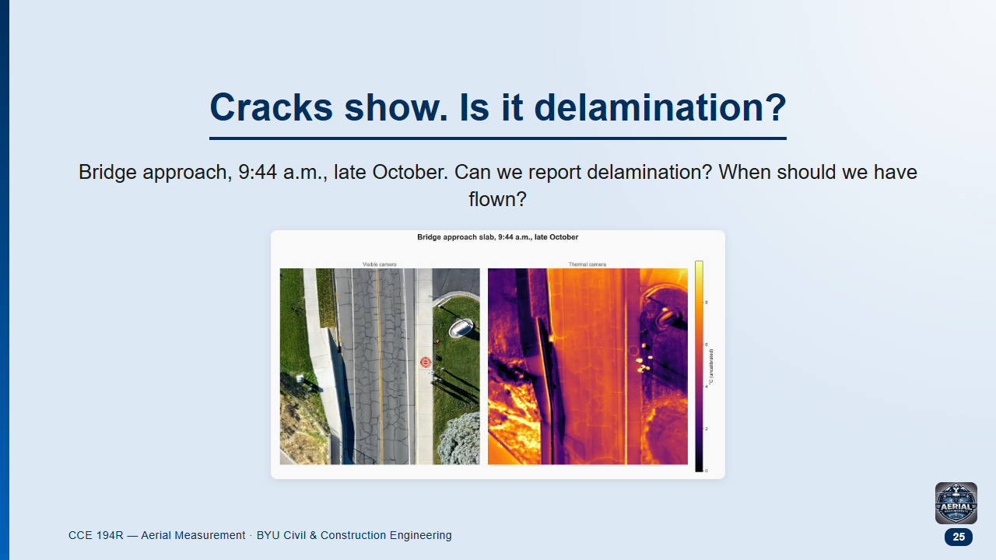
Notes:
Groups of 3, 3 min, then class.
Likely answers: "Yes, we can see damage" and "at dawn, when it's coldest."

Slide 26
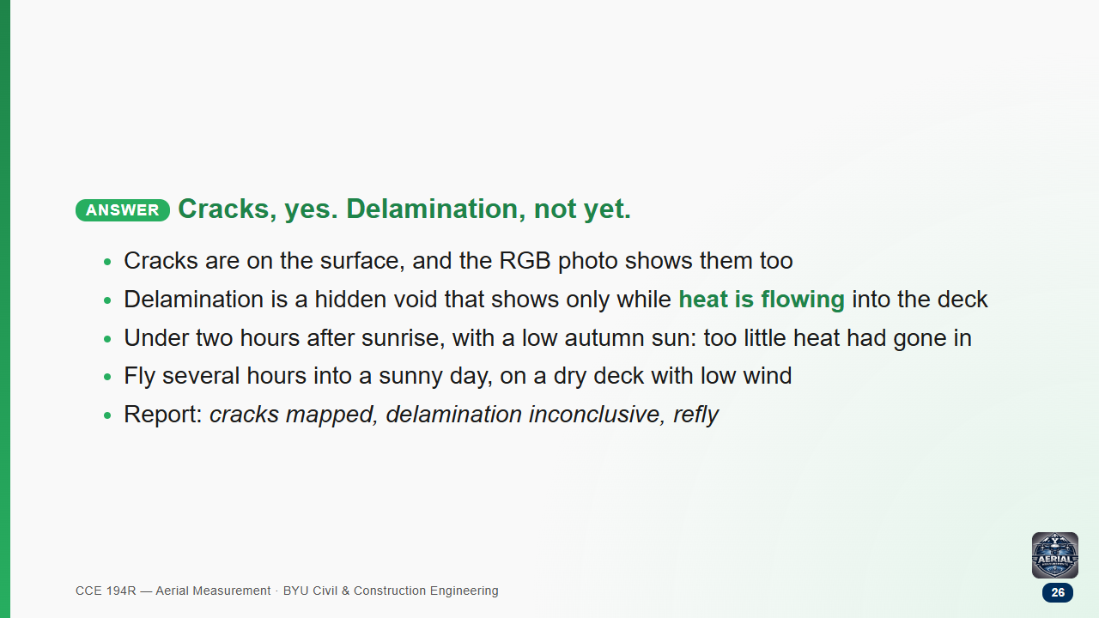

Slide 27
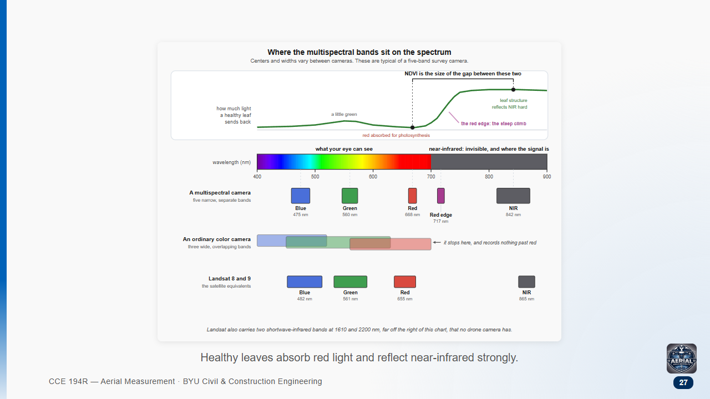

Slide 28
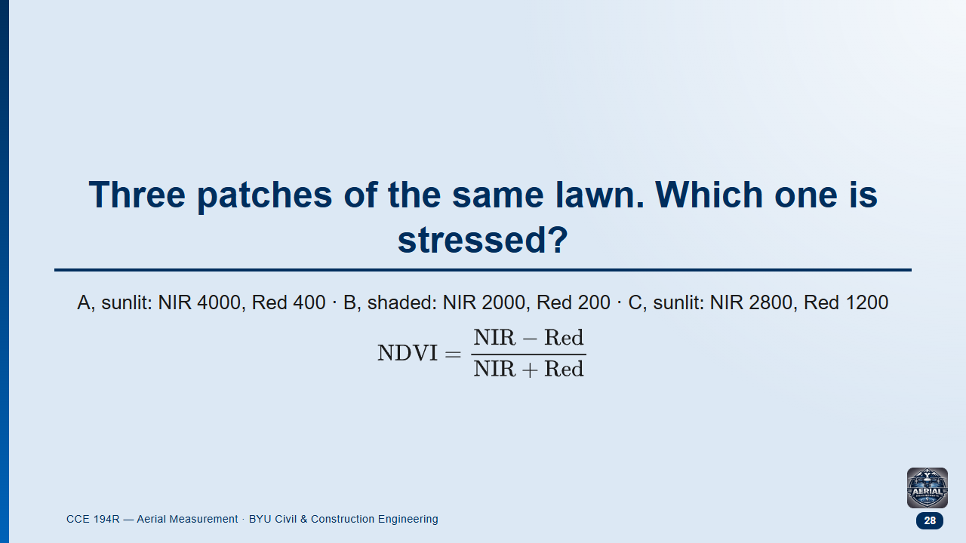
Notes:
Pairs 3 min, then class. Illustrative numbers.
Likely answer: B, because its raw NIR is the lowest.

Slide 29
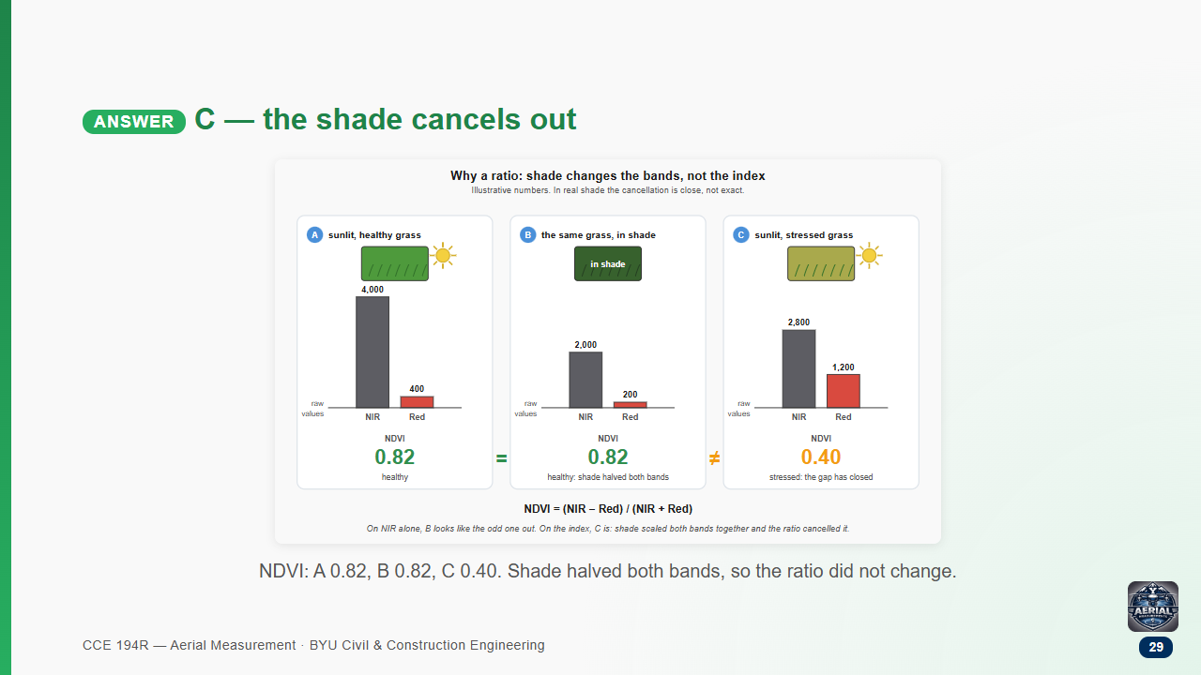

Slide 30
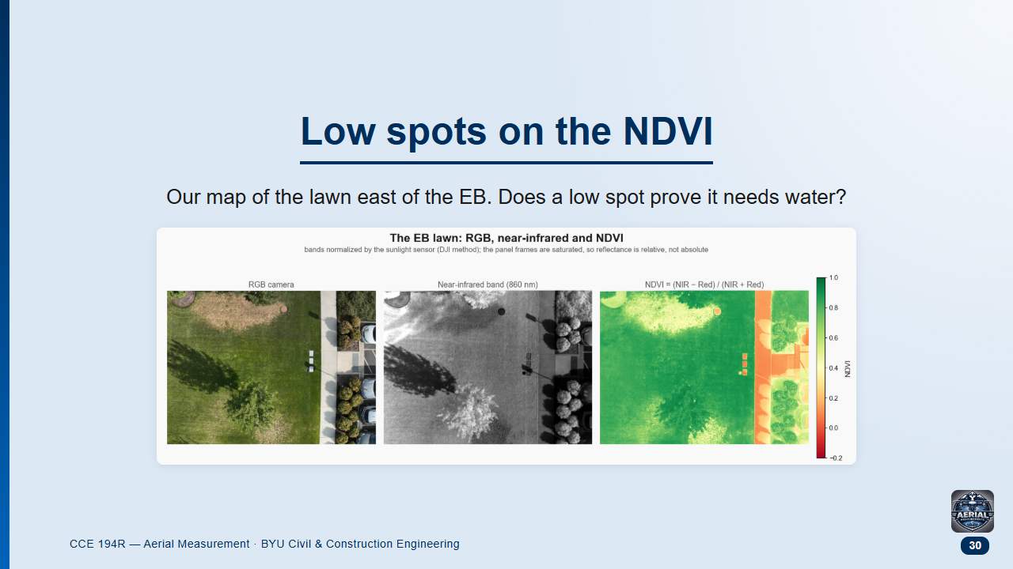
Notes:
Groups 1.5 min, then class.
Likely answer: yes.

Slide 31
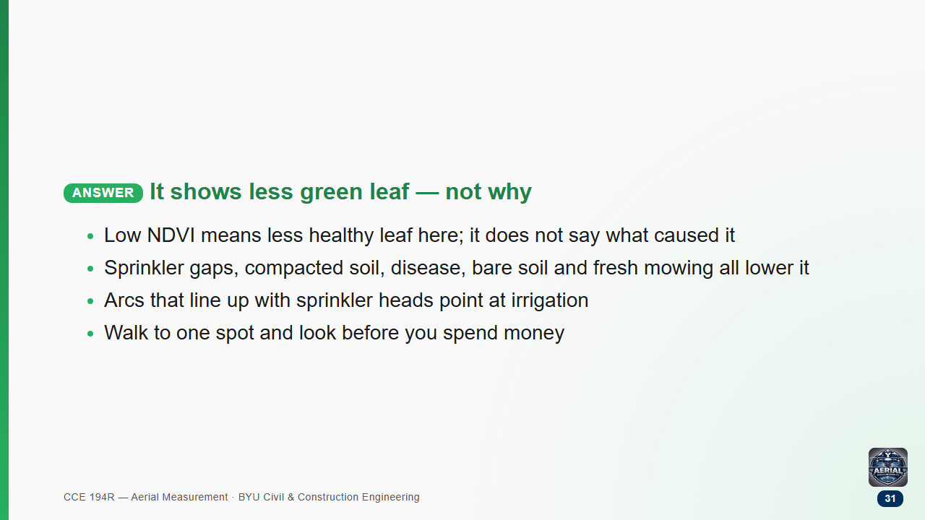

Slide 32
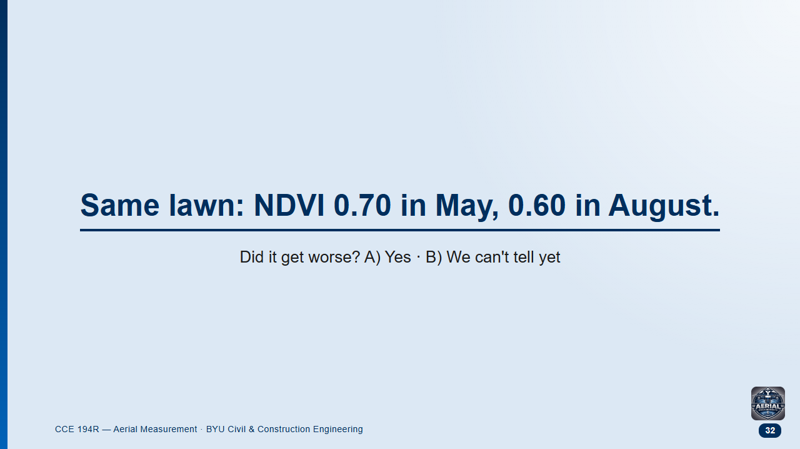
Notes:
Groups 1.5 min, then class.
Likely answer: A. Students over-apply "ratios cancel the lighting".

Slide 33
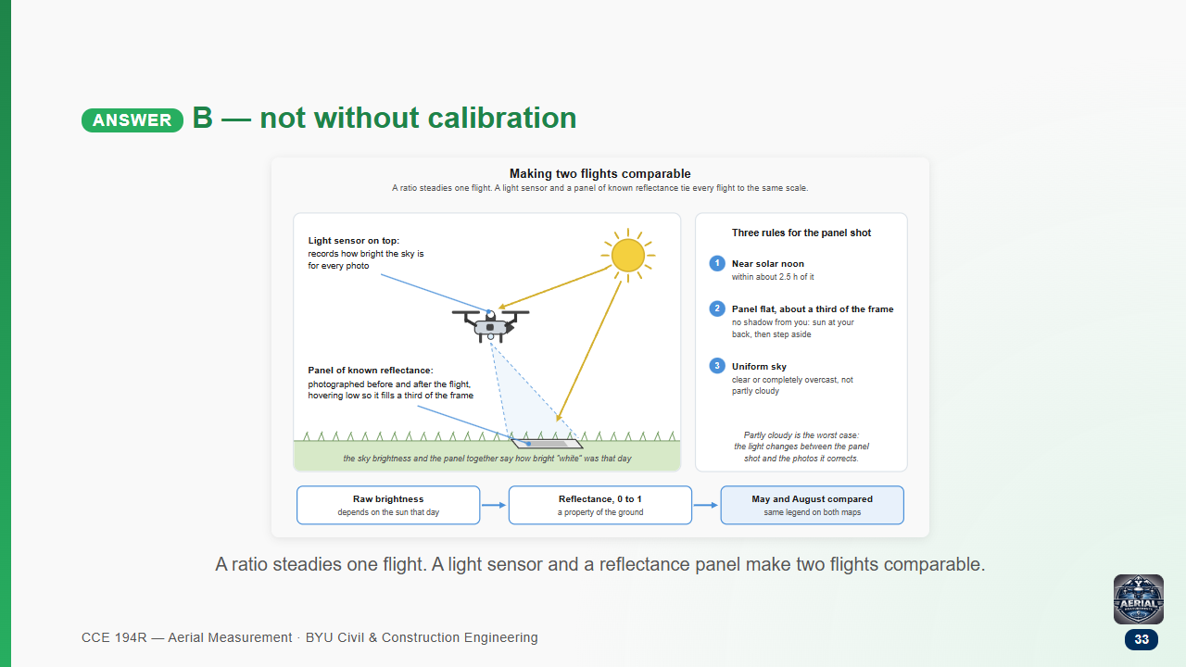

Slide 34
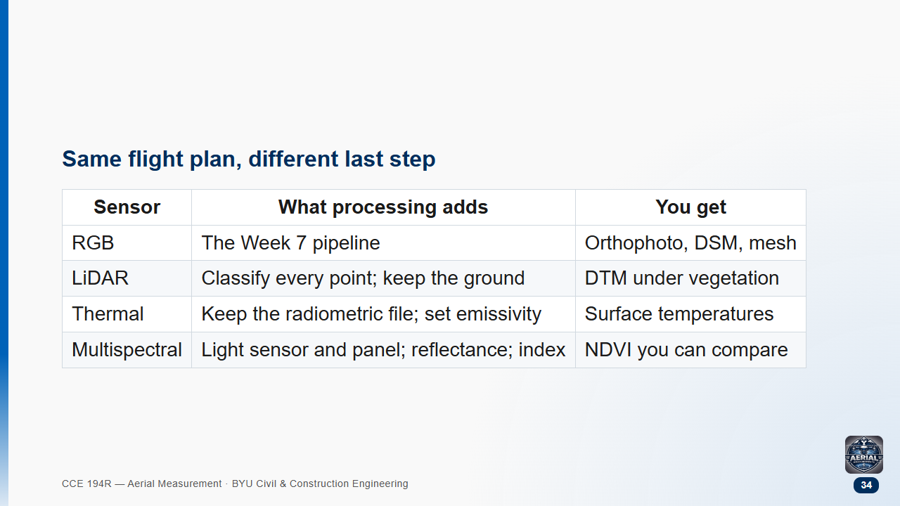

Slide 35
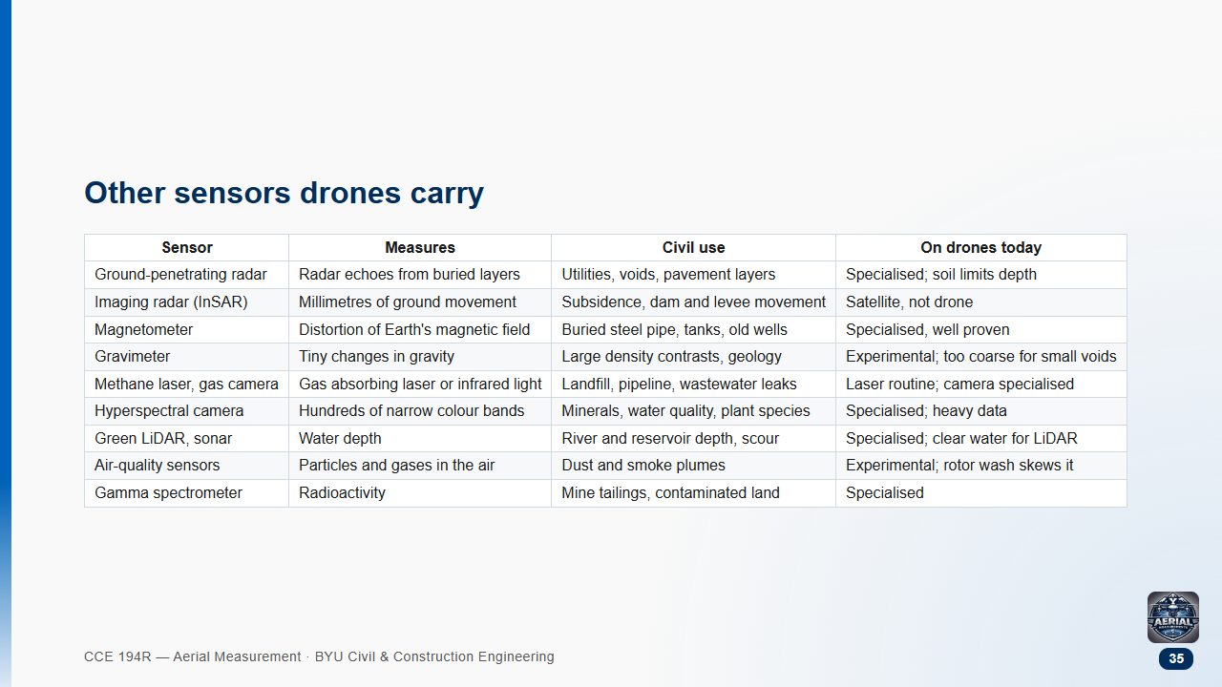
Notes:
GPR: soil sets the depth, not the sensor. Wet clay can cut it to under a metre; dry sand allows several. Drone GPR flies within about a metre of the ground; most GPR is still pushed on a cart.
InSAR: a satellite product you download (USGS uses it for subsidence from groundwater pumping). It is the "radar" in most subsidence stories.
Magnetometer: ferrous metal only. DOE's NETL switched from helicopters to drones around 2015 to find undocumented oil and gas wells.
Gravimeter: drone systems err by about 0.5-3 mGal; a sinkhole void is about 0.01-0.13 mGal. Ground surveys can find voids by gravity; drones cannot yet.
Methane laser: reads concentration times path length (ppm·m), not a point value; a leak rate needs wind and a model.
Hyperspectral: 100+ narrow bands against multispectral's 4-10; gigabytes per flight.
Water depth: green LiDAR reaches about twice the Secchi depth in clear water; tethered sonar works in muddy water.
Air quality: finds the plume; weak for compliance numbers.
Gamma: legacy uranium mines on the Colorado Plateau.
Sources: .claude/local/scratch/week08_check/other_sensors.md in the course repo.

Slide 36
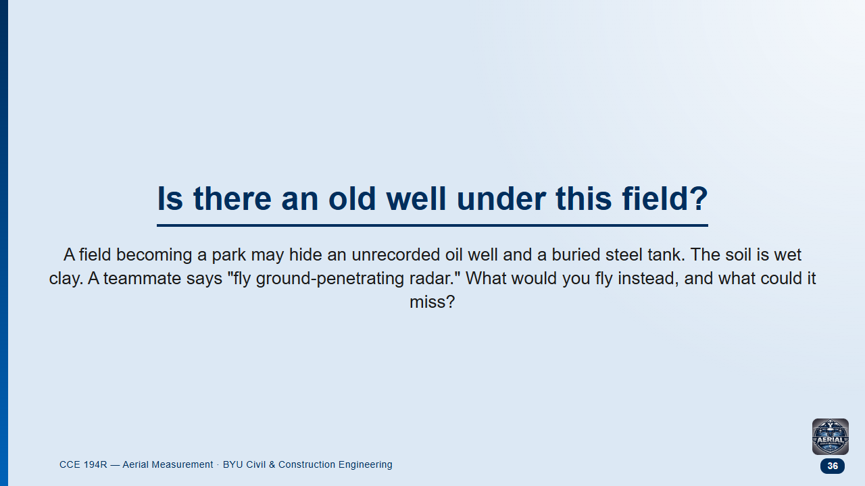
Notes:
Groups 2 min, then class.
Likely answer: GPR, because "radar sees underground".

Slide 37
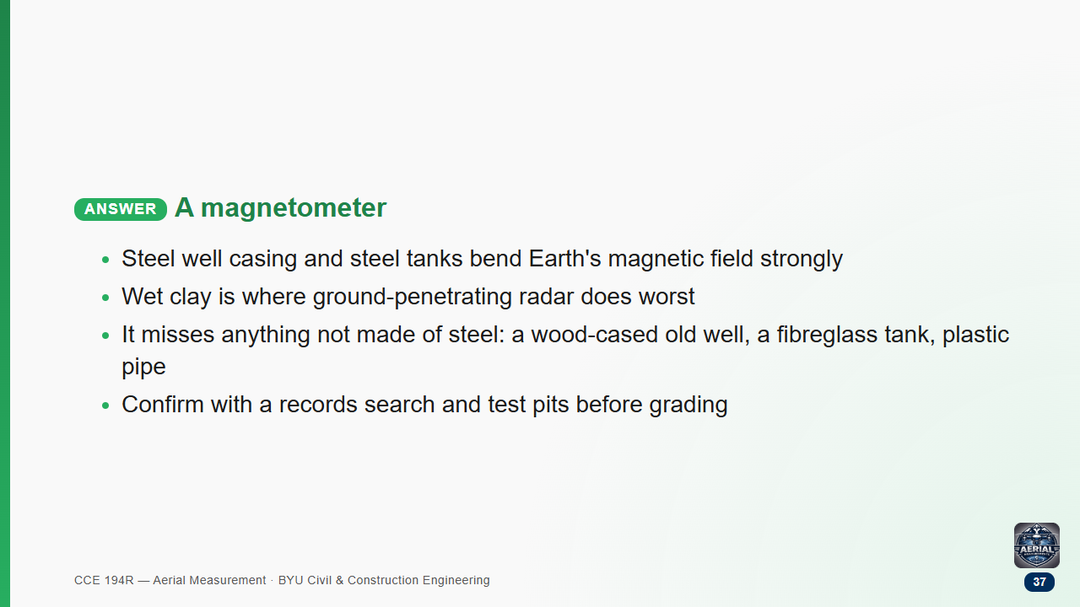

Slide 38
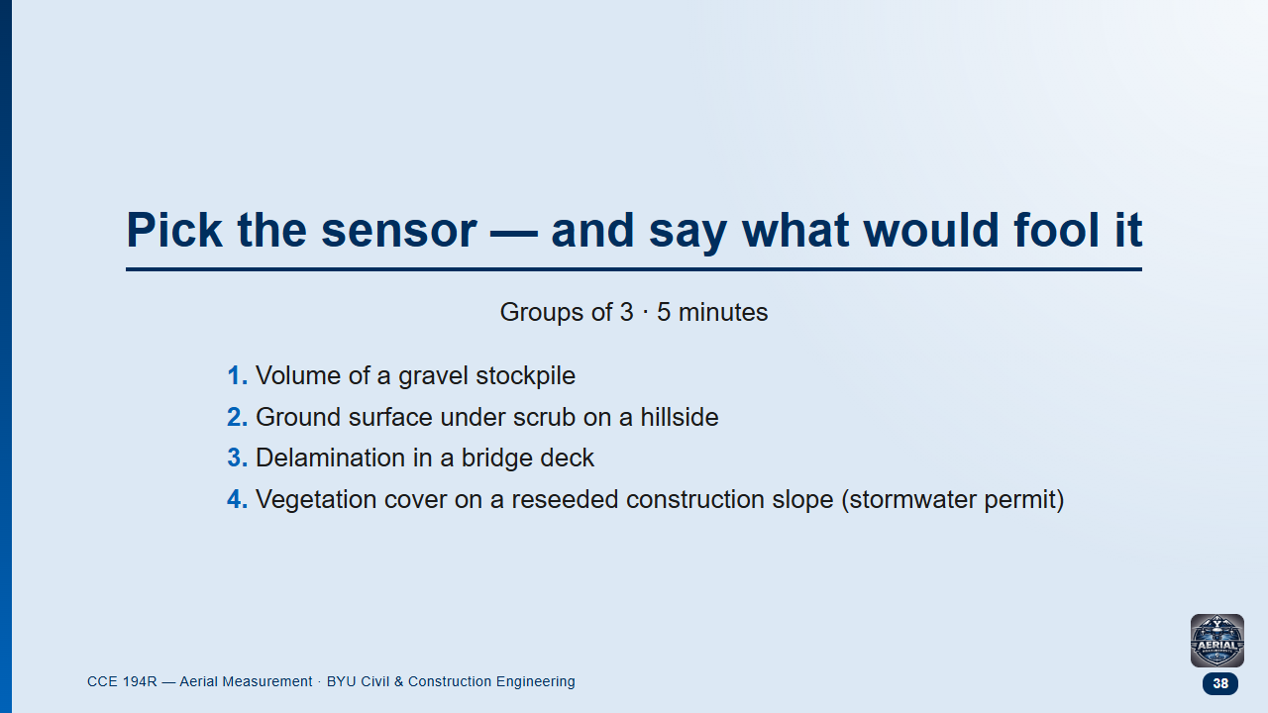
Notes:
Each group takes all four; one group reports each.

Slide 39
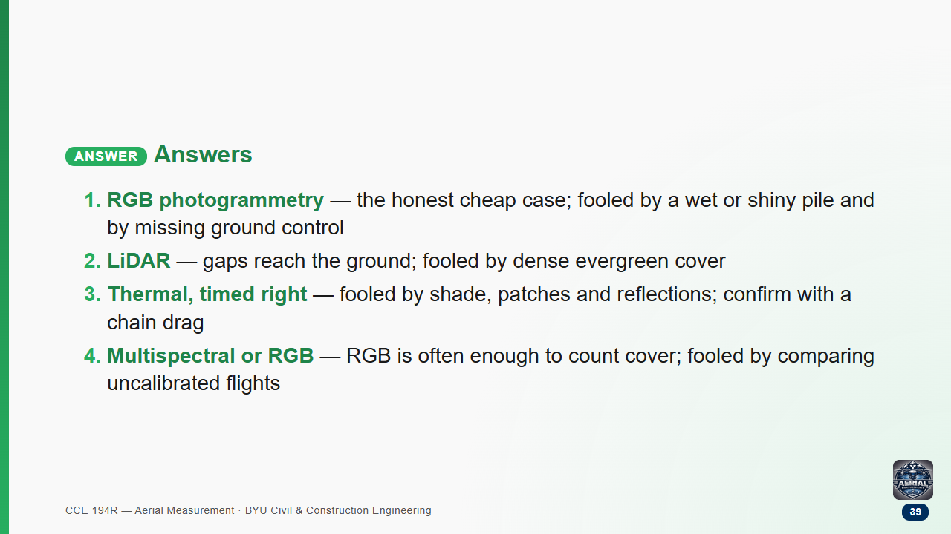

Slide 40
