Slide 1


Slide 2
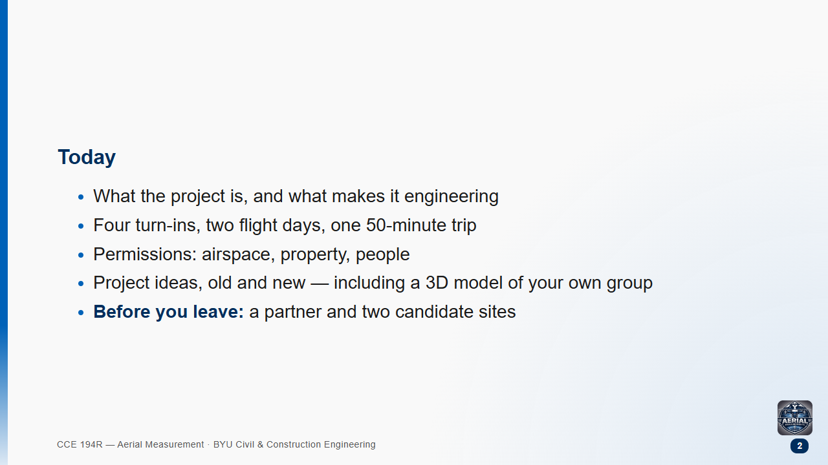
Notes:
Groups form today; the proposal is due Thursday night. Keep the lecture to about 40 minutes and leave 10 for pairing up and picking sites.

Slide 3
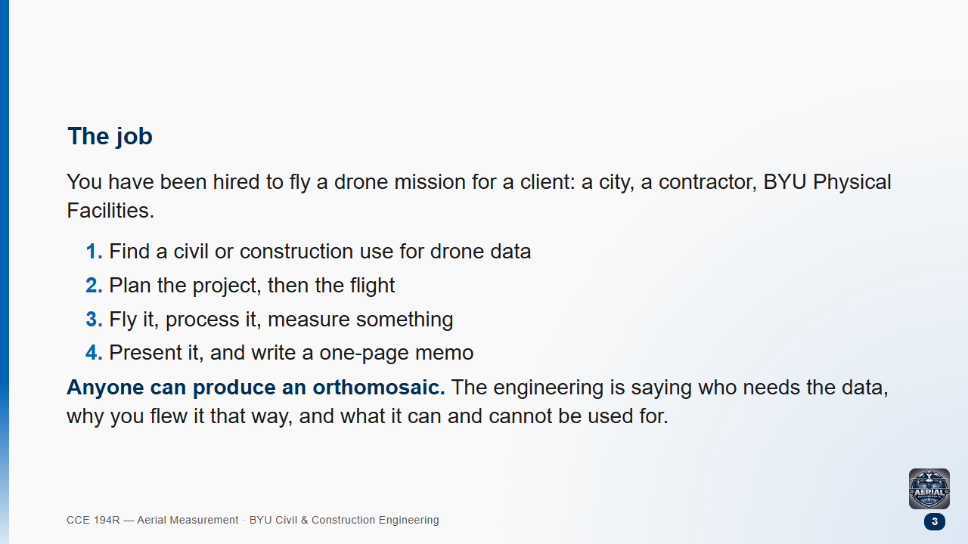

Slide 4
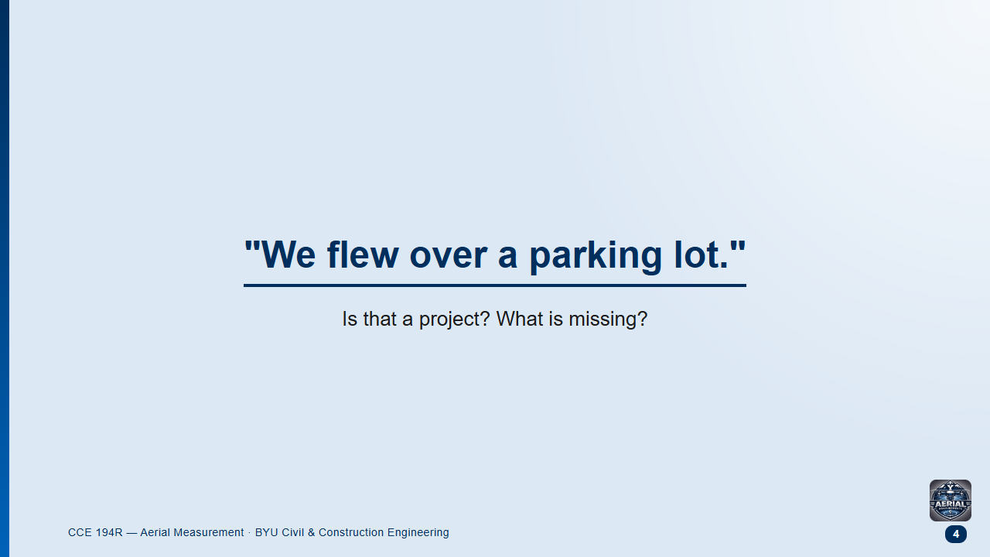
Notes:
Pairs 1 min, then take three answers.
Likely answer: "it needs a better site" or "a 3D model". Push toward who and why.

Slide 5
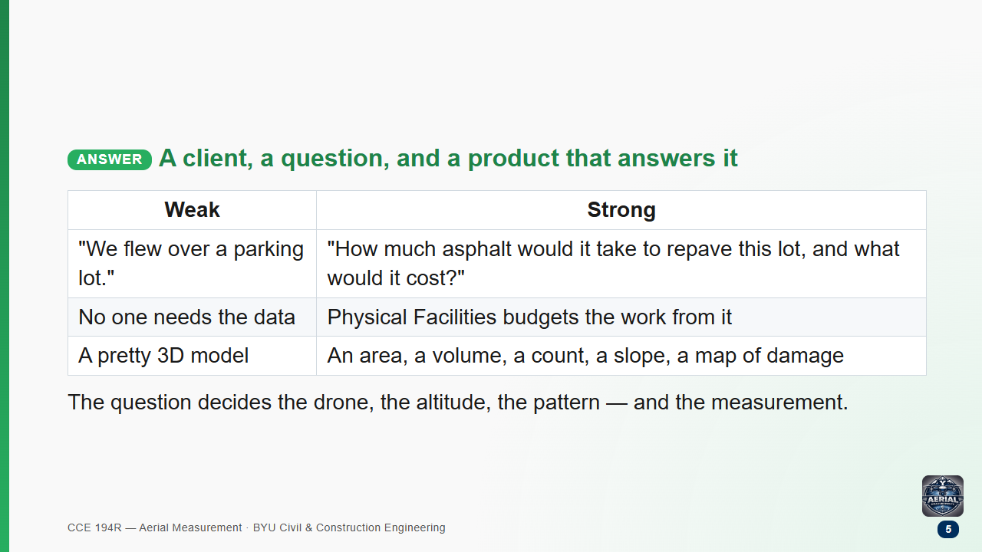

Slide 6
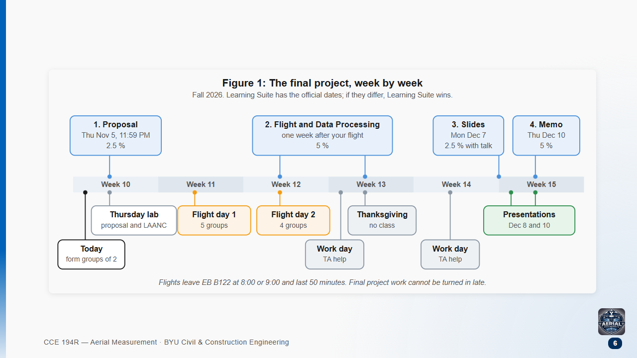
Notes:
Weights: proposal 2.5 %, flight and processing 5 %, presentation 2.5 %, memo 5 % — 15 % of the course.
Nothing in the project can be turned in late. Learning Suite has the official dates.

Slide 7
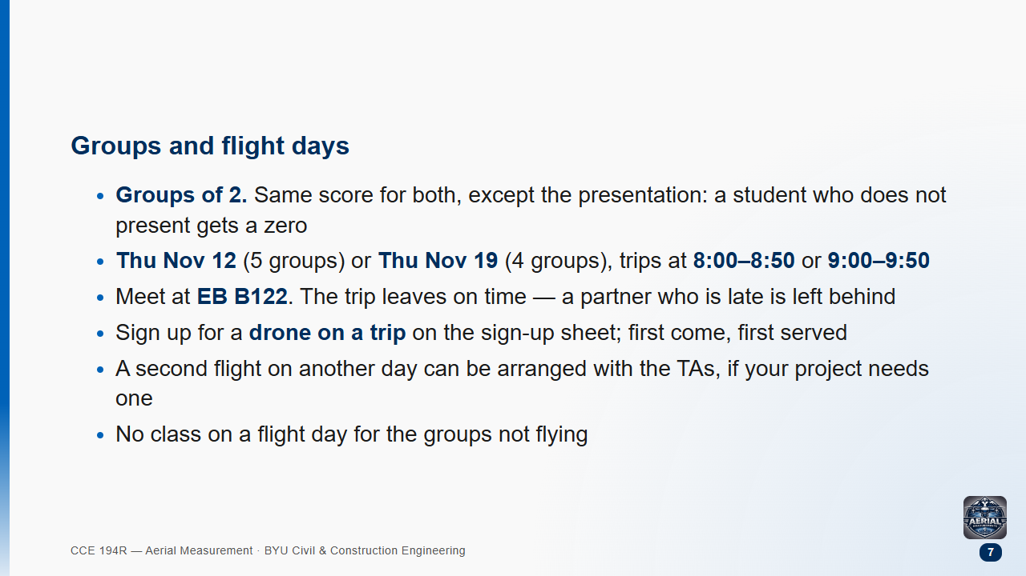

Slide 8
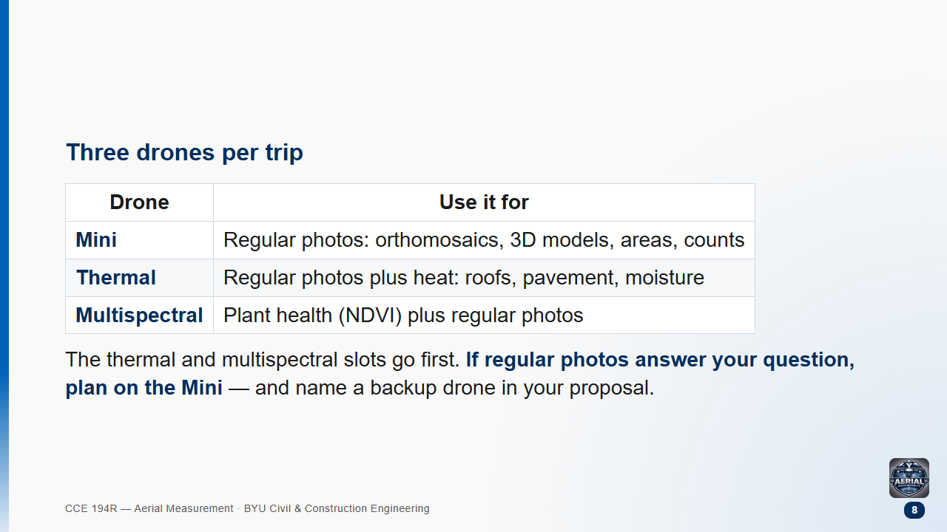

Slide 9
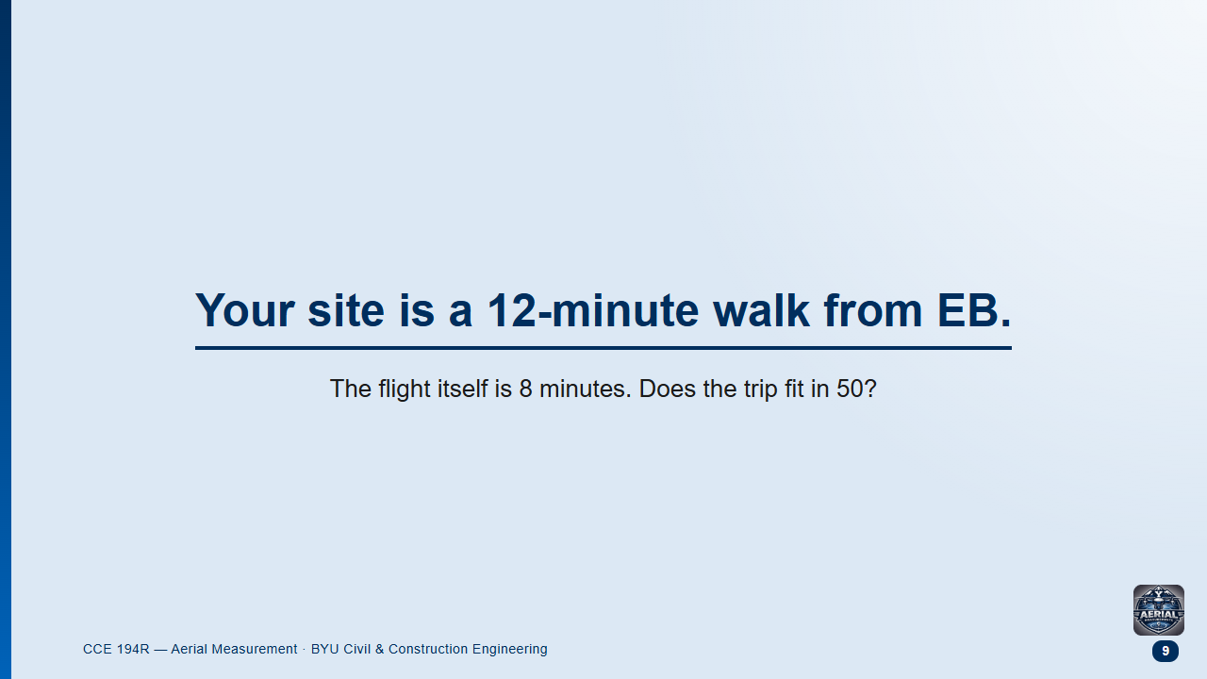
Notes:
Pairs 2 min: make them list every step, not just the flight.
Likely answer: "yes, 12 + 8 + 12 = 32". The missing pieces are checkout, setup, checklists, extra photos, pack-up.

Slide 10
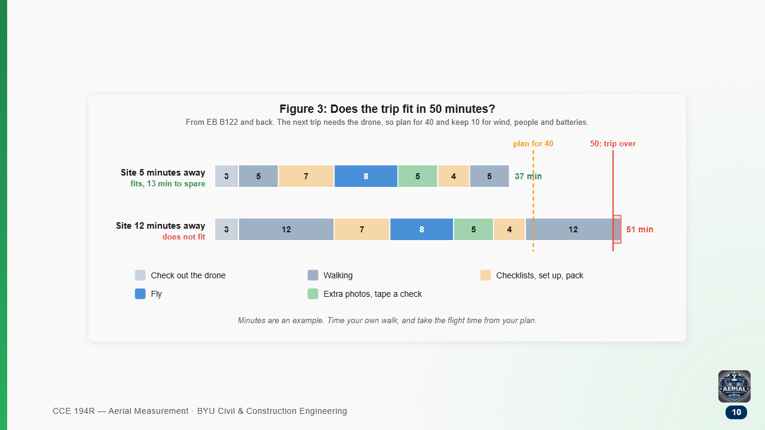
Notes:
The flight is the small part. Walking both ways and the checklists are most of the trip.
Plan for 40 and keep 10 for wind, a pedestrian, or a battery swap. Time your own walk this week.

Slide 11
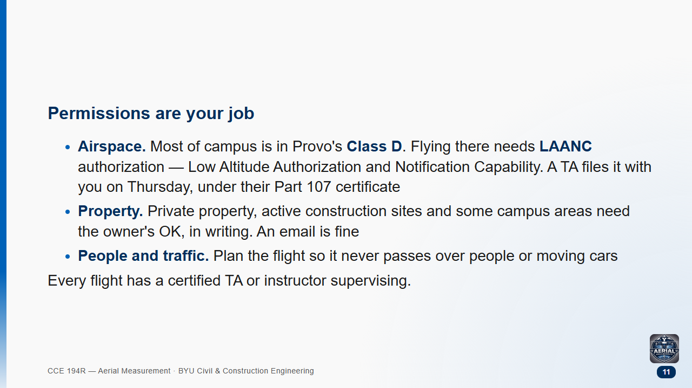

Slide 12
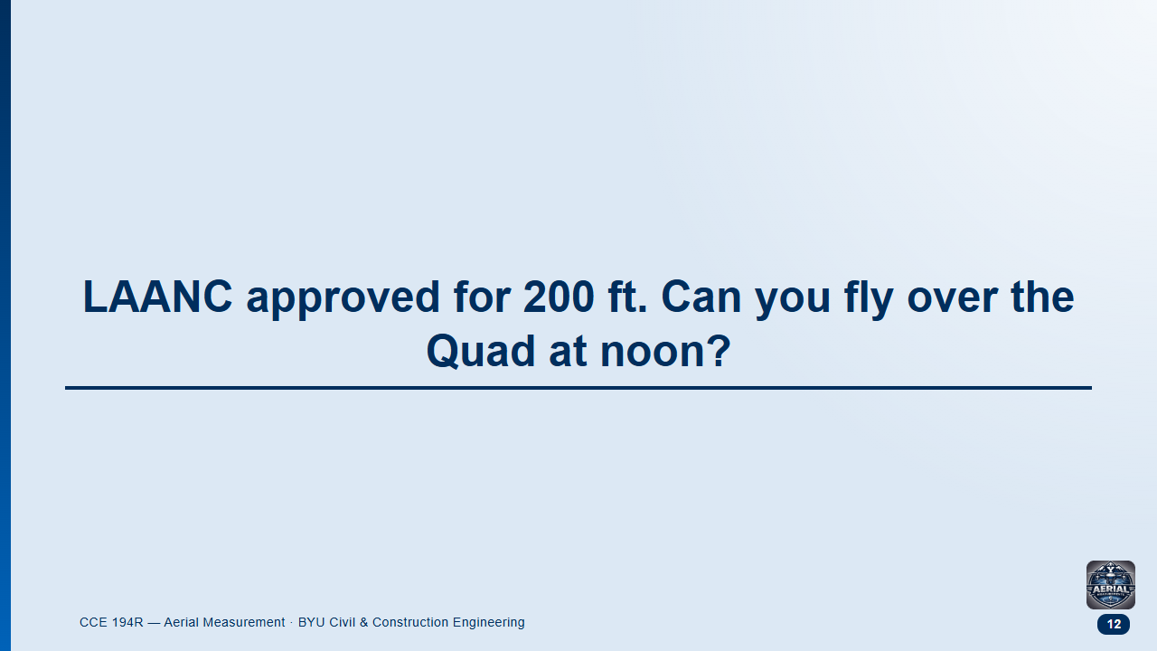
Notes:
Pairs 1 min. Likely answer: "yes, we have authorization".

Slide 13
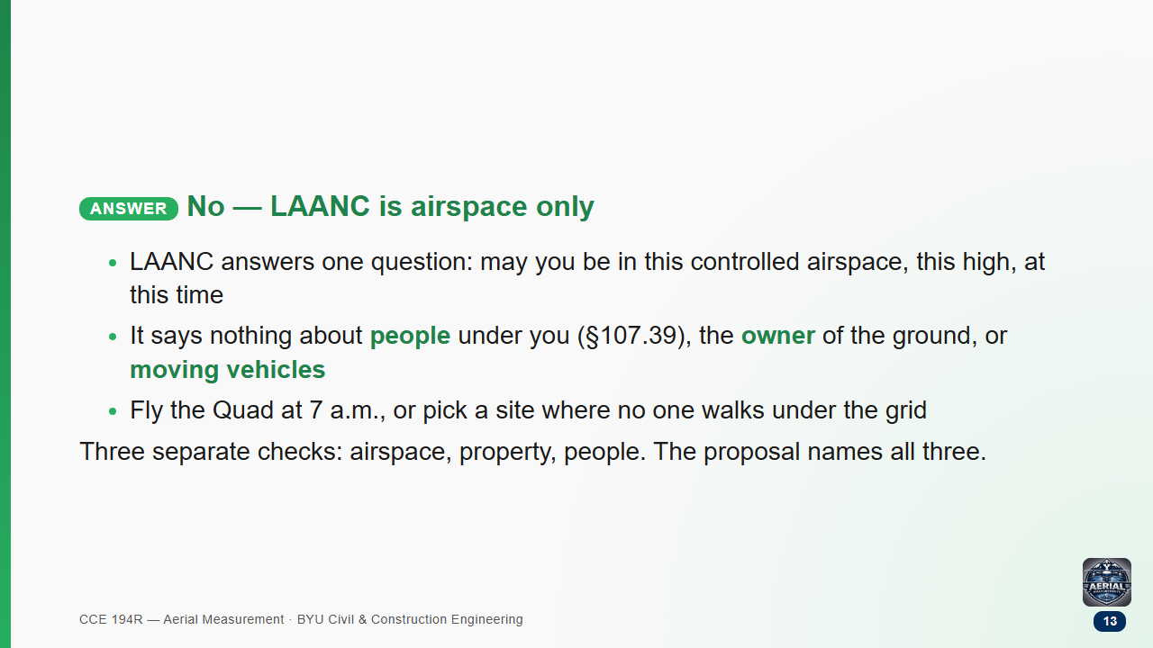

Slide 14
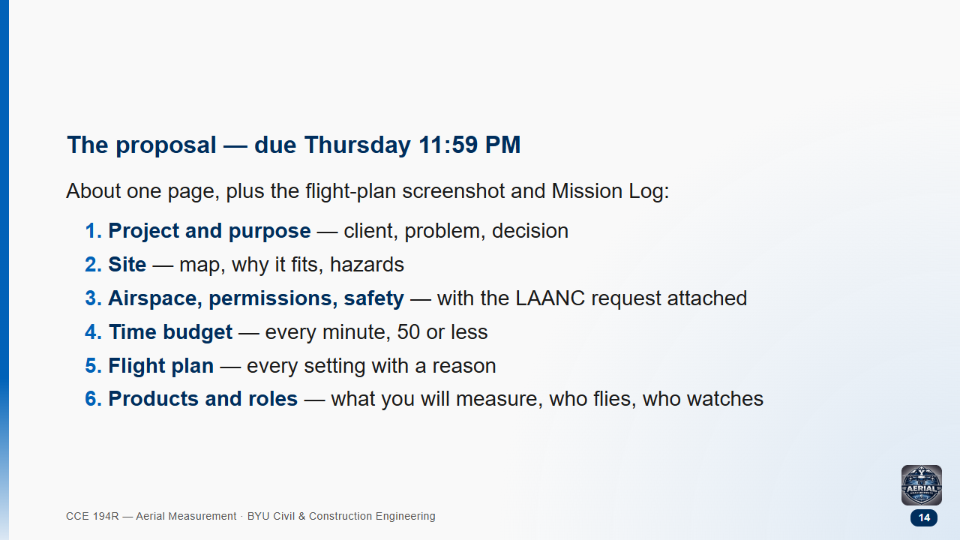

Slide 15
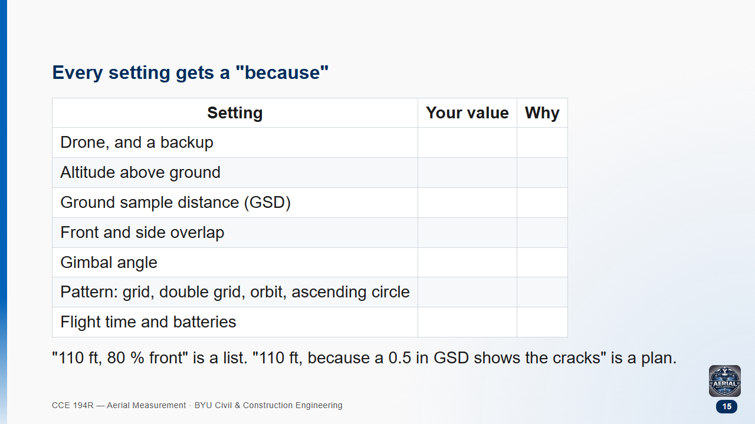

Slide 16
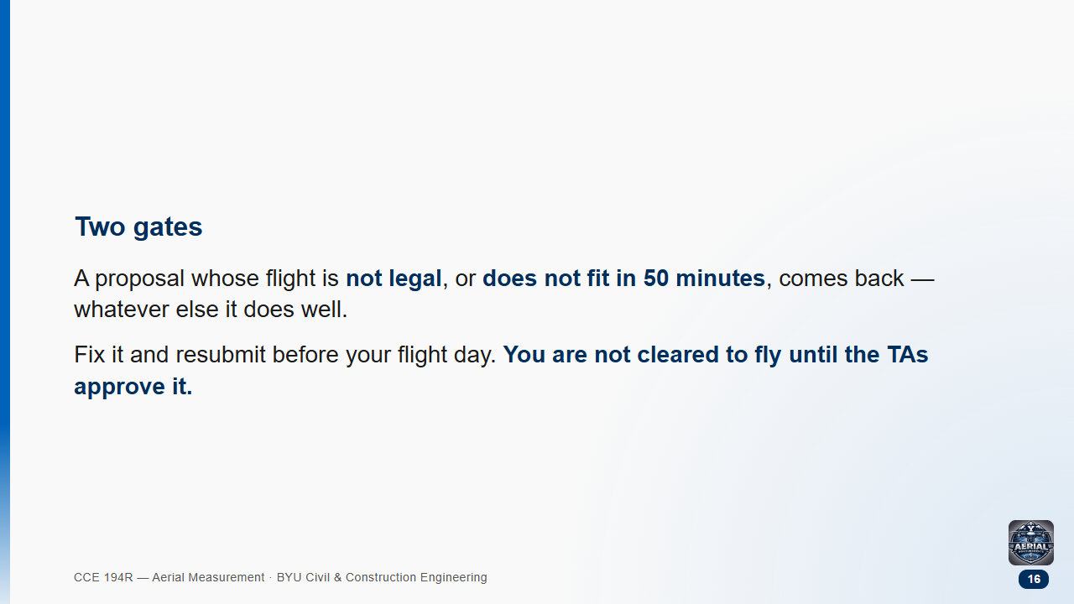

Slide 17


Slide 18
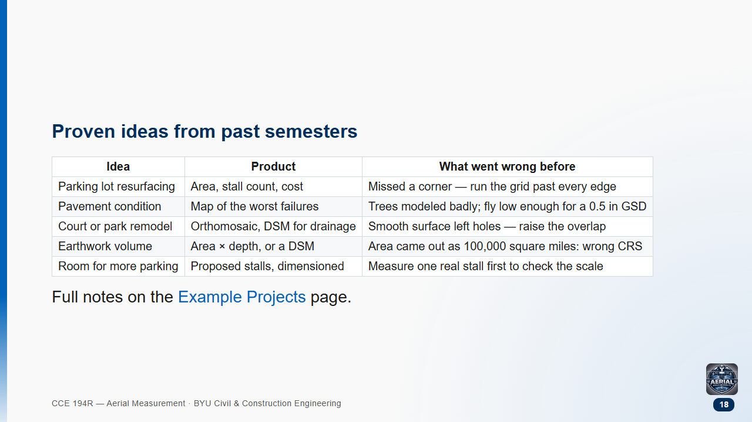

Slide 19
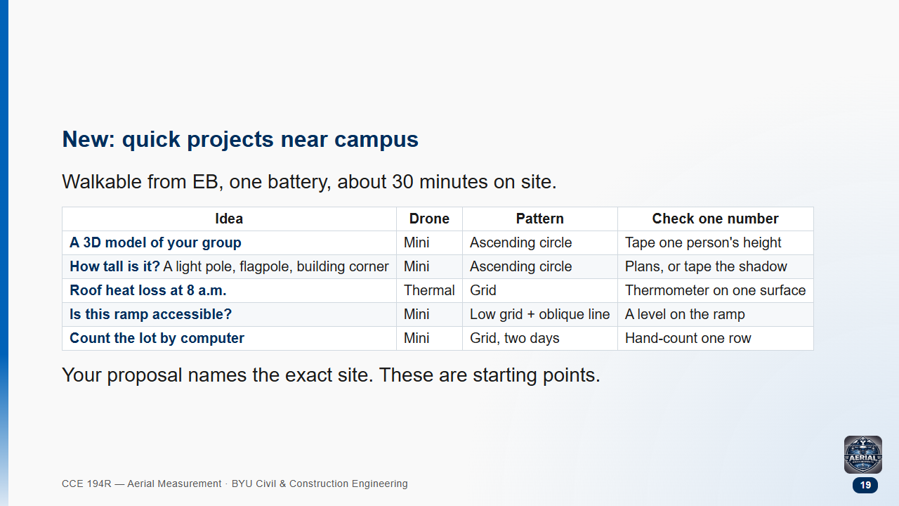

Slide 20
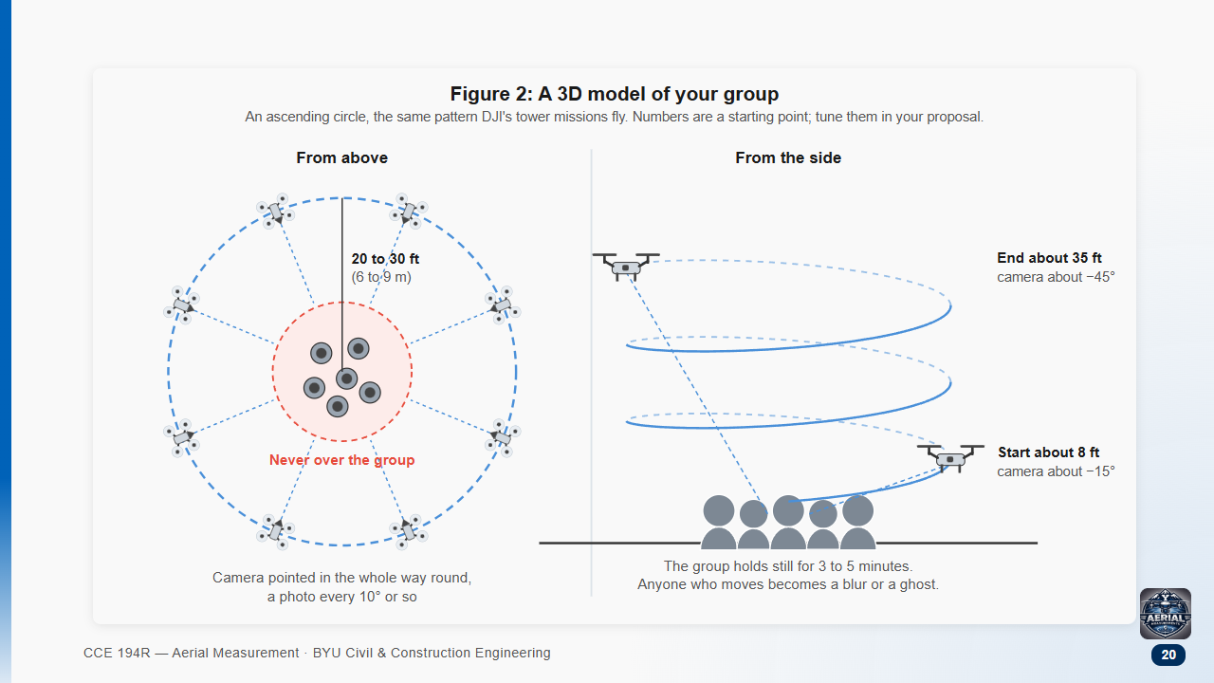
Notes:
The fun one. DJI's tower-inspection missions fly exactly this: an ascending circle with the camera locked on the centre. A TA sets it up with you.
The measurement: tape one person's height and compare it with the mesh. That one number is the whole engineering point.
Anyone who moves becomes a ghost — that is a real lesson about what photogrammetry assumes (nothing moves between photos).

Slide 21
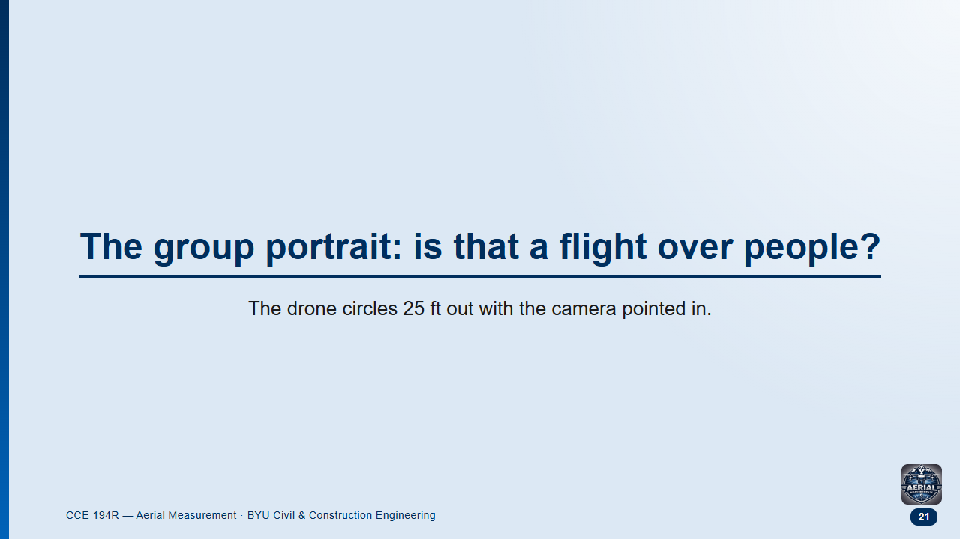
Notes:
Pairs 1 min. Likely answers split between "yes, they are under it" and "no, they are participating".

Slide 22
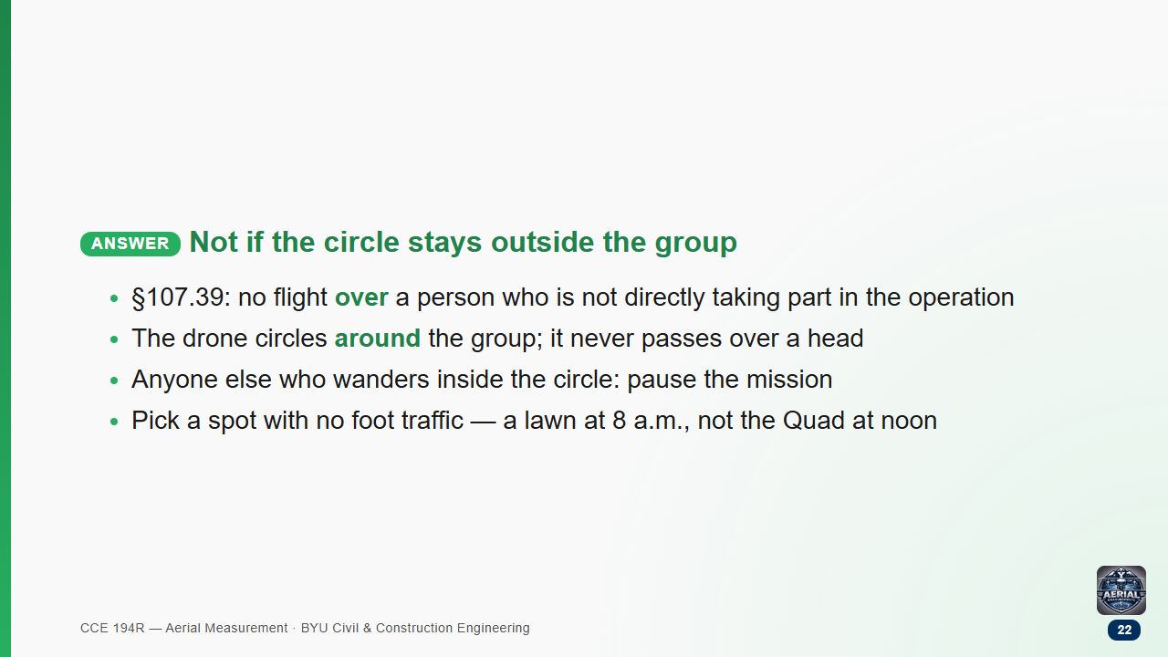

Slide 23
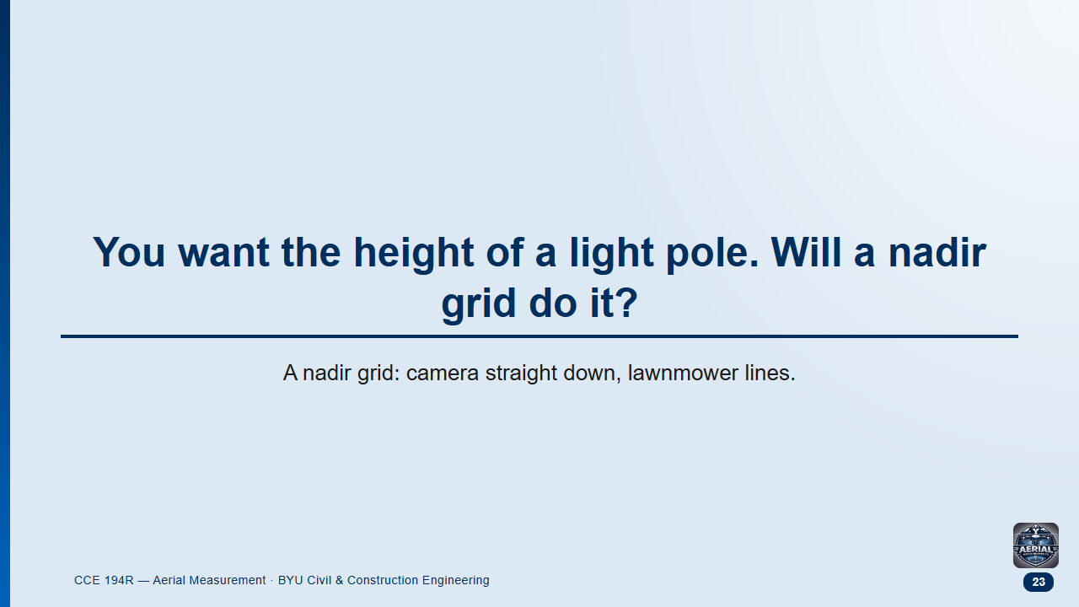
Notes:
Pairs 1 min. Likely answer: "yes, the DSM gives the height".
Follow-up: what does a thin pole look like from straight above?

Slide 24
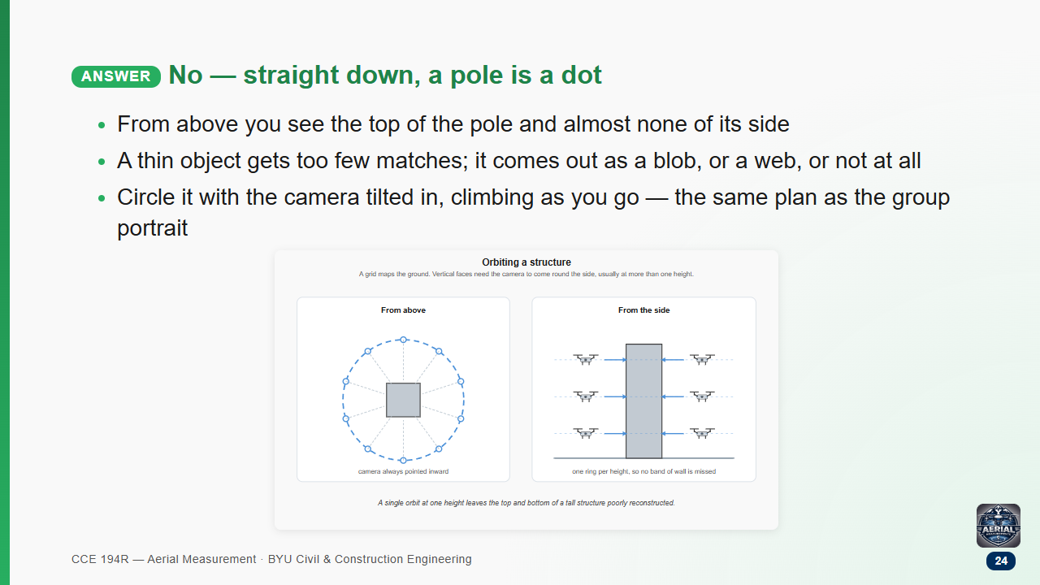

Slide 25
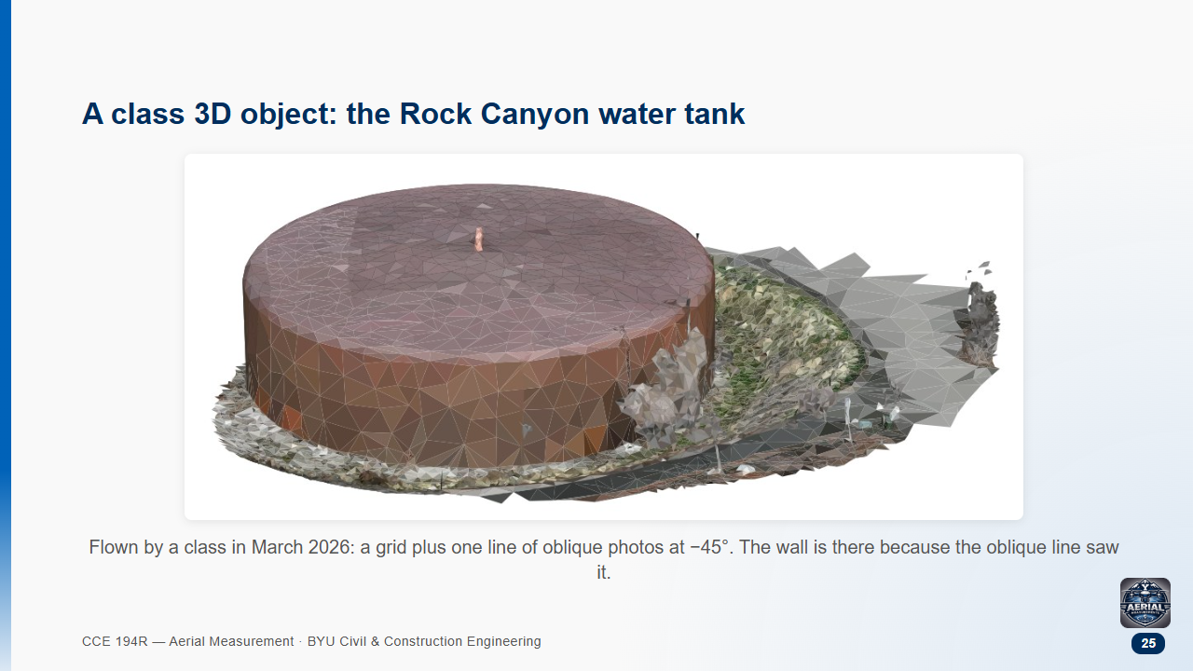

Slide 26
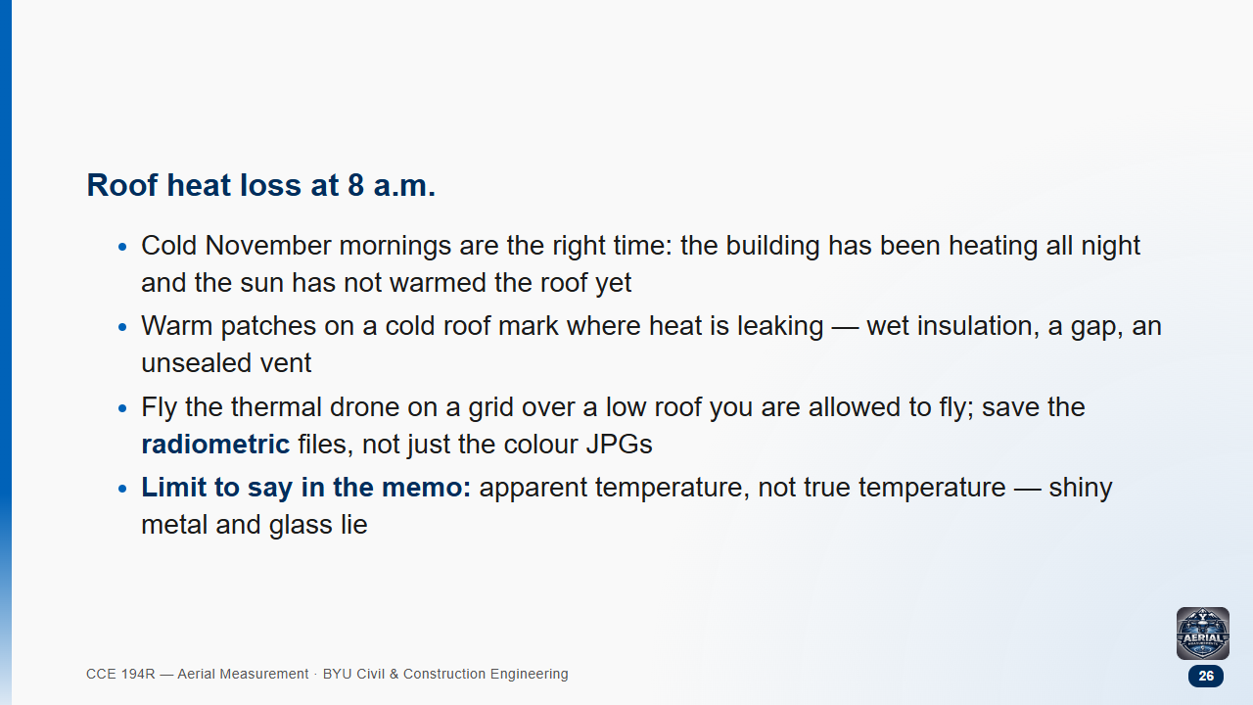

Slide 27
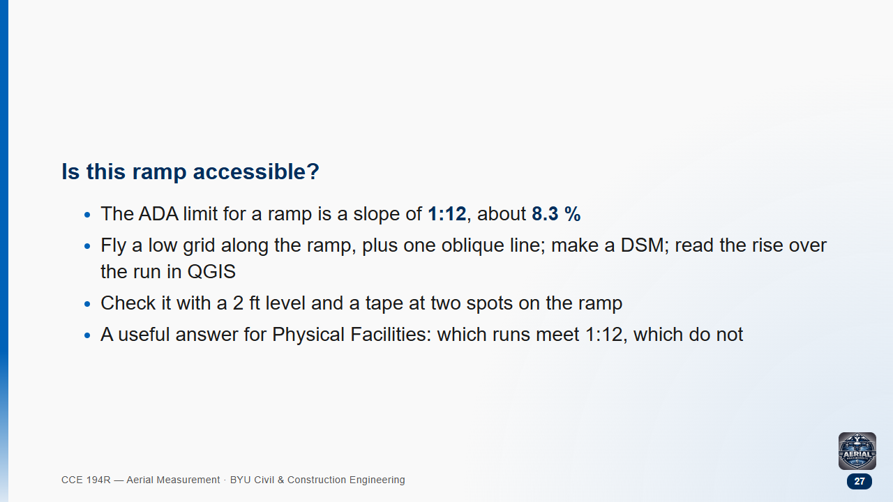

Slide 28
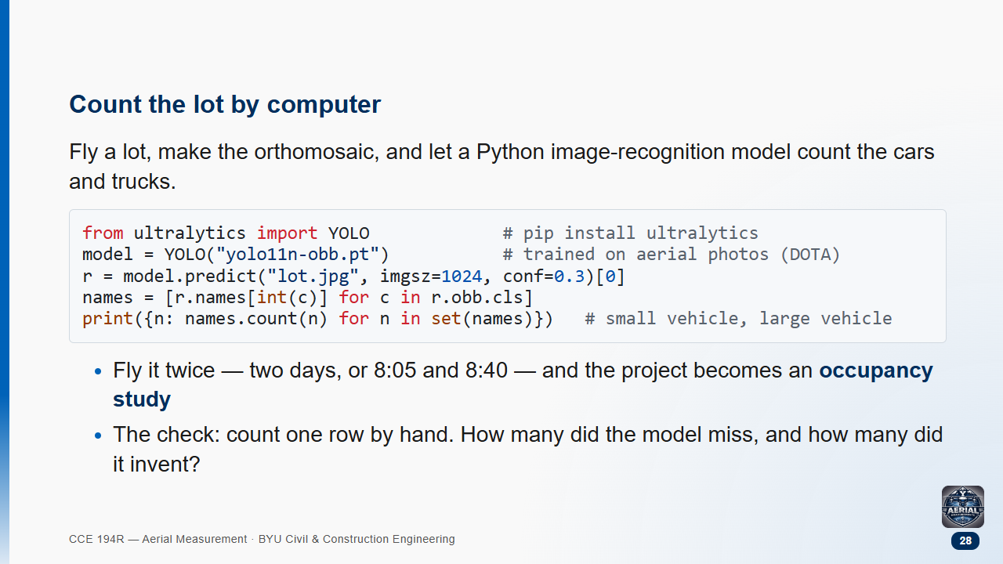
Notes:
The DOTA model was trained on aerial photos, so it knows cars from above; a street-view model does not.
It expects coarser pixels than our 1 cm orthomosaics: export a reduced copy, or a crop of the lot, so a car is a few dozen pixels long.
This snippet is a starting point that a TA should run once on the class orthophoto before a group relies on it.

Slide 29
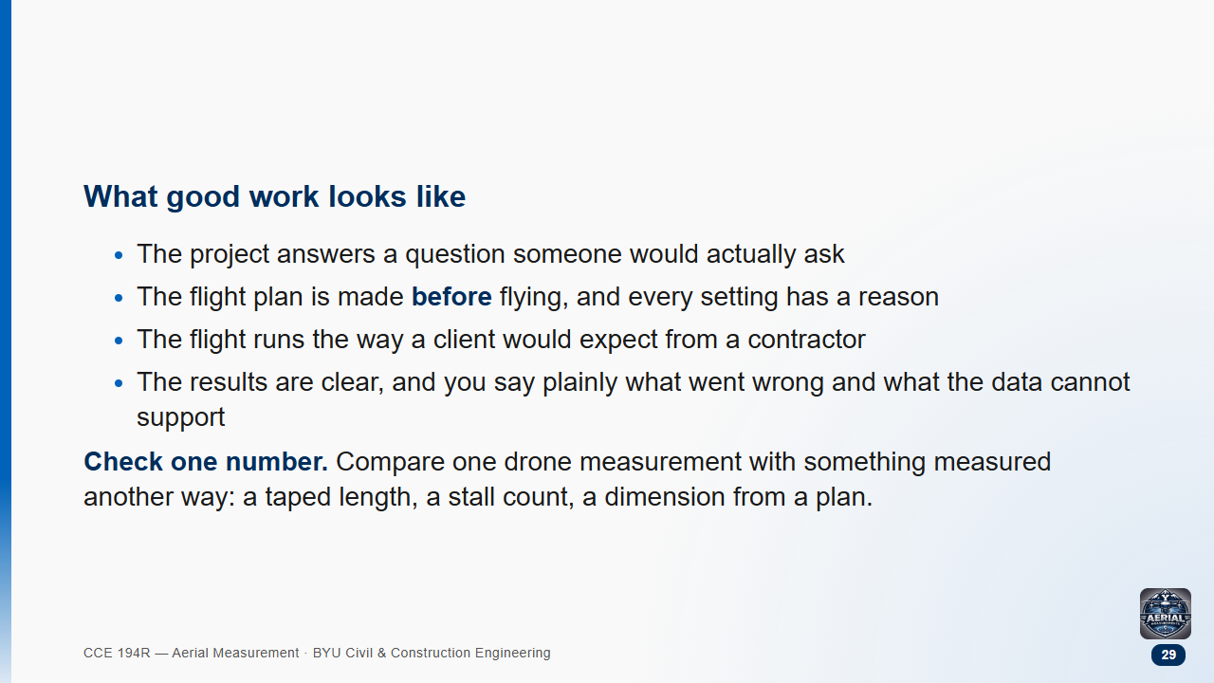

Slide 30
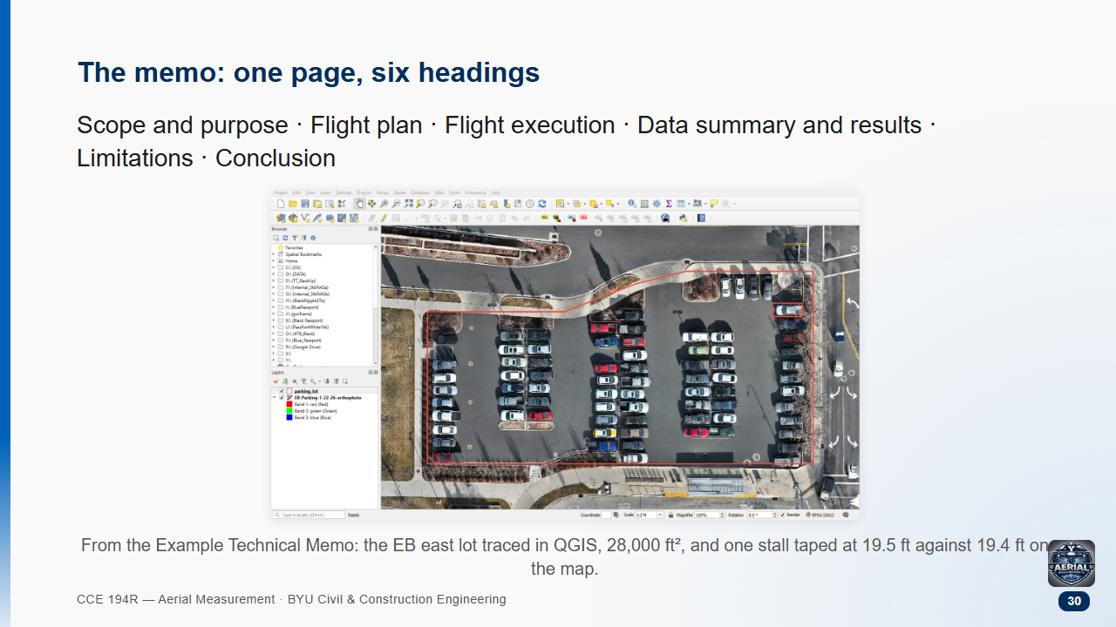

Slide 31

Notes:
Pairs 2 min. This is the question every presentation will get.

Slide 32
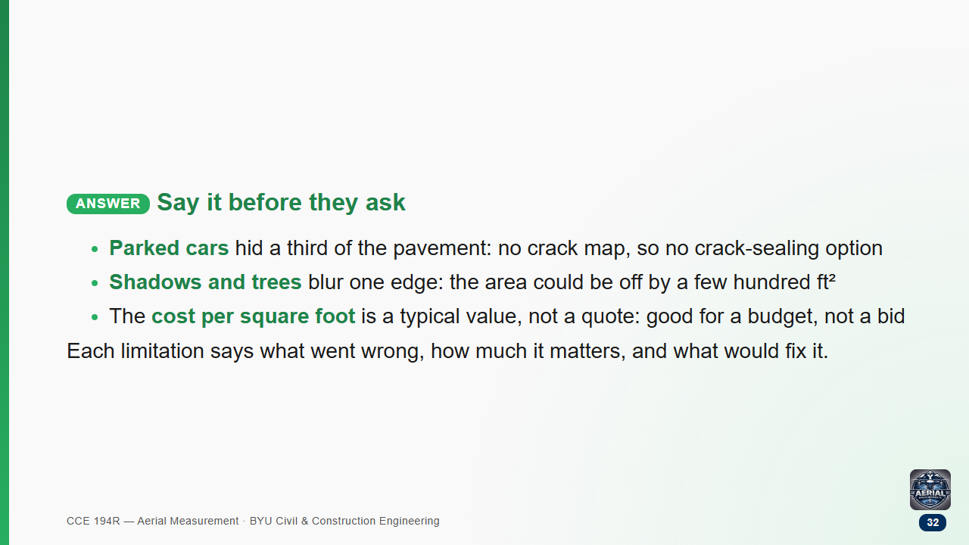

Slide 33
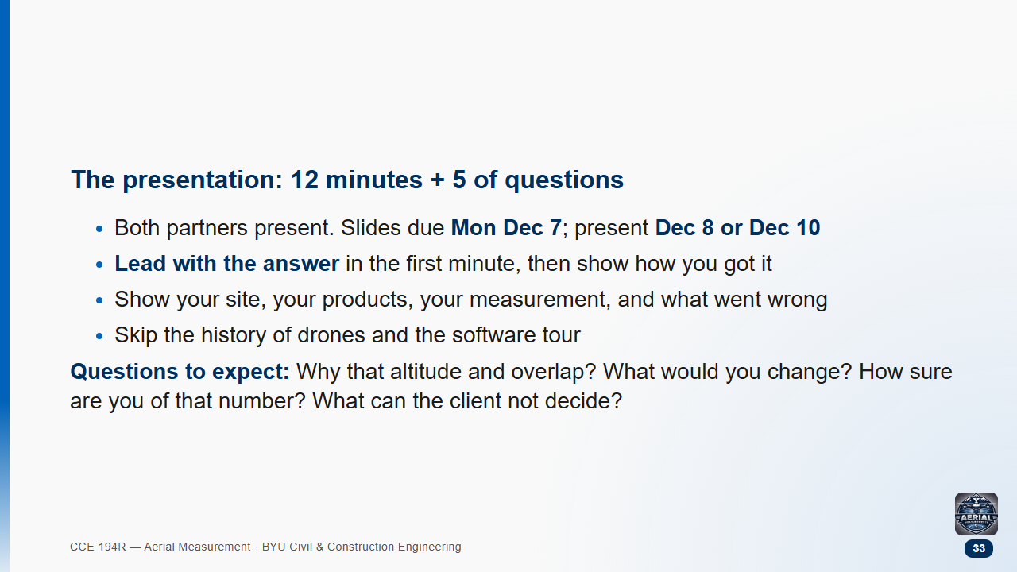

Slide 34
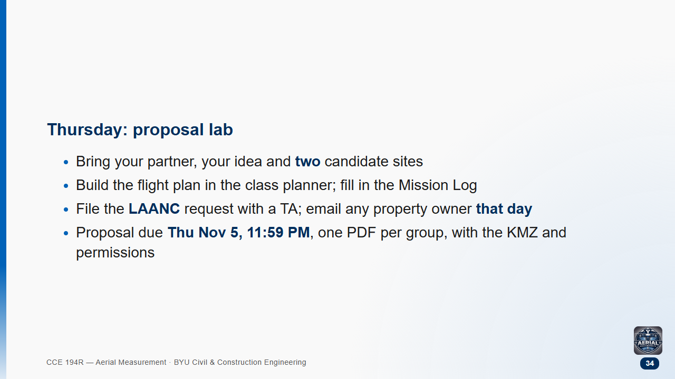

Slide 35


