Slide 1
Github Actions

Slide 2
Overview
What is Github Actions
Using workflows
Creating custom actions

Slide 3
What is Github Actions
Continuous Integration/Continuous Deployment
Directly integrated with Github
Much of the work is already done for you (reusability)

Slide 4
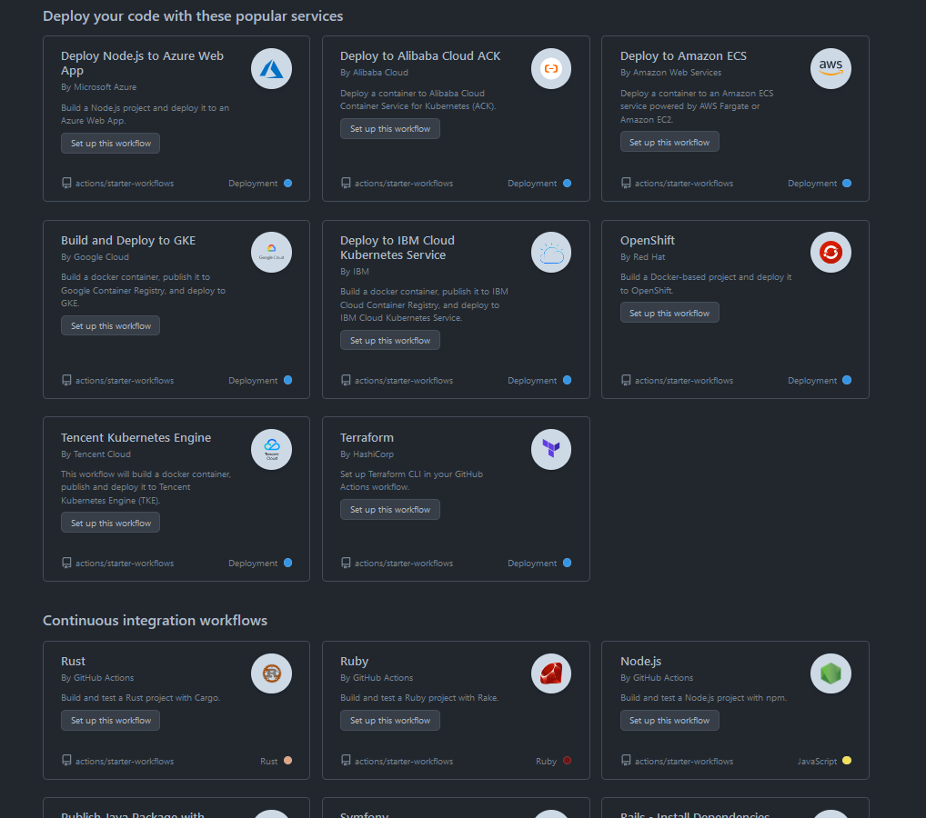
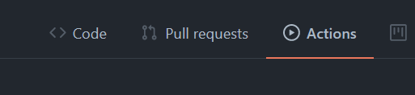

Slide 5
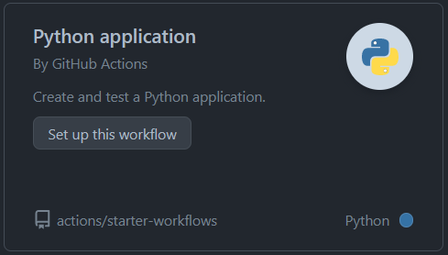
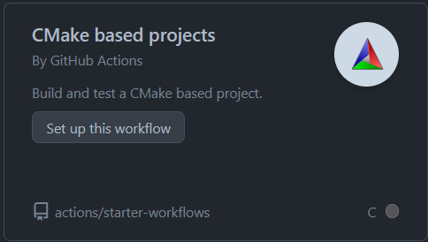
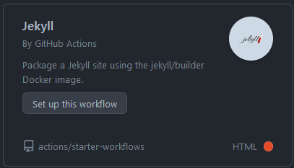
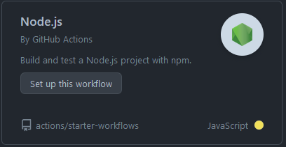
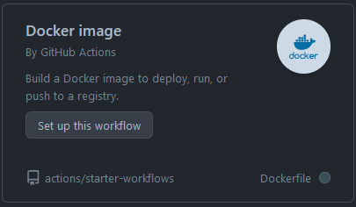
CI Workflow Examples

Slide 6
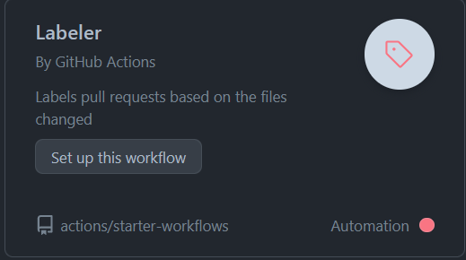
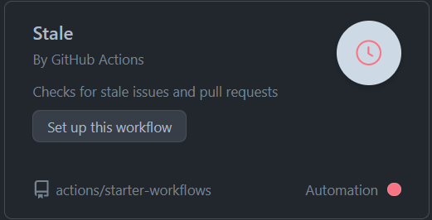
Github Task Automation examples
. . . or anything else!

Slide 7
How to add an workflow
Insert a .yml file at {repository-name}/.github/workflows/
Define the following
Name
Workflow trigger
What jobs to run

Slide 8
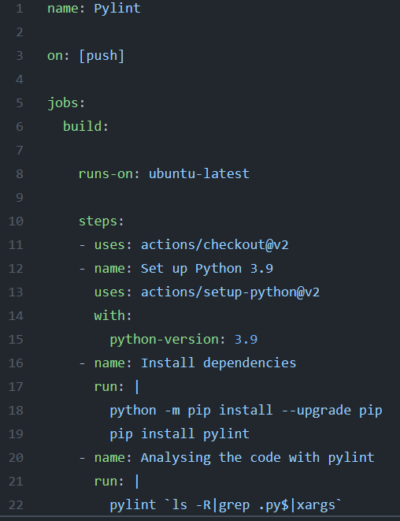
Name
Trigger
“Workflow file”
Jobs
“Action”

Slide 9
Creating a custom action (Docker)
Action metadata file – action.yml
Dockerfile
Action code – entrypoint.sh

Slide 10
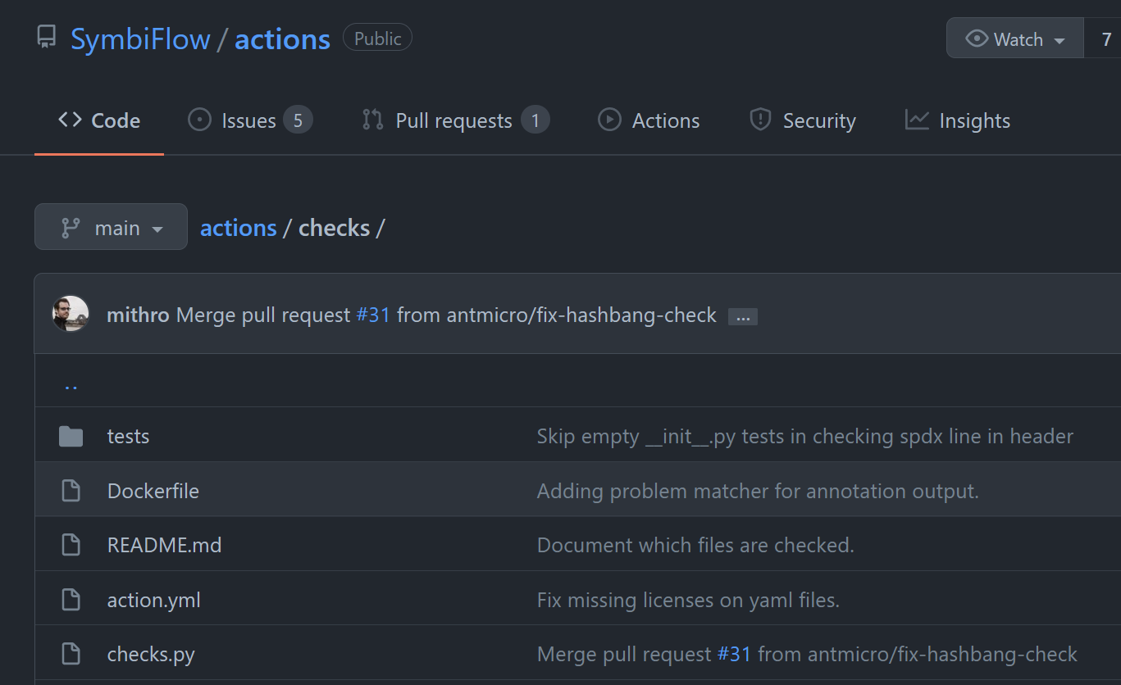

Slide 11
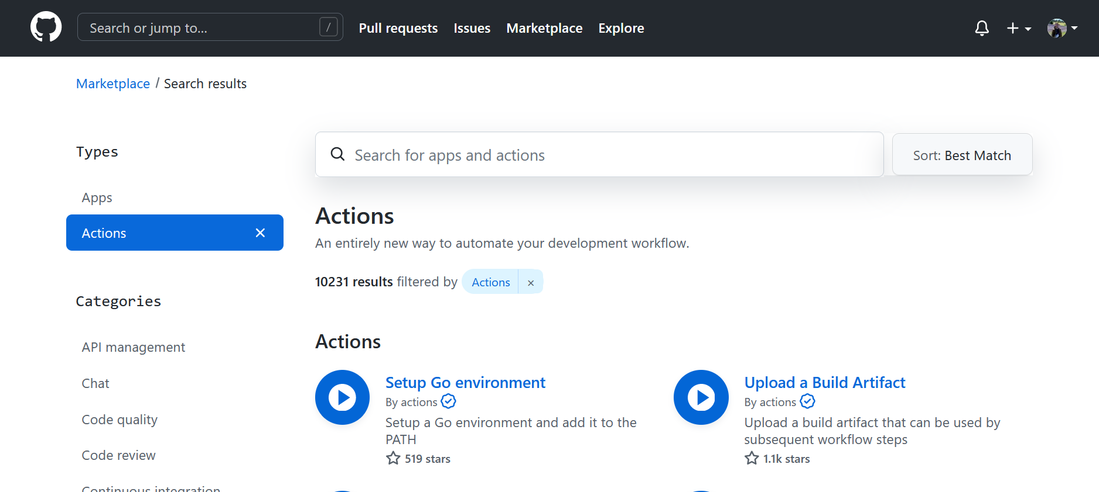

Slide 12
