Slide 1
Lab 4 - Arithmetic
EcEn 220

Slide 2
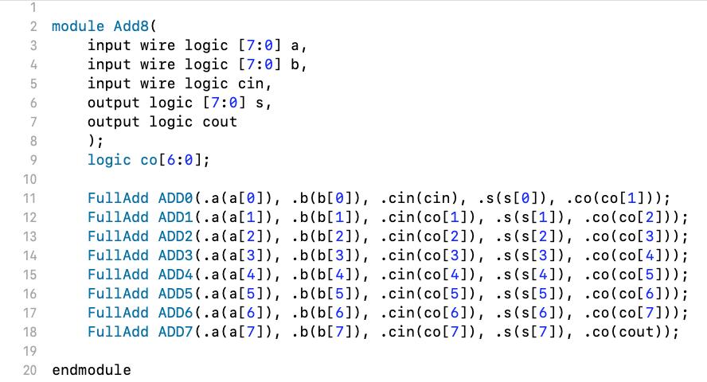
Common Errors
Signal order is wrong
Output = Input
co[7]

Slide 3
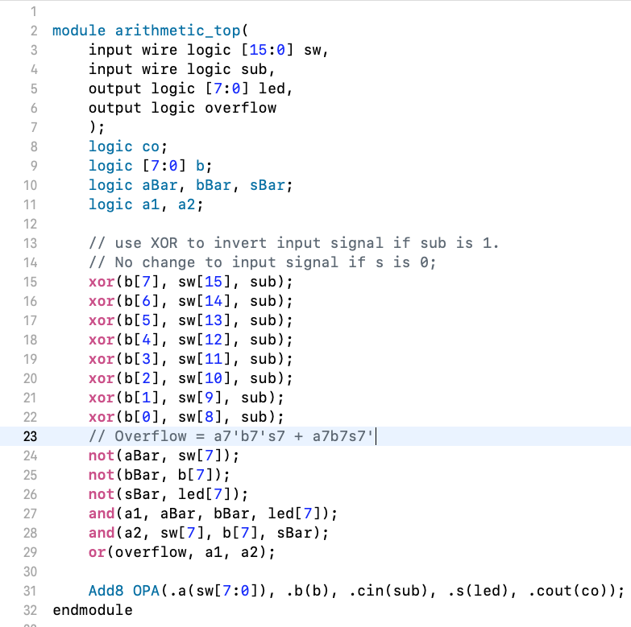
wrong module name: Arithmetic_Top or
wrong signal name: Sw that do not match testbench
missing “wire”, wrong width [0:15] or sw[15:0]
Input and output swapped
add redundant output co: mismatch w/ testbench
wrong width [15:8] or b[7:0]
logic overflow;
declare the same signal twice
wrong B sign bit – should not be sw[15]
wrong B sign bit – should not be sw[15]
wrong b – should not be sw[15:8]

Slide 4
Lab 4
2's complement binary addition, subtraction, and overflow detection
2's complement binary adder
Hierarchical design
Testbench to validate the design

Slide 5
2’s Complement Binary to Decimal
10000100 -124
00011001 25
Negate 2’s Complement Binary
01111100 124
11100111 -25
2’s Complement Binary Addition
10000100 (-124) + 01100100 (100) = 11101000 = -24
01111111 (127) + 10011001 (-103) = 00011000 = 24
01111111 (127) + 01100111 (103) = 11100110 Overflow
00011010 (26) + 01001001 (73) = 01100011 = 99
11100110 (-26) + 10110111 (-73) = 10011101 = -99
10000100 (-124) + 10011001 (-103) = 00011101 Overflow
2’s Complement Binary Subtraction
10000100 (-124) - 01100100 (100) = 00100000 Overflow
01111111 (127) - 10011001 (-103) = 11100110 Overflow
01111111 (127) - 01100111 (103) = 00011000 = 24
00011010 (26) - 01001001 (73) = 11010001 = -47
11100110 (-26) - 10110111 (-73) = 00101111 = 47
10000100 (-124) - 10011001 (-103) = 11101011 = -21
sw = 0110010010000100
sw = 1001100101111111
sw = 0110011101111111
sw = 0100100100011010
sw = 1011011111100110
sw = 1001100110000100
sw = 0110010010000100
sw = 1001100101111111
sw = 0110011101111111
sw = 0100100100011010
sw = 1011011111100110
sw = 1001100110000100

Slide 6
2’s Complement Binary to Decimal
00011001 ->
10000100 ->

Slide 7
Sign Extension from 8 bits to 9 bits
10000100 ->
00011001 ->
110000100
000011001

Slide 8
Negate 2’s Complement Binary
+103
01100111 ->
10011000 + 1 =
10100100 ->
01011011 + 1 =
10011001
-103
-92
01011100
+92

Slide 9
Addition of Two 2’s Complement Numbers
10000100
+ 00111111
11000011
-124
63
-61
01100111
+ 10100100
00001011
+103
- 92
+ 11

Slide 10
Subtraction of Two 2’s Complement Numbers
10000100
- 10011001
10000100
+ 01100111
11101011
-124
-124
-103
+103
- 21
-21
01100111
- 11101011
01100111
+ 00010101
01111100
+103
+103
- 21
+ 21
+124
+124

Slide 11
Full Adder Derivation
A | B | C_{in} | C_{out} | S
0 | 0 | 0 | 0 | 0
0 | 0 | 1 | 0 | 1
0 | 1 | 0 | 0 | 1
0 | 1 | 1 | 1 | 0
1 | 0 | 0 | 0 | 1
1 | 0 | 1 | 1 | 0
1 | 1 | 0 | 1 | 0
1 | 1 | 1 | 1 | 1
C_{out} = A’BC_{in}+ AB’C_{in} + A BC_{in}’+ ABC_{in}
= A’BC_{in}+ ABC_{in}
+ AB’C_{in} + ABC_{in}
+ A BC_{in}’+ ABC_{in}
= BC_{in} + AC_{in} + AB
S = A’B’C_{in} + A’BC_{in}’+ AB’C_{in}’ + ABC
= A ⊕ B ⊕ C

Slide 12
Single-bit Full Adder
A_{i}
B_{i}
S_{i}
A_{i}
B_{i}
C_{i}
A_{i}
C_{i+1}
Full
Adder
C_{i}
B_{i}
B_{i}
C_{i+1}
C_{i}
S_{i}
A_{i}
C_{i}

Slide 13
Single-Bit Full Adder
module FullAdd(
input wire logic a,
input wire logic b,
input wire logic cin,
output logic s,
output logic co
);
…….
endmodule
A | B | C_{in} | C_{out} | S
0 | 0 | 0 | 0 | 0
0 | 0 | 1 | 0 | 1
0 | 1 | 0 | 0 | 1
0 | 1 | 1 | 1 | 0
1 | 0 | 0 | 0 | 1
1 | 0 | 1 | 1 | 0
1 | 1 | 0 | 1 | 0
1 | 1 | 1 | 1 | 1
Use structural SV to build a single-bit full adder.
Create a tcl file to perform simulation on your design for all 8 possible input conditions.

Slide 14
8-Bit Adder
module Add8(
input wire logic [7:0] a,
input wire logic [7:0] b,
input wire logic cin,
output logic [7:0] s,
output logic co
);
…….
endmodule
Use SV hierarchy to combine eight single-bit adders to one 8-bit adder.
S₇
S₆
S₅
S₄
S₃
S₂
S₁
S₀
co
Full Adder
C₇
Full Adder
C₆
Full Adder
C₅
Full Adder
C₄
Full Adder
C₃
Full Adder
C₂
Full Adder
C₁
Full Adder
cin
A₇ B₇
A₆ B₆
A₅ B₅
A₄ B₄
A₃ B₃
A₂ B₂
A₁ B₁
A₀ B₀

Slide 15
8-Bit Adder
S₇
S₆
S₅
S₄
S₃
S₂
S₁
S₀
co
Full Adder
C₇
Full Adder
C₆
Full Adder
C₅
Full Adder
C₄
Full Adder
C₃
Full Adder
C₂
Full Adder
C₁
Full Adder
cin
A₇ B₇
A₆ B₆
A₅ B₅
A₄ B₄
A₃ B₃
A₂ B₂
A₁ B₁
A₀ B₀
Refer to Chapter 11 how to use SV hierarchy.
Simulate your design with a new tcl file that assign all 8 bits with single add-force command.
For example, add_force cin 0
add_force a 10001010
add_force b 00001010
run 10 ns

Slide 16
1. Adding a positive binary number to a negative binary number.
2. Adding two positive binary numbers without overflow.
3. Adding two positive binary numbers with overflow.
4. Adding two negative binary numbers without overflow.
5. Adding two negative binary numbers with overflow.

Slide 17
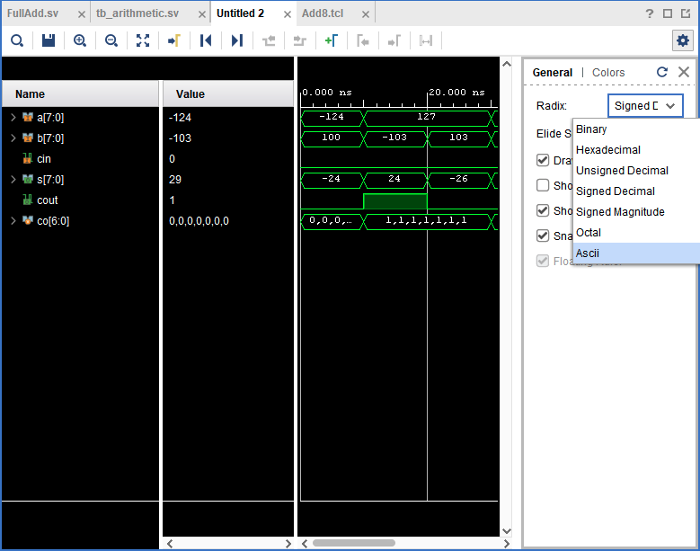

Slide 18
No Overflow Detection
S₇
S₆
S₅
S₄
S₃
S₂
S₁
S₀
co
Full Adder
C₇
Full Adder
C₆
Full Adder
C₅
Full Adder
C₄
Full Adder
C₃
Full Adder
C₂
Full Adder
C₁
Full Adder
cin
A₇ B₇
A₆ B₆
A₅ B₅
A₄ B₄
A₃ B₃
A₂ B₂
A₁ B₁
A₀ B₀
This 8-bit adder does not have overflow detection function. You will have to examine the simulation output to determine if there is overflow.
Show a TA your Tcl script for the FullAdd module tests all possible combinations.
Show a TA your simulation for your Add8 module and explain how you know your circuit is correct and how you know whether overflow occurred.

Slide 19
10000100 -124
00011001 25
01111100 124
11100111 -25
10000100 (-124) + 01100100 (100) = -24
01111111 (127) + 10011001 (-103) = 24
01111111 (127) + 01100111 (103) = Overflow
00011010 (26) + 01001001 (73) = 99
11100110 (-26) + 10110111 (-73) = -99
10000100 (-124) + 10011001 (-103) = Overflow
10000100 (-124) - 01100100 (100) = Overflow
01111111 (127) - 10011001 (-103) = Overflow
01111111 (127) - 01100111 (103) = 24
00011010 (26) - 01001001 (73) = -47
11100110 (-26) - 10110111 (-73) = 47
10000100 (-124) - 10011001 (-103) = -21

Slide 20
led[7:0]
✘
overflow
8
arithmetic_top
Overflow Detector 2
✘
8
c7
s[7:0]
Add8
co
co
cin
Sub
s[7]
b[7:0]
a[7:0]
Overflow Detector 1
b[7]
8
8
a[7]
Invert?
sw[15:8]
sw[7:0]
overflow
16
sw[15:0]

Slide 21
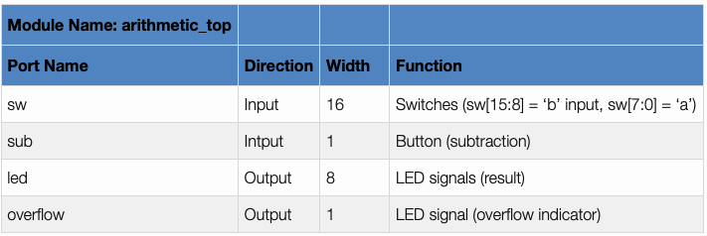
Top-Level Design
Build a top-level module that instances your 8-bit adder module.
Connect sub to cin of the Add8 module.
Include logic gates to negate B if sub is 1.
Include logic gates to detect overflow.

Slide 22
Detecting Overflow
2’s Complement overflow occurs if:
Adding two positive numbers gives a negative result
Adding two negative numbers gives a positive result
2’s Complement overflow can never occur when:
Adding a positive and a negative number together
overflow = A[7]B[7]S[7]’ + A [7]’B[7]’S[7];
Detect overflow by looking at the signs

Slide 23
module arithmetic_top(
input wire logic [15:0] sw,
input wire logic sub,
output logic [7:0] led,
output logic overflow
);
…
overflow = ABS’ + A’B’S;
Add8 OPA(.a(?), .b(?), .cin(?), .s(?), .cout(?));
endmodule
You should use the .port(wire) way of mapping ports on instances to your wires (see Program 11.1.2 in the textbook).

Slide 24
What is missing?
Use the sub signal to determine if the second operand must be inverted.
Use the sub signal (0 for addition and 1 for subtraction) to complete negating the second operand.
sub | any bit from B | Invert?
0 | 0 | 0
0 | 1 | 1
1 | 0 | 1
1 | 1 | 0

Slide 25
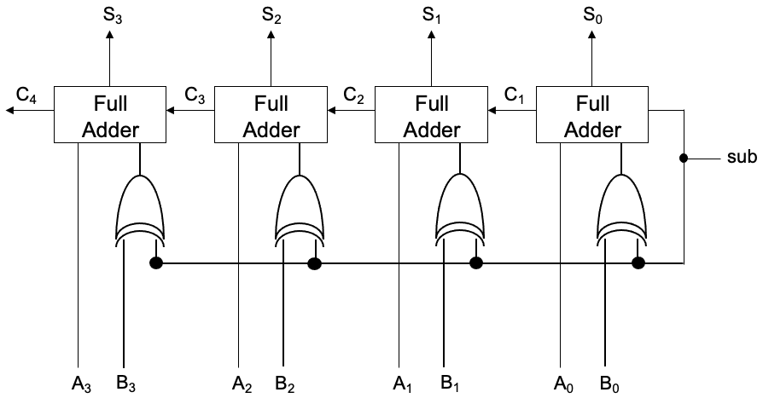

Slide 26
Testbench
TCL is not convenient for testing complex digital circuits.
Testbenches are SystemVerilog files that are used to test your circuit and are not used for designing new logic circuits.
You will be given a SystemVerilog testbench file that will test your circuit for all future labs.

Slide 27
Adding a Testbench and Simulating with a Testbench
Add the testbench as simulation source.
Select the testbench and Set As Top.
Run Behavioral Simulation.
Enter “run all” in Tcl Console.
Make sure 0 errors.
Check simulation result to debug your circuit.

Slide 28
Synthesis, Implementation, Bit File
Create and add XDC constraints file
Synthesize
Implement
Download the bit file.

