Slide 1
ygrader A Python package to help automate grading
Jeff Goeders

Slide 2
ygrader
Used to help automate grading (or any other processing) of student submissions on LearningSuite (or Github).
What does ygrader do?
Reads in a CSV file with student grades + ZIP of submissions.
Matches submissions to students.
For each student (or group) that needs a grade:
Gets their (latest) submission
Extracts their files to a temporary directory.
Calls your callback function where you can do anything you want with the student’s submission, then return a grade.
CSV is updated with student(s) grade.

Slide 3
ygrader
Learning Suite
export
Empty CSV of grades
Zip of all student submissions
Your Python grader software
Student name, netid, section, etc.
Directory with submitted files
Callback Function
(used to grade
each student)
ygrader
Grade for assignment
CSV of grades
Learning Suite
import

Slide 4
Major Features
Supports “fully automated” grading
Make your callback return the student grade and it will automatically be recorded
You can run arbitrary Python code in your callback:
Build and run student software, run MATLAB, run SPICE, check for program outputs, etc.
Supports “partially automated” grading
If your callback doesn’t return a grade, the program will prompt for one.
You or TAs can run/view student submission and subjectively choose a grade.
Supports group-based assignments
Not just for grading
Useful for running analysis on student submissions (ie, run all code through plagiarism checker)
Pause (Ctrl+C) and resume grading at any time.

Slide 5
Install
pip3 install ygrader
Or, if you want to use the source code:
https://github.com/byu-cpe/ygrader
Notes:
In software, one thing changes at a time.
Can’t see everything

Slide 6
What do you need to do?
Create your callback function that will perform grading
Instance a ygrader.Grader object, configure it, and then run!

Slide 7
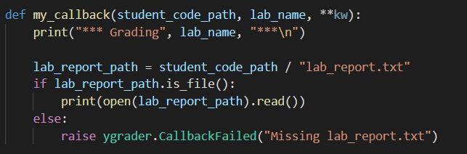
Simple Callback Example
This code looks for a submitted file called “lab_report.txt” and prints its contents
If it’s missing, an exception is thrown.

Slide 8
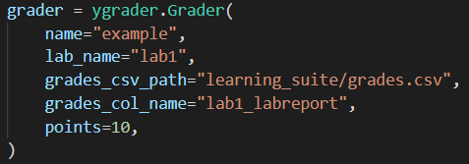
Instance Grader Object
Name for this grading project
Name for this assignment (useful if your project can grade multiple different assignments)
Path to CSV with grades, and column name in CSV where grades should be put.
Maximum possible points for this assignment.

Slide 9
Set Callback Function

Slide 10
Set Submission System
ygrader supports student submissions from LearningSuite or Github Classroom, so you have to configure it appropriately:
Path to ZIP of student submissions

Slide 11

Run it!

Slide 12
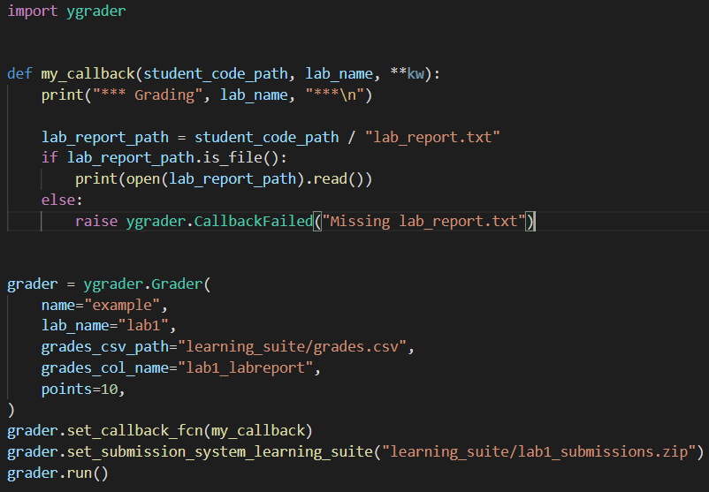
Putting it all together:

Slide 13
Running this Example
This example is available at github.com/byu-cpe/ygrader-example
Program output on next slide:

Slide 14
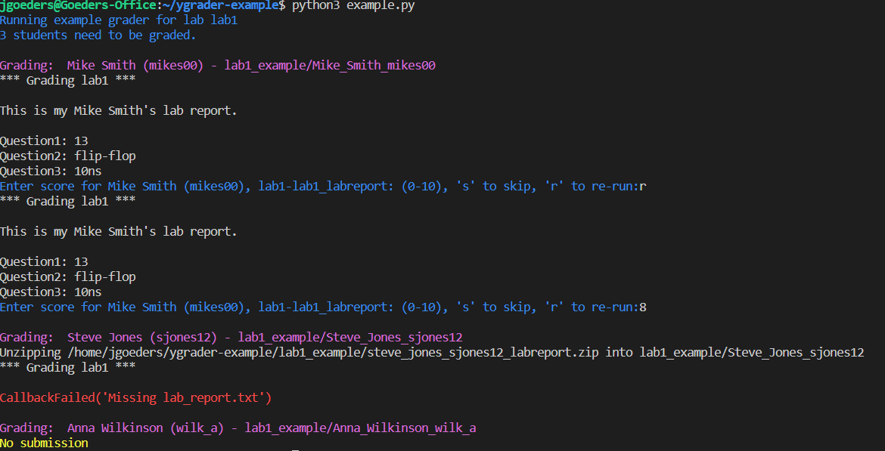
# of students who need to be graded.
Callback run for 1st student
Grader chooses to re-run 1st student
Grader enters score
2nd student is missing correct file
3rd student has no submission

Slide 15
Documentation
https://byu-pygrader.readthedocs.io/en/latest/

