Slide 1
Key-Value Databases

Slide 2
Keys and Values
A variety of key-value databases are available to developers, and they all share three essential features:
  Simplicity
  Speed
  Scalability
Applications require a variety of different values, but most operations only need primary key access to data
  best seller lists, shopping carts, customer preferences, session management, sales rank, and product catalog
  Database system doesn’t need to know about the data
  Store anything you want in the data
Most systems use a hash function on the keys so the key can be more flexible
  String, object, etc.

Slide 3
Assumptions
Query Model
  Primary key access to blobs
  No operations span multiple data items
  Not relational
  Relatively small
ACID
  Systems that provide ACID guarantees tend to have poor availability
  Key-Value databases generally target weaker consistency
  No isolation guarantees
Efficiency
  Commodity hardware
  Stringent latency requirements
  Consistently achieve latency and throughput requirements

Slide 4
System Interface
Get(key)
  Locate the object replicas
  Return a single object or list of objects with conflicting versions/timestamps
Put(key, object)
  Determine where object goes based on the key
  Write replicas
Delete(key)
Both key and object are just bytes
  Note that the key is determined by the application

Slide 5
Keys and Values
Key
  Unique identifier for the value
  At a minimum, a key is a string of characters
  Redis allows strings, lists, sets, sorted sets, hashes, and bit arrays as keys
  Typically, the key is hashed into the distributed hash table to find the location of the data
Values
  Blob
Namespace
  Collection of key-value pairs
  Defines an additional prefix for keys
  Example: ComputerScience:keyname Statisitics:keyname
  Allows for use of the same keyname in each namespace

Slide 6
Designing for Key-Value Databases
When you design an application that uses a key-value database, you should consider several factors, including
  How to structure keys
  What types of information you want to capture in values
  How to compensate for limitations of key-value databases
  How to introduce abstractions that help create higher-level organizational structures than simple key-value pairs

Slide 7
Keys
Keys should follow a naming convention
  Adds structure to the database
General guidelines.
  Use meaningful and unambiguous naming components, such as 'cust' for customer or 'inv' for inventory.
  Use range-based components when you would like to retrieve ranges of values. Ranges include dates or integer counters.
  Use a common delimiter when appending components to make a key. The ‘:’ is a commonly used delimiter, but any character that will not otherwise appear in the key will work.
  Keep keys as short as possible without sacrificing the other characteristics mentioned in this list.
A well-designed key pattern helps minimize the amount of code a developer needs to write to create functions that access and set values.

Slide 8
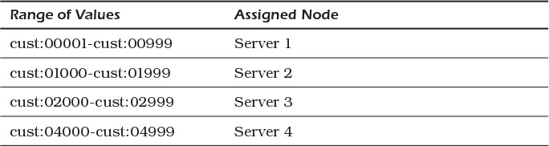
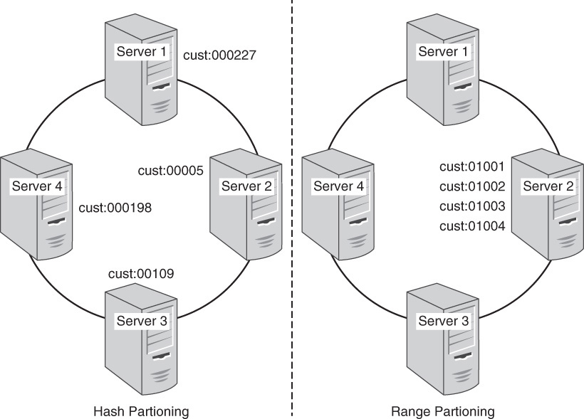
Keys and Partitioning
Remember that the key will most likely be used for partitioning the data
Depending on key structure and partitioning algorithm data can end up on different nodes and yield different load balancing

Slide 9
Values
Structured or Simple?
Simple
  Much like a table column
  Single value
  Key is structured for accessing the data
    Customer:1234:name
    Customer:1234:address
Structured
  Value is a blob which contains structured data
  Customer:1234:nameAddr = { 'Jane Anderson' ,
  '39 NE River St. Portland, OR 97222'}

Slide 10
Values
Structured or Simple? Which is best?
  It depends
Consider your queries.
  How often do you ask for more than one value for a given customer?
Cost and performance are mostly determined by the number of queries
  Disk seek and read time
  Latency vs. bandwidth
  But be careful!

Slide 11
Remember
Lookup is by key only
  Some databases have added limited forms of value search like a text search
No support for range queries
  Unless you somehow design it into your key
  Most likely still requires multiple queries
No standard query language
  Get(key)
  Set(key, value)
  Delete(key)

Slide 12
Design Patterns
Emulating Tables
Aggregates
Atomic Aggregates
Enumerable Keys
Range Keys

Slide 13


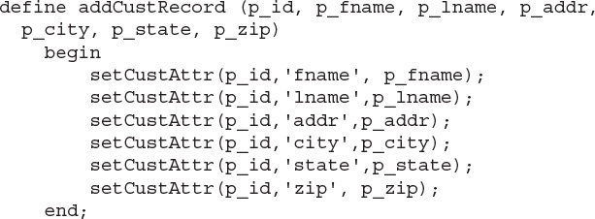
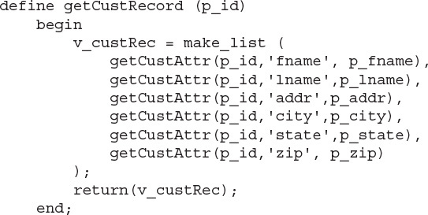
Emulating Tables
Key-Value Databases do not support tables, but…
Use the key to indicate table structure
  Add a consistent separator to build up the key
  Example: Tablename:Key:Field → cust:1234:fname
Use string operations to build the key
Define higher level functions for getting and setting “rows” and ”columns”

Slide 14
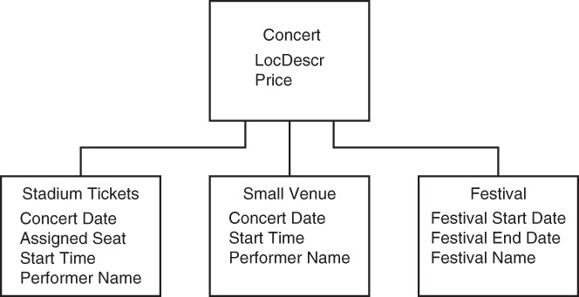
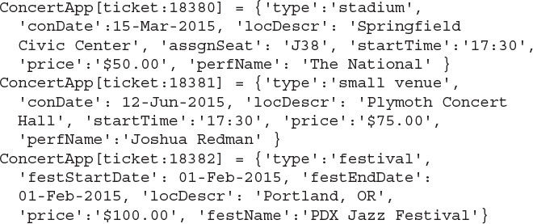
Aggregates
Inheritance and subtype relationships
In relational databases, we used partitioning methods
  Horizontal partitioning
  Vertical partitioning
  Unification
Mostly, we were concerned with eliminating redundancy and nulls
Key-Value databases are much more flexible
  Use a structured value
  Add a type field
  Add only those fields that are necessary for that type

Slide 15
Atomic Aggregates - Enumerable Keys – Range Keys
Atomic Aggregates
  Akin to a transaction
    But we can’t do ACID transactions
  Value contains structured data that must all be updated at once or not at all
    Single Set operation will set all the values
Enumerable Keys
  Key contains some sort of enumerable value
  Example – ticketLog:9888
  Or maybe better – ticketLog:20211102:58
    Date is encoded so we can lookup tickets sold on a particular day
Range Keys
  Key with a value to indicate range of another key
  Example ticketLogRange:20211102 = {“min”: 0, “max”:256}

Slide 16
Dynamo: Amazon’s Highly Available Key-value Store
https://www.allthingsdistributed.com/files/amazon-dynamo-sosp2007.pdf

Slide 17
Dynamo Goals
Reliability
Always-on
Even the slightest outage has significant financial consequences
Scalability
customers should be able to view and add items to their shopping cart even if disks are failing, network routes are flapping, or data centers are being destroyed by tornados.
Always have failures

Slide 18
Dynamo
Many operations only need primary key access to data
  best seller lists, shopping carts, customer preferences, session management, sales rank, and product catalog
Dynamo uses a synthesis of well known techniques to achieve scalability and availability: Data is partitioned and replicated using consistent hashing [10], and consistency is facilitated by object versioning [12]. The consistency among replicas during updates is maintained by a quorum-like technique and a decentralized replica synchronization protocol. Dynamo employs a gossip based distributed failure detection and membership protocol. Dynamo is a completely decentralized system with minimal need for manual administration. Storage nodes can be added and removed from Dynamo without requiring any manual partitioning or redistribution.

Slide 19
Assumptions
Query Model
  Primary key access to blobs
  No operations span multiple data items
  Not relational
  Relatively small
ACID
  Systems that provide ACID guarantees tend to have poor availability
  Dynamo targets weaker consistency
  No isolation guarantees
Efficiency
  Commodity hardware
  Stringent latency requirements
  Consistently achieve latency and throughput requirements

Slide 20
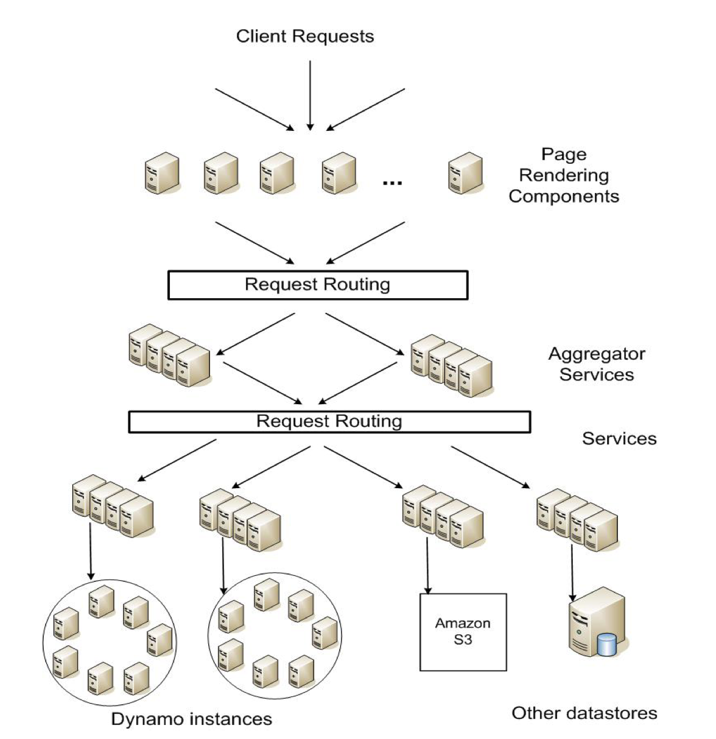
Service Level Agreements
  Average, median, and expected variance
  System must meet agreement
If the system performance is not meeting the agreements, we must be able to scale the system to the point it does meet the SLA

Slide 21
Design Considerations
Data consistency and replication tradeoffs
  Strong consistency and high data availability cannot be achieved simultaneously
Availability can be increased by using optimistic replication
  Changes are allowed to propagate to replicas in the background
  Eventually consistent
Conflict resolution
  When?
    Reads or writes?
    Dynamo is “always writeable” – even in the presence of server failures
    Conflict resolution happens on reads
  Who?
    Data store or application?
    Data store can only use simple policies – last write wins etc.
    Application can do better → merge

Slide 22
Design Considerations
Symmetry
  Every node is the same
Decentralization
  Peer to peer
  No centralized control
Heterogeneity
  Work should be proportional to capabilities

Slide 23
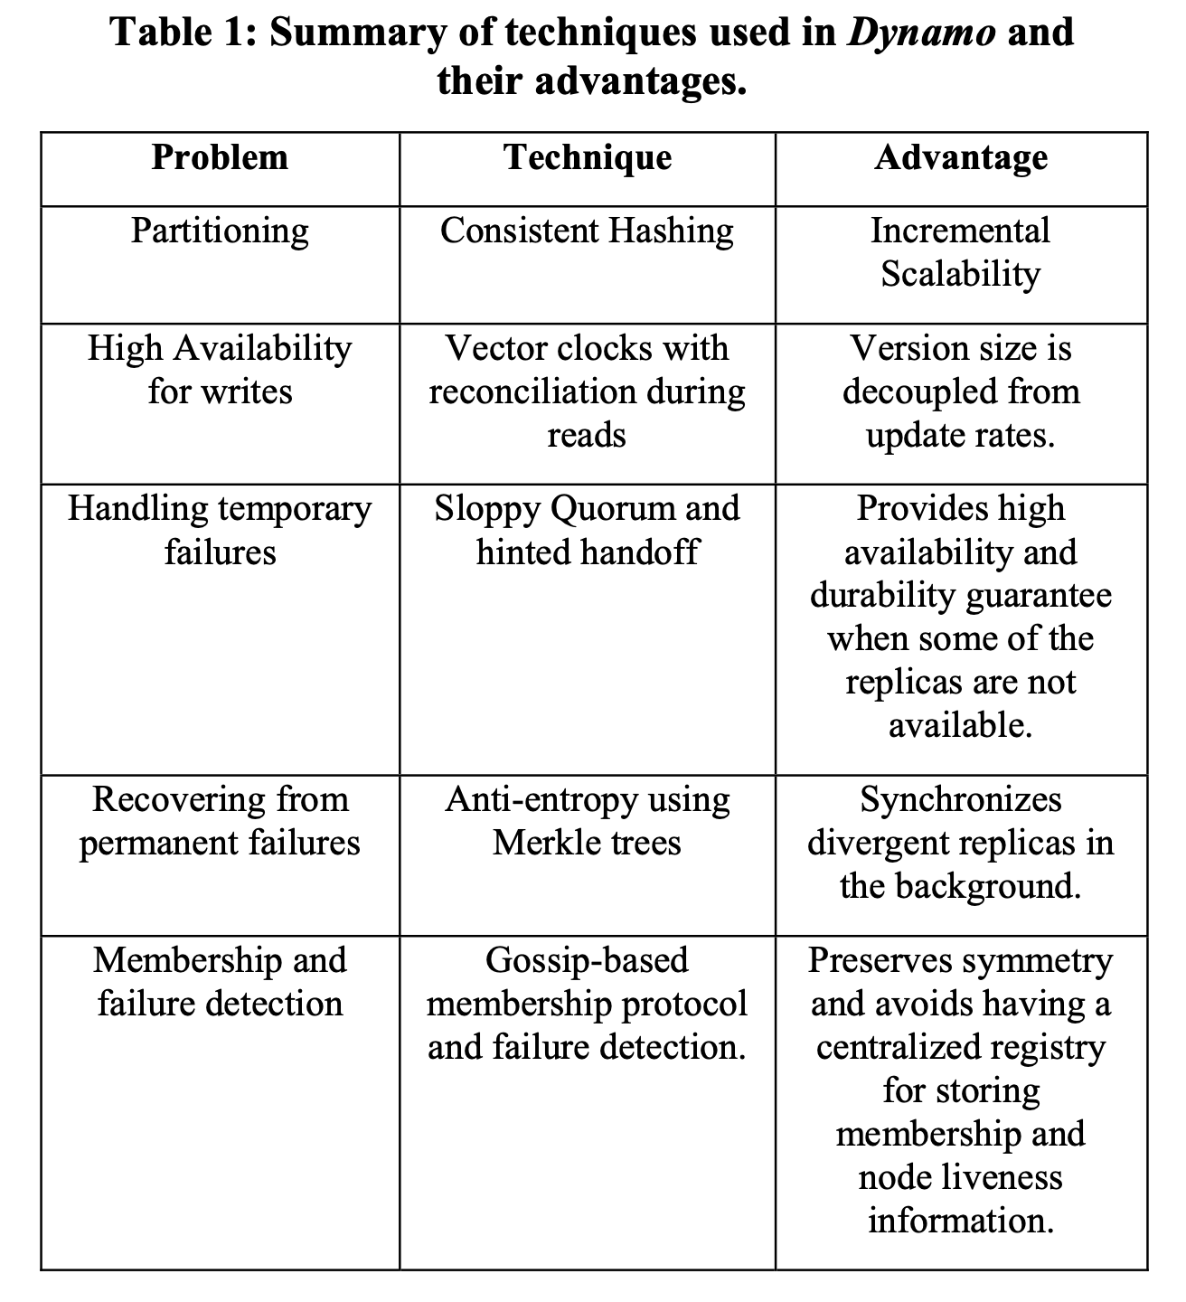

Slide 24
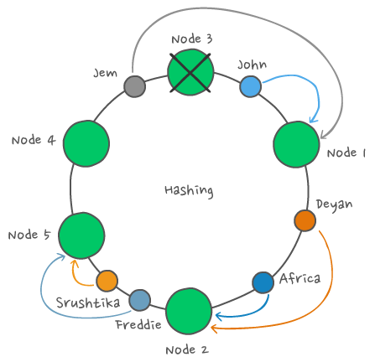
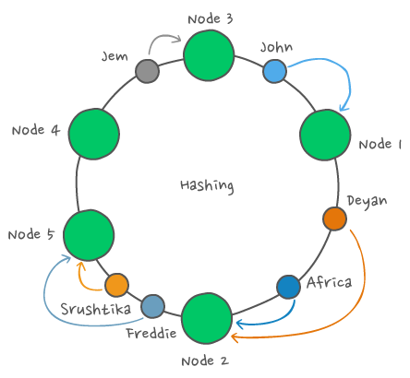
Partitioning
Consistent Hashing with virtual nodes
Departure or arrival of a node only affects its immediate neighbors and other nodes remain unaffected.

Slide 25
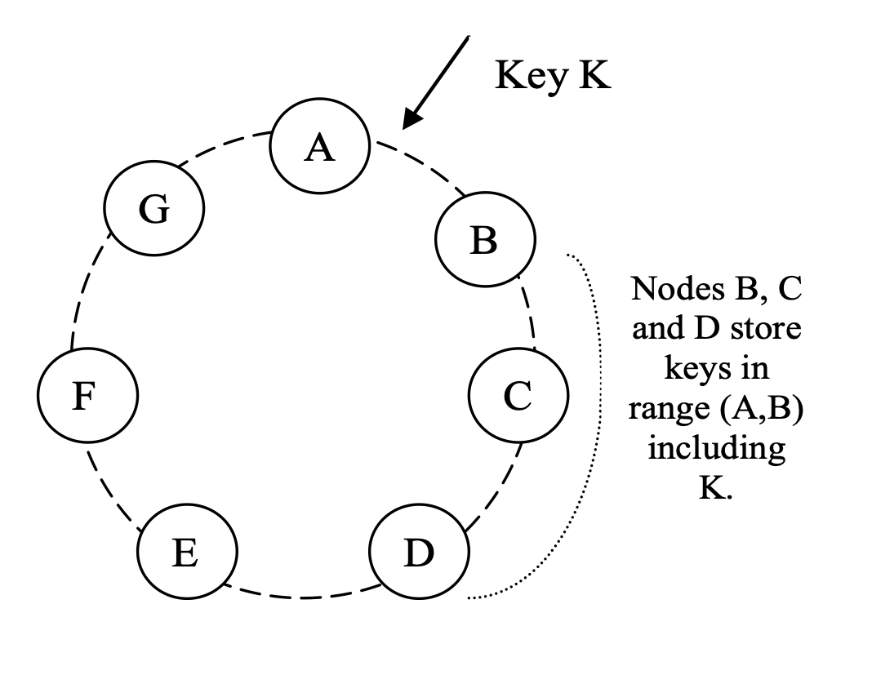
Replication
Primary location determined by consistent hashing
  Key K will be stored on Node B
Replicas go to next nodes in the ring
  Not virtual
If Replication factor N = 3, Node D will store the keys that fall in the ranges (A, B], (B, C], and (C, D]

Slide 26
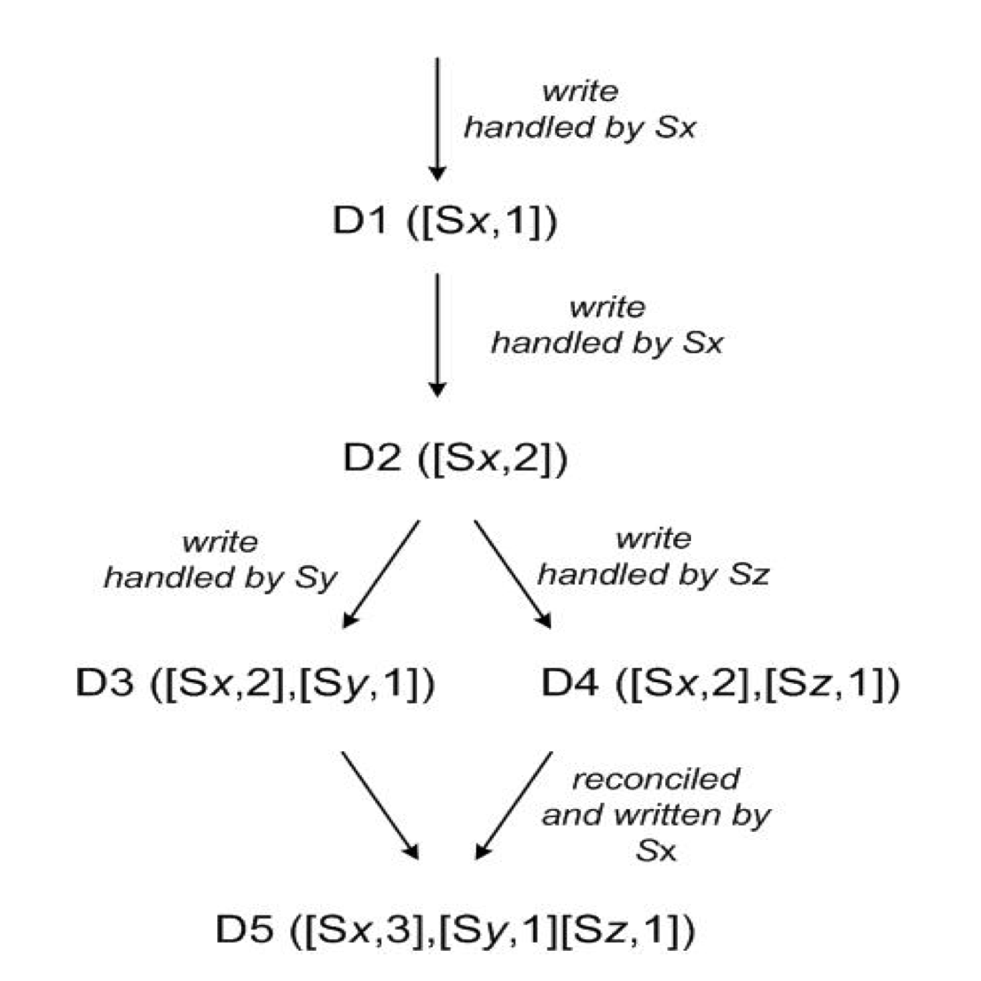
Data Versioning
Eventual Consistency
Each modification has a new and immutable version of the data
Version branching may happen, in the presence of failures combined with concurrent updates, resulting in conflicting versions of an object.
Vector clocks
  If the counters on the first object’s clock are less-than-or-equal to all of the nodes in the second clock, then the first is an ancestor of the second and can be forgotten. Otherwise, the two changes are considered to be in conflict and require reconciliation.

Slide 27
Execution of Operations
Any node
  Auto load balancer or partition aware client
Upon receiving a put() request for a key, the coordinator generates the vector clock for the new version and writes the new version locally. The coordinator then sends the new version (along with the new vector clock) to the N highest-ranked reachable nodes. If at least W-1 nodes respond then the write is considered successful.
Similarly, for a get() request, the coordinator requests all existing versions of data for that key from the N highest-ranked reachable nodes in the preference list for that key, and then waits for R responses before returning the result to the client. If the coordinator ends up gathering multiple versions of the data, it returns all the versions it deems to be causally unrelated. The divergent versions are then reconciled and the reconciled version superseding the current versions is written back.
Client
Replication Factor
N = 3
Get(John)

Slide 28
Hinted Handoff
Replication Factor
N = 3
Consider the example of Dynamo configuration given in Figure 2 with N=3. In this example, if node A is temporarily down or unreachable during a write operation then a replica that would normally have lived on A will now be sent to node D.
  Node A’s replication set would be A,B,C –> D is one beyond
This is done to maintain the desired availability and durability guarantees. The replica sent to D will have a hint in its metadata that suggests which node was the intended recipient of the replica (in this case A). Nodes that receive hinted replicas will keep them in a separate local database that is scanned periodically. Upon detecting that A has recovered, D will attempt to deliver the replica to A. Once the transfer succeeds, D may delete the object from its local store without decreasing the total number of replicas in the system.
When node A fails,
Hinted handoff goes to D
1 step beyond replica set
Keeps #replicas consistent

Slide 29
Hinted Handoff
Ensures that read and write operations are not failed due to temporary node or network failures
It is imperative that a highly available storage system be capable of handling the failure of an entire data center(s).
Dynamo is configured such that each object is replicated across multiple data centers. In essence, the preference list of a key is constructed such that the storage nodes are spread across multiple data centers.

Slide 30
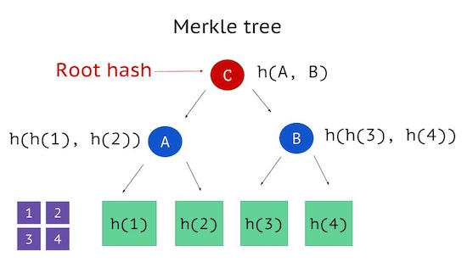
Replica Inconsistency
Merkle Tree
  Leaves are hashes of individual keys
  Parents are hashes of their children
If the hash values of the root of two trees are equal, then the values of the leaf nodes in the tree are equal and the nodes require no synchronization.
If not, it implies that the values of some replicas are different. In such cases, the nodes may exchange the hash values of children and the process continues until it reaches the leaves of the trees, at which point the hosts can identify the keys that are “out of sync”.

Slide 31
Membership & Failure Detection
Outages are considered transient and shouldn’t result in rebalance
Administrator or System must issue a command to add/remove nodes
  Happens on one node – gossiped to the rest
Failure is determined when a node doesn’t respond to messages
  Considered transient – periodically check back
Explicit add/remove eliminates need for global failure state

Slide 32
Implementation
Written in Java
Pluggable persistence
  Berkeley Database (BDB)
  BDB Java Edition
  MySQL
  In memory buffer with persistent backing
Built on top of event-driven messaging

Slide 33
Lessons Learned
Reconciliation patterns
  Business logic specific
    shopping cart → merge
  Timestamp based
    Customer session information → Last write wins
  High performance read
    Product catalog → get only the first replica that responds because all are the same
Clients can tune parameters to fit their needs
  N – number of replicates
  R – number of responses for a read
  W – number of responses for a write
  Commonly (3,2,2)

Slide 34
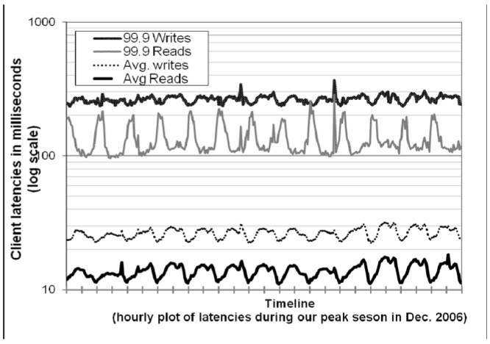
Performance
Typical SLA requires 99.9% of reads and writes within 300 ms
Note: difference between avg and 99.9
  High variability
Can tune for higher performance
  tradeoffs

Slide 35
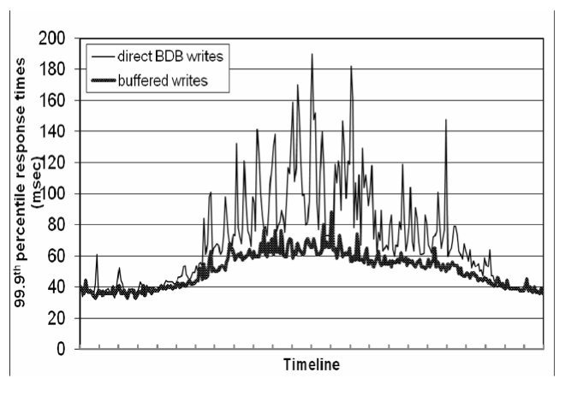
Optimization – Buffered Writes
Performance – Durability tradeoff
  Write to memory
  Periodically write to disk
Lowered 99.9% latency by a factor of 5
To reduce the durability risk, the write operation is refined to have the coordinator choose one out of the N replicas to perform a “durable write”. Since the coordinator waits only for W responses, the performance of the write operation is not affected by the performance of the durable write operation performed by a single replica.

Slide 36
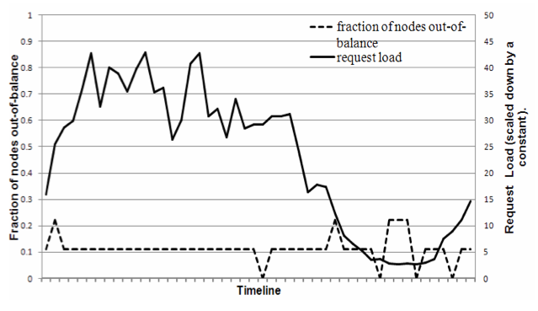
Load Balance
During high loads balance is pretty good
Low loads can cause imbalance
Why?

Slide 37
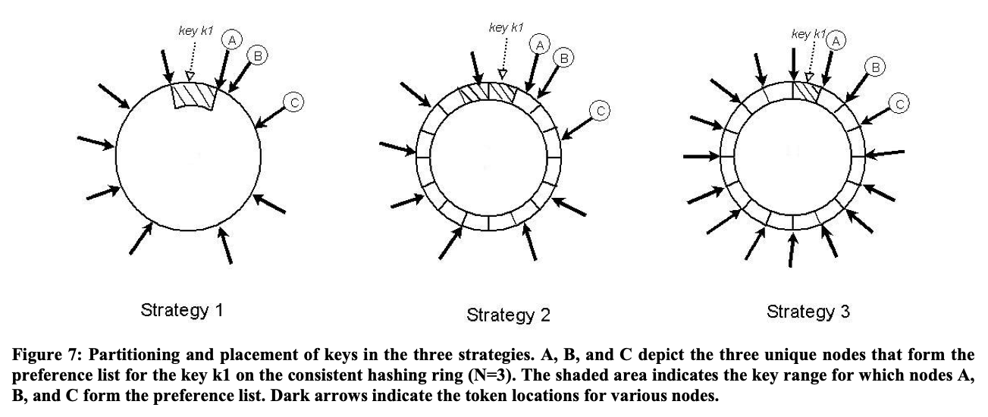
Partition by node position
Basic Consistent Hashing
Consistent Hashing with equal size partitions
Key is stored on first N nodes encountered when walking the ring from the end of the partition
Equal size partitions with
moving the consistent hashing
locations

Slide 38
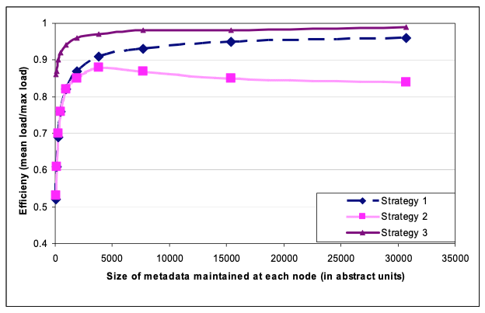

Slide 39
Performance takeaways
Basic Consistent Hashing (Strategy 1) does pretty good
Strategy 3 does better because of equal size partitions
  Better load balance
Strategy 2 doesn’t do well because it must keep track of more information
  Equal size partitions and hash locations and mapping

Slide 40
Client or Server driven coordination?
Server driven
  Client can talk to anyone
  Load is directed by a load balancing system
  Request is then forwarded to appropriate nodes
Client driven
  Client periodically requests state of the system
    Nodes and locations etc.
  Client then can talk directly to the appropriate nodes
  Avoid the extra network hop
  Depends on how fresh the information is
    Currently clients poll every 10 seconds

Slide 41
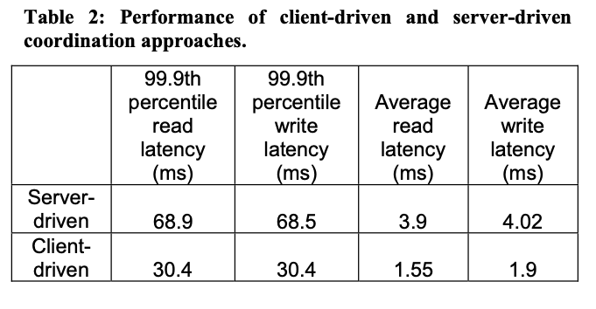

Slide 42
Discussion
Many Amazon internal services have used Dynamo for the past two years and it has provided significant levels of availability to its applications. In particular, applications have received successful responses (without timing out) for 99.9995% of its requests and no data loss event has occurred to date.
The primary advantage of Dynamo is that it provides the necessary knobs using the three parameters of (N,R,W) to tune their instance based on their needs.
For new applications that want to use Dynamo, some analysis is required during the initial stages of the development to pick the right conflict resolution mechanisms that meet the business case appropriately.
Gossip model works well for hundreds of nodes but might be a problem for thousands of nodes

