Slide 1
MongoDB Sharding

Slide 2
Partitioning
User defines shard key
Shard key defines range of data
Key space is like points on a line
Range is a segment of that line

Slide 3
Data Distribution
Initially 1 chunk
Default max chunk size: 64mb
MongoDB automatically splits & migrates chunks when max reached

Slide 4
Routing and Balancing
Queries routed to specific shards
MongoDB balances cluster
MongoDB migrates data to new nodes

Slide 5
MongoDB Auto-Sharding
Minimal effort required
  Same interface as single mongod
Two steps
  Enable Sharding for a database
  Shard collection within database

Slide 6
What is a Shard?
Shard is a node of the cluster
Shard can be a single mongod or a replica set

Slide 7
Meta Data Storage
Config Server
  Stores cluster chunk ranges and locations
  Can have only 1 or 3 (production must have 3)
  Not a replica set

Slide 8
Routing and Managing Data
Mongos
  Acts as a router / balancer
  No local data (persists to config database)
  Can have 1 or many

Slide 9
Sharding infrastructure

Slide 10
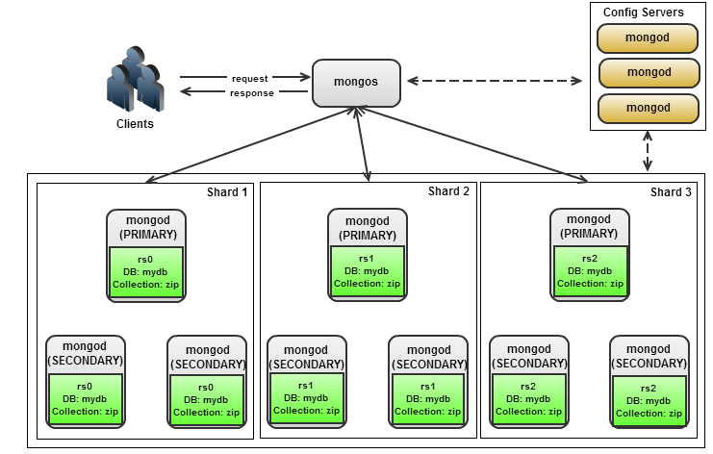
Replica sets

Slide 11
Partitioning
Remember partitioning is based on ranges
Notes:
Quick review from earlier.

Slide 12
Chunk is a section of the entire range

Slide 13
Chunk splitting
A chunk is split once it exceeds the maximum size
There is no split point if all documents have the same shard key
Chunk split is a logical operation (no data is moved)
Notes:
Once chunk size is reached, mongos asks mongod to split a chunk
+ internal function called splitVector()
mongod counts number of documents on each side of split
+ based on avg. document size `db.stats()`
Chunk split is a **logical** operation (no data has moved)
Max on first chunk should be 14

Slide 14
Balancing
Balancer is running on mongos
Once the difference in chunks between the most dense shard and the least dense shard is above the migration threshold, a balancing round starts

Slide 15
Acquiring the Balancer Lock
The balancer on mongos takes out a “balancer lock”
To see the status of these locks:
  use config
  db.locks.find({ _id: “balancer” })
Notes:
Balancer lock actually held on config server.

Slide 16
Moving the chunk
The mongos sends a moveChunk command to source shard
The source shard then notifies destination shard
Destination shard starts pulling documents from source shard
Notes:
Moved chunk on shard2 should be gray

Slide 17
Committing Migration
When complete, destination shard updates config server
  Provides new locations of the chunks
Notes:
How do the other mongoses know that their configuration is out of date?
When does the chunk version on the shard itself get updated?

Slide 18
Cleanup
Source shard deletes moved data
  Must wait for open cursors to either close or time out
  NoTimeout cursors may prevent the release of the lock
The mongos releases the balancer lock after old chunks are deleted

Slide 19
Cluster Request Routing
Targeted Queries
Scatter Gather Queries
Scatter Gather Queries with Sort

Slide 20
Cluster Request Routing: Targeted Query

Slide 21
Routable request received

Slide 22
Request routed to appropriate shard

Slide 23
Shard returns results

Slide 24
Mongos returns results to client

Slide 25
Cluster Request Routing: Non-Targeted Query

Slide 26
Non-Targeted Request Received

Slide 27
Request sent to all shards

Slide 28
Shards return results to mongos

Slide 29
Mongos returns results to client

Slide 30
Cluster Request Routing: Non-Targeted Query with Sort

Slide 31
Non-Targeted request with sort received

Slide 32
Request sent to all shards

Slide 33
Query and sort performed locally

Slide 34
Shards return results to mongos

Slide 35
Mongos merges sorted results
Notes:
The mongos does not have to load the whole set into memory since each shard sorts locally. The mongos can just getMore from the shards as needed and incrementally return the results to the client.

Slide 36
Mongos returns results to client

Slide 37
Shard Key

Slide 38
Shard Key
The choice of shard key affects the creation and distribution of chunks across the available shards. The distribution of data affects the efficiency and performance of operations within the sharded cluster.
The ideal shard key allows MongoDB to distribute documents evenly throughout the cluster while also facilitating common query patterns.
When you choose your shard key, consider:
  the cardinality of the shard key
  the frequency with which shard key values occur
  whether a potential shard key grows monotonically
Sharding Query Patterns
Shard Key Limitations
Notes:
_id could be unique across shards if used as shard key.
we could only guarantee uniqueness of (any) attributes if the keys are used as shard keys with unique attribute equals true

Slide 39
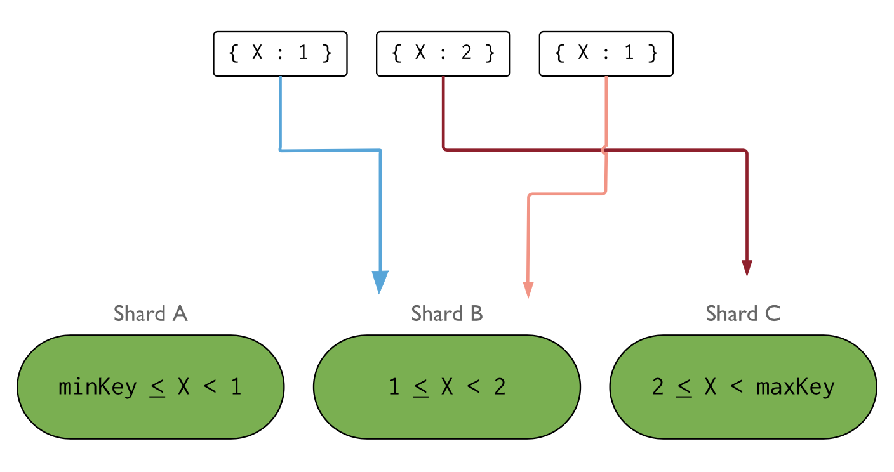
Shard Key Cardinality
The cardinality of a shard key determines the maximum number of chunks the balancer can create.
A shard key with low cardinality reduces the effectiveness of horizontal scaling in the cluster.

Slide 40
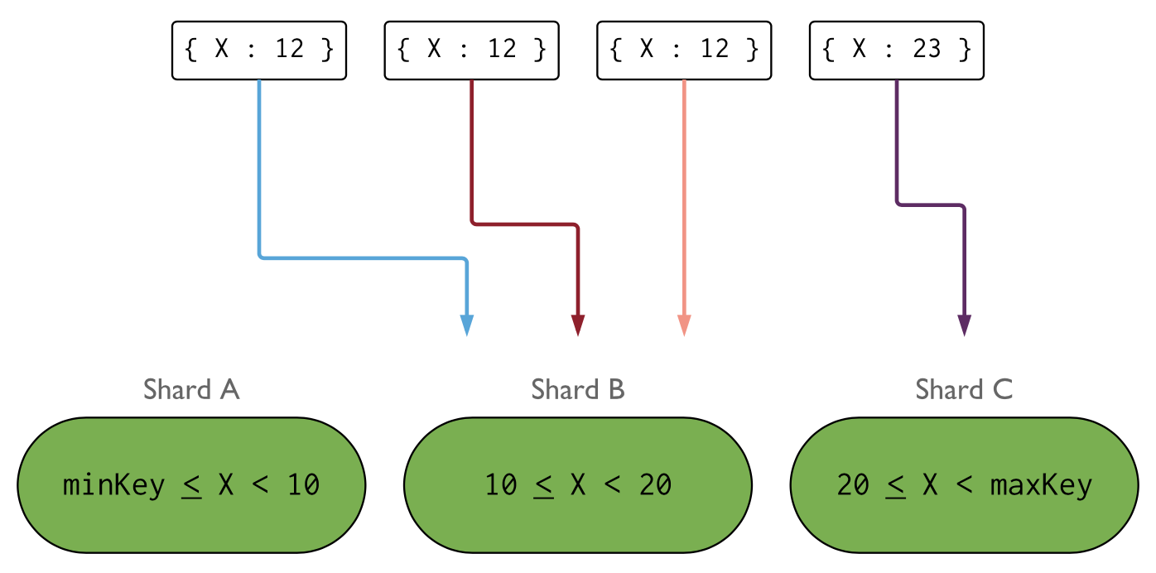
Shard Key Frequency
The frequency of the shard key represents how often a given shard key value occurs in the data.
If the majority of documents contain only a subset of the possible shard key values, then the chunks storing the documents with those values can become a bottleneck within the cluster.

Slide 41
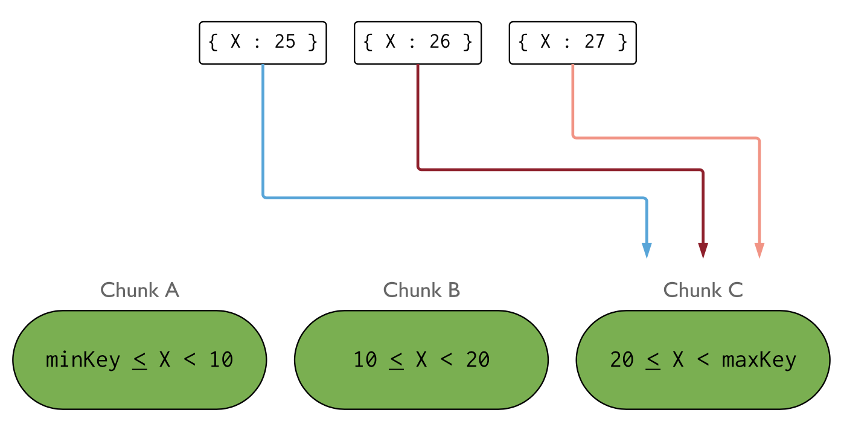
Monotonically Changing Shard Keys
A shard key on a value that increases or decreases monotonically is more likely to distribute inserts to a single chunk within the cluster.

Slide 42
Notes to the presenter
The upcoming section goes into detail about shard key considerations by working through a small example.
This is a large deck, and if you’re pressed for time you might opt to skip this.
However, if you’re delivering the combined sharding talk (meaning there isn’t an advanced sharding talk accompanying this one) it might be worth diving into this briefly for a few minutes.

Slide 43
Example: Email Storage
Most common scenario, can be applied to 90% cases
Each document can be up to 16MB
Each user may have GBs of storage
Most common query: get user emails sorted by time
Indexes on {_id}, {user, time}, {recipients}
{
_id: ObjectId(),
user: 123,
time: Date(),
subject: “...”,
recipients: [],
body: “...”,
attachments: []
}
Notes:
This section can be skipped for the intro talk, but might be good to include if you’re doing the combined sharding talk.

Slide 44
Example: Email Storage
 | Cardinality | Query Isolation | Reliability | Index Locality
Notes:
Reliability = if we lost an entire shard what would be the effect on the system?
For most frequently used/largest indexes, how are they partitioned across shards?

Slide 45
Example: Email Storage
 | Cardinality | Query Isolation | Reliability | Index Locality
_id | Doc level | Scatter/gather | All users affected | Good
Notes:
Reliability = if we lost an entire shard what would be the effect on the system?
For most frequently used/largest indexes, how are they partitioned across shards?

Slide 46
Example: Email Storage
 | Cardinality | Query Isolation | Reliability | Index Locality
_id | Doc level | Scatter/gather | All users affected | Good
hash(_id) | Hash level | Scatter/gather | All users affected | Poor
Notes:
Reliability = if we lost an entire shard what would be the effect on the system?
For most frequently used/largest indexes, how are they partitioned across shards?

Slide 47
Example: Email Storage
 | Cardinality | Query Isolation | Reliability | Index Locality
_id | Doc level | Scatter/gather | All users affected | Good
hash(_id) | Hash level | Scatter/gather | All users affected | Poor
user | Many docs | Targeted | Some users affected | Good
Notes:
Reliability = if we lost an entire shard what would be the effect on the system?
For most frequently used/largest indexes, how are they partitioned across shards?

Slide 48
Example: Email Storage
 | Cardinality | Query Isolation | Reliability | Index Locality
_id | Doc level | Scatter/gather | All users affected | Good
hash(_id) | Hash level | Scatter/gather | All users affected | Poor
user | Many docs | Targeted | Some users affected | Good
user, time | Doc level | Targeted | Some users affected | Good
Notes:
Compound shard key, utilize already existing (used) index, partition chunk for "power" users.
For those users more than one shard *may* need to be queried in a targeted query.
Reliability = if we lost an entire shard what would be the effect on the system?
For most frequently used/largest indexes, how are they partitioned across shards?

