Slide 1
More MongoDB

Slide 2
References
Relational DBMS
  Foreign keys refer to primary keys (or unique attributes)
  Referential Integrity: The referenced primary key must exist
  Join: Very often done on foreign key – primary key
MongoDB: No join
  De-normalized documents: Related data is stored inside the document
  Sometimes the related data is stored in another document
    The document refers to the _id of the other document
Source
  http://stackoverflow.com/questions/6334048/foreign-keys-in-mongo
  http://docs.mongodb.org/manual/reference/database-references/

Slide 3
Insert, using reference
original_id = ObjectId() // make an id
db.books.insert( {
_id : original_id,
title: "My very own book, 1st edition"
})
db.books.insert( {
title: "My very own book, 2nd edition",
prev_edition_id : original_id // refer to the other id
})
ObjectID _id is an autoindexed field. MongoDB uses B-Tree indexes so lookup is on the order of O(log n)

Slide 4
Functions
MongoDB can store functions
  db.system.js.save({ _id: functionName, value: theFunction });
  system.js is a special collection
Programming language: JavaScript
db.loadServerScripts();
  Loads the scripts / functions
  Necessary before calling a function
Source
  http://docs.mongodb.org/manual/tutorial/store-javascript-function-on-server/

Slide 5
Cursors and iteration
The find(…) method returns a cursor.
This cursor can be iterated using the forEach(…) method
  db.books.find().forEach(function(book) {print("Book: " + book.title);});
  Function defined inside forEach
Another example
  db.system.js.save({ _id: printTitle, value: function(element) {
  print(element.title);
  }
  );
  db.books.find().forEach(printTitle);
  Function defined and stored in the database
Source
  http://docs.mongodb.org/manual/reference/method/cursor.forEach/

Slide 6
Aggregations

Slide 7
Intro
Beyond CRUD(Create, Read, Update, Delete)
Aggregations very powerful
  Able to get statistics about large amounts of data
  Create graphs to visualize data

Slide 8
What are aggregations?
From MongoDB documentation:
  Aggregation operations process data records and return computed results. Aggregation operations group values from multiple documents together, and can perform variety of operations on the grouped data to return a single result.
  Reference: https://docs.mongodb.com/manual/aggregation/
  Able to look at massive amounts of data in a simplified way
  Ex. Counting how many students are in a Students table.

Slide 9
MySQL recap of aggregations
Group by was a way to aggregate data
Count the number of titles published by an artist.
SELECT ArtistID, COUNT(*)
FROM Artists INNER JOIN Titles
ON Artists.ArtistID = Titles.ArtistID
GROUP BY ArtistID;

Slide 10
MongoDB Review
Remember that you can do READ operations like below:
db.collection.find();
// use pretty to print pretty
db.colleciton.find().pretty();
// simplest format of aggregation
// use count to count number
db.collection.find().count();
// or use dinstinct to get unique set of results
db.collection.find().distinct("fieldName");

Slide 11
MongoDB Review
Projections:
  Limit the amount of fields to be returned by a find() query
db.collection.find( <query filter>, <projection> )

Slide 12
MongoDB Aggregations
Three types:
  Aggregation pipeline
  Map-reduce
  Single purpose aggregation operations
We will only be going over Aggregation pipeline & introduce Map-Reduce operations

Slide 13
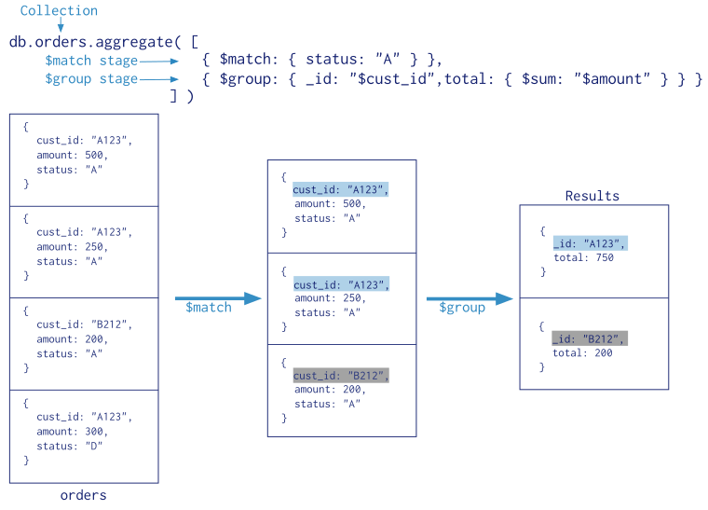

Slide 14
Aggregation Pipeline
Separates data aggregation into a pipeline with stages you define
  The previous slide separates the data into $match and $group stages
  Aggregation pipelines are not limited to just $match and $group stages
    $group
    $match
    $lookup
    $count
    $limit
    $merge
    $out
    $sort
    $geoNear
    $unwind
  https://docs.mongodb.com/manual/reference/operator/aggregation-pipeline/
And many others.

Slide 15
Group stage
Groups documents by some specified expression and outputs to the next stage a document for each distinct grouping.
  The output documents contain an _id field which contains the distinct group by key
  { $group: { _id: <expression>, <field1>: { <accumulator1> : <expression1> }, ... } }
  The _id field is mandatory; however, you can specify an _id value of null to calculate accumulated values for all the input documents as a whole.

Slide 16
Group Example
Given the below sales collection, we can group by month, day, and year:
db.sales.insertMany([
{ "_id" : 1, "item" : "abc", "price" : 10, "quantity" : 2, "date" : ISODate("2014-03-01T08:00:00Z") },
{ "_id" : 2, "item" : "jkl", "price" : 20, "quantity" : 1, "date" : ISODate("2014-03-01T09:00:00Z") },
{ "_id" : 3, "item" : "xyz", "price" : 5, "quantity" : 10, "date" : ISODate("2014-03-15T09:00:00Z") },
{ "_id" : 4, "item" : "xyz", "price" : 5, "quantity" : 20, "date" : ISODate("2014-04-04T11:21:39.736Z") },
{ "_id" : 5, "item" : "abc", "price" : 10, "quantity" : 10, "date" : ISODate("2014-04-04T21:23:13.331Z") }])

Slide 17
Group Example (Continued)
db.sales.aggregate(
[
{
$group : {
_id : { month: { $month: "$date" }, day: { $dayOfMonth: "$date" }, year: { $year: "$date" } },
totalPrice: { $sum: { $multiply: [ "$price", "$quantity" ] } },
averageQuantity: { $avg: "$quantity" },
count: { $sum: 1 }
}
}
]
)

Slide 18
Group by null
db.sales.aggregate(
[
{
$group : {
_id : null,
totalPrice: { $sum: { $multiply: [ "$price", "$quantity" ] } },
averageQuantity: { $avg: "$quantity" },
count: { $sum: 1 }
}
}
]
)

Slide 19
Match Stage
Filters the documents to pass only the documents that match the specified condition(s) to the next pipeline stage.
{ $match: { <query> } }

Slide 20
Example with Articles collection
db.articles.insertMany([
{ "_id" : ObjectId("512bc95fe835e68f199c8686"), "author" : "dave", "score" : 80, "views" : 100 },
{ "_id" : ObjectId("512bc962e835e68f199c8687"), "author" : "dave", "score" : 85, "views" : 521 },
{ "_id" : ObjectId("55f5a192d4bede9ac365b257"), "author" : "ahn", "score" : 60, "views" : 1000 },
{ "_id" : ObjectId("55f5a192d4bede9ac365b258"), "author" : "li", "score" : 55, "views" : 5000 },
{ "_id" : ObjectId("55f5a1d3d4bede9ac365b259"), "author" : "annT", "score" : 60, "views" : 50 },
{ "_id" : ObjectId("55f5a1d3d4bede9ac365b25a"), "author" : "li", "score" : 94, "views" : 999 },
{ "_id" : ObjectId("55f5a1d3d4bede9ac365b25b"), "author" : "ty", "score" : 95, "views" : 1000 }])

Slide 21
Example with Articles collection
Find all articles that have an author of “dave”
db.articles.aggregate(
[ { $match : { author : "dave" } } ]
);

Slide 22
Combine Group and Match
Find the number of articles that either have a score between 70 and 90, or have views greater than or equal to 1000
db.articles.aggregate( [
{ $match: { $or: [ { score: { $gt: 70, $lt: 90 } }, { views: { $gte: 1000 } } ] } },
{ $group: { _id: null, count: { $sum: 1 } } }
] );

Slide 23
Zips collection
Download and mongoimport the zips.json file to follow along
  mongoimport --db examples --collection zipcodes --file fileName.json
  mongoimport --type csv -d examples -c zipcodes --headerline --drop uszips.csv
Each document in the zipcodes collection has the following form:
{
"_id": "10280",
"city": "NEW YORK",
"state": "NY",
"pop": 5574,
"loc": [ -74.016323, 40.710537 ]
…
}

Slide 24
Learn By Example
The above aggregation returns states with a population above 10 million:
Two stages, group and match
  Group stage groups the documents by the state field, then adds up the sum of the population and assigns it to the “totalPop”.
  Match stage filters the above grouped docs to output only those docs whose totalPop is greater than 10 million
db.zipcodes.aggregate( [
{ $group: { _id: "$state", totalPop: { $sum: "$pop" } } },
{ $match: { totalPop: { $gte: 10 * 1000 * 1000 } } }
] )

Slide 25
Equivalent MySQL command
SELECT state, SUM(pop) AS totalPop
FROM zipcodes
GROUP BY state
HAVING totalPop >= (10 * 1000 * 1000);

Slide 26
More accumulator operators
Name | Description
$sum | return a sum of numerical values. Ignore non-numeric values.
$avg | returns an average of numerical values. Ignore non-numeric values.
$first | returns a value from the first document for each group. Order is only defined if the documents are in a defined order.
$last | similar to above but returns last document.
$max | returns the highest expression value for each group.
$min | similar to above but returns the lowest
$push | return an array of expression values for each group.
$addToSet | returns an array of unique expression values for each group
$stdDevPop | returns the population standard deviation of the input values.
$stdDevSamp | returns the sample standard deviation of the input values.

Slide 27
More Examples (Return average city population by state)
Two group stages:
  The first groups the documents by the combination of city and state. It then uses the $sum aggregation to get the total population for each combination of city and state
  The second $group stage groups the above results by state. It then averages that grouping and assigns that value to the avgCityPop field.
db.zipcodes.aggregate( [
{ $group: { _id: { state: "$state", city: "$city" }, pop: { $sum: "$pop" } } },
{ $group: { _id: "$_id.state", avgCityPop: { $avg: "$pop" } } }
] )

Slide 28
More Examples (Return largest and smallest cities by state)
db.zipcodes.aggregate( [
{ $group:
{
_id: { state: "$state", city: "$city" },
pop: { $sum: "$pop" }
}
},
{ $sort: { pop: 1 } },
{ $group:
{
_id : "$_id.state",
biggestCity: { $last: "$_id.city" },
biggestPop: { $last: "$pop" },
smallestCity: { $first: "$_id.city" },
smallestPop: { $first: "$pop" }
}
},
// the following $project is optional, and
// modifies the output format.
{ $project:
{ _id: 0,
state: "$_id",
biggestCity: { name: "$biggestCity", pop: "$biggestPop" },
smallestCity: { name: "$smallestCity", pop: "$smallestPop" }
}
},
{$sort: {state: 1}}
] )

Slide 29
Return largest and smallest cities by state
The aggregation pipeline has a $group stage, a $sort stage, another $group, and then a $project stage and a final $sort stage
  The first $group stage groups documents by combination of the city and state and calculate the sum of the population.
  The $sort stage orders the documents by the pop field value from smallest to largest.
  The second $group stage groups the new sorted documents by the _id.state field and outputs a document for each state.
  Last $project stage rename _id field to state and moves the biggestCity, biggestPop, smallestCity and smallestPop into biggestCity and smallestCity embedded documents.
  Last $sort stage sorts the list by state

Slide 30
$lookup
Performs a left outer join to a collection in the same database to filter in documents from the "joined" collection for processing. The $lookup stage adds a new array field to each input document. The new array field contains the matching documents from the "joined" collection. The $lookup stage passes these reshaped documents to the next stage.
Starting in MongoDB 5.1, $lookup works across sharded collections.

Slide 31
$lookup
Can also be thought of as a subselect
{
$lookup:
{
from: <collection to join>,
localField: <field from the input documents>,
foreignField: <field from the documents of the "from" collection>,
as: <output array field>
}
}
https://docs.mongodb.com/manual/reference/operator/aggregation/lookup/
SELECT *, <output array field>
FROM collection
WHERE <output array field> IN (
SELECT *
FROM <collection to join>
WHERE <foreignField> = <collection.localField>
);

Slide 32
$lookup
db.orders.insert([
{ "_id" : 1, "item" : "almonds", "price" : 12, "quantity" : 2 },
{ "_id" : 2, "item" : "pecans", "price" : 20, "quantity" : 1 },
{ "_id" : 3 }
])
db.inventory.insert([
{ "_id" : 1, "sku" : "almonds", "description": "product 1", "instock" : 120 },
{ "_id" : 2, "sku" : "bread", "description": "product 2", "instock" : 80 },
{ "_id" : 3, "sku" : "cashews", "description": "product 3", "instock" : 60 },
{ "_id" : 4, "sku" : "pecans", "description": "product 4", "instock" : 70 },
{ "_id" : 5, "sku": null, "description": "Incomplete" },
{ "_id" : 6 }
])
db.orders.aggregate([
{
$lookup:
{
from: "inventory",
localField: "item",
foreignField: "sku",
as: "inventory_docs"
}
}
])

Slide 33
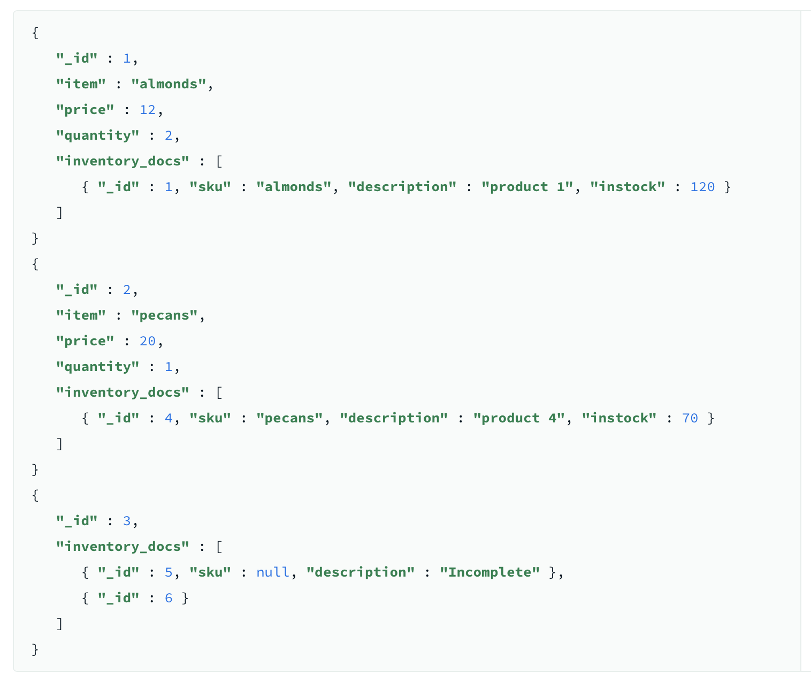
$lookup
db.orders.aggregate([
{
$lookup:
{
from: "inventory",
localField: "item",
foreignField: "sku",
as: "inventory_docs"
}
}
])
Select *, inventory_docs from orders left join inventory on orders.item = inventory.sku --- kinda

Slide 34
$lookup
db.posts.aggregate([
{
$lookup:
{
from: "comments",
localField: "title",
foreignField: "postTitle",
as: "comments"
}
}
])
posts
{ "title" : "my first post", "author" : "Jim", "likes" : 5 }, { "title" : "my second post", "author" : "Jim", "likes" : 2 }, { "title" : "hello world", "author" : "Joe", "likes" : 3 }
comments
{ "postTitle" : "my first post", "comment" : "great read", "likes" : 3 }, { "postTitle" : "my second post", "comment" : "good info", "likes" : 0 }, { "postTitle" : "my second post", "comment" : "i liked this post", "likes" : 12 }, { "postTitle" : "hello world", "comment" : "not my favorite", "likes" : 8 }, { "postTitle" : "my last post", "comment" : null, "likes" : 0 }

Slide 35
$lookup
{
"title" : "my first post",
"author" : "Jim",
"likes" : 5,
"comments" : [
{ "postTitle" : "my first post",
"comment" : "great read",
"likes" : 3
}
]
},
{
"title" : "my second post",
"author" : "Jim",
"likes" : 2,
"comments" : [
{
"postTitle" : "my second post",
"comment" : "good info",
"likes" : 0
},
{
"postTitle" : "my second post",
"comment" : "i liked this post",
"likes" : 12
}
]
},
{
"title" : "hello world",
"author" : "Joe",
"likes" : 3,
"comments" : [
{
"postTitle" : "hello world",
"comment" : "not my favorite",
"likes" : 8
}
]
}
db.posts.aggregate([
{
$lookup:
{
from: "comments",
localField: "title",
foreignField: "postTitle",
as: "comments"
}
}
])
posts left join comments on posts.title = comments.postTitle
Place the joined objects in comments field

Slide 36
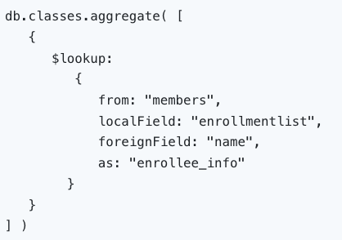
$lookup – array membership
db.classes.insertMany( [
{ _id: 1, title: "Reading is ...", enrollmentlist: [ "giraffe2", "pandabear", "artie" ], days: ["M", "W", "F"] },
{ _id: 2, title: "But Writing ...", enrollmentlist: [ "giraffe1", "artie" ], days: ["T", "F"] }
] )
db.members.insertMany( [
{ _id: 1, name: "artie", joined: new Date("2016-05-01"), status: "A" },
{ _id: 2, name: "giraffe", joined: new Date("2017-05-01"), status: "D" },
{ _id: 3, name: "giraffe1", joined: new Date("2017-10-01"), status: "A" },
{ _id: 4, name: "panda", joined: new Date("2018-10-11"), status: "A" },
{ _id: 5, name: "pandabear", joined: new Date("2018-12-01"), status: "A" },
{ _id: 6, name: "giraffe2", joined: new Date("2018-12-01"), status: "D" }
] )

Slide 37
$lookup
{
"_id" : 1,
"title" : "Reading is ...",
"enrollmentlist" : [ "giraffe2", "pandabear", "artie" ],
"days" : [ "M", "W", "F" ],
"enrollee_info" : [
{
"_id" : 1,
"name" :
"artie",
"joined" : ISODate("2016-05-01T00:00:00Z"),
"status" : "A"
},
{
"_id" : 5,
"name" :
"pandabear",
"joined" : ISODate("2018-12-01T00:00:00Z"),
"status" : "A" },
{
"_id" : 6,
"name" :
"giraffe2",
"joined" : ISODate("2018-12-01T00:00:00Z"),
"status" : "D" }
]
}
{
"_id" : 2,
"title" : "But Writing ...",
"enrollmentlist" : [ "giraffe1", "artie" ],
"days" : [ "T", "F" ],
"enrollee_info" : [
{ "_id" : 1, "name" : "artie", "joined" : ISODate("2016-05-01T00:00:00Z"), "status" : "A" },
{ "_id" : 3, "name" : "giraffe1", "joined" : ISODate("2017-10-01T00:00:00Z"), "status" : "A" }
]
}

Slide 38
$lookup – correlated subqueries
Inner query is based on current values of outer query
Return a list of the orders and the possible warehouses that may fulfill the order:
db.orders.insertMany( [
{ "_id" : 1, "item" : "almonds", "price" : 12, "ordered" : 2 },
{ "_id" : 2, "item" : "pecans", "price" : 20, "ordered" : 1 },
{ "_id" : 3, "item" : "cookies", "price" : 10, "ordered" : 60 }
] )
SELECT *, stockdata
FROM orders
WHERE stockdata IN (
SELECT warehouse, instock
FROM warehouses
WHERE stock_item = orders.item
AND instock >= orders.ordered
);
db.warehouses.insertMany( [
{ "_id" : 1, "stock_item" : "almonds", warehouse: "A", "instock" : 120 },
{ "_id" : 2, "stock_item" : "pecans", warehouse: "A", "instock" : 80 },
{ "_id" : 3, "stock_item" : "almonds", warehouse: "B", "instock" : 60 },
{ "_id" : 4, "stock_item" : "cookies", warehouse: "B", "instock" : 40 },
{ "_id" : 5, "stock_item" : "cookies", warehouse: "A", "instock" : 80 }
] )

Slide 39
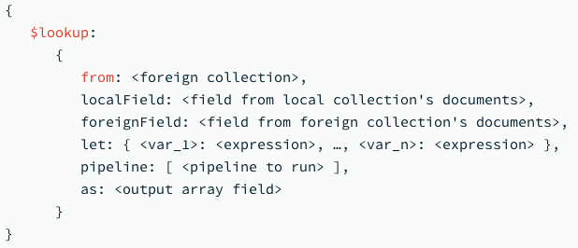
$lookup – correlated subqueries
Defines variables to be used in the subquerie (pipeline)
If localField and foreignField are not specified, it is a full join rather than join on field equality

Slide 40
{
_id: 1,
item: 'almonds',
price: 12,
ordered: 2,
stockdata: [
{ warehouse: 'A', instock: 120 },
{ warehouse: 'B', instock: 60 }
]
},
{
_id: 2,
item: 'pecans',
price: 20,
ordered: 1,
stockdata: [ { warehouse: 'A', instock: 80 } ]
},
{
_id: 3,
item: 'cookies',
price: 10,
ordered: 60,
stockdata: [ { warehouse: 'A', instock: 80 } ]
}
db.orders.aggregate( [
{
$lookup:
{
from: "warehouses",
let: { order_item: "$item", order_qty: "$ordered" },
pipeline: [
{ $match:
{ $expr:
{ $and:
[
{ $eq: [ "$stock_item", "$$order_item" ] },
{ $gte: [ "$instock", "$$order_qty" ] }
]
}
}
},
{ $project: { stock_item: 0, _id: 0 } }
],
as: "stockdata"
}
}
] )
Cookies order of 60 cannot be fulfilled by warehouse B
Not enough in stock there

Slide 41
Explain
{
"stages" : [
{
"$cursor" : {
"query" : {
},
"fields" : {
"city" : 1,
"pop" : 1,
"state" : 1,
"_id" : 0
},
"queryPlanner" : {
"plannerVersion" : 1,
"namespace" : "test.zipcodes",
"indexFilterSet" : false,
"parsedQuery" : {
},
"queryHash" : "8B3D4AB8",
"planCacheKey" : "8B3D4AB8",
"winningPlan" : {
"stage" : "COLLSCAN",
"direction" : "forward"
},
"rejectedPlans" : [ ]
}
}
},
{
"$group" : {
"_id" : {
"state" : "$state",
"city" : "$city"
},
"pop" : {
"$sum" : "$pop"
}
}
},
{
"$sort" : {
"sortKey" : {
"pop" : 1
}
}
},
{
"$group" : {
"_id" : "$_id.state",
"biggestCity" : {
"$last" : "$_id.city"
},
"biggestPop" : {
"$last" : "$pop"
},
"smallestCity" : {
"$first" : "$_id.city"
},
"smallestPop" : {
"$first" : "$pop"
}
}
},
{
"$project" : {
"_id" : false,
"state" : "$_id",
"biggestCity" : {
"name" : "$biggestCity",
"pop" : "$biggestPop"
},
"smallestCity" : {
"name" : "$smallestCity",
"pop" : "$smallestPop"
}
}
}
],
"serverInfo" : {
"host" : "Quinns-MacBook-Pro.local",
"port" : 27017,
"version" : "4.2.3",
"gitVersion" : "6874650b362138df74be53d366bbefc321ea32d4"
},
"ok" : 1
}
db.zipcodes.explain().aggregate( [
{ $group:
{
_id: { state: "$state", city: "$city" },
pop: { $sum: "$pop" }
}
},
{ $sort: { pop: 1 } },
{ $group:
{
_id : "$_id.state",
biggestCity: { $last: "$_id.city" },
biggestPop: { $last: "$pop" },
smallestCity: { $first: "$_id.city" },
smallestPop: { $first: "$pop" }
}
},
// the following $project is optional, and
// modifies the output format.
{ $project:
{ _id: 0,
state: "$_id",
biggestCity: { name: "$biggestCity", pop: "$biggestPop" },
smallestCity: { name: "$smallestCity", pop: "$smallestPop" }
}
}
] )

Slide 42
Demo
First download and run MongoDB Compass
Google Search "MongoDB Atlas"
  Click "Start Free" and go through the signup process
Login at cloud.mongodb.com
Click "Build a Database"
  Make sure "Free" is selected
  Select a Cloud Provider and Region
  Click Create
  Enter a username & password and finish off the configuration
Click "Connect" then select "Connect using MongoDB Compass" and then "I have MongoDB Compass"
  Copy the connection string and close
Paste the connection string into compass
  Replace the <password> with your password

Slide 43
Demo Continued
Click + next to Databases to create a new database
  I named my database Zips and the collection was zipcodes
Click the "ADD DATA" button and select "Import JSON or CSV file"
  Use the file explorer to select zips.json
  You can download zips.json from the class Canvas site
In the Filter box type
  {state: "UT", city: "PROVO"}
  You should see 3 entries for 84601, 84604, and 84606
  If you eliminate the state field, you should see an entry for PROVO, SD
Try the aggregations from the presentation using the Aggregations tab
  Be sure to click the "</> Text" button on the right side
  Copy and paste in the following aggregation
[
{ $group: { _id: { state: "$state", city: "$city" }, pop: { $sum: "$pop" } } },
{ $group: { _id: "$_id.state", avgCityPop: { $avg: "$pop" } } }
]

Slide 44
Map-Reduce

Slide 45
Map-Reduce
Idea popularized by Google, 2004
  Duplicated by Yahoo in Hadoop
General syntax
  mapReduce(map function, reduce functions, arguments)
Map function
  Maps all documents into a hash table (key, values)
Reduce function
  Reduces the values to a single value.
  Like a sum or an average of the values.
Arguments
  Defines how to get the result document
Similar to SQL
  Select … group by …
Sources
  http://docs.mongodb.org/manual/core/map-reduce/
  https://www.youtube.com/watch?v=WovfjprPD_I

Slide 46
MapReduce: A Bird’s-Eye View
In MapReduce, chunks are processed in
isolation by tasks called Mappers
The outputs from the mappers are denoted as
intermediate outputs (IOs) and are brought
into a second set of tasks called Reducers
The process of bringing together IOs into a set
of Reducers is known as shuffling process
The Reducers produce the final outputs (FOs)
Overall, MapReduce breaks the data flow into two phases,
map phase and reduce phase
chunks
C0
C1
C2
C3
Map Phase
M0
M1
M2
M3
mappers
IO0
IO1
IO2
IO3
Shuffling Data
Reduce Phase
Reducers
R0
R1
FO0
FO1

Slide 47
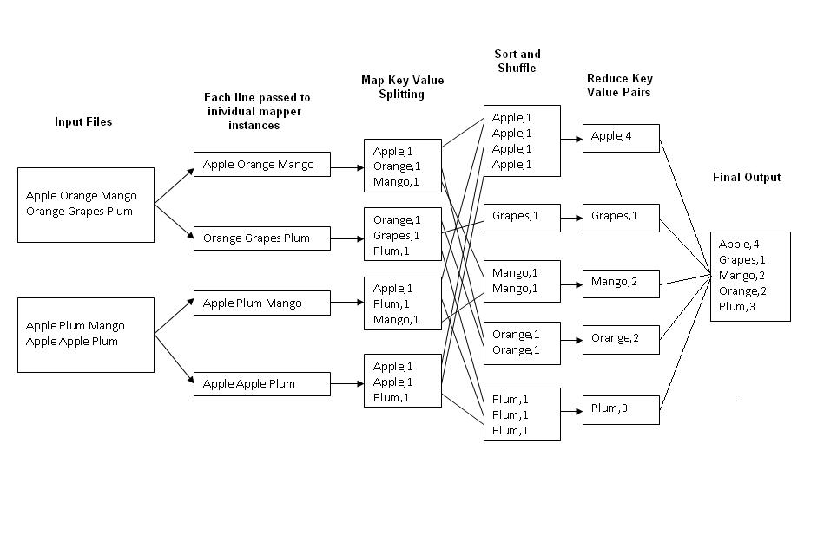
MapReduce: Word Counting
map(key, value):
// key: document name; value: text of the document
for each word w in value:
emit(w, 1)
reduce(key, values):
// key: a word; value: an iterator over counts
result = 0
for each count v in values:
result += v
emit(key, result)
Map
Tasks
Reduce
Tasks

Slide 48
Map-Reduce, two simple examples
Example
  var mapFunction = function() { emit(this.publisher, 1); };
  var reduceFunction = function(key, value) { return Array.sum(value); }
  var res = db.books.mapReduce(mapFunction, reduceFunction, { out: "map_reduce_example" });
  db.map_reduce_example.find();
  var mapFunction = function() {emit(this.state, 1); };
  var reduceFunction = function(key, value) { return Array.sum(value); };
  var res = db.zipcodes.mapReduce(mapFunction, reduceFunction, { out: "map_reduce_example" });
  db.map_reduce_example.find();

Slide 49
Map-Reduce, another simple example
Example
  var mapFunction = function() { emit(this.publisher, this.pages); };
  var reduceFunction = function(key, value) { return Array.avg(value); }
  var res = db.books.mapReduce(mapFunction, reduceFunction, { out: "map_reduce_example" });
  db.map_reduce_example.find();

Slide 50
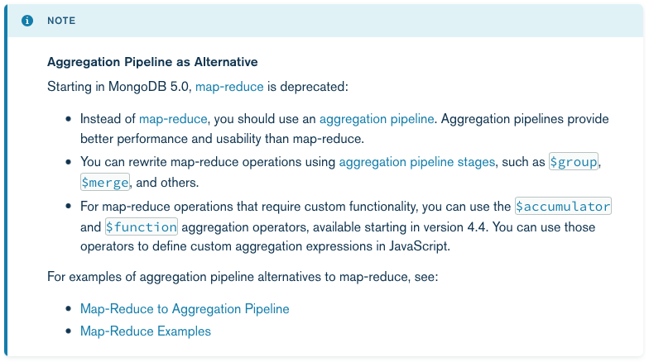

Slide 51
References
SQL aggregation to MongoDB aggregation comparison
Aggregation pipeline API documentation

