Slide 1



Redis
Redis Key-Value Database:
Practical Introduction
SoftUni Team
Technical Trainers
Software University
http://softuni.bg

Slide 2


Table of Contents
What is Redis?
Installing and Running Redis
Redis Commands
  String Commands
  Working with Keys
  Working with Hashes
  Working with Lists
  Working with Sets
  Working with Sorted Sets

Slide 3

Redis
Ultra-Fast Data Structure Server

Slide 4
What is Redis?
Redis is:
  Ultra-fast in-memory key-value data store
  Powerful data structure server
  Open-source software: http://redis.io
Redis stores data structures:
  Strings, lists, hashes, sets, sorted sets
  Publish / subscribe messaging

Slide 5

Redis: Features
Redis is really fast
  Non-blocking I/O, single threaded
  100,000+ read / writes per second
Redis is not a database
  It complements your existing data storage layer
  E.g. StackOverflow uses Redis for data caching
For small labs Redis may replace entirely the database
  Trade performance for durability → data is persisted immediately

Slide 6
Installing Redis
To install Redis on Linux / Mac OS X:
  Download from http://redis.io/download
  Install it and run it
To install Redis on Windows:
  Download https://github.com/MSOpenTech/redis
    Compile the solution in the msvs folder and build it with VS
  The easier way: use the Windows package manager Chocolatey
    http://chocolatey.org
Easiest is to use docker → docker pull redis
choco install redis

Slide 7
Running Redis
On Linux / Mac OS X start / stop the Redis service
  The default Redis port is 6379 (the service name is redis_6379)
On Windows start / stop the "redis" service
Use the console-based (CLI) client or just connect with Telnet:
sudo service redis_6379 start
sudo service redis_6379 stop
sc start redis
sc stop redis
redis-cli
telnet localhost 6379

Slide 8
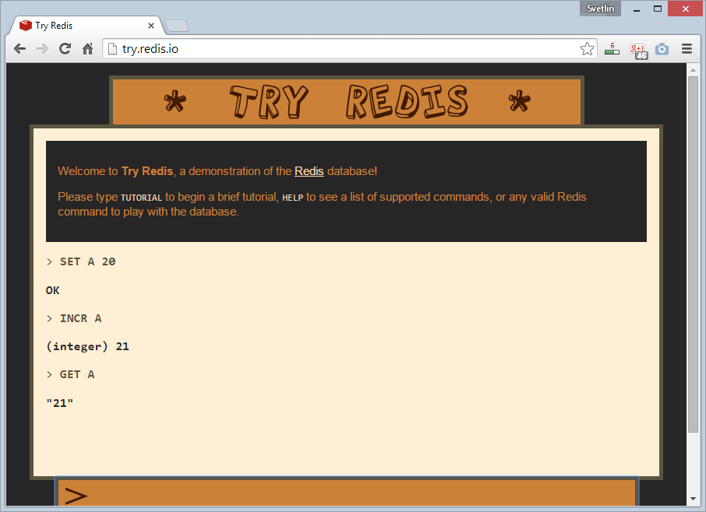
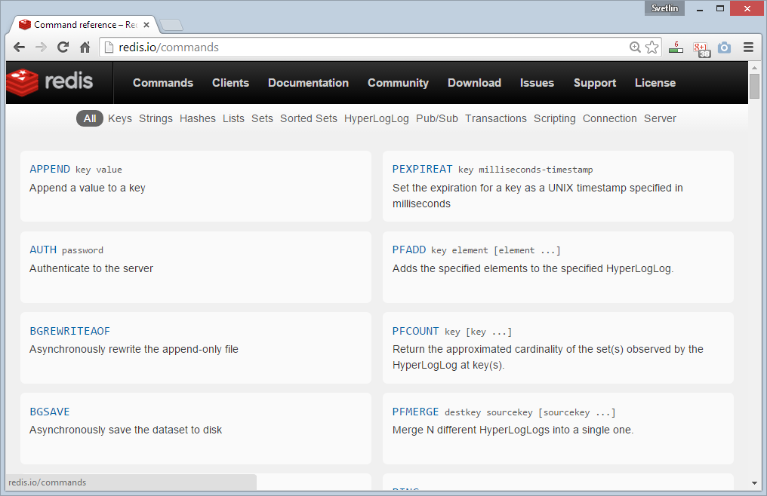
Redis: Basic Commands

Slide 9
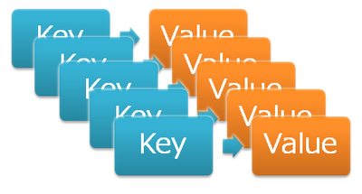
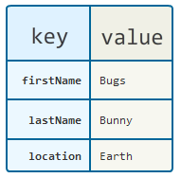
Redis: Data Model
Redis keeps key-value pairs
  Every item is stored as key + value
Keys are unique identifiers
Values can be different data structures:
  Strings (numbers are stored as strings)
  Lists (of strings)
  Hash tables: string → string
  Sets / sorted sets (of strings)

Slide 10
Redis: Commands
Redis works as interpreter of commands:
SET name "Nakov"
OK
GET name
"Nakov"
DEL name
(integer) 1
GET name
(nil)
Play with the command-line client redis-cli
Or play with Redis online at http://try.redis.io

Slide 11
String Commands
SET [key] [value]
  Assigns a string value in a key
GET [key] / MGET [keys]
  Returns the value by key / keys
INCR [key] / DECR [key]
  Increments / decrements a key
STRLEN [key]
  Returns the length of a string
SET name "hi"
OK
GET name
"hi"
SET name abc
OK
GET "name"
"abc"
GET Name
(nil)
SET a 1234
OK
INCR a
(integer) 1235
GET a
"1235"
MGET a name
1) "1235"
2) "asdda"
STRLEN a
(integer) 4

Slide 12
Working with Keys
EXISTS [key]
  Checks whether a key exists
TYPE [key]
  Returns the type of a key
DEL [key]
  Deletes a key
EXPIRE [key] [t]
  Deletes a key after t seconds
SET count 5
OK
TYPE count
string
EXISTS count
(integer) 1
DEL count
(integer) 1
EXISTS count
(integer) 0
SET a 1234
OK
GET a
"1234"
EXPIRE a 5
(integer) 1
EXISTS a
(integer) 1
EXISTS a
(integer) 0

Slide 13
Working with Hashes (Hash Tables)
HSET [key] [field] [value]
  Assigns a value for given field
HKEYS [key]
  Returns the fields (keys) is in a hash
HGET [key] [field]
  Returns a value by fields from a hash
HDEL [key] [field]
  Deletes a fields from a hash
HSET user name "peter"
(integer) 1
HSET user age 23
(integer) 1
HKEYS user
1) "name"
2) "age"
HGET user age
"23"
HDEL user age
(integer) 1

Slide 14
Working with Lists
RPUSH / LPUSH [list] [value]
  Appends / prepend a value to a list
LINDEX [list] [index]
  Returns a value given index in a list
LLEN [list]
  Returns the length of a list
LRANGE [list] [start] [count]
  Returns a sub-list (range of values)
RPUSH names "peter"
(integer) 1
LPUSH names Nakov
(integer) 1
LINDEX names 0
"Nakov"
LLEN names
(integer) 2
LRANGE names 0 100
1) "Nakov"
2) "peter"

Slide 15
Working with Sets
SADD [set] [value]
  Appends a value to a set
SMEMBERS [set]
  Returns the values from a set
SREM [set] [value]
  Deletes a value from a set
SCARD [set]
  Returns the stack size (items count)
SADD users "peter"
(integer) 1
SADD users "peter"
(integer) 0
SADD users maria
(integer) 1
SMEMBERS users
1) "peter"
2) "maria"
SREM users maria
(integer) 1

Slide 16
Working with Sorted Sets
# ZADD setname score value [score value] …
# sorted set is sorted by score
ZADD myzset 1 "one"
(integer) 1
ZADD myzset 1 "uno"
(integer) 1
ZADD myzset 2 "two" 3 "three"
(integer) 2
ZRANGE myzset 0 -1 WITHSCORES
1) "one"
2) 1.0
3) "uno"
4) 1.0
5) "two"
…
Learn more at http://redis.io/commands#sorted_set

Slide 17
Publish / Subscribe Commands
First user subscribes to certain channel "news"
Another user sends messages to the same channel "news"
Learn more at http://redis.io/commands#pubsub
SUBSCRIBE news
1) "subscribe"
2) "news"
3) (integer) 1
PUBLISH news "hello"
(integer) 1

Slide 18
Using Redis as a Database
Special naming can help using Redis as database
Add a user "peter".
SADD users:names peter
HSET users:peter name "Peter Petrov"
HSET users:peter email "pp@gmail.com"
SADD users:names maria
HSET users:maria name "Maria Ivanova"
HSET users:maria email "maria@yahoo.com"
SMEMBERS users:names
HGETALL users:peter
Use "users:peter" as key to hold user data
Add a user "maria".
List all users
List all properties for user "peter"

Slide 19
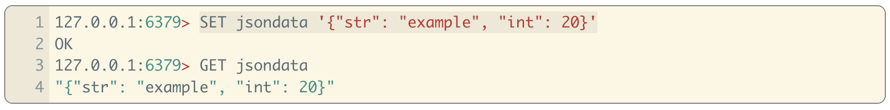
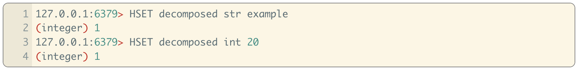
Redis and JSON data
By default Redis doesn't directly support JSON but
  Can store as a string or
  Can store as a hash – but then you have to get the items individually
There is a JSON module you can install for more functionality

Slide 20
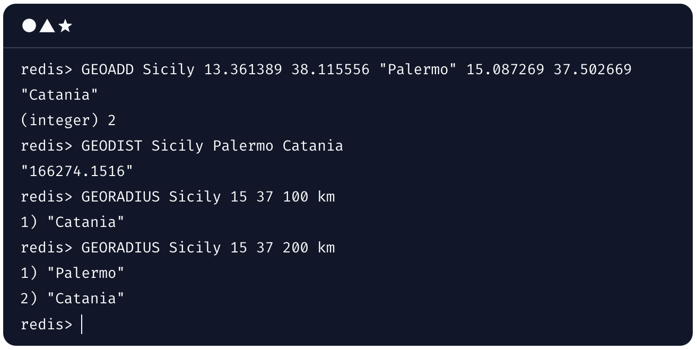
Redis and GEO data
Redis uses sorted sets to store geospatial data
  Adds other functionality
GEOADD longitude latitude name [longitude latitude name …]

Slide 21
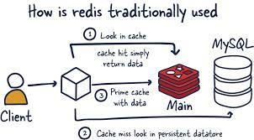
Redis Use Cases
Caching
  In memory cache of database
Chat, messaging, and queues
  Pub/Sub architecture is great for this
Session store
  Faster access to session information – keyed by session key
Real time analytics
  Store data in Redis and also archive. Realtime analytics can be done on the Redis data

Slide 22
Demo Time

Slide 23
Redis Cluster
Redis does not use consistent hashing
Every key is conceptually part of a “hash slot”
  CRC16 of the key mod 16384
  16384 hash slots
Each node is responsible for a subset of the hash slots
  Example: For 3 nodes
    Node A contains hash slots from 0 to 5500.
    Node B contains hash slots from 5501 to 11000.
    Node C contains hash slots from 11001 to 16383.

Slide 24
Redis Cluster
When adding new nodes, all nodes are affected
  Adding a new node will readjust all hash slots
  But communication is nearest neighbor only
You can force keys to be stored in same hash slot
  Use brackets {} to identify the portion of the key that is hashed
  Example: this{foo}key and another{foo}key

Slide 25
Redis Cluster Replication
Redis uses a master-replica model
Each hash slot has from 1 to N replicas
  N is defined at cluster setup
Replica nodes mirror the master-replica
When a node fails, a replica (mirror) node is promoted
A single host can run multiple replicas
  Typically a master and possibly one or more replicas

Slide 26
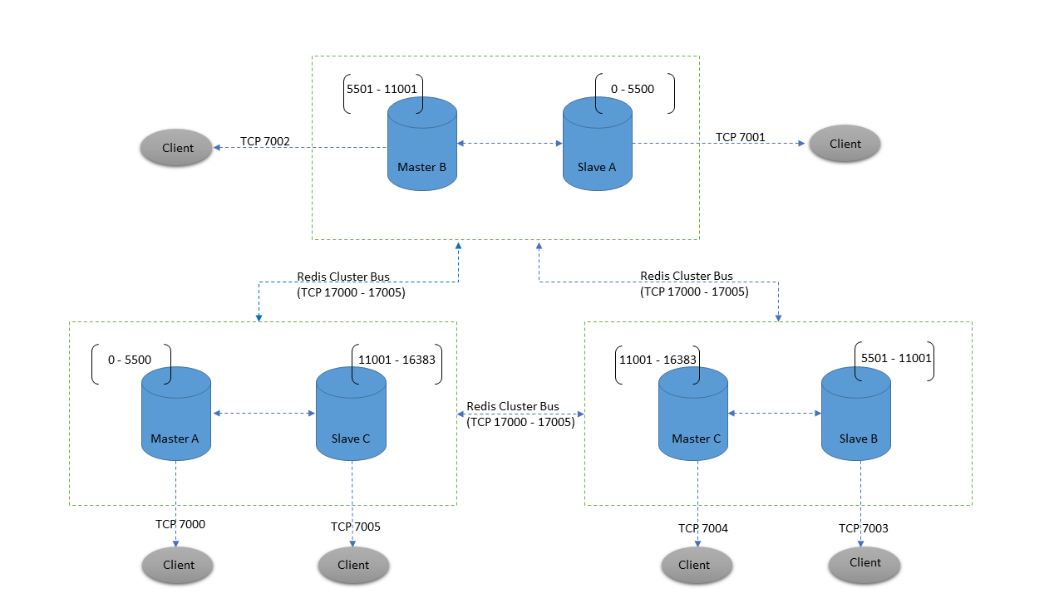
Redis Cluster
Replica A
Replica C
Replica B

Slide 27
Redis Cluster Consistency
Redis cluster is not able to guarantee strong consistency
Asynchronous replication
  Your client writes to B
  B replies OK
  B propagates the write to its replicas
  If B crashes before writing to its replicas, we could be out of date
Performance – Consistency tradeoff
Inconsistency can also occur in cluster partition events

Slide 28
Redis Cluster
Clients can talk to any node
  Request will be forwarded to the node that owns the hash slot
Clients can cache the hash slot map to direct communication
  Needs to be periodically refreshed

Slide 29


Summary
Redis is ultra-fast in-memory data store
  Not a database, used along with databases
Supports strings, numbers, lists, hashes,
sets, sorted sets, publish / subscribe
messaging
Used for caching / simple apps
Databases

Slide 30













Redis
https://softuni.bg/courses/databases

Slide 31
License
This course (slides, examples, demos, videos, homework, etc.)
is licensed under the "Creative Commons Attribution-NonCommercial-ShareAlike 4.0 International" license
Attribution: this work may contain portions from
  "Databases" course by Telerik Academy under CC-BY-NC-SA license

Slide 32





Free Trainings @ Software University
Software University Foundation – softuni.org
Software University – High-Quality Education, Profession and Job for Software Developers
  softuni.bg
  Software University @ Facebook
  facebook.com/SoftwareUniversity
  Software University @ YouTube
  youtube.com/SoftwareUniversity
  Software University Forums – forum.softuni.bg

