Slide 1
Spark
Fast, Interactive, Language-Integrated Cluster Computing

Slide 2
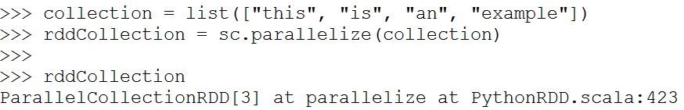
Resilient Distributed Datasets (RDD)
RDD can be created from existing collections
RDD can also be created from an existing file
sc.textFile(“file.txt”)
sc.textFile(“directory/*.txt”)
sc.textFile(“hdfs://namenode:9000/path/file”)

Slide 3
Spark Operations
Once an RDD is created, we have a distributed collection of records that we can manipulate
There are 2 types of operations we can perform
  Transformation
    Applies the same function to all the records
    Lazy evaluation – not evaluated immediately
  Action
    Runs some computation or aggregation operation and returns the result to the driver program where SparkContext is running
    Eager evaluation – evaluated right way

Slide 4
Transformations
Create a new dataset from an existing one.
Evaluated lazily – won’t be executed until action is called for

Slide 5
Transformations

Slide 6
Transformations

Slide 7
Transformations

Slide 8
Actions
Kick off evaluations and begin computation
Specify the result of an operation or aggregation

Slide 9
Actions

Slide 10
Actions

Slide 11
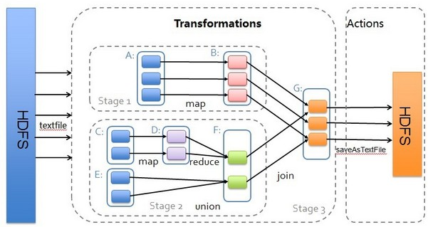
Transformations & Actions

Slide 12
Three ways to interact with Spark Cluster
Pyspark API:
- Transformations on RDD’s
Spark DataFrames
- Abstract RDD’s as DataFrames
SparkSQL
- Register data frames and execute SQL code with spark context

Slide 13
PySpark API

Slide 14
Wordcount Example
https://colab.research.google.com/drive/1eSQA3Qd303Wl1Jl05FbZ9SetDGXv3gVl?usp=sharing

Slide 15
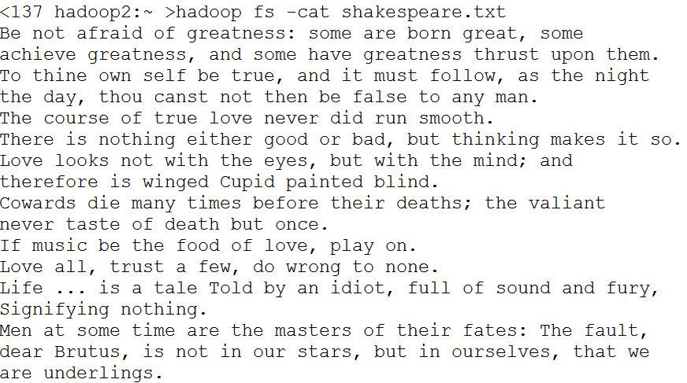
Another Example
Input data: Shakespeare’s quotes

Slide 16
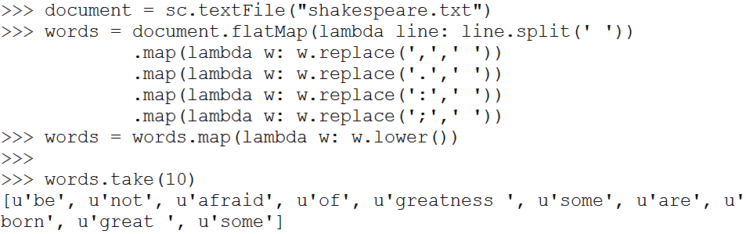
Another WordCount Example
Need to perform more preprocessing:
  Remove punctuations (colons, periods, commas, semicolons)
  Convert letters to lower-case

Slide 17
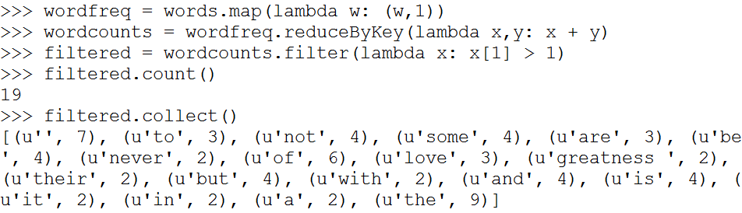
Another WordCount Example
Count the frequency of words and filter out the words that appear only once

Slide 18
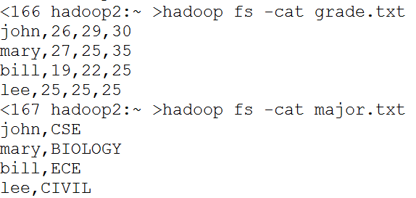
Example: Grade data
Input data
Schema:
  grade( name, hw1, hw2, hw3 )
  major( name, dept )

Slide 19
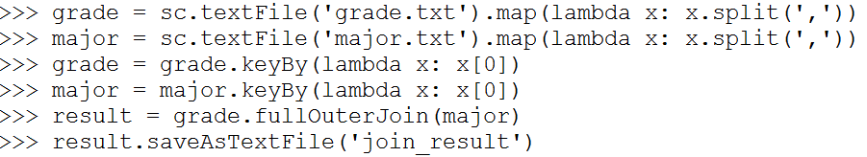
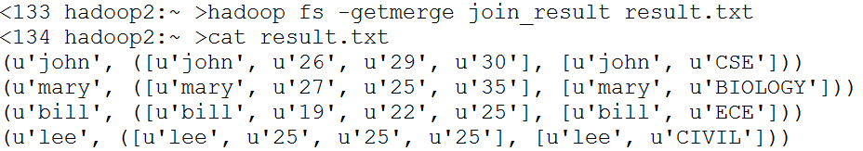
Example: Grade data
Create a joined RDD from RDDs for grade and major

Slide 20
Example: Grade data
Create a joined RDD from RDDs for grade and major
Use rdd.keyBy() to specify the keys for joining
We still need to process the result to merge the tuples → PAINFUL

Slide 21
Spark DataFrames

Slide 22
DataFrames in Spark
Distributed collection of data grouped into named columns
(i.e. RDD with schema)
Domain-specific functions designed for common tasks
  Metadata
  Sampling
  Project, filter, aggregation, join, …
  User Defined Functions
Available in Python, Scala, Java, and R
Analogous to pandas DataFrame
Useful commands
  rdd.toDF(schema): convert rdd to DataFrame with specified schema
  df.join(df2, condition, type): join two data frames
  df.filter( expression ): apply filter to the rows
  df.groupBy( group ): apply group by operator
  df.agg([col: func]) : apply aggregation function on columns

Slide 23
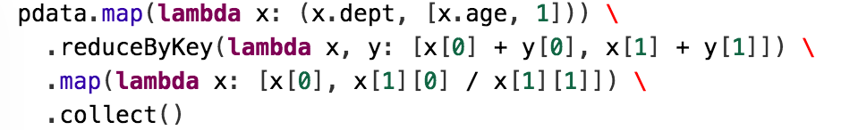


Slide 24
Spark DataFrame
Similar APIs as single-node tools like Pandas, R, i.e., easy to learn
> head(filter(df, df$waiting < 50)) # an example in R
## eruptions waiting
##1 1.750 47
##2 1.750 47
##3 1.867 48
result = gradeDF.join(majorDF, gradeDF['name'] == majorDF['name'], how='inner')
*Old Faithful geyser data from http://www.stat.cmu.edu/~larry/all-of-statistics/=data/faithful.dat

Slide 25
DataFrame Example
https://colab.research.google.com/drive/1p1RUAcrucqvmiKB6uXQ3xNx5mJviCJqA#scrollTo=sIlbT4okLvUs

Slide 26
Example: Grade Data
We can do this all with SQL inside Spark too
# First, register the table for SQL so it will be recognized in the SQL statement
studentsDF.registerTempTable("studentsDF")
res = spark.sql("""
select collegename, AVG(hwgrade) from studentsDF
group by studentsDF.collegename
order by 2
""")
res.show()
+-----------+-----------------+
|collegename| avg(hwgrade) |
+-----------+-----------------+
| EGR |75.33333333333333|
| NATSCI | 87.0 |
+-----------+-----------------+

Slide 27
Spark RDD Execution
Java/Scala
frontend
opaque closures
(user-defined functions)
Python
frontend
JVM
backend
Python
backend

Slide 28
Spark DataFrame Execution
DataFrame
frontend
Logical Plan
Intermediate representation for computation
Catalyst
optimizer
Physical execution

Slide 29
Spark DataFrame Execution
Python
DF
Java/Scala
DF
R
DF
Simple wrappers to create logical plan
Logical Plan
Intermediate representation for computation
Catalyst
optimizer
Physical
execution

Slide 30
Performance
RDD

Slide 31
Benefit of Logical Plan:
Performance Parity Across Languages
DataFrame
RDD

Slide 32
Questions?

Slide 33
Further Optimizations
Spark 1.6
14M
rows/s
Whole-stage code generation
  Remove expensive iterator calls
  Fuse across multiple operators
Spark 2.0
125M
rows/s
Optimized input / output
  Parquet + built-in cache
Parquet
in 1.6
11M
rows/s
Parquet
in 2.0
90M
rows/s
Automatically applies to SQL, DataFrames, Datasets

