Slide 1
Autoindexing Historical Letters and Diaries
Using Deep Learning

Slide 2

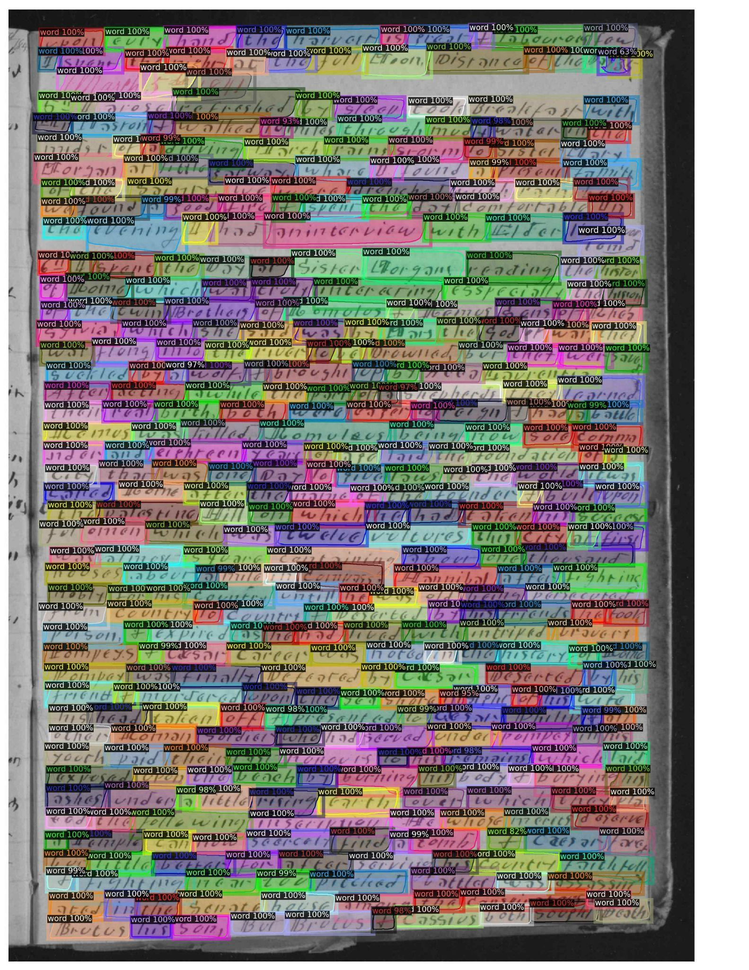







Segmentation
Notes:
Here’s a sample of the segmentation model’s output (the model is Detectron2, a Convolutional Neural Network)
The colored boxes are regions that the model identified as words
On the side, you can see some of the “snippets” that the model produces
We pass these snippets on to the next step of the process, transcription

Slide 3
Transcription
th I arose refreshed by sleep took Breakfast with
Tr Maston & walked
miles through mud i water in the
mid of a driving March rains storm to sister Mary
Morgan at little garway whare I found a plesent family
of the saint. we were drenched with rain, but
we found a good fire & spent the day comfortable in
the evening I had interview with Eder little
4tt I spent the Day at sister organs reading the history
of come which was truly interesting esspecially the hiram
of the twin Brothers of Loomis & Remus sons of Thes
sylvia, which she said was by Mars the God of war thes
war long into the river to be Drowned but they wer save
setled by
wolf & brought up by Acca Laurentia.
After acting awhile the part of a shepherds they learned
their real birth both were eager to reign & had a battle
Remus was killed romuleus being now sole comma
nder and eighteen years of age laid the foundation of a
city that was one Day to give laws to the world
Notes:
Finally, all the transcribed text is put into order
This is the actual output of our model
NOTE: many of the spelling errors are actually faithful to the source text (such as “whare”, “plesent”, “romuleus”)
Currently, an entire page can be transcribed in less than 30 seconds, with ~85% accuracy
Humans take around 11 minutes per page, and yield ~95% accuracy
So, Deep learning methods are 90% as accurate and more than 20 times faster than human transcribers

Slide 4
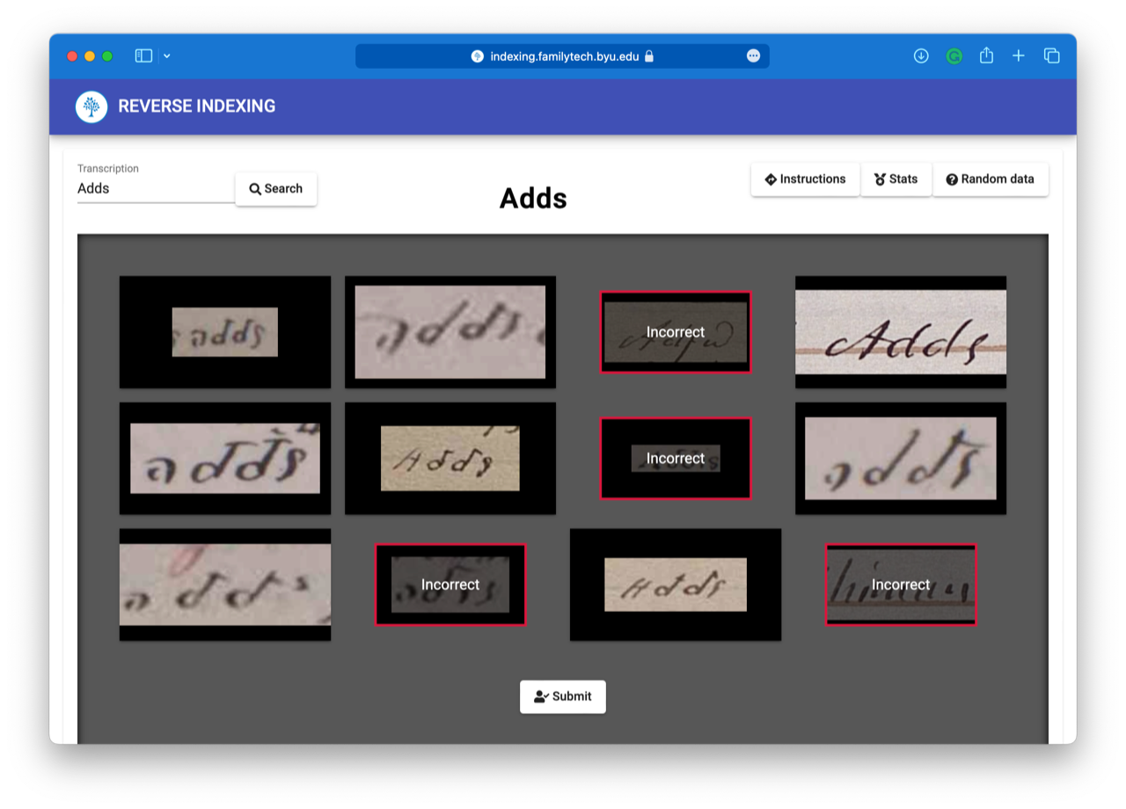
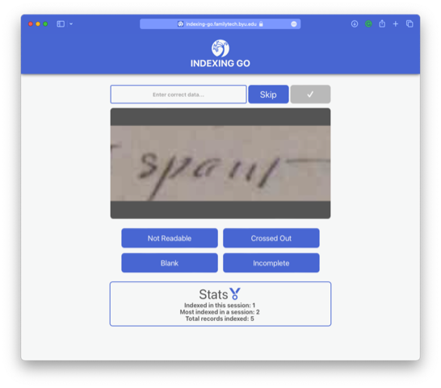
Error Correction
Notes:
Reverse indexing is an efficient way to identify and correct errors in model output
Two stages: error identification and correction
This process allows 13 mistranscribed words to be corrected every minute, based on recent tests.
This is much more time efficient than the current way of error correcting (requires two workers to read every word in the document)

