Slide 1

Attendance

Slide 2
DNS
Domain Name System

Slide 3
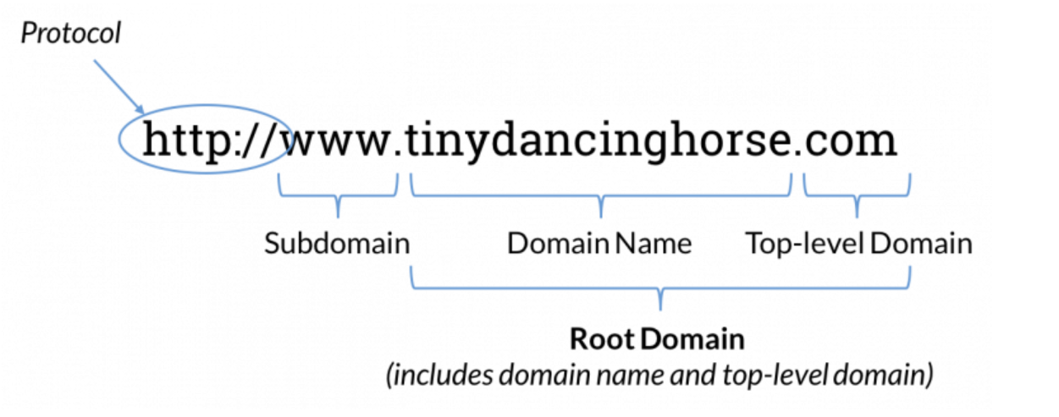
What is DNS and what is it used for?
Domain names – easy to remember address used to access websites
DNS turns domain names → IP addresses
tinydancinghorse.com → 208.192.15.3

Slide 4
What are DNS servers?
Local Cache
DNS Resolver
Root
TLD
Authoritative

Slide 5

Local Cache
Browser cache
In today’s world it usually is stored in the Local OS
Local OS cache
Windows: ipconfig /displaydns
Mac: sudo discoveryutil udnscachestats

Slide 6


DNS Resolver
Cache’s that tend to have the popular more used domain names
Helps find domain IP if not in cache
ISP
Cloudflare 1.1.1.1
Google 8.8.8.8

Slide 7
Root DNS Server
Stores IP addresses of the TLD servers.
13 logical root name servers
https://www.iana.org/domains/root/servers
Many different physical servers
https://root-servers.org/

Slide 8

Top Level Domain Server
Store the IP addresses of the authoritative name servers within the domains under them
.com
.org
.edu
.uk
.us

Slide 9

Authoritative Server
Contains the match tables of the domain name to the IP address
Examples:
Cloudflare
Google
OpenDNS
No-IP
Your very own custom DNS server

Slide 10
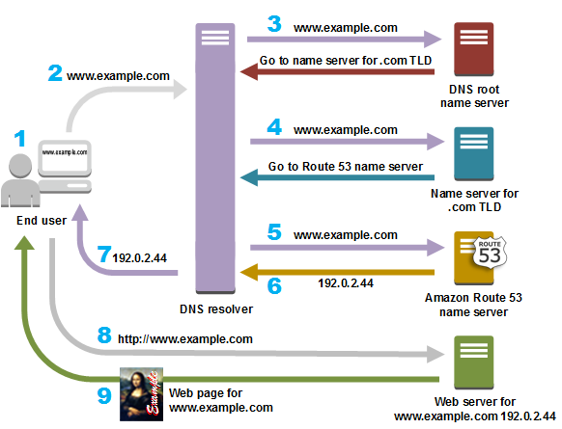
DNS Process broken down

Slide 11
User queries for domain. Browser sends query to resolver

Slide 12
Resolver queries root server

Slide 13
Resolver queries TLD name server

Slide 14
Resolver queries Auth Server

Slide 15
User Receives the IP address of domain name

Slide 16
Browser queries webpage directly

Slide 17
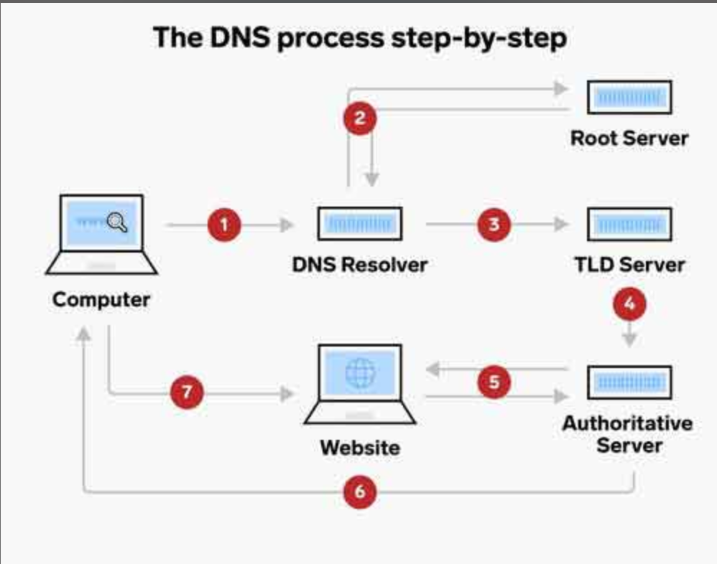
Activity

Slide 18
Notecard
Source: ________ (color) Our Search ___________ (domain name)
Root? ______ (Does it exist in the root DNS?)
TLD:________(Write down the chart number)
Auth: _____ . _____ . _____ . _____ (Write the IP address)
Web: _____________ (Write down the PC/person the packet is returned to)
Resolver Checks: ______ ______

Slide 19
Practice
Practice 1
Source IP: Purple
Domain searched: TechTribeHub.org
Practice 2
Source IP: Brown
Domain searched: CodeCrafty.edu

Slide 20
Team 1 Team 2
Packet 1:
Source IP: Red
Domain searched: NetworkNurturer.org
Packet 2:
Source IP: White
Domain searched: DataMasters.org
Packet 3:
Source IP: Silver
Domain searched: BojanglesGood.io
Packet 4:
Source IP: Orange
Domain searched: PixelPioneers.net
Packet 5:
Source IP: Black
Domain searched: DevDynasty.com
Packet 1:
Source IP: Blue
Domain searched: WebWizardry.com
Packet 2:
Source IP: Gray
Domain searched: GreenEnergyX.com
Packet 3:
Source IP: Yellow
Domain searched: SecureNest.edu
Packet 4:
Source IP: Green
Domain searched: JohnHarper.gov
Packet 5:
Source IP: Pink
Domain searched: CyberGuardPro.org

Slide 21
Attendance

