Slide 1
Simulating IMT Response and Performance
Daniel Jarvis, Thesis Defense

Slide 2
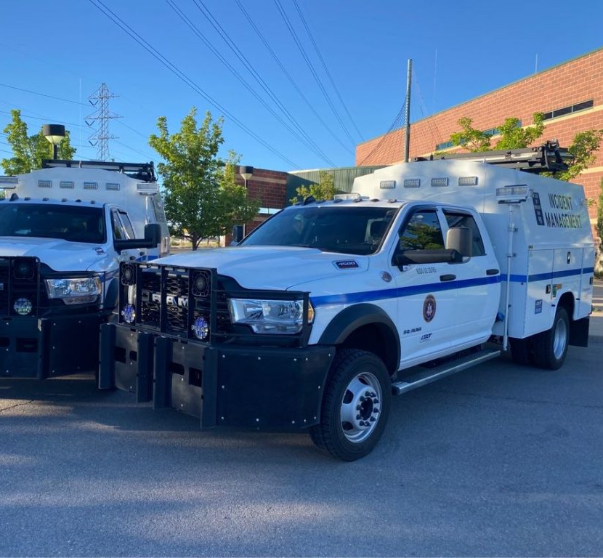
Overview / Introduction
Literature Review
IMT Optimization
Incident Modeling
Research Needed
Methodology
Model Design
Implementation in Utah
Results
Vehicle Hours of Delay
IMT Performance Analysis
Conclusions
Implications
Limitations
Next Steps

Slide 3
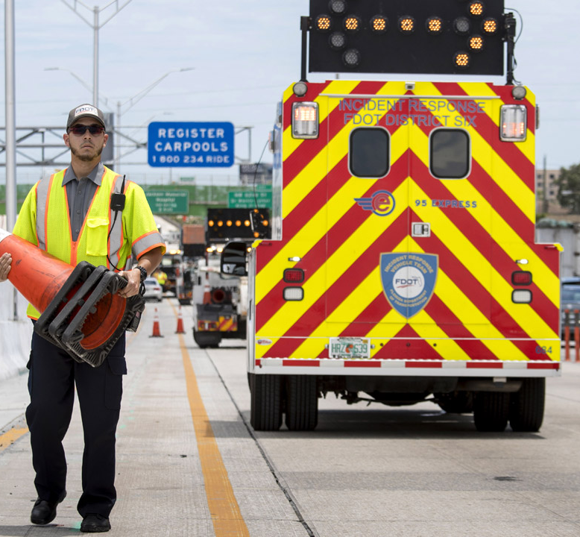
Lit. Review – IMT Optimization
IMT programs improve traffic
Roadway Clearance Time
Excess User Costs
Strategic IMT placement studies
Research focuses on deployment
Studies use diverse models
Models lack comparative analysis

Slide 4
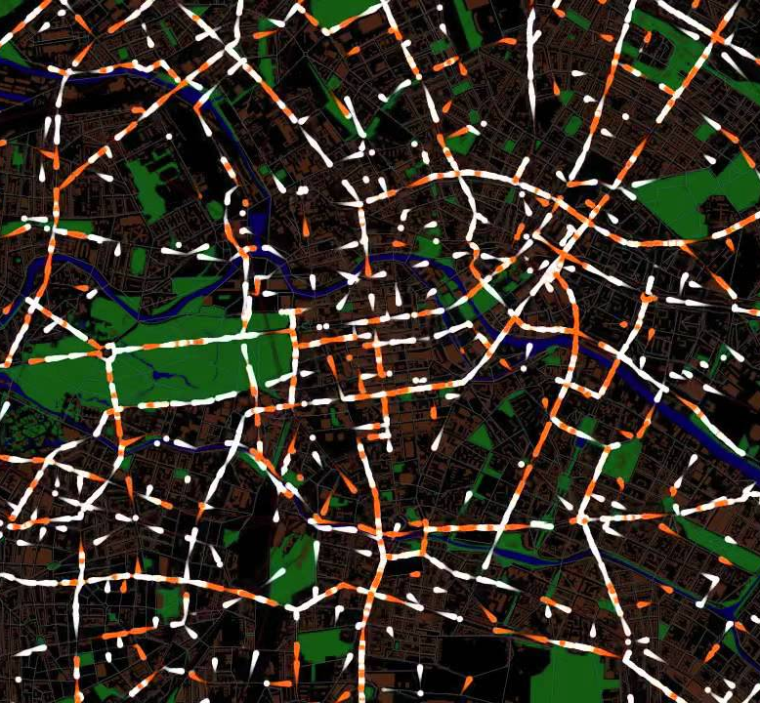
Lit. Review – Incident Modeling
DTA Models: Assess incident delay and travel impact
Applications: Customized for varied needs
Simulation: MATSim for realistic traffic flow scenarios
Management: Incorporating incident management
Research Needs: IMT simulations

Slide 5
Lit. Review – Research Needed
Limitations
Statistical Noise
Modeling Errors
Programing for agent behavior
Vehicle Travel Behavior
Further Investigations
IMTs Travel (Distance and Time)
Incident Response Times
Increasing Fleet Sizes
Sending Additional Vehicles

Slide 6
Methods – Model Design
Literature Review
IMT Optimization
Incident Modeling
Research Needed
Methodology
Model Design
Model Implementation in Utah
Results
Vehicle Hours of Delay
IMT Performance Analysis
Conclusions
Implications
Limitations
Next Steps

Slide 7
Methods – Implementation in Utah
Limitations
Statistical Noise
Modeling Errors
Programing for agent behavior
Vehicle Travel Behavior
Further Investigations
IMTs Travel (Distance and Time)
Incident Response Times
Increasing Fleet Sizes
Sending Additional Vehicles

Slide 8
Results – VHD
Limitations
Statistical Noise
Modeling Errors
Programing for agent behavior
Vehicle Travel Behavior
Further Investigations
IMTs Travel (Distance and Time)
Incident Response Times
Increasing Fleet Sizes
Sending Additional Vehicles

Slide 9
Results – IMT Performance
Limitations
Statistical Noise
Modeling Errors
Programing for agent behavior
Vehicle Travel Behavior
Further Investigations
IMTs Travel (Distance and Time)
Incident Response Times
Increasing Fleet Sizes
Sending Additional Vehicles

Slide 10
Conclusions – Implications
Limitations
Statistical Noise
Modeling Errors
Programing for agent behavior
Vehicle Travel Behavior
Further Investigations
IMTs Travel (Distance and Time)
Incident Response Times
Increasing Fleet Sizes
Sending Additional Vehicles

Slide 11
Conclusions – Limitations
Limitations
Statistical Noise
Modeling Errors
Programing for agent behavior
Vehicle Travel Behavior
Further Investigations
IMTs Travel (Distance and Time)
Incident Response Times
Increasing Fleet Sizes
Sending Additional Vehicles

Slide 12
Conclusions – Next Steps
Limitations
Statistical Noise
Modeling Errors
Programing for agent behavior
Vehicle Travel Behavior
Further Investigations
IMTs Travel (Distance and Time)
Incident Response Times
Increasing Fleet Sizes
Sending Additional Vehicles

Slide 13
Discussion

Slide 14
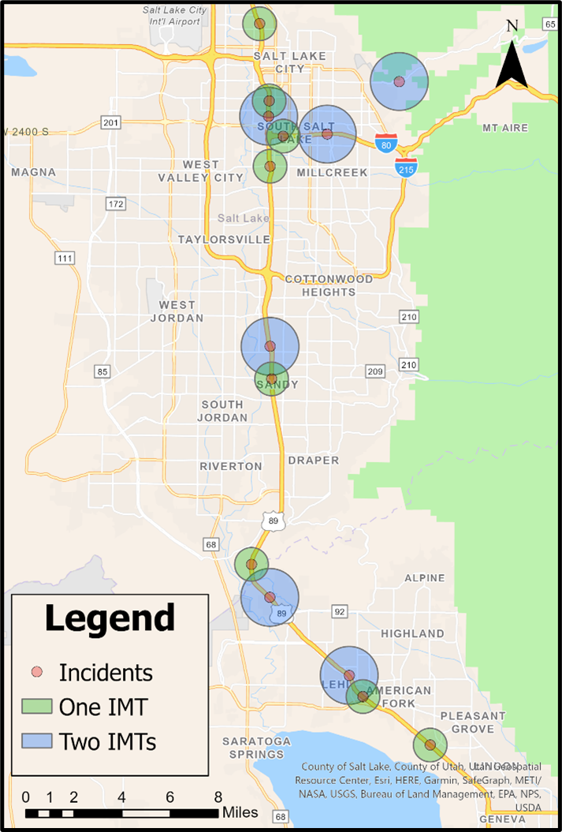
Example Scenarios
1. Baseline
2. Incidents Only
3. Incidents + IMTs
100% of the WFRC plans file
15 incidents
20 IMTs
300 iterations per simulation

Slide 15
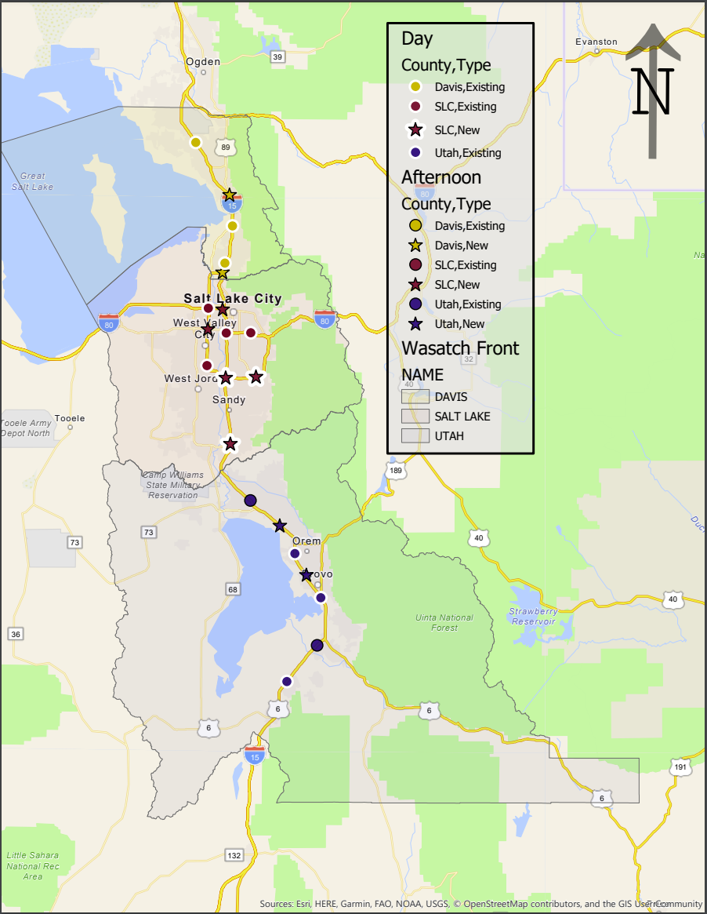
IMT Fleet Arrangements

Slide 16
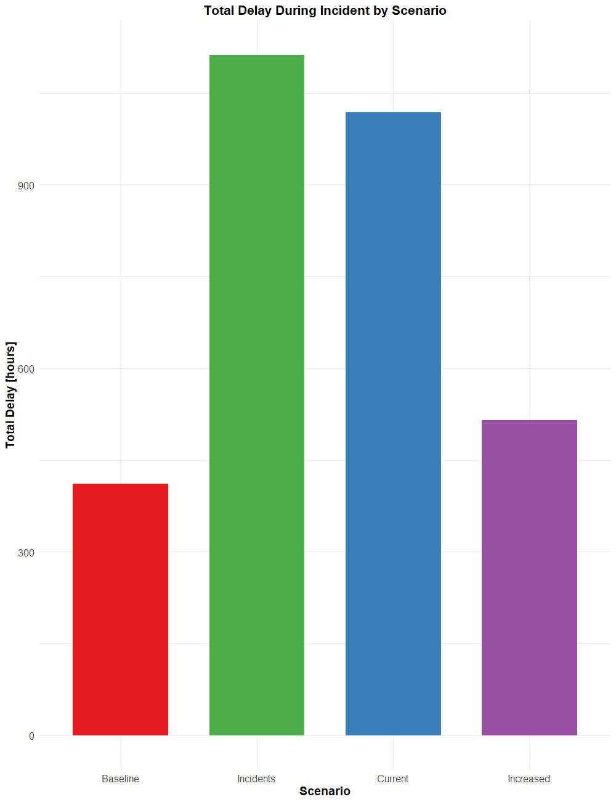
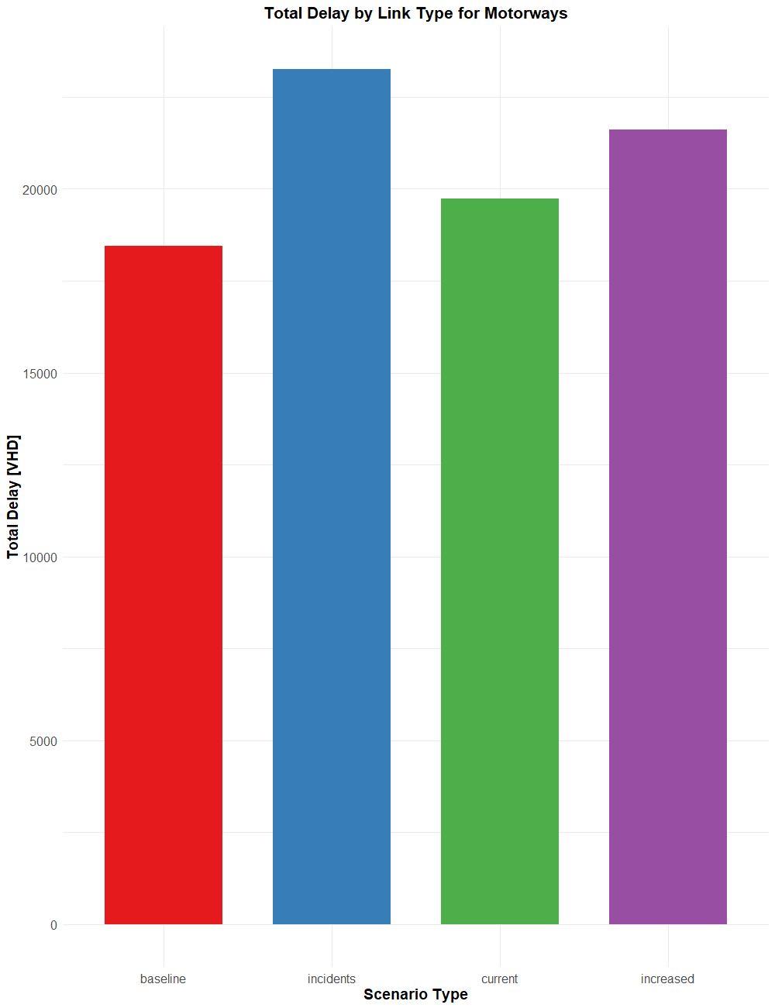
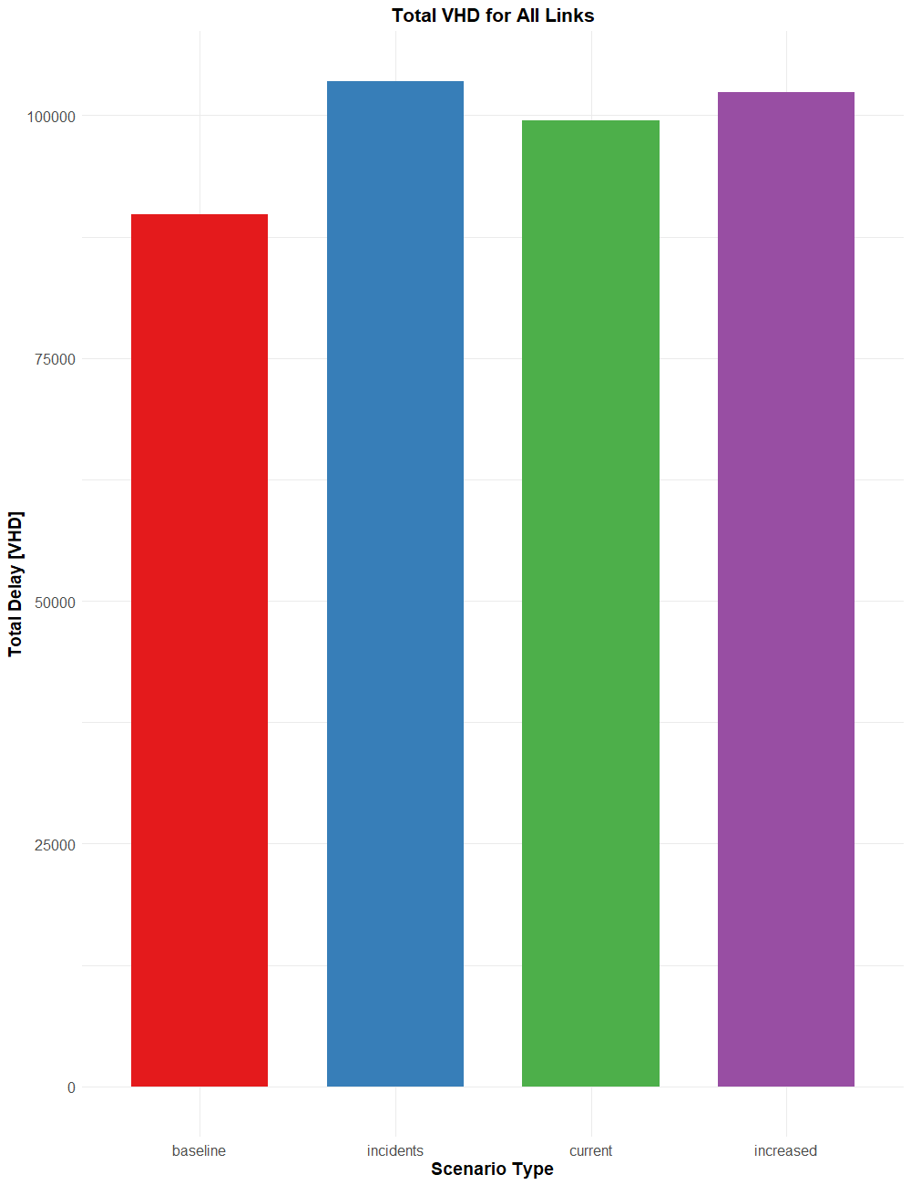
Results - VHD

Slide 17
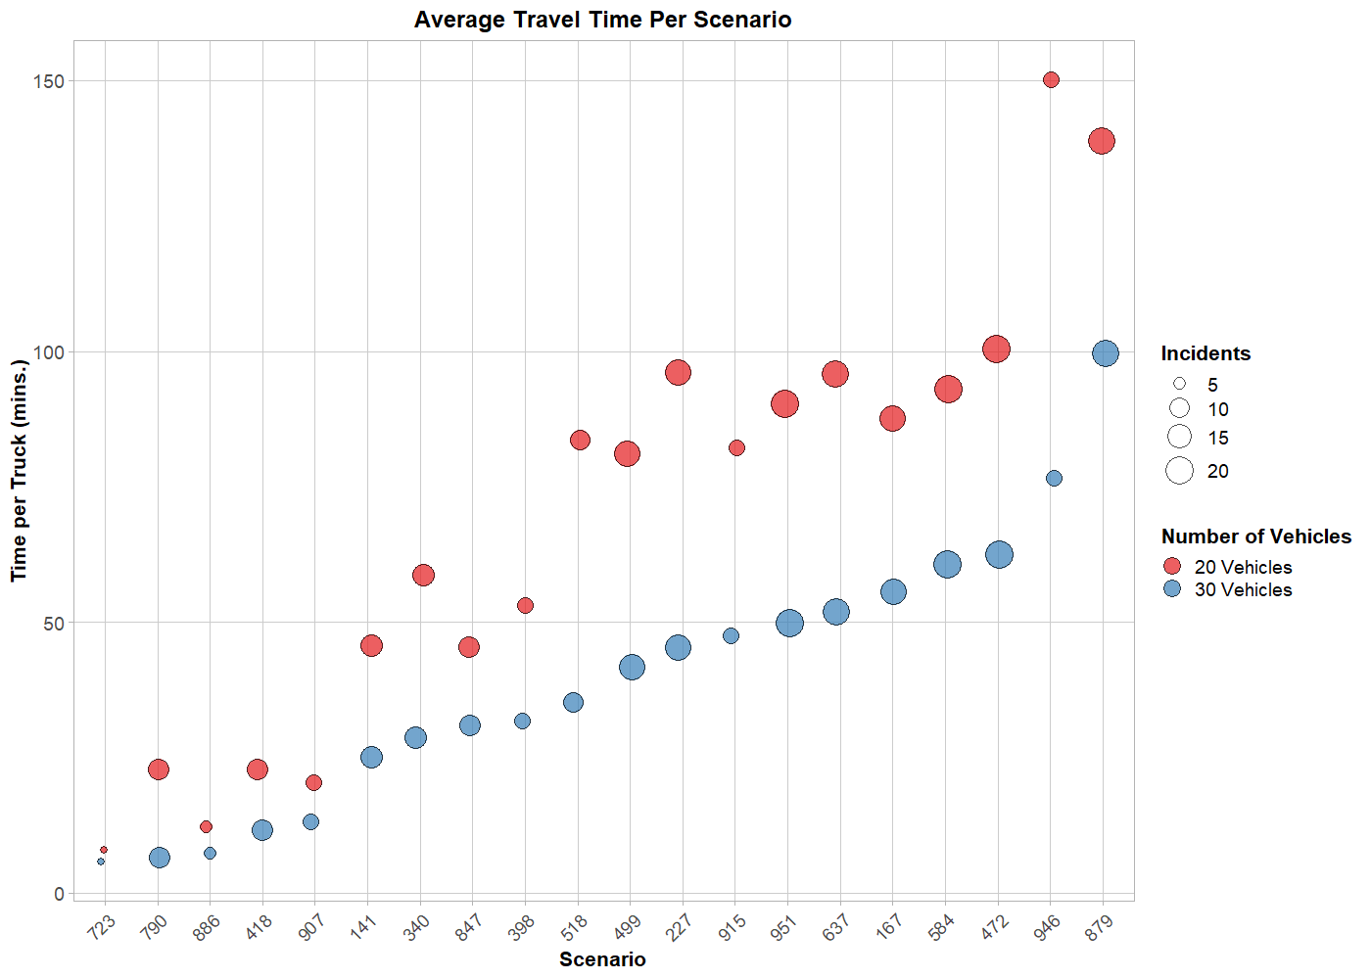
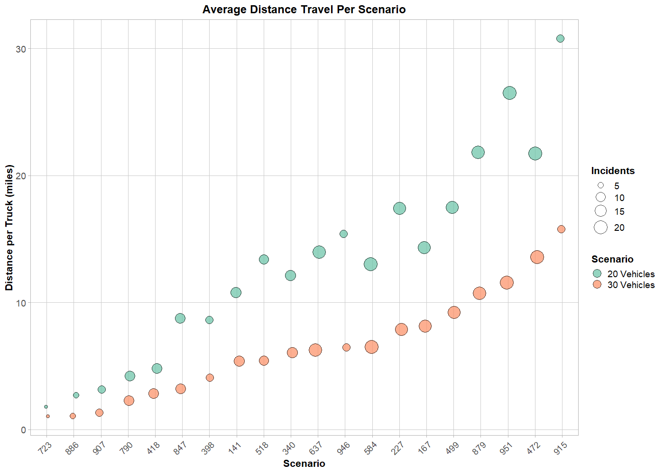
Results - Trucks

Slide 18
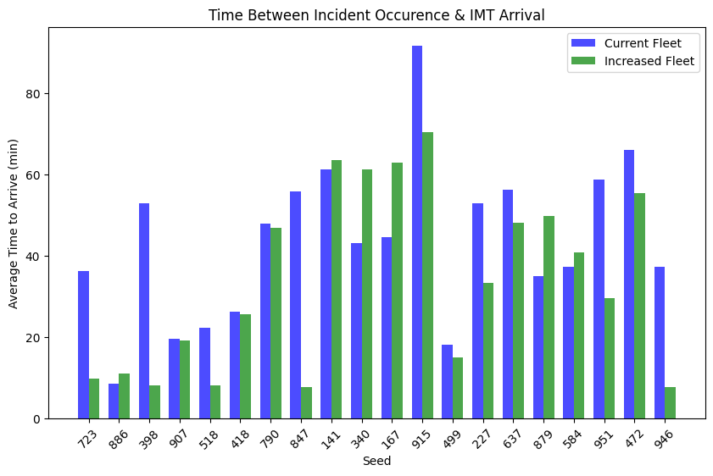
Results - Response

Slide 19
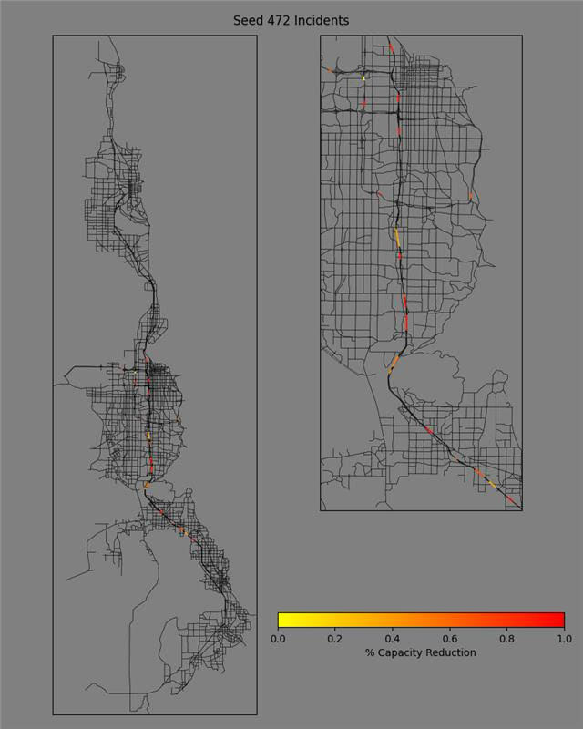
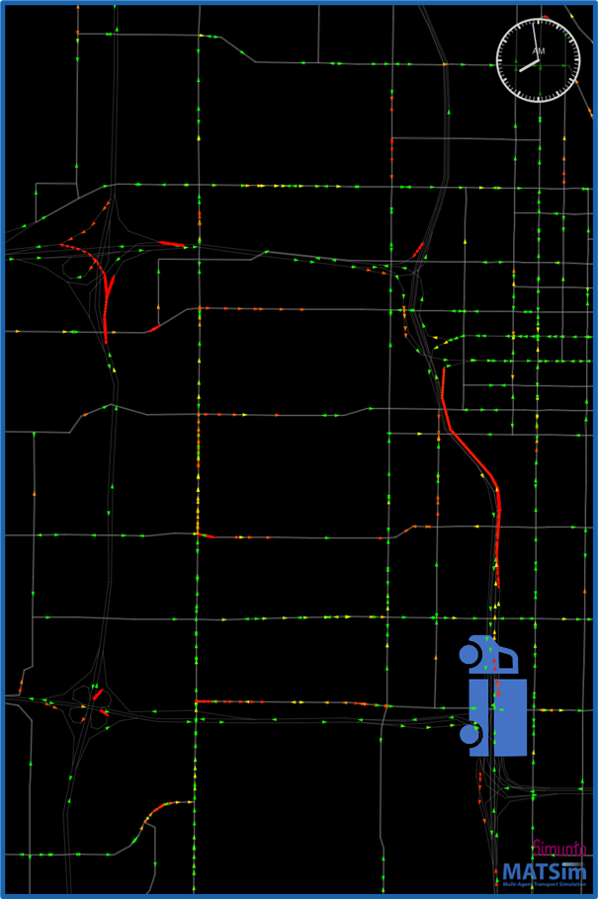
Results – Capacity - Video
Notes:
I am going to add the video to this or the next slide

Slide 20
Limitations – Further Investigations
Limitations
Statistical Noise
Modeling Errors
Programing for agent behavior
Vehicle Travel Behavior
Further Investigations
IMTs Travel (Distance and Time)
Incident Response Times
Increasing Fleet Sizes
Sending Additional Vehicles

