Slide 1
Simulating IMT Response and Performance
Daniel Jarvis, Thesis Defense

Slide 2
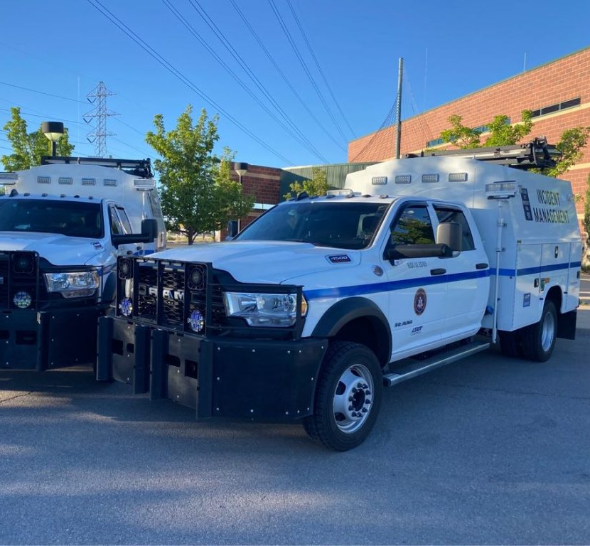
Overview
IMT Strategies to Mitigate Traffic Impacts
Visualizing Incident Effects through Simulation Models
Connecting IMT Performance with Simulation Outcomes
Applying MATSim to Scenario-based Simulations
Analyzing the Effects of Increasing Traffic Incidents
Assessing the Impact of Additional IMT Interventions
Utilizing Model for Strategic IMT Evaluation
Proposed Enhancements to Optimize the Traffic Model

Slide 3
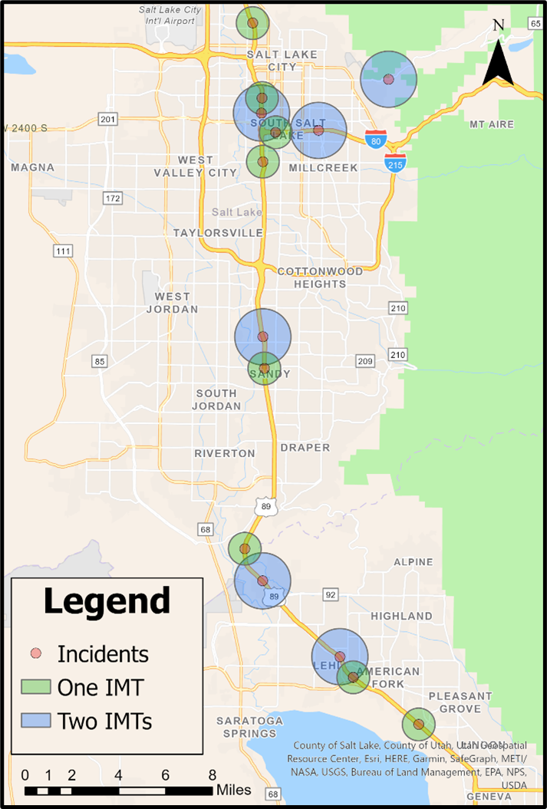
Example Scenarios
1. Baseline
2. Incidents Only
3. Incidents + IMTs
100% of the WFRC plans file
15 incidents
20 IMTs
300 iterations per simulation

Slide 4
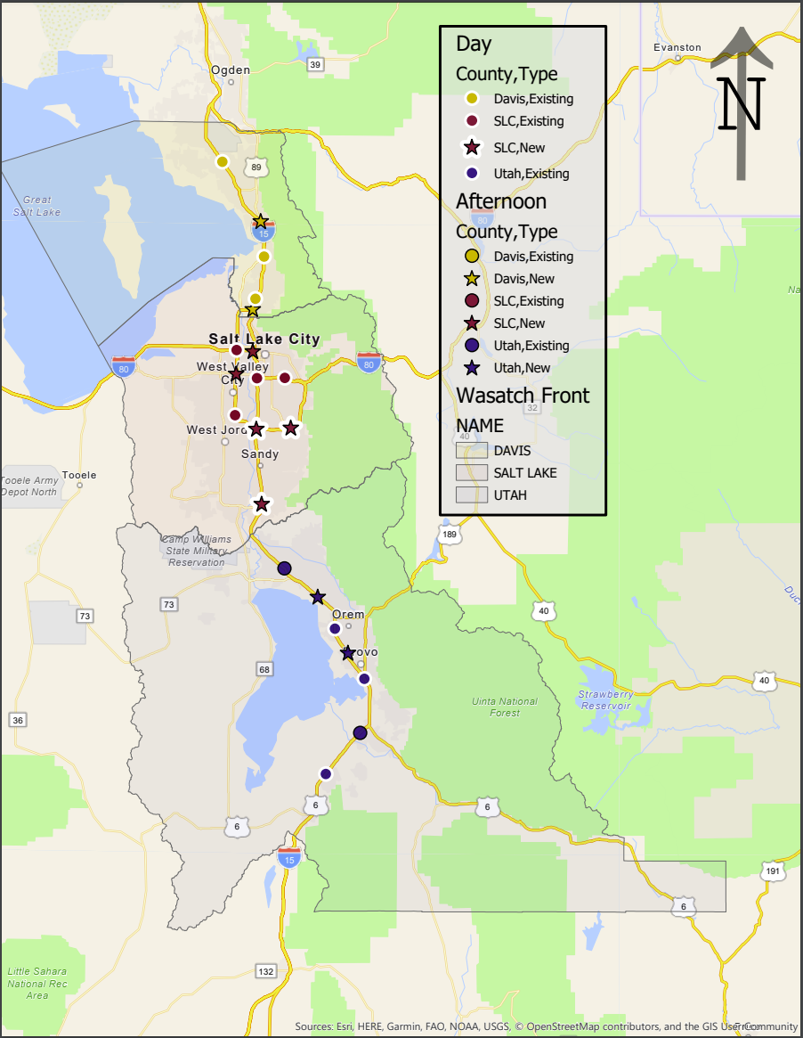
IMT Fleet Arrangements

Slide 5
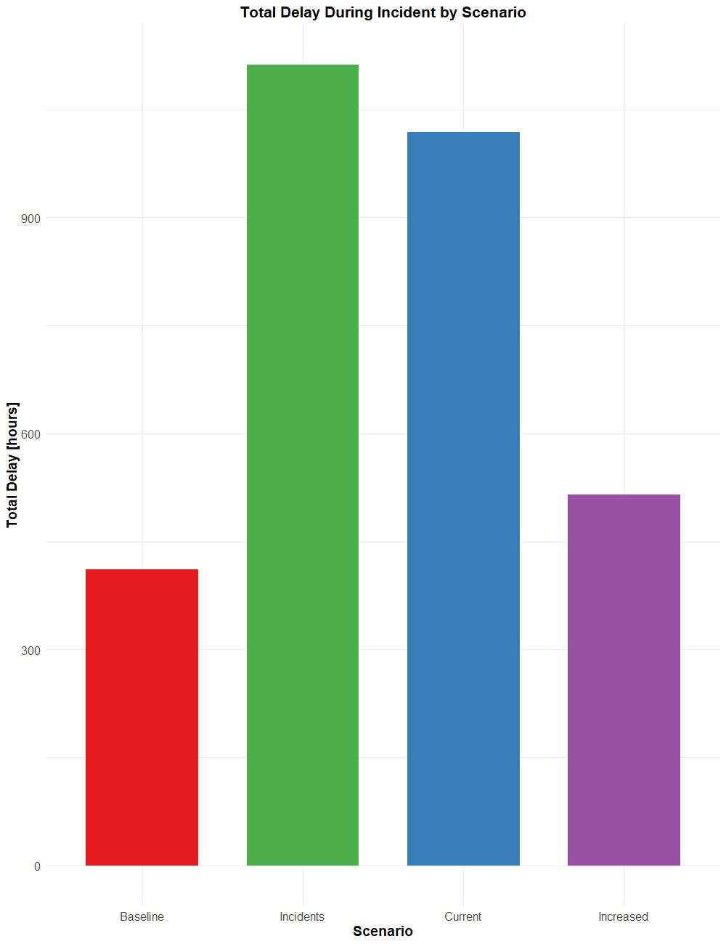
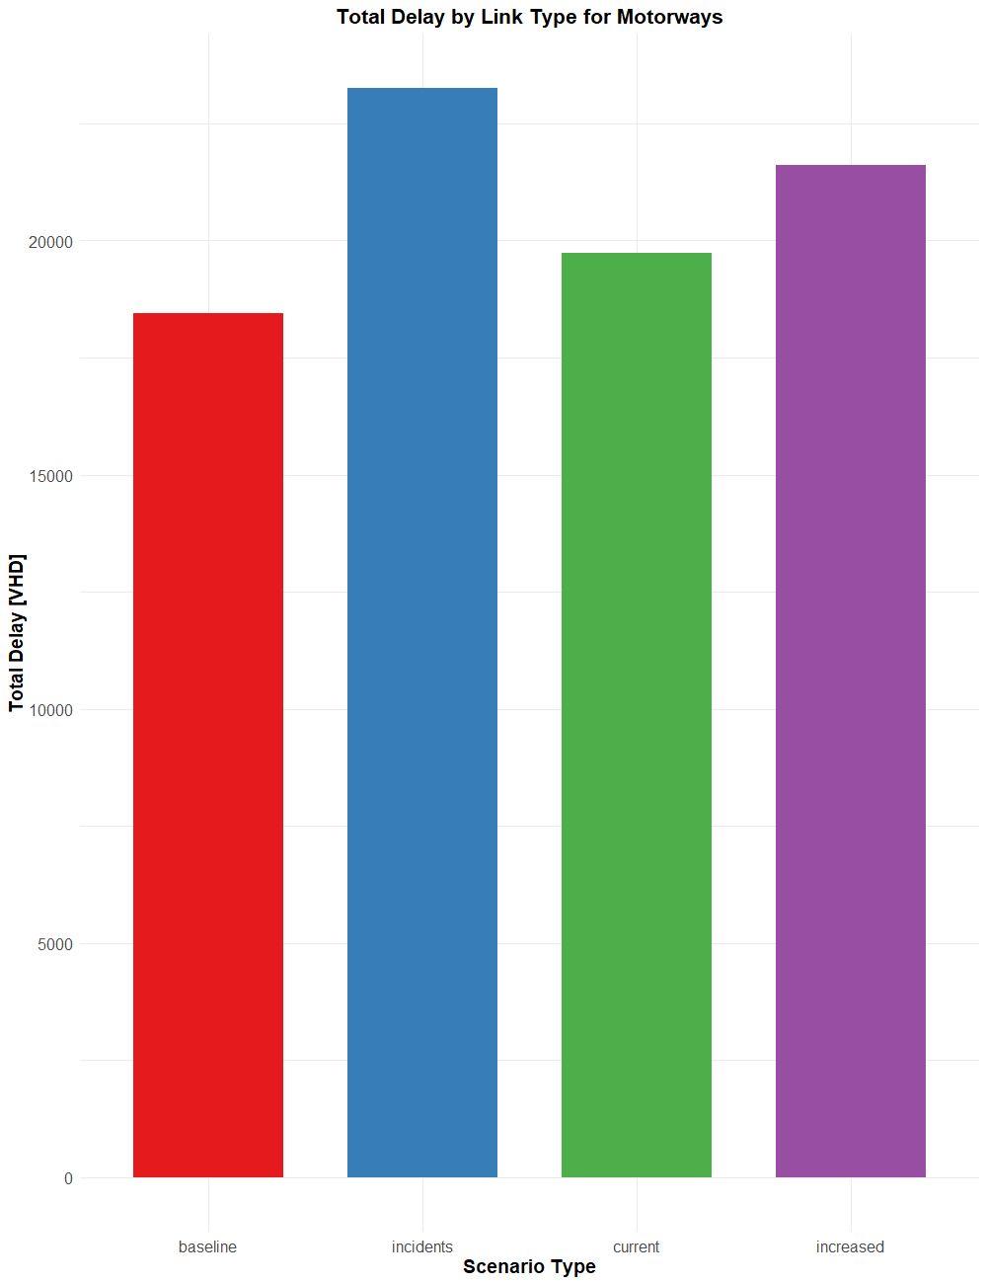
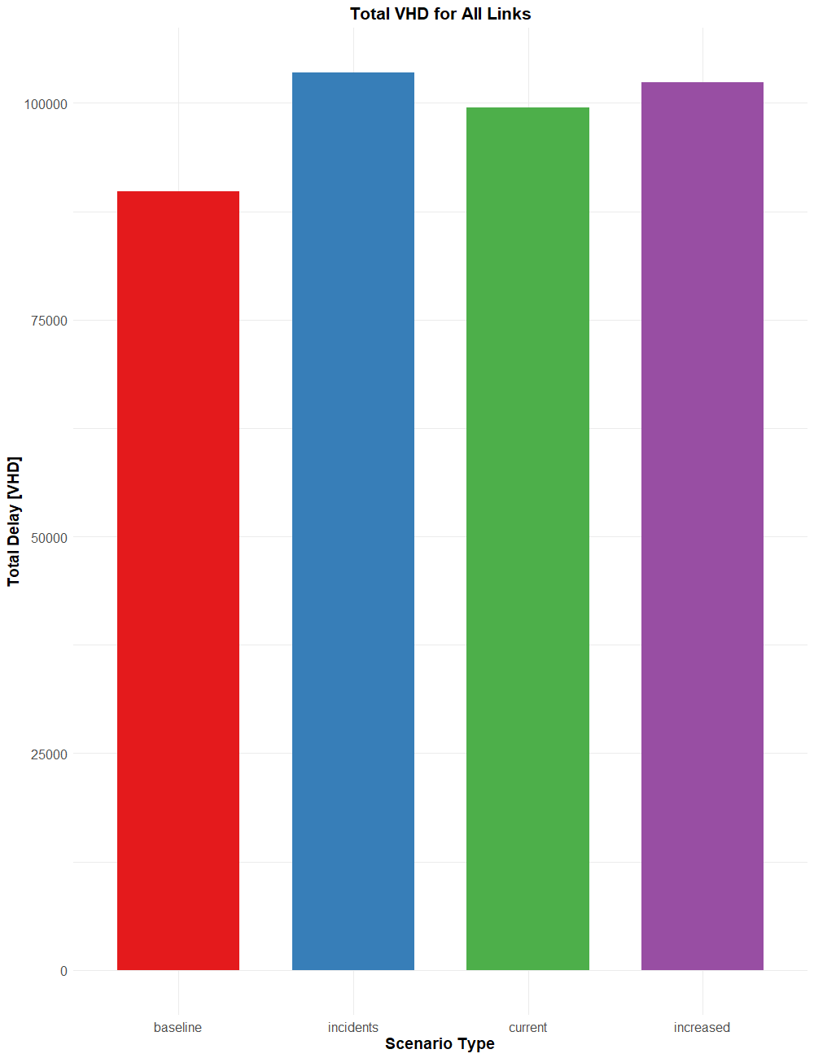
Results - VHD

Slide 6
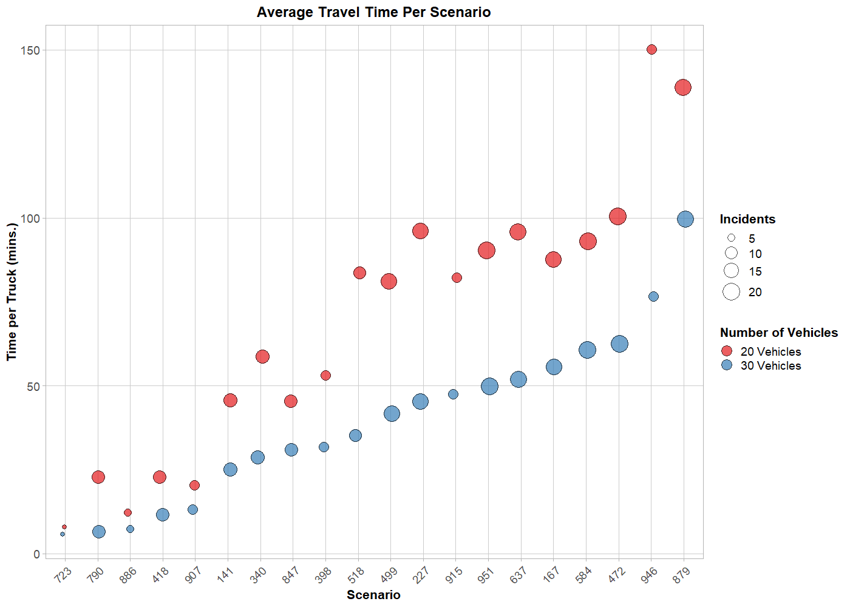
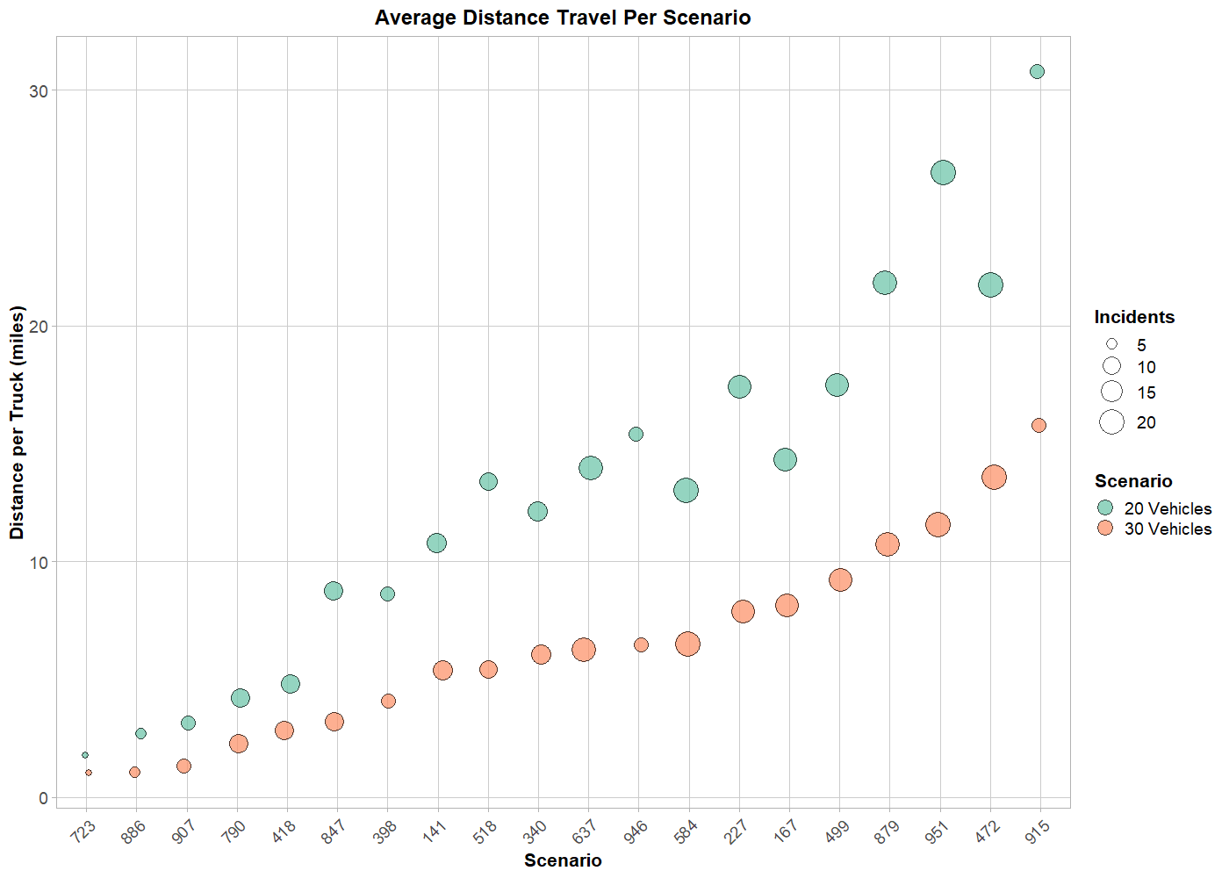
Results - Trucks

Slide 7
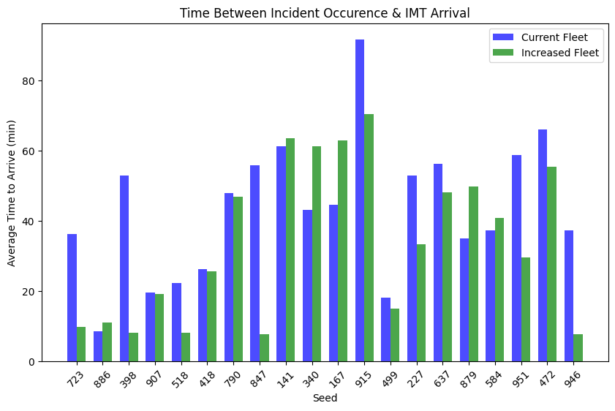
Results - Response

Slide 8
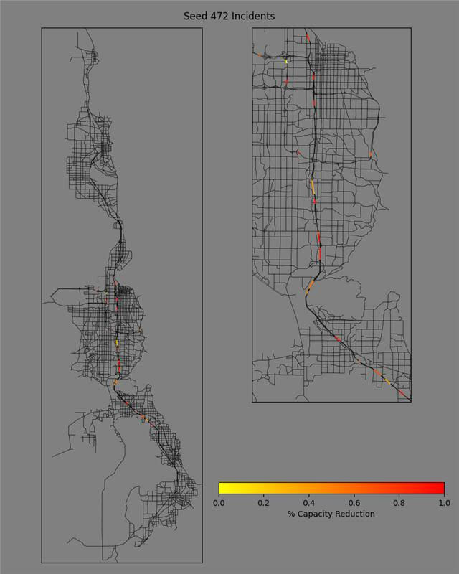
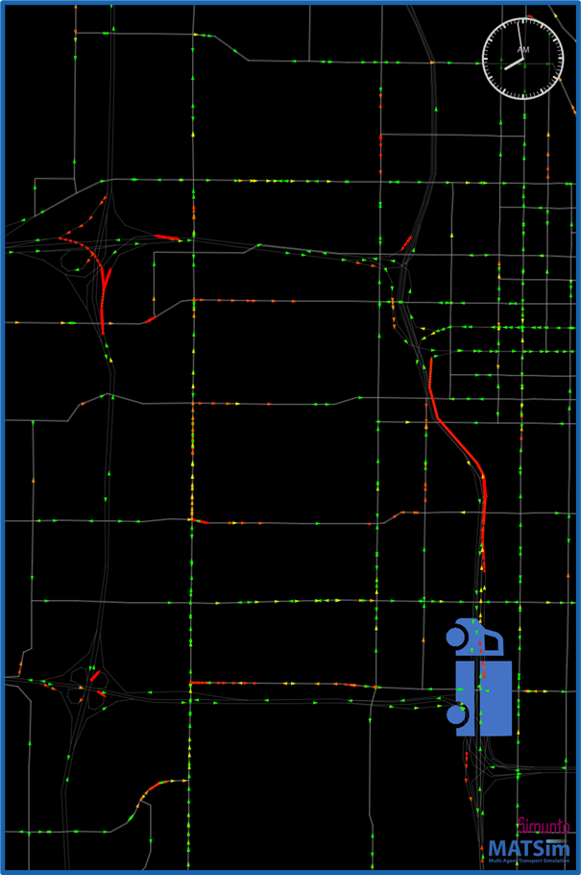
Results – Capacity - Video
Notes:
I am going to add the video to this or the next slide

Slide 9
Limitations – Further Investigations
Limitations
Statistical Noise
Modeling Errors
Programing for agent behavior
Vehicle Travel Behavior
Further Investigations
IMTs Travel (Distance and Time)
Incident Response Times
Increasing Fleet Sizes
Sending Additional Vehicles

Slide 10
Discussion

