Slide 1
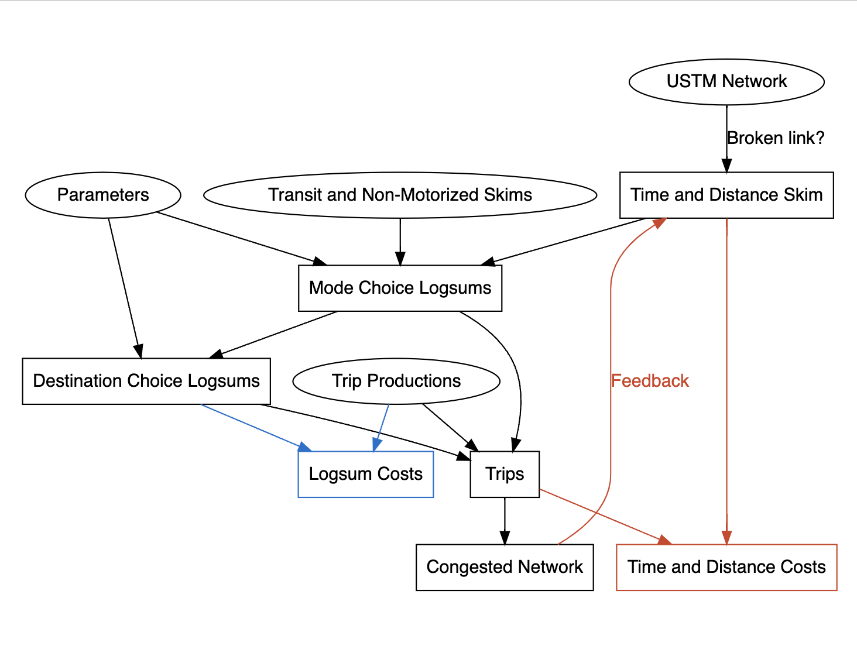
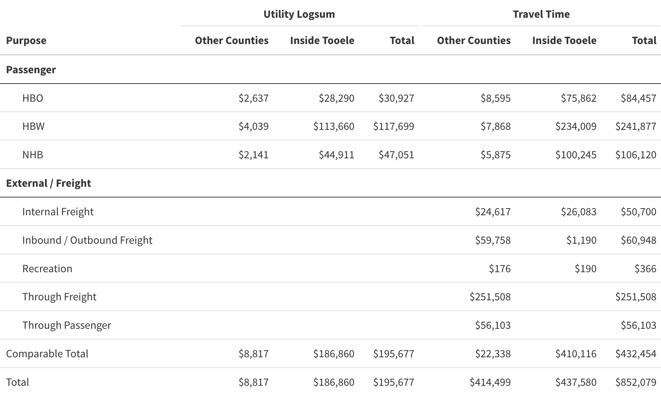
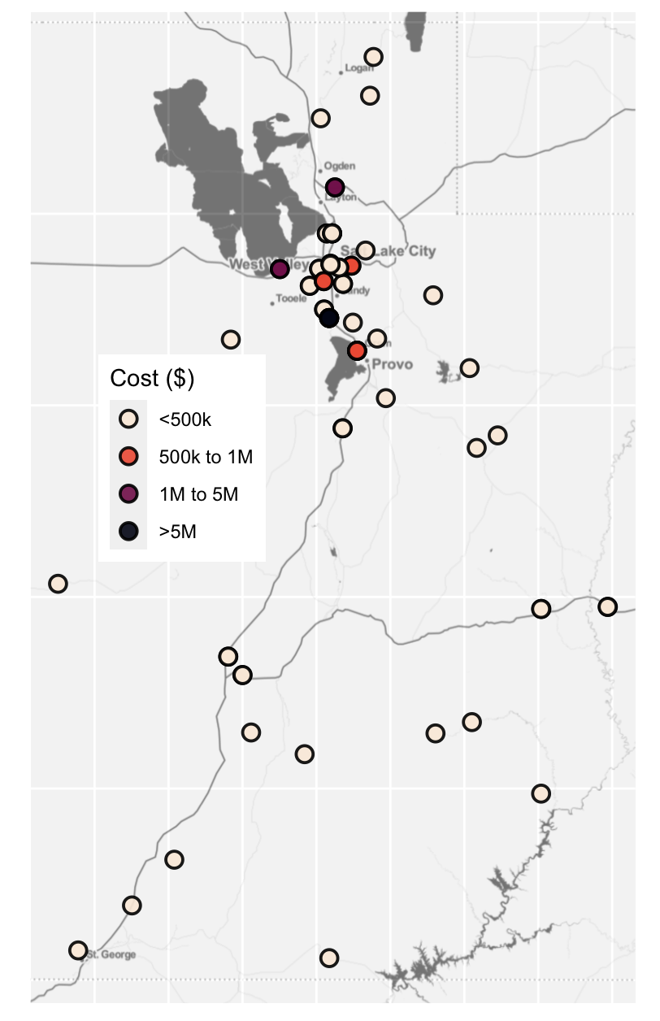
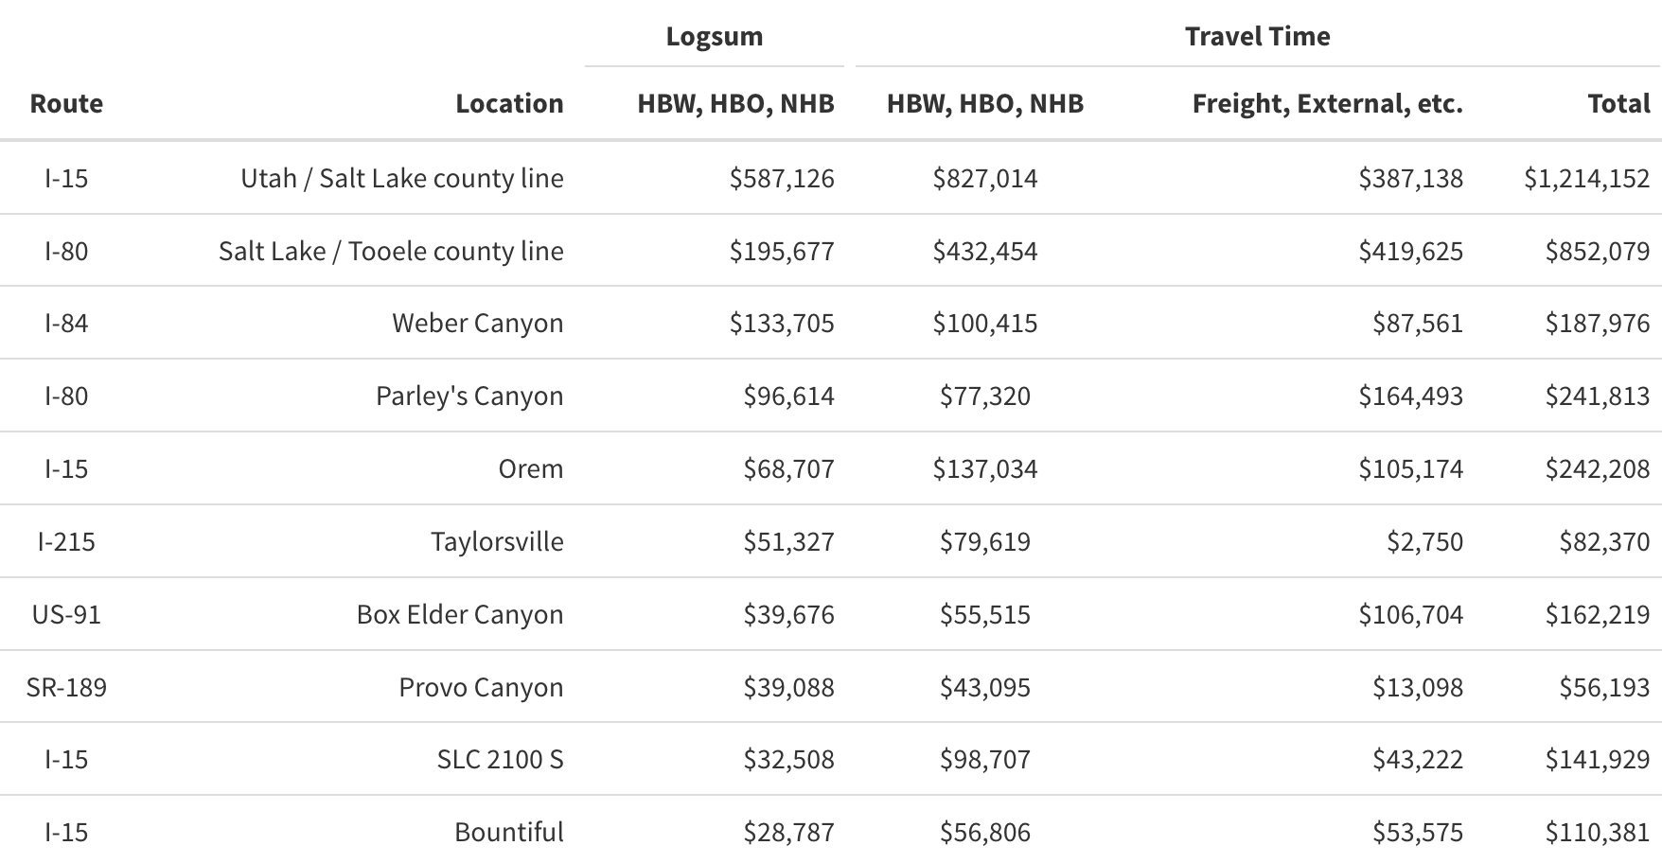
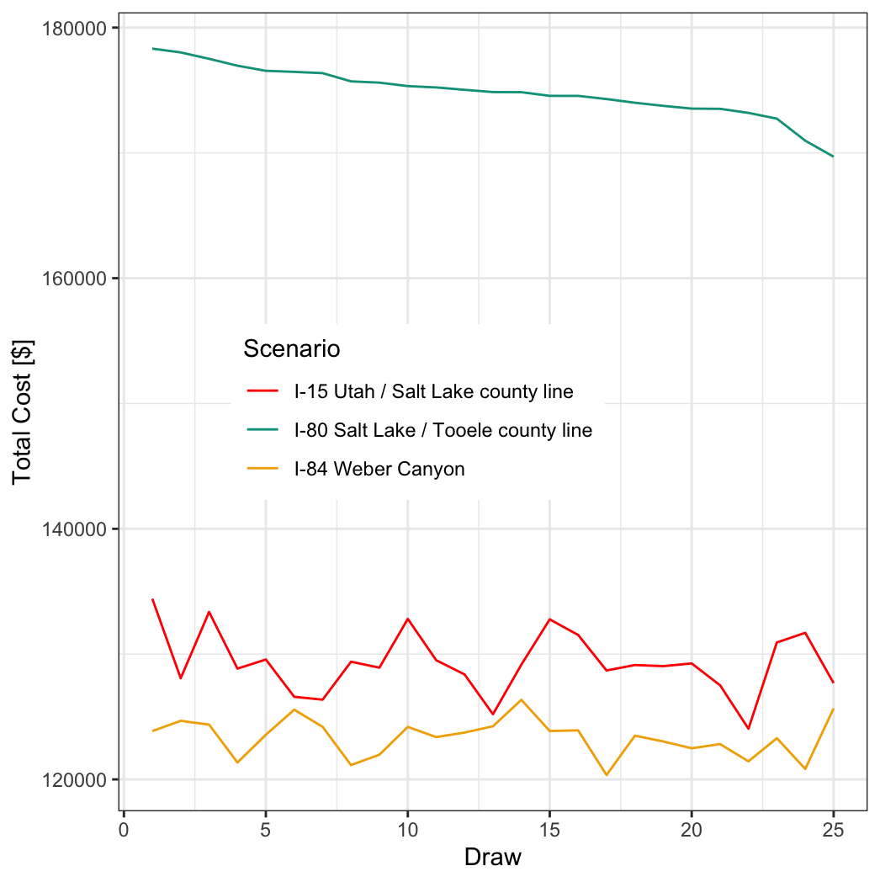


A utility-based approach to modeling systemic resilience of highway networks with an application in Utah
Built a statewide trip-based model
Sensitive to route, mode, and destination options
Robust to changes in parameters
Using accessibility logsums instead of excess travel times leads to a different prioritization of critical facilities.
Greg Macfarlane
Max Barnes
Natalie Gray
Model design
Detail for I-80 at Tooele / Salt Lake Line
The resilience of transportation networks is an important consideration in management and planning, but practical techniques to identify systemically critical links are limited. Further, current practical techniques ignore that when transportation networks are damaged or degraded, people potentially change destinations and modes as well as travel routes. In this research, we develop a model to examine network highway resilience based on changes to mode and destination choice logsums, and apply this model to 41 scenarios representing the loss of links on the statewide highway network in Utah. The results of the analysis suggest a fundamentally different prioritization scheme than would be identified solely through a methodology based on increased travel times.
Rankings of the most critical projects are different by method
The rankings are robust
This study was funded by the Utah Department of Transportation. The authors alone are responsible for the preparation and accuracy of the information, data, analysis, discussions, recommendations, and conclusions presented herein. The contents do not necessarily reflect the views, opinions, endorsements, or policies of the Utah Department of Transportation or the US Department of Transportation. The Utah Department of Transportation makes no representation or warranty of any kind, and assumes no liability therefore.

