Slide 1


Extending Model Checking using Inductive
Proofs in Distributed Digital Currency Protocols
Kyle Storey
Master’s Thesis Defense
May 4, 2023
1

Slide 2
Model Checkers
Theorem Provers
Pros:
Support for distributed systems
Directly model the protocol
Easily verify safety properties
Easily verify liveness properties
Cons:
Computationally complex
Only suitable for small systems
Pros:
Powerful reasoning techniques
Can prove properties on arbitrarily large or even infinite systems
Cons:
Direct implementation of the protocol complicates proof
Non-trivial to prove safety properties
Very difficult to prove liveness properties

Slide 3
Thesis
Combining model checkers and theorem provers can be an effective method to verify distributed algorithms that support any number of participants.
We will use algorithms within MyCHIPs—a novel digital currency based on personal credit—as case study of these methods.

Slide 4
What is MyCHIPs?
Cindy
Digs Well
Fixes Car
Pays
Pays
John
Bob
Bank
Pays
Installs Solar Panels
Notes:
MyCHIPs can be best understood by first considering a barter with more then 2 people.
Bob’s car broke down and he needs it fixed.
Cindy can fix the car but would like a well dug on her property
John can dig the well but would like solar panels installed on his roof
Bob can install those solar panels.
We can see that if everyone did their piece everyone would be happy.
If they were to arrange for this using USD Bob is just up a tree and needs money so he goes to the bank for a loan.
He then gives that money to Cindy who gives that money to john, who gives the same money back to Bob.
Bob brings the money back to the bank and they take it and then ask Bob to pay a little interest.
MyCHIPs considers if new information technology will allow us to cut out the Bank as a middleman.
In MyCHIPs Bob would give Cindy an IOU, Cindy would give John an IOU and John would give Bob an IOU
So there is a cycle where each person in the cycle is in debt to their successor in the cycle.
What MyCHIPs does is identify these cycles and arranges for everyone to forgive each others debt.
This is done using a distributed algorithm called a credit lift.

Slide 5
An example a credit lift
Referee
Originator
Relay 1
Relay 2
Promise
Promise
Promise
Phase
Promise
Commit
Signature
Signature
Status
Signature
Signature
Commit
Phase
Notes:
I’ll use one example of how the credit lift algorithm works, then define it formally using a mealy machine later.
There are 3 phases to the credit lift algorithm.
The first is the discovery phase where a cycle is identified, because no value is exchanged in this phase we don’t verify this phase
The second phase is the promise phase where each node agrees to forgive each other’s debt if everyone in the cycle agrees.
Once all have agreed we start the commit phase where the nodes forgive the debt.
There are 3 unique types of nodes in the lift.
The originator which is a node in the cycle of debt that initiates the lift.
Any number of relay nodes which is a node in the cycle that is not the originator. (In this example we have 2)
Finally, we have the referee which serves to ensure that all the nodes agree on if the lift should commit or be nullified as will become more clear with this example.
So to start the lift the originator sends a promise to Relay 1
The promise has 3 pieces. The value of the lift, how much debt is being forgiven, a timestamp that is some point in the future where if the lift has not completed by then we will nullify it, and it will identify the referee. This promise is a contract to forgive Relay 1’s debt that is valid with the referee’s signature.
When Relay 1 receives the promise if it still wants to participate in the lift it sends a similar promise to Relay 2.
Relay 2 then sends the promise to it’s successor which happens to be the originator.
This completes the promise phase and the originator knows everyone has agreed.
The originator then needs to obtain the Referee’s signature to make the promises valid.
The originator sends the lift record to the referee in a commit message.
The referee looks at the timestamp, and checks to make sure according to it’s clock the lift completed in time. In this way the referee serves as an authoritative clock.
In this example the lift did complete in time so it signs the record and gives the Originator it’s signature.
The originator then gives this signature to Relay 2 to get it’s debt forgiven.
Unfortunatly Relay 2 experiances some error and crashes. Because of this it fails for forward the signature to Relay 1.
After a long time, Relay one received the promise and according to it’s clock the lift should have been completed by then.
Relay one sends a message to the referee requesting the status of the lift.
The referee see’s in it’s records that it has previously signed that lift and provides Relay 1 with the signature.
Now all active nodes have reached consensus that the lift is committed. If some time later Relay 2 recovers it

Slide 6
The mealy machine model
Tigger / Action
Recipient ! Message
Sender ? Message
Originator
Referee
Relay
No Lift
No Lift
No Lift
True /
Pred ! Promise
True /
Referee ! Status
Node[i] ? Status /
Node[i] ! Pend
Referee ? Void /
Succ ! Void
Pend
Successor ? Promise /
Predecessor ! Promise
Node[i] ? Status ⋁
Node[i] ? Commit / Node[i] ! Void
Originator ? Commit /
Originator ! Signature
Succ ? Promise /
Referee ! Commit
True /
Referee ! Status
Call
Pend
Referee ? Void ⋁ Predecessor ? Void /
Successor ! Void
Referee ? Signature ⋁
Predecessor ? Signature /
Successor ! Signature
Referee ? Void /
Succ ! Void
Referee ? Signature /
Succ ! Signature
Void
Good
Void
Good
Void
Good
Node[i] ? Status /
Node[i] ! Void
Node[i] ? Status /
Node[i] ! Signature
Notes:
We can formalize the actions that each type of agent can take using a Mealy machine. The states and transitions impose a partial order on the actions that can be taken by each node. Using this partial order, we can define the set of possible traces by construction. We can use this to prove that the properties that hold on a small system extend to a larger system through conformance. One important feature of this model is it does not explicitly model time, instead it models decisions agents make based on time as non-deterministic choices.

Slide 7
Required Properties
P1: Termination
  Lifts always eventually are committed or nullified for every active node.
P2: Consensus
  At the final state of the lift, every active node agrees that the lift was committed, or every active node agrees the lift was nullified.
P3: Harmless
  The balance of every active node on the final state of the lift is equal to or greater than its initial balance.
P4: Agreement
  Every active pair of nodes on the final state of the lift agree on their shared tally.

Slide 8
Verifying an arbitrarily large system
Originator
Validate
Relay n
Referee
Relay 1
Validate (Option)
Validate (Option)
Validate (Option)
Notes:
We would like to verify that these properties hold for a lift with any number of relay nodes
If we have only a 1 or 2 relay nodes we can verify these properties using model checking, but it’s the arbitrarily large size, this . . . Here, that makes it tricky.
Of course I’m not the first person to try and solve a problem like this and there are two pieces of related work that I want to highlight to frame my work and describe the contribution.

Slide 9
Infinite State Model Checking
0
1
0
2
1
3
1
2
2
1
3
3
2
3
4
4
Notes:
Clarke Grumberg and Browne
Infinite state model checking uses model checking techniques but adjusts them to allow it to operate on infinite state spaces.
C G and B were considering a system with an arbitrary number of identical processes. They posited that you could look at a system with just 2 processes and show that properties proven there extend to any number of processes.
They do this by looking at the state space itself. The identify respective patters in the states, and define new state matching to effectively consider two unique but similar cases as the same case. In this way it akin to abstract interpretation.
This is a pretty effective method, but I took a different approach that is based trace theory and conformance.
Soundness

Slide 10
Trace Theory
Black Box
A
A
A
C
F
B
E
F
C
C
F
D
E
E
Notes:
Dill 1988
The second piece is Trace Theory that was published by Dill in 1988.
Dill was working in a entirely different context. Dill wanted to do heirarical analysis of electronic circuits.
What dill was considering is: “When is it safe to substitute one module for another?”
To solve this he considered possible traces of events for a circuit. For example ….
What Dill considered was if we consider the module as a black box if we can show some sort of equivilance between the possible traces we can show safe substitution.
He defines a conformance relation which is a relation on the possible traces of a pair of modules, with the property that if one modules traces conform the another then it is a safe substitution.

Slide 11
Our Approach
Originator
Commit Send
Commit Receive
Referee
Promise Receive
Commit Send
Commit Receive
Promise Send
Status Send
Status Receive
Relay
Notes:
So the way to think about my work is that we are solving a similar problem as Clarke Grumburg and Brown but using trace theory and conformance as a tool in our proof that if properties hold in the small system that extends to a large system.
Intuitivly how this works is to start with a base system with one originator, one referee, and one relay node, and use conformance to consider swapping the relay node with a black box.

Slide 12
Our Approach
Originator
Commit Send
Commit Receive
Referee
Promise Receive
Commit Send
Commit Receive
Promise Send
Status Send
Status Receive
Black Box
Notes:
We can then consider what could be in the black box.

Slide 13
Our Approach
Originator
Commit Send
Commit Receive
Referee
Promise Receive
Commit Send
Commit Receive
Promise Send
Status Send
Status Receive
Black Box
Black Box

Slide 14
Status Send
Status Receive
Promise Receive
Promise Send
Relay
Commit Send
Commit Receive
Notes:
Of course we could just put a relay node in the black box and that would generate the correct traces of inputs and outputs

Slide 15
Status Send
Status Receive
Aggregator
Promise Receive
Promise Send
Relay n
Relay 1
Commit Send
Commit Receive
Notes:
But the question is, instead of one relay node, can we put a chain of n relay nodes in the box.
Can we prove that the traces of events possible with this chain of relay nodes conforming to a single relay node?
It turns out this is pretty tricky to prove directly because the relay nodes according to their definition have lots of internal state to keep track of and even some non-deterministic choices which is tricky.
However, we can describe this black box another way which makes this proof easier.

Slide 16
Status Send
Status Receive
Promise Receive
Promise Send
Relay
Commit Send
Commit Receive
Notes:
Instead of defining the behavior of the module with mealy machines and non-deterministic choices, we can instead write a series of rules that determine if a trace of events should be possible.
Similar to the “Chinese Room” argument
When we have a module that is implemented with validity rules like this we will call it a “Black-Box” model.

Slide 17



Core Lemmas
Base case proven with model checking
Conformance of n+1 relay nodes to n relay nodes
Conformance equivalence of relay node definition and validity rules
Notes:
So here is the game plan:
We will build an inductive proof using model checking results on a small system as a base case and utilize conformance in two ways.
First we will use conformance to show that a chain of n+1 relay nodes conforms to a chain of n relay nodes using the Black box model where this is easier to prove.
Second we will use conformance to show that the black box model implementation

Slide 18
Proof Intuition
Originator
Commit Send
Commit Receive
Referee
Promise Receive
Commit Send
Commit Receive
Promise Send
Status Send
Status Receive
Relay
Notes:
So to give some intuition of how the inductive proof is organized. We will start with a base system with just one originator, one referee node, and one relay node. We then use our third lemma conformance equivilance to convert the relay node mealy machine implementation into the validity rules implementation. We then use our 2nd lemma to show that a chain of n+1 relay nodes is a safe substitution for n relay nodes swap in a chain of two validity rules implementations.

Slide 19
Originator
Proof Intuition
Commit Send
Commit Receive
Referee
Promise Receive
Commit Send
Commit Receive
Promise Send
Status Send
Status Receive
Relay n+1
Relay n
Notes:
Finally we use conformance equivilance to swap back in the mealy machine definition. This is our inductive step.

Slide 20
Core Lemmas
Base case proven with model checking
Conformance of n+1 relay nodes to n relay nodes
Conformance equivalence of relay node definition and validity rules
Notes:
Come back multiple times to this as a sign/overview slide

Slide 21
Model Checking
Tigger / Action
Recipient ! Message
Sender ? Message
Originator
Referee
Relay
No Lift
No Lift
No Lift
True /
Pred ! Promise
True /
Referee ! Status
Node[i] ? Status /
Node[i] ! Pend
Referee ? Void /
Succ ! Void
Pend
Successor ? Promise /
Predecessor ! Promise
Node[i] ? Status ⋁
Node[i] ? Commit / Node[i] ! Void
Originator ? Commit /
Originator ! Signature
Succ ? Promise /
Referee ! Commit
True /
Referee ! Status
Call
Pend
Referee ? Void ⋁ Predecessor ? Void /
Successor ! Void
Referee ? Signature ⋁
Predecessor ? Signature /
Successor ! Signature
Referee ? Void /
Succ ! Void
Referee ? Signature /
Succ ! Signature
Void
Good
Void
Good
Void
Good
Node[i] ? Status /
Node[i] ! Void
Node[i] ? Status /
Node[i] ! Signature
Notes:
Like I mentioned before for the model checking we implement these mealy machines directly. We used the model checker spin which has nice constructs for channels for messages and nondeterministic choices which makes implementing this mealy machine fairly trivial.
However, later for the black box model we will need to write validity rules that are equivilant to these mealy machines. So we would like to make sure that these are as simple as possible to simplify the validity rules. But we need to still capture all the critical behavior.
There is one place we can make a simplification. Because we don’t model time explicity but instead model all decisions made based on time as non-deterministic choices we can remove a case that is essentially just a delay.
That is the case where the relay node request the status from the referee, the lift has not committed yet but the timestamp has not expiered either and the referee responds PEND. You can note that this case has a transition to the same state in the relay and in the referee. We get back to the same state. This is equivilant to a delay. To simplify this we remove this edge. Just to ensure this doesn’t cause any problems we implemented both models and verified the 4 properties hold on both models in spin but use the simplified model as our base case.

Slide 22
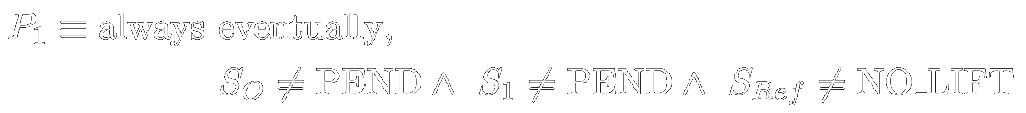
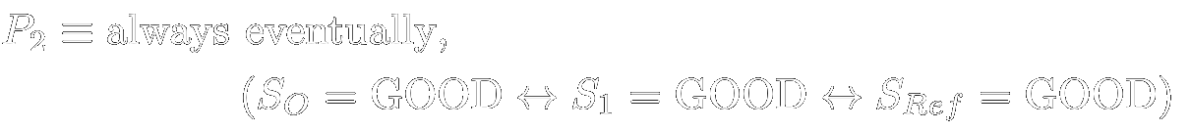
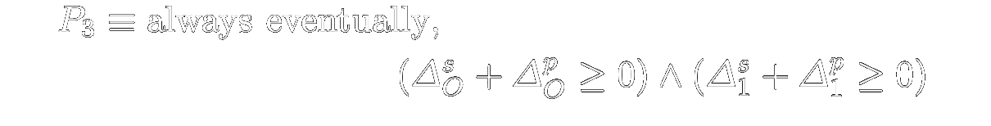
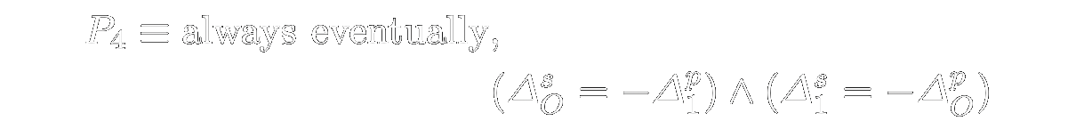
Defining the Properties

Slide 23
Model Checking Results
15625
172726
10.358 s
Unique States
Edges
Total processing time on an Intel(R) Xeon(R) CPU E5-2640 v3 @ 2.60GHz
All Properties Verified
23

Slide 24
Core Lemmas
Base case proven with model checking
Conformance of n+1 relay nodes to n relay nodes
Conformance equivalence of relay node definition and validity rules
✓
Notes:
Come back multiple times to this as a sign/overview slide

Slide 25
Conformance
Status Send
Status Receive
Promise Send
Promise Receive
Commit Send
Commit Receive

Slide 26
Projection
0PS
1PR
1PS
2PR
2PS
0PR
0CS
2CR
2CS
1CR
1CS
0CR

Slide 27
Projection
0PS
1PR
1PS
2PR
2PS
0PR
0CS
2CR
2CS
1CR
1CS
0CR

Slide 28
Conformance
Status Send
Status Receive
Promise Send
Promise Receive
Commit Send
Commit Receive

Slide 29
Core Lemmas
Base case proven with model checking
Conformance of n+1 relay nodes to n relay nodes
Conformance equivalence of relay node definition and validity rules
✓
Notes:
Come back multiple times to this as a sign/overview slide

Slide 30
Validity Rules
Has required actions
Has no duplicate receives
All receives causal
All sends triggered
All ids in range
Promise forward commit backward
Phase sequence correct
All ref receives causal

Slide 31
larger_conforms_to_smaller
has_required_actions_independent_of_proj
has_no_duplicate_receives_independent_of_proj
all_ids_in_range_independent_of_proj
promise_forward_commit_backward_independen
t_of_proj
all_sends_triggered_independent_of_proj
phase_sequence_correct_independent_of_proj
all_ref_recieves_causal_independent_of_proj
valid_implies_all_receives_causal_in_proj
happens_before_independent_of_proj
mod_limit_wrap_eq
in_projection_remains
projected_in_or_out
action_equal_decidable

Slide 32

larger_conforms_to_smaller

Slide 33
Theorem Prover Results
24
1960
7.926 s
Lemmas and Theorems
Lines of Code
Total processing time on an Intel(R) Xeon(R) CPU E5-2640 v3 @ 2.60GHz
All lemmas and theorems proven
33

Slide 34
Core Lemmas
Base case proven with model checking
Conformance of n+1 relay nodes to n relay nodes
Conformance equivalence of relay node definition and validity rules
✓
✓
Notes:
Come back multiple times to this as a sign/overview slide

Slide 35
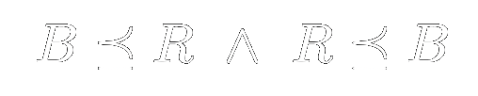
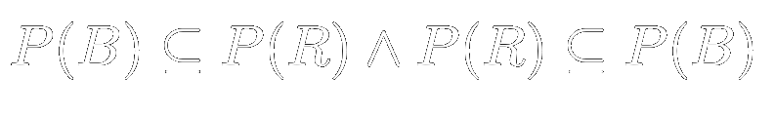

Slide 36

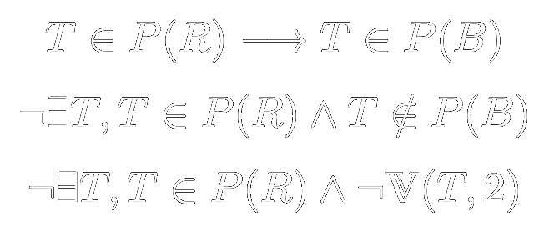
Notes:
If the possible traces by the definition is not a subset of the traces allowed by the validity rules, then there must exist some trace that violates the rules.
This is something spin can check, we encode the validity rules as properties and verify that they hold

Slide 37
Model Checking Results
11478
73805
23.490 s
Unique States
Edges
Total processing time on an Intel(R) Xeon(R) CPU E5-2640 v3 @ 2.60GHz
All Validity Rules Verified
37

Slide 38
Core Lemmas
Base case proven with model checking
Conformance of n+1 relay nodes to n relay nodes
Conformance equivalence of relay node definition and validity rules
✓
✓
✓
Notes:
Come back multiple times to this as a sign/overview slide

Slide 39

PR
PR
PR
PR
PR
PR
PR
PR
PR
SS
PS
PS
PS
PS
PS
PS
PS
PS
SR
SS
CR
CR
SS
SS
SS
SS
SS
SR
CS
CR
SR
SR
CR
CR
SR
CR
CR
SR
CS
CS
CS
SR
Notes:
Felt like a crazy hand wave. Make both ways clear

Slide 40
Model Checking Results
36 - 8308
9
28.352 s
States searched before finding witness trace
Witness Traces Found
Total processing time on an Intel(R) Xeon(R) CPU E5-2640 v3 @ 2.60GHz
Witness trace for each equivalence class found
40

Slide 41
Core Lemmas
Base case proven with model checking
Conformance of n+1 relay nodes to n relay nodes
Conformance equivalence of relay node definition and validity rules
✓
✓
✓
Notes:
Come back multiple times to this as a sign/overview slide

Slide 42
Conclusion
Extended Model Checking Results with an Inductive Proof
Used conformance in 2 ways:
  To move from one implementation to another
  To prove an inductive step
Black-box approach to inductive proof means new properties only need to be verified with model checking.
Proven that 4 properties hold on the MyCHIPs lift protocol with an arbitrary number of participating nodes

Slide 43

Questions?

