Slide 1
Data Persistence
The DAO and DTO Patterns

Slide 2
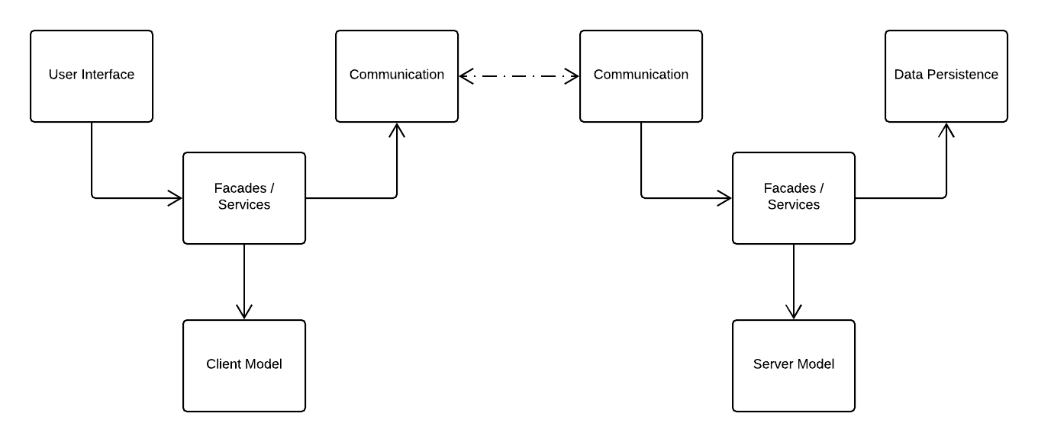
Client / Server Architecture

Slide 3
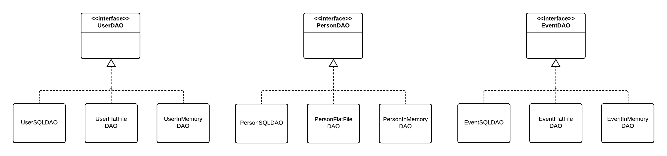
Data Access Objects (DAOs)

Slide 4
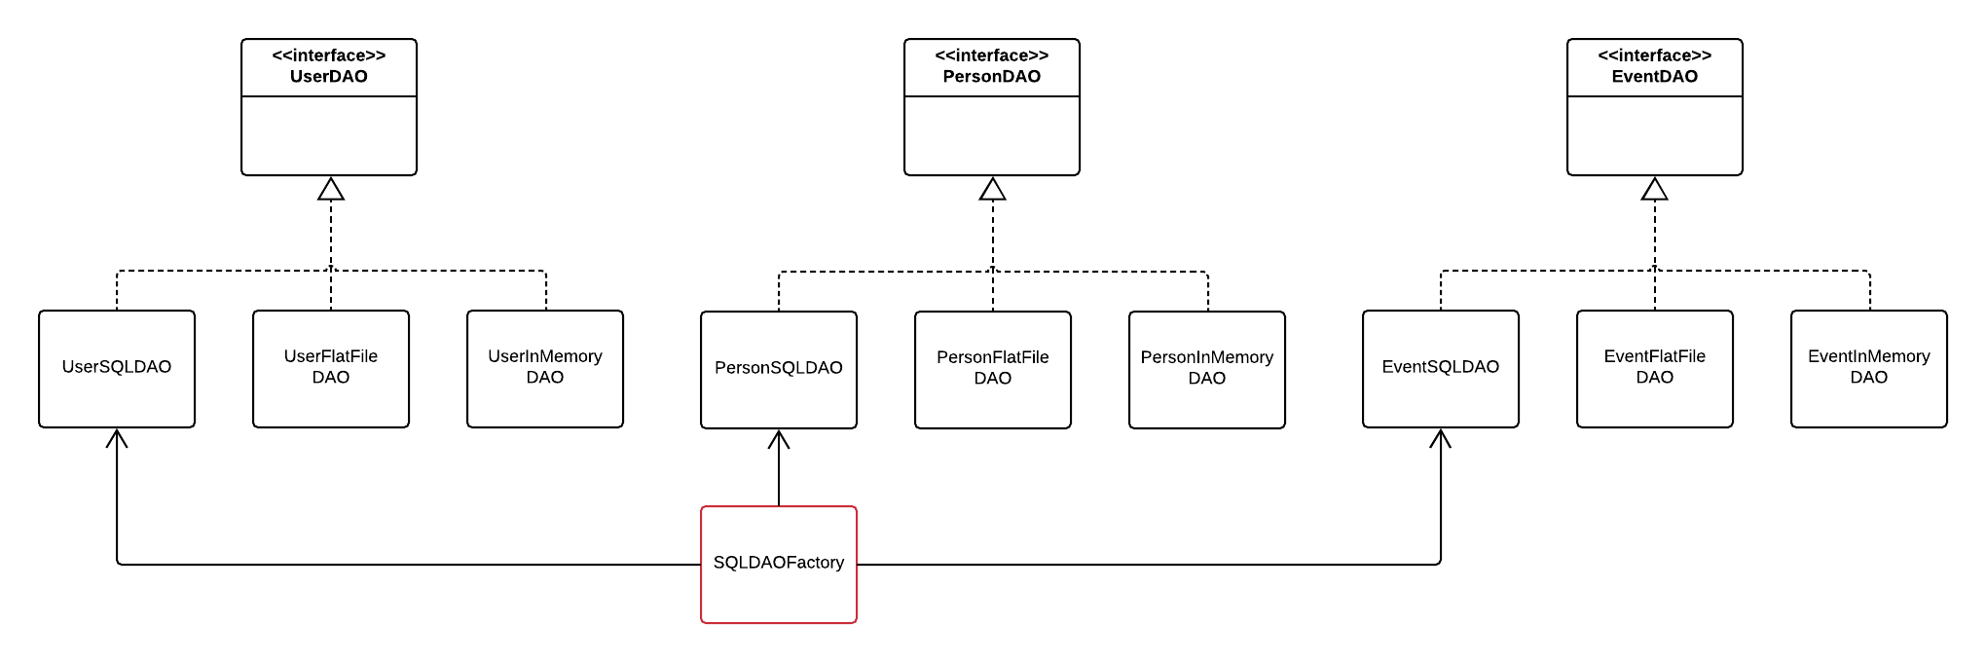
Data Access Objects (DAOs)

Slide 5
Data Transfer Objects (DTOs)
Data-only (plus accessors) classes used to move (or “transfer”) data from point A to point B in an application
Moving data into and out of the Data Persistence subsystem
Create, Update, Delete: DTOs passed into DAOs
Read: DTOs passed out of DAOs
Transferring data between client and server (typically over a network)
Web API parameters
Web API results

Slide 6
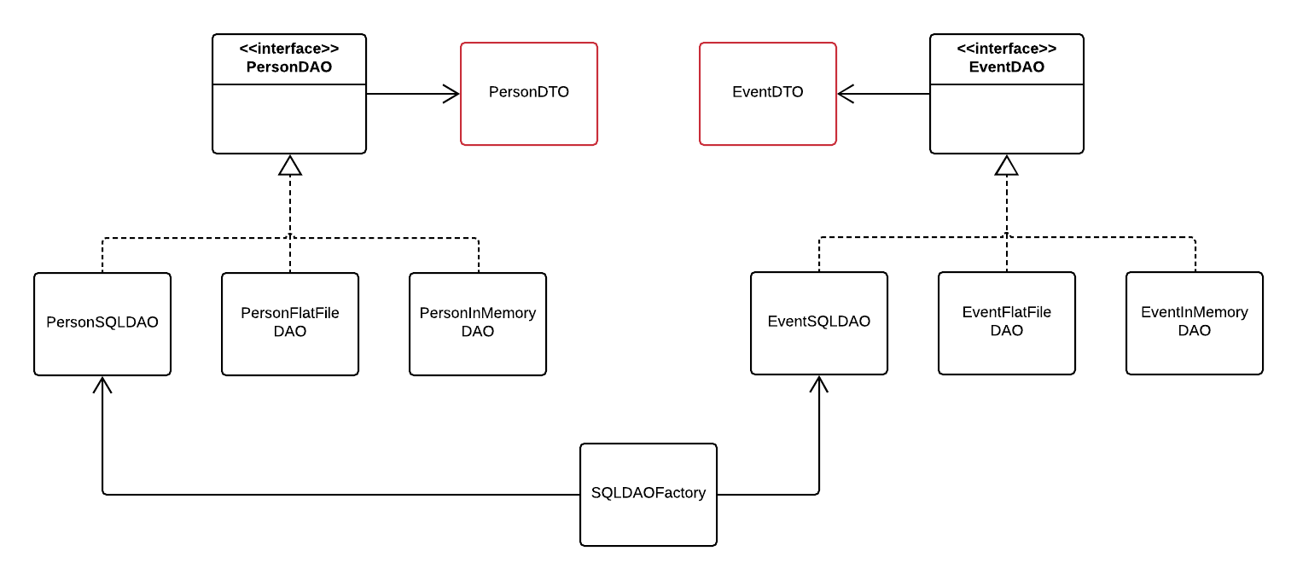
DAOs with DTOs

Slide 7
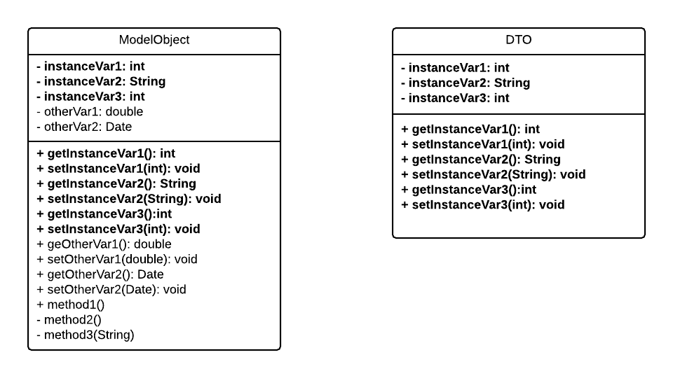
Model Objects and DTOs

Slide 8
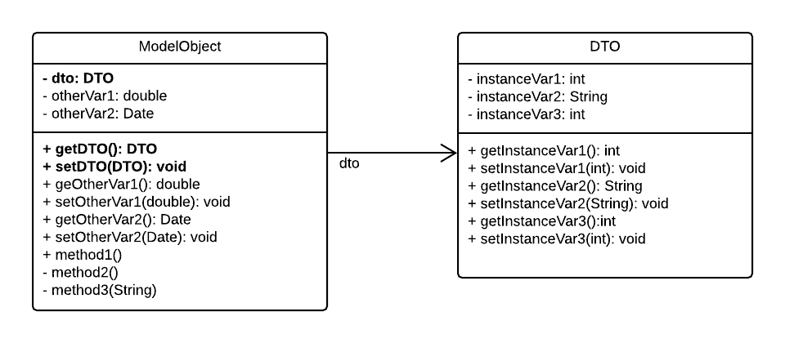
Model Object Using DTOs

Slide 9
Original Client / Server Architecture

Slide 10
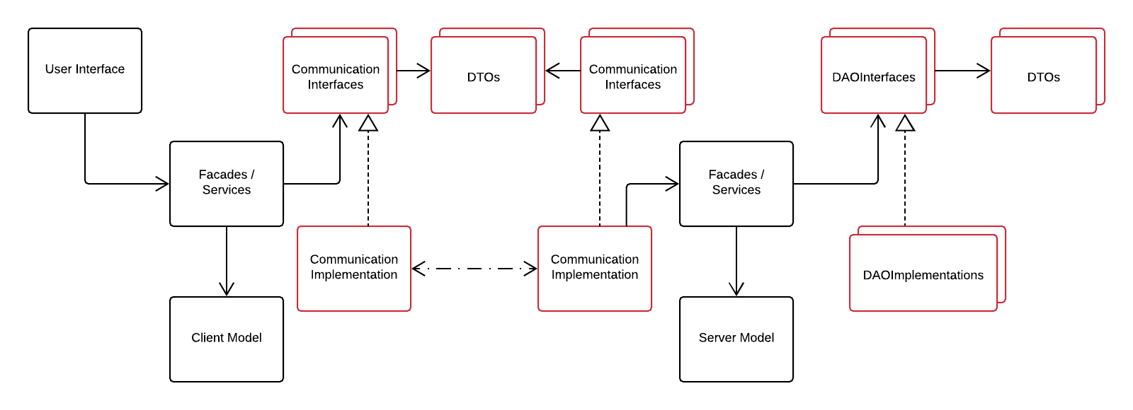
DAO / DTO Client / Server Architecture

Slide 11
Transactions
See TransactionManager.java example
Service or façade does the following:
Calls begin()
Calls each DAO method to be included in the transaction
Calls end(Boolean) (from within a finally block) (pass ‘false’ if any of the DAOs threw an SQLException)
Each DAO in the transaction calls getConnection()to use the same connection (and therefore be part of the same transaction)

Slide 12
Questions to Consider
Who calls the DAO methods?
Should DAO methods throw SQL Exceptions?
Why or why not?
How do DAOs get connections?
Why should this matter?
What problem(s) do you see with the Service or Façade classes calling the TransactionManger?
How can we avoid them?

