Slide 1
Command Design Pattern
Source: Design Patterns – Elements of Reusable Object-Oriented Software; Gamma, et. al.

Slide 2
Problem
Sometimes a class needs to perform actions without knowing what the actions are

Slide 3
Example: GUI Toolkit
A GUI toolkit provides a full complement of components
  Buttons, scroll bars, text boxes, menus, etc.
Toolkit components know how to draw themselves on the screen, but they don't know how to perform application logic
Application developers need a way to associate application logic with GUI components
  What should happen when a button is pressed?
  What should happen when a menu item is selected?
GUI components need to perform an unknown operation when they are activated by the user

Slide 4
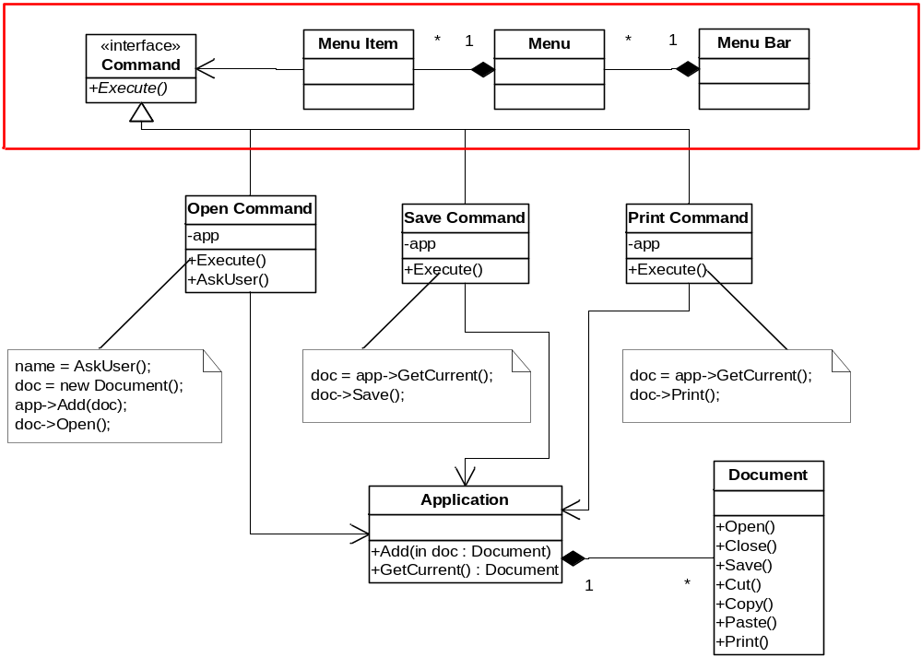
Solution

Slide 5
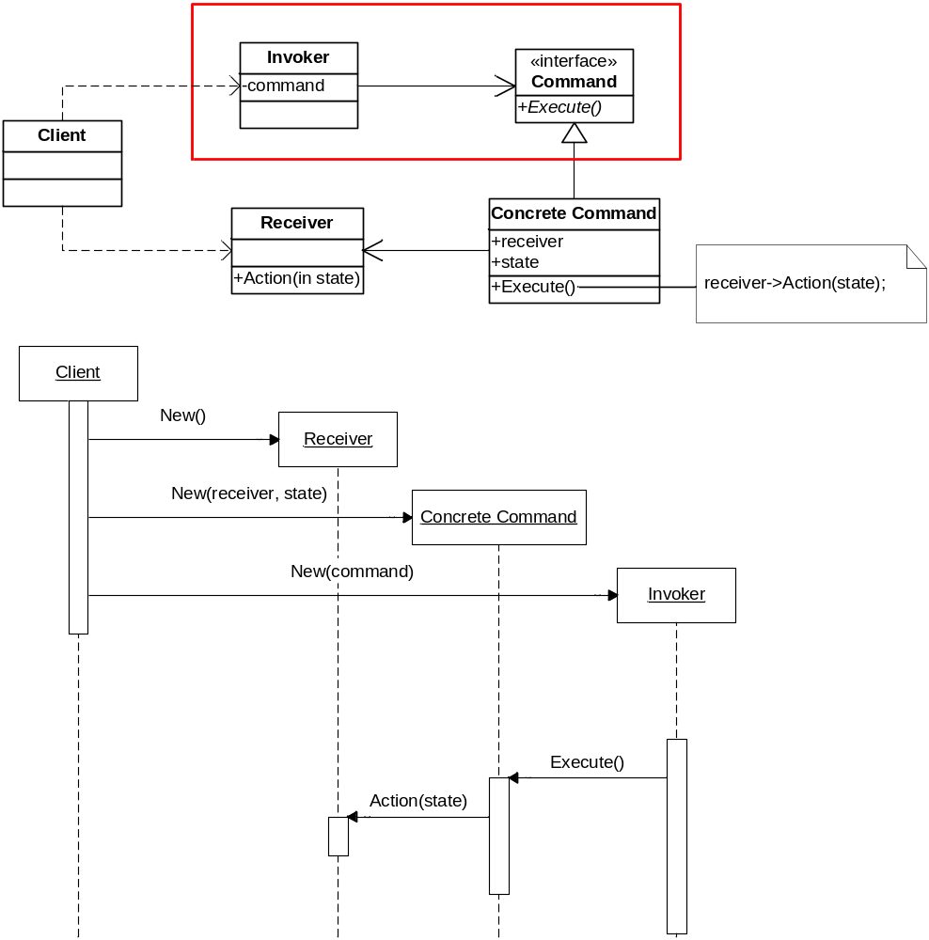
Solution

Slide 6
Consequences
Completely decouples objects from the actions they execute
Objects can be parameterized with arbitrary actions
Adding new kinds of actions is easy
  Just create a new class that implements the Command interface

Slide 7
Known Uses: Task Scheduling Service
Generic task scheduling service allow tasks to be scheduled by
  Interval (e.g., every hour)
  Date/time (e.g., on February 8th at 1:00pm)
  Etc.
Tasks are defined using Command objects
Scheduling service executes Command object at the appropriate time, having no idea what it actually does

Slide 8
Known Uses: Undo/Redo
Store a list of actions performed by the user
Each action has
  A “do” method that knows how to perform the action
  An “undo” method that knows how to reverse the action
Store a pointer to the most recent action performed by the user
Undo – “undo” the current action and back up the pointer
Redo – move the pointer forward and “redo” the current action

Slide 9
Known Uses: Recording user actions
Macros
  Record a sequence of user actions so they can be turned into a macro
  Macro can be re-executed on demand by the user

Slide 10
Known Uses: Multi-user network games
Actions performed by a player must be broadcast to all other players and executed on their local machines
How could we use the Command pattern to do this?

