Slide 1
Computer Science 340 Software Design & Testing
Software Reuse
Adapter and Decorator Patterns

Slide 2
The Quest for Software Reuse
Reuse is an important goal of software design.
Software developers are notorious for “reinventing the wheel”
by repeating work that has been done many times in the past.
For years, people have touted the virtue of the reuse achieved
by hardware engineers, who frequently use off-the-shelf (OTS)
components in their designs.
The hope has been that similar reuse could be achieved
through properly designed software “components”.

Slide 3
Benefits of Reuse
Timeliness
Decreased maintenance effort
Decreased testing effort
Reliability
Efficiency
Consistency
Lower cost
Less redundancy in the work

Slide 4
Examples of Successful Reuse
OS APIs are used by all programs that run on the OS (e.g., the Windows scroll bar)
Built-in libraries provided by programming languages are reused by all programs written in that language (e.g., Java code library and C++ STL)
Third-party libraries that perform generally-useful functions, such as: OpenSSL (secure communication), zlib (compression), Gson, Apache Commons, Guava (useful Java libraries) (many others)
Application Frameworks: GUI Frameworks (Java Swing, WPF), Web App Frameworks (RoR, Spring Web MVC), Enterprise App Frameworks (Java EE, Spring, etc.

Slide 5
Forces Operating Against Reuse
At first glance, the lack of reuse in software makes little sense, but there are reasons for it.
What conditions must exist to make a class reusable?
Generality (customizable to the present need)
Performant (general without sacrificing performance)
Available across programming languages and operating systems
Easily obtainable (inexpensive or free, reasonable licensing, downloadable on web)
Well documented
Well supported and maintained
Source code available
Awareness (if I don’t know about it, I can’t use it)
Maturity and Humility (overcome NIH syndrome and the urge to do it myself)
If all relevant conditions are satisfied, reuse will often occur.

Slide 6
Forms of Reuse
Binaries
Source code
Design patterns
Specifications
Requirements, Functional, Design
People
Knowledge and experience

Slide 7
Techniques for Reusing / Customizing Class Behavior
Composition
Class A “uses” Class B to do its work
Reuse a class by creating an object and calling methods on it
Create “wrappers” to add additional functionality, if needed
The most common form of code reuse (we do this all the time)
Inheritance
Inherit superclass functionality
Customize superclass behavior by overriding its methods
Totally replace or augment with pre/post processing
Extend superclass functionality by adding new variables/methods
Parameterization
Design a class so its behavior/functionality can be customized to the current application
Generic Types
E.g., C++ templates, Java and C# generics (e.g., ArrayList<Device>)
Provide “options” that can be customized by the client through constructor parameters, method parameters, or properties
E.g., a GUI ListBox class might provide the following sorting options (None, Ascending, Descending)

Slide 8
Parameterization Example: Java Generics
Java classes can be declared and coded with generic types that are determined at runtime (similar to C++ templates)
Makes classes safer to reuse with different types
Reduces or eliminates the need for unsafe casts (down casts)
Array class example

Slide 9
Adapter Pattern
You have a class that does all or part of what you need, but the interface it supports is not the interface expected by the rest of the application. You can write an "adapter" class to translate between the interface expected by clients, and the interface provided by the class.
Convert the interface of a class into another interface clients expect. Adapter lets classes work together that couldn't otherwise because of incompatible interfaces.
Provides a way to convert the interface of a class to what you need without modifying the class.

Slide 10
Adapter: Convert a Class’s Interface

Slide 11
Adapter Pattern
Why not just modify the class to support the interface required by its clients?
1) You don't have the source code for the third-party class.
2) You have the source code, but you don't want to couple the class to the interface expected by clients (i.e., in general there is a different interface that you prefer for the class, but for integration purposes you must support the mandated interface).

Slide 12
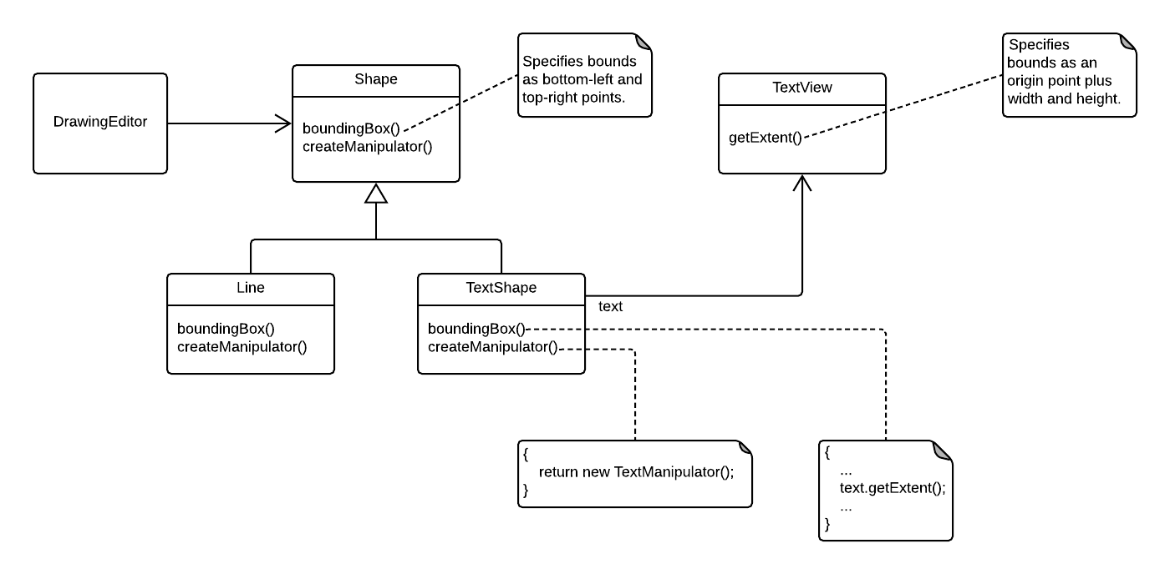
Adapter Pattern (GoF Example)

Slide 13
Adapter

Slide 14
Decorator Pattern
Sometimes we need to be able to add functionality to an object in a flexible and dynamic way without sub-classing the object
Useful in cases where there are multiple combinations of functionality to add
Example: Shape with or without borders and/or scrollbars
Shape, ShapeWithBorder, ShapeWithDoubleBorder, ShapeWithScrollbars, ShapeWithBordersAndScrollbars, etc.

Slide 15
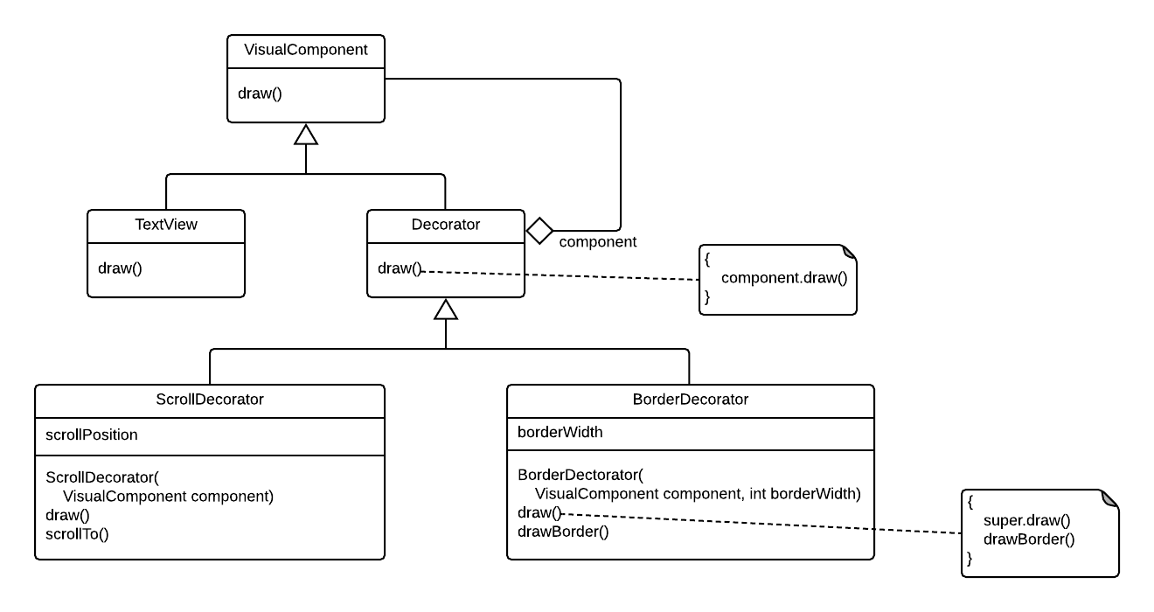
Decorator Pattern (GoF Example)

Slide 16
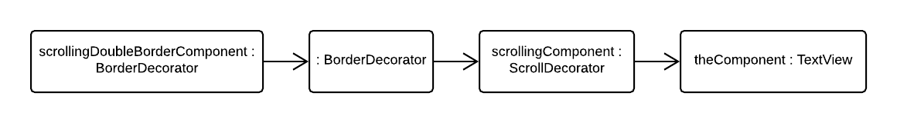
Decorator Pattern (GoF Example)
VisualComponent theComponent = new TextView();
VisualComponent scrollingComponent = new
ScrollDecorator( theComponent );
VisualComponent scrollingDoubleBorderComponent = new
BorderDecorator( new BorderDecorator(
scrollingComponent, 1 ), 2 );
...
scrollingDoubleBorderComponent.draw();

Slide 17
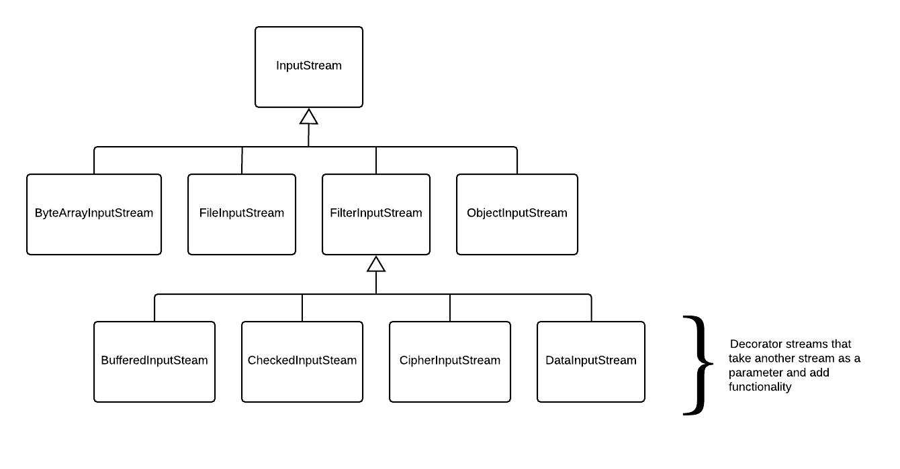
Decorator Pattern Example: Java Stream Classes

