Slide 1
Computer Science 340 Software Design & Testing
Software Reuse
Strategy Pattern

Slide 2
Examples of reusable code
Sort(Person[]);
How could we make this sorting algorithm more reusable?

Slide 3
Examples of reusable code
Sort(Person[]);
How could we make this sorting algorithm more reusable?
Sort(Comparable[])
interface Comparable { int compareTo(Object o); }

Slide 4
Examples of reusable code
Sort(Person[]);
How could we make this sorting algorithm more reusable?
Sort(Comparable[])
interface Comparable { int compareTo(Object o); }
Sort(Object[], Comparator)
interface Comparator { int compare(Object o1, Object o2); }

Slide 5
Examples of reusable code
Sort(Person[]);
How could we make this sorting algorithm more reusable?
Sort(Comparable[])
interface Comparable { int compareTo(Object o); }
Sort(Object[], Comparator)
interface Comparator { int compare(Object o1, Object o2); }

Slide 6
Strategy Pattern : Customize a Class’s Functionality with Replaceable Algorithms
Class C implements some generally useful functionality
C does most of the work, but some aspects of its behavior depend on external factors
C’s behavior is customized by passing in an “algorithm” that C invokes at appropriate times
The “algorithms” that customize C’s behavior are called “strategies”
A “strategy” is an object that implements some interface expected by C by providing an implementation for the interface’s method(s)
C invokes the client-provided strategies as needed to perform its work
This is an alternative to using inheritance to customize a class’s behavior

Slide 7
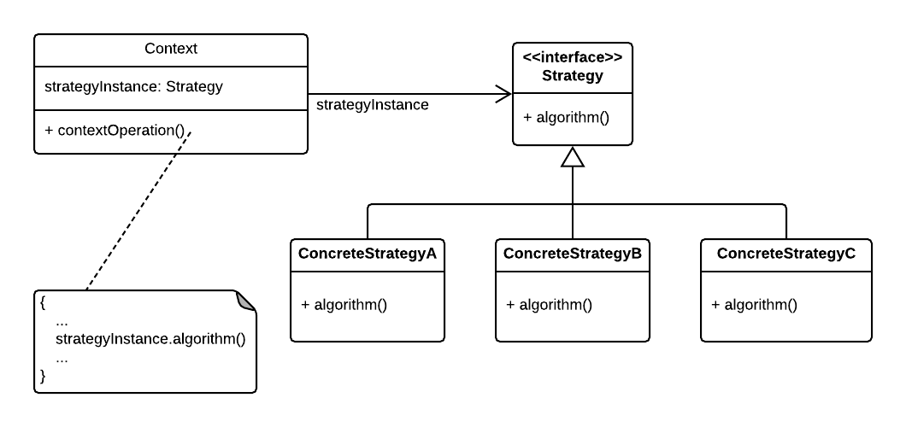
Strategy Pattern

Slide 8
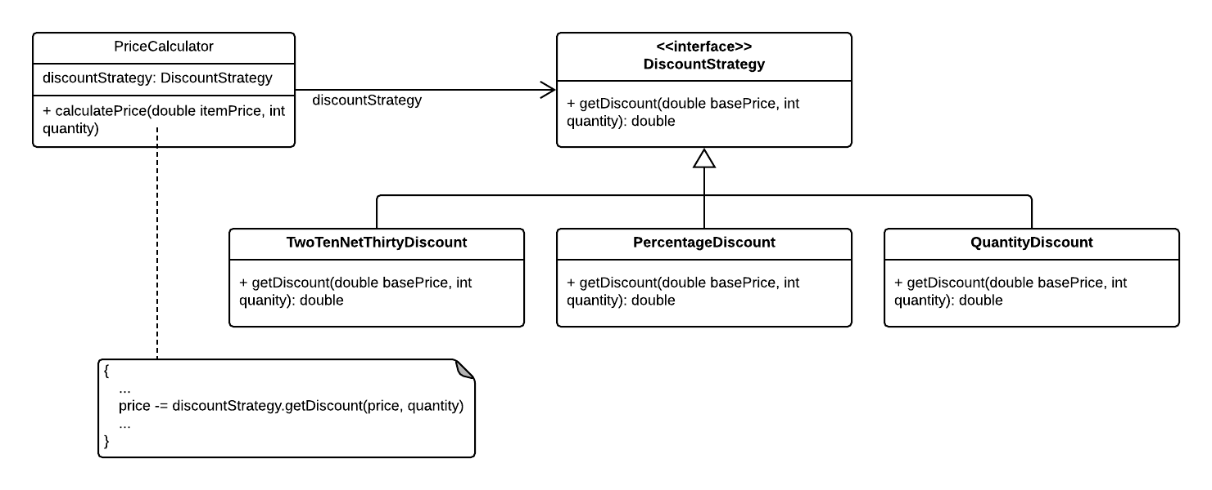
Strategy Pattern: Discount Price Example

Slide 9
Strategy Pattern: Discount Price Example
Code Example
Price Calculator / Discount Strategy
Provides different strategies / algorithms for calculating price discounts
Strategy specific parameters are passed in through the strategy constructors

Slide 10
Strategy Pattern Example
C++ map class template
template <typename Key, typename Value, typename Comparator, typename Allocator > class map { … }
Key and value types can be specified (of course)
By default, uses Key’s < operator to sort
If you don’t like that, Comparator class can be specified to customize sorting
Overloads bool operator ()(Key a, Key b)
Memory allocator class can be specified to customize memory management
Implements a standard memory allocator interface (allocate block, deallocate block, etc.)

Slide 11
Strategy Pattern Example
CLogger class
Logging class that provides customizable thread synchronization behavior
If multiple threads will be logging messages, thread synchronization will be needed
If only one thread will be logging messages, no thread synchronization is needed
In order to avoid unnecessary overhead due to thread synchronization, the CLogger class allows the client to specify the desired thread synchronization behavior

