Slide 1
Asynchronous Messaging

Slide 2
Synchronous API Call
Server
Client
API
Handler
Client calls API on Server
Server must be up and running for call to work
Server API handler performs request immediately, and returns result to client
Works fine if:
Server is up and not overloaded
Requested operation doesn’t take very long
What if the server is down or overloaded?
What if requested operation takes a long time?

Slide 3
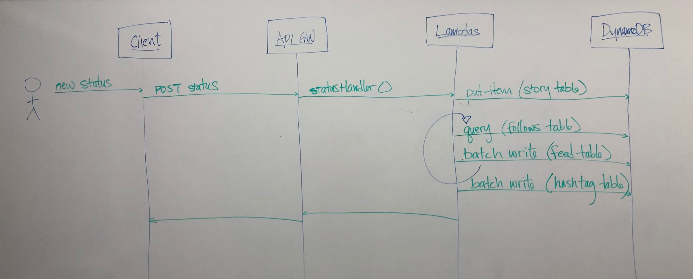
Example
Twitter
Server
Twitter
Client
SendStatus(status)
API
Handler

Slide 4
Milestone 5 requirements
For milestone 5 you will be improving the performance and scalability of your application in order to meet the following requirements:
The perceived latency of the create new status operation (from the perspective of the author) is to be less than 1000 milliseconds.
When a new status is created, that status is added to the feeds of all of the followers of the author within 120 seconds, for authors with up to 10K followers.

Slide 5
Asynchronous Messaging
Producer
Message Broker
Consumer
Send(msg)
msg = Receive()
Queue 1
Queue 2
Producer calls MessageBroker to put message in queue
Consumer polls MessageBroker to retrieve messages from queue
Producer and Consumer are decoupled
Producer can still send messages even if Consumer is busy or not even running
Consumer can retrieve messages from queue asynchronously at any time
Producer and Consumer need not know about each other (just need to agree on message format)
There can be any number of Producers and Consumers using the same queue

Slide 6
Example
Twitter
Server
Twitter
Client
AWS SQS
Lambda
(distributes status to feeds)
SendStatus(status)
API
Handler
Send(msg)
Process(msg)
Queue 1
Queue 2

Slide 7
Milestone 5 requirements
Can a single lambda append a status to all follower feeds within 120 seconds?
Maybe
What if it takes longer than 120 seconds?

Slide 8
Example
Twitter
Server
Twitter
Client
AWS SQS
SendStatus(status)
API
Handler
Send(msg)
Process(msg)
Lambda
(divides work into batches)
Queue 1
Send(batch)
Lambda
(distributes status to subset of followers)
Queue 2
Process(batch)

