Slide 1
Façade Design Pattern
Source: Design Patterns – Elements of Reusable Object-Oriented Software; Gamma, et. al.

Slide 2
Problem
A subsystem contains lots of classes, all of which are necessary to perform its function
Most of the subsystem's internal complexity is not directly relevant to its clients
We want to simplify the client's interface to the subsystem to make it easier to use
We want to minimize client dependencies on the subsystem's internal details

Slide 3
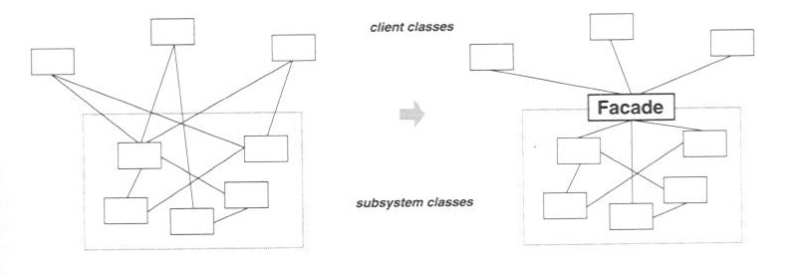
Solution
Introduce a Façade object that provides a simplified interface to the subsystem
The Façade's interface provides exactly those operations needed by most clients, and no more
The Façade translates high-level client requests into lower-level requests on subsystem objects
Internal subsystem objects have no knowledge of the Façade

Slide 4
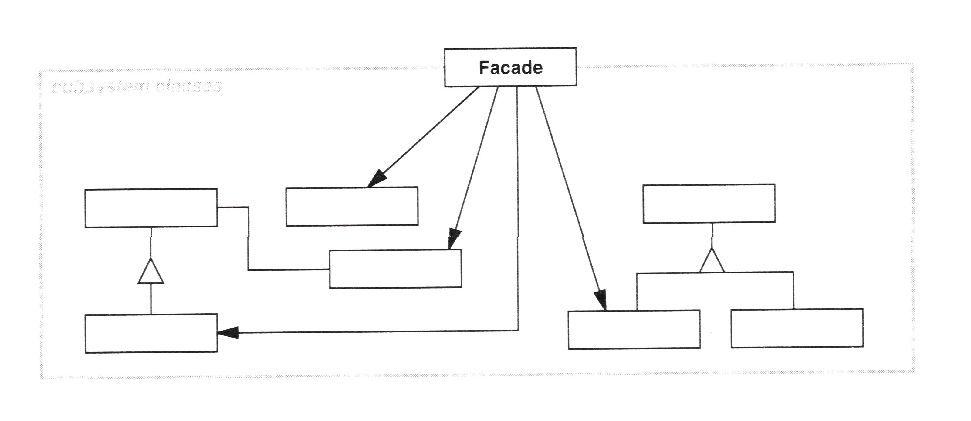
Solution
Most clients interact with the subsystem strictly through the Façade
Advanced clients may still be allowed to access the full scope of subsystem functionality, but most clients don't need or want to
Similar to keeping a class' implementation details private, and making public only those operations directly needed by clients (i.e., information hiding)

Slide 5
Consequences
Makes using the subsystem easier
Reduces coupling between clients and the subsystem
Reduces compilation dependencies, thus minimizing recompilation time
Useful for defining the interfaces between layers in a layered system

Slide 6
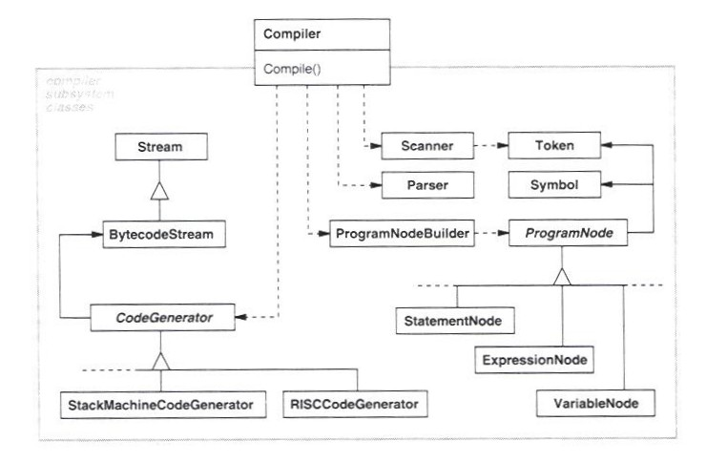
Known Uses: Compilers

Slide 7
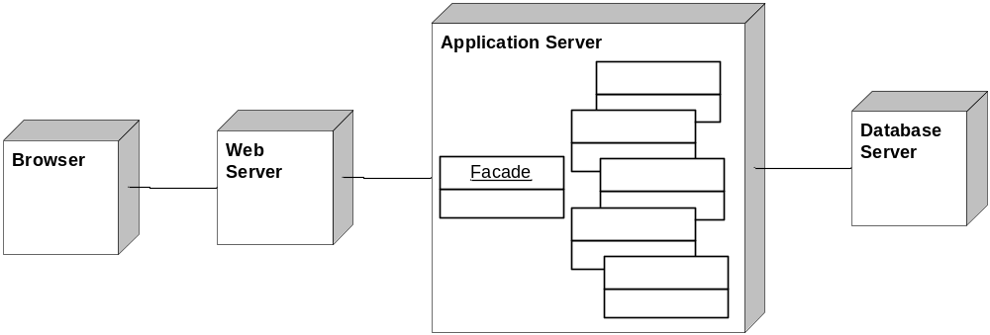
Known Uses: Web Applications

Slide 8
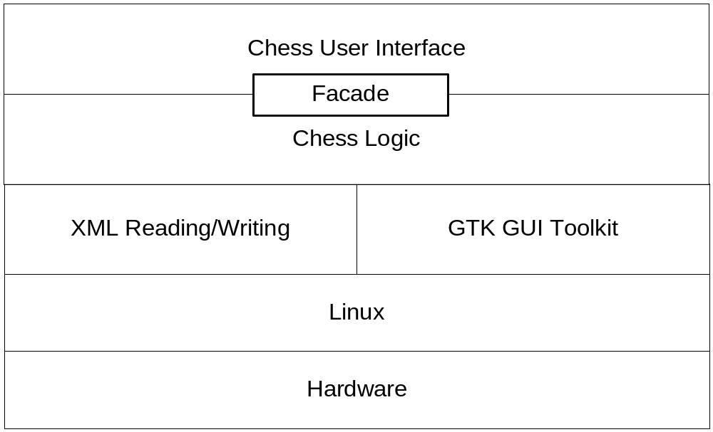
Known Uses: CS240 Chess Program

Slide 9
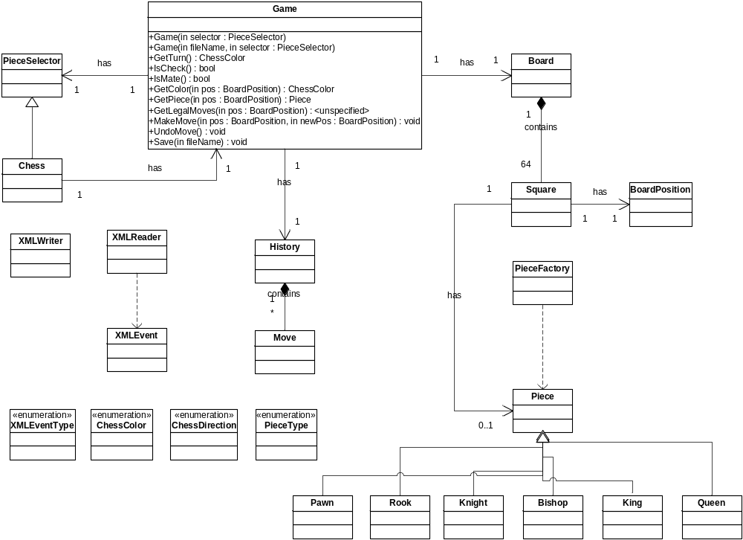
Known Uses: CS240 Chess Program

