Slide 1
Computer Science 340 Software Design & Testing
Template Method Pattern

Slide 2
Sample Output
Rental Record for Dinsdale Pirhana
Monty Python and the Holy Grail 3.5
Star Trek 27 6
Star Wars 3.2 3
Wallace and Gromit 6
Amount owed is 18.5
You earned 5 frequent renter points

Slide 3
Similar Statement Methods
public String statement() {
Enumeration rentals = _rentals.elements();
String result = "Rental Record for " + getName() + "\n";
while (rentals.hasMoreElements()) {
Rental each = (Rental) rentals.nextElement();
result += "\t" + each.getMovie().getTitle()+ "\t" +
String.valueOf(each.getCharge()) + "\n";
}
result += "Amount owed is " + String.valueOf(getTotalCharge()) + "\n";
result += "You earned " + String.valueOf(getTotalFrequentRenterPoints()) +
" frequent renter points";
return result;
}
public String htmlStatement() {
Enumeration rentals = _rentals.elements();
String result = "<H1>Rentals for <EM>" + getName() + "</EM></H1><P>\n";
while (rentals.hasMoreElements()) {
Rental each = (Rental) rentals.nextElement();
result += each.getMovie().getTitle()+ ": " +
String.valueOf(each.getCharge()) + "<BR>\n";
}
result += "<P>You owe <EM>" +
String.valueOf(getTotalCharge()) + "</EM><P>\n";
result += "On this rental you earned <EM>" +
String.valueOf(getTotalFrequentRenterPoints()) +
"</EM> frequent renter points<P>";
return result;
}

Slide 4
How could you get rid of the duplication using the Strategy pattern?

Slide 5
How could you get rid of the duplication using the Strategy pattern?
interface StatementBuilder {
String headerString(Customer aCustomer);
String eachRentalString (Rental aRental);
String footerString (Customer aCustomer);
}
class Statement {
private StatementBuilder builder;
public Statement(StatementBuilder builder) {
this.builder = builder;
}
public String value(Customer aCustomer) {
Enumeration rentals = aCustomer.getRentals();
String result = builder.headerString(aCustomer);
while (rentals.hasMoreElements()) {
Rental each = (Rental) rentals.nextElement();
result += builder.eachRentalString(each);
}
result += builder.footerString(aCustomer);
return result;
}
}

Slide 6
How could you get rid of the duplication using inheritance?

Slide 7
How could you get rid of the duplication using inheritance?
abstract class Statement {
public Statement() {
}
public String value(Customer aCustomer) {
Enumeration rentals = aCustomer.getRentals();
String result = builder.headerString(aCustomer);
while (rentals.hasMoreElements()) {
Rental each = (Rental) rentals.nextElement();
result += builder.eachRentalString(each);
}
result += builder.footerString(aCustomer);
return result;
}
abstract String headerString(Customer aCustomer);
abstract String eachRentalString (Rental aRental);
abstract String footerString (Customer aCustomer);
}

Slide 8
Html and Text Subclasses

Slide 9
Template Method Pattern
Code that is duplicated in multiple places should be centralized in one place (i.e., avoid duplication)
Composition: Put common code in a method on a class to which multiple clients will delegate
Inheritance: Put the common code in a method on a super-class, and make the clients sub-classes (i.e., clients inherit common code)
What if an algorithm is duplicated in several places, but the copies are SIMILAR rather than IDENTICAL?
Use the Template Method pattern
Put the common algorithm in a super-class
Clients inherit common code from super-class
Some steps of the algorithm are delegated to subclasses through polymorphic method calls
Subclasses customize the algorithm by implementing the delegated steps

Slide 10
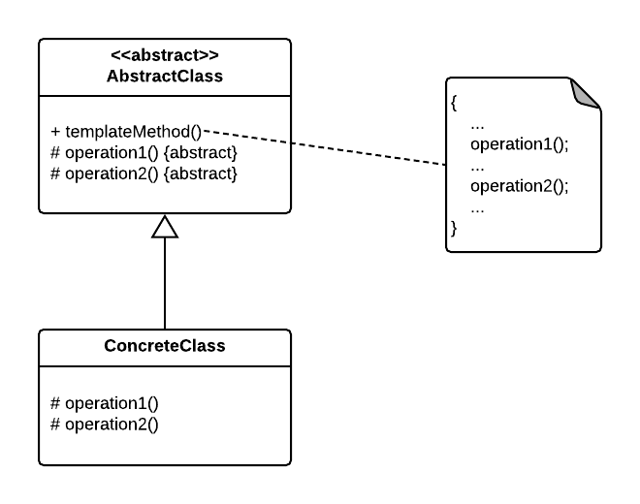
Template Method Pattern

Slide 11
//Now we can extend this class in order
//to implement actual games:
class Monopoly extends Game {
/* Specific declarations for the Monopoly game. */
/* Implementation of abstract methods */
void initializeGame() {
// Initialize players
// Initialize money
}
void makePlay(int player) {
// Process one turn of player
}
boolean endOfGame() {
// Return true if game is over
// according to Monopoly rules
}
void printWinner() {
// Display who won
}
/* Specific methods for the Monopoly game. */
// ...
}
/**
* An abstract class that is common to several games in
* which players play against the others, but only one is
* playing at a given time.
*/
abstract class Game {
protected int playersCount;
/* A template method : */
public final void playOneGame(int playersCount) {
this.playersCount = playersCount;
initializeGame();
int j = 0;
while (!endOfGame()) {
makePlay(j);
j = (j + 1) % playersCount;
}
printWinner();
}
abstract void initializeGame();
abstract void makePlay(int player);
abstract boolean endOfGame();
abstract void printWinner();
}

Slide 12
Refactoring with the Template Method Pattern
Make the similar code as similar as possible in the classes that duplicate it
Similar code diverges unnecessarily over time
Create a common base class for all classes with similar code
Put one copy of the similar code/method(s) in the parent (this becomes the template method)
Identify and extract what needs to vary by subclass
Create abstract methods for the code that needs to vary
Replace the code that needs to vary with calls to the abstract methods in the template method
Override the abstract methods in the subclasses with their version of the varying code (pulled out of their copy of the template method override(s))
Delete the template method override(s) in the subclasses

