Slide 1

CS 340
UML
Class Diagrams

Slide 2
A model is an abstraction of a system, specifying the modeled system from a certain viewpoint and at a certain level of abstraction

Slide 3
Complexity and Modeling
Modeling is a well-accepted engineering technique for dealing with complexity
Models let us focus on one view of the system while ignoring irrelevant details (a simplification of reality)
  Example: Plumbers only care about plumbing, so we give them plumbing diagrams; electricians only care about electrical work, so we give them electrical diagrams, etc.
Models can be created at different levels of abstraction
  10,000 ft. view vs. 10 ft. view
  High-level: sketch of the building's exterior for the customer
  Low-level: detailed electrical plan for the electrician

Slide 4
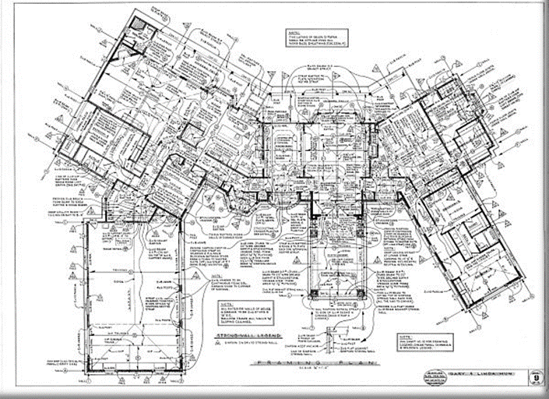
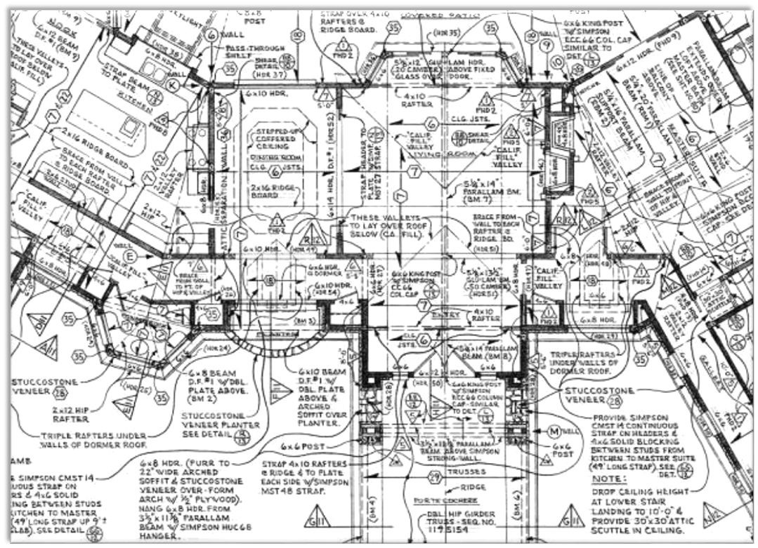

Slide 5
Software Modeling
Why do we create models of software systems?
Models help us visualize and understand the system we're building
Models are used to document the design of the system and communicate it to others
Models serve as a guide during system construction

Slide 6
UML
Unified Modeling Language
History
Models
  Data
  Behavior
  Interaction
  Packaging

Slide 7
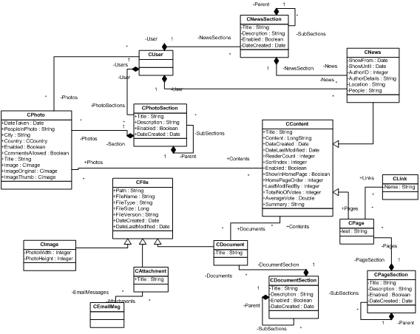

Slide 8
Levels of Models
Conceptual Model – Problem Understanding
Specification/Requirement Document – Solutions
High-Level Design Model
  Systems, Packages, Classes
  Interactions, Interfaces
Low-Level Design Model
  Class Conceptual Model
  May be better done with Class documentation such as Javadoc
Implementation
  Should be done in code not UML
Notes:
Student bias.

Slide 9
UML Models
Structural/Data
  Class Diagram
  Object Diagram
Behavior
  Use Case Diagram
  State Diagram
  Activity Diagram
Interaction
  Communication Diagram
  Sequence Diagram
Physical Diagram
  Component Diagram
  Deployment Diagrams

Slide 10
Classes At the Conceptual Level
A Class – typically named with a common noun.
At the conceptual level the class is a set of objects with common properties.
Mother

Slide 11
Classes At the Design Level
A Class – typically named with a common noun.
At the design level a Class is a Type.
Visibility constraints (optional) :
+ (public), - (private), # (protected), / (derived), _ (static), ~ (package).
We may add cardinality constraints to an attribute. In this case it means that a
Mother has 1 or more names. If the cardinality constraint is omitted it is assumed to be the cardinality constraint “1”.
For some situations we may omit the Method Section or the Attribute Section.
Mother
Attribute Section
- name : Name [1.. *]
- age : int
+ print()
+ equals(Object)
Method Section

Slide 12
Objects
An Object – notice the name is underlined.
While some find Objects useful in the Class diagram others
do not.
Clara

Slide 13
Associations
An association can be thought of as a declarative sentence.
The name in the association is optional but suggested.
Typical association constraints are 1, 0..1, *, 1..*, n..m.
UML 1.0 supported a notation for an arbitrary set of non-negative integers (e.g. 2:4, 6,12 meaning the set
{2,3,4,6,12}
Most associations are binary.
Child
has
Mother
*
1

Slide 14
Associations Continued
Roles
  Although this example has 2 roles, there may be only 1, or most often 0 roles on an association.
  Roles can be viewed as Specializations
While not all versions of UML support the same annotations, you may find some when reading UML diagrams.
Male
1
is married to
1
Female
Husband
Wife
Mother
has
{ordered}
Child
1
1..*

Slide 15
Directed Associations
Should only be used as a design construct
  Means that we can access an Address via a Person, but, given an Address we can’t determine the Person associated with it.
  If the association constraint on the opposite side of the navigability arrow is a 1, then this is equivalent to
  Notice the cardinality constraint to the right of the attribute.
Person
has
Address
1
1..*
Person
address : Address [1..*]

Slide 16
Aggregation/Composition
Aggregation
  Can be read as Person is subpart of a Company
  Can be transitive but acyclic.
  Some people prefer to just use associations.
  Can use “comb” representation if there are different types of subparts.
Composition
  Can be read as “A Car is composed of 1 or more Car Parts”.
  A much stronger form of Aggregation. Some suggest it implies a Car Part cannot exist unless it is part of a car.
  Notice there is no association constraint next to the black diamond because it is always 1.
Company
1..*
Person
0..*
Employee
Car
1..*
Car Part

Slide 17
Generalization/Specialization
  For conceptual modeling every Faculty Member, Staff Member, and Student is a BYU Person. “Is A” Semantics. That is, subset semantics. In this case the set, Student, is a subset of the set BYU Person.
  At the Design level it represents “subtype” or “inheritance” semantics.
  A generalization/specialization often has a single specialization.
  Though not standard UML, I may include the following annotations: {union}, {disjoint}, and {partition}.
BYU Person
Faculty Member
Staff Member
Student

Slide 18
General Constraints/Notes
General Constraints
  {A Father must be a male Person}
  I often omit the braces.
  Can be expressed formally in OCL, a type of first-order logic.
Notes
  I use text such as
    NOTE: A Note
    or
    Note: Information
A Note
Family
History

Slide 19
Dependency
Used in design models. Especially good for representing dependencies that aren’t obvious, such as assumptions.
There is no notation for indicating why Person depends on Address. I use notes to add the information.
Person
Address

Slide 20
Association Class
Useful when thinking of an association as an object.
Could use an n-ary relation.
Husband
married
Wife
1..*
1..*
Marriage Information
date : Date
temple: Temple

Slide 21
N-ary Associations
Date
In UML the association constraints are binary functional dependencies.
They tried to extend that idea to n-ary associations. It didn’t work well.
Here the 4 association constraints mean
  For a given Husband, Wife, and Temple in the association there are 1 or more Dates.
  For a given Husband, Wife, and Date in the association there is 1 and only 1 Temple.
  For a given Husband, Date and Temple in the association there is 1 and only 1 Wife.
  For a given Wife, Date, and Temple in the association there is 1 and only 1 Husband.
Because this is awkward it is not used as much as it could be.
If we interpret the constraints as participation constraints (see ORM, and OSA) then the semantics are much easier to understand.
1..*
Husband
Wife
1
1
1
A Husband married a Wife
on a given Date at a particular Temple
Temple

Slide 22
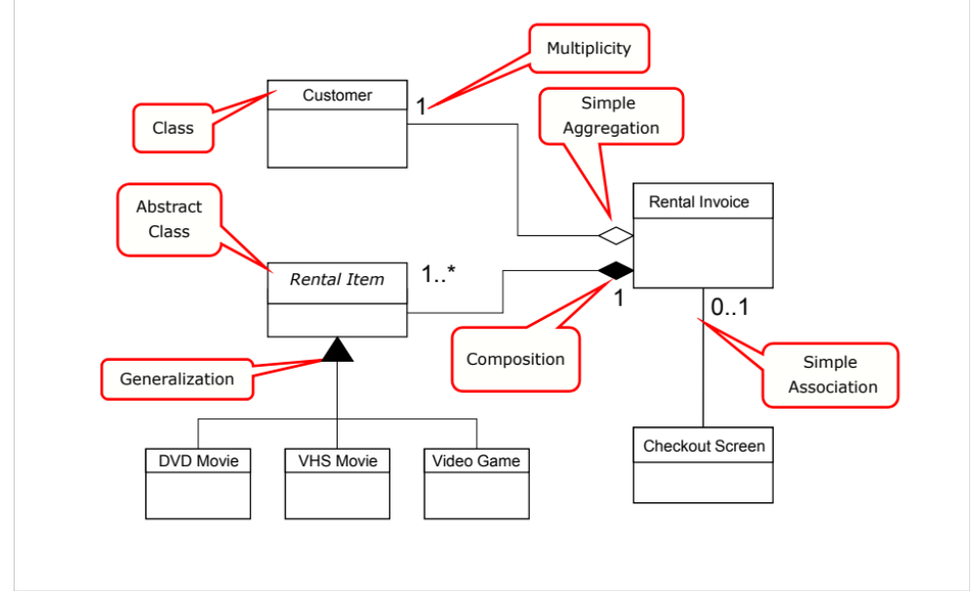

Slide 23
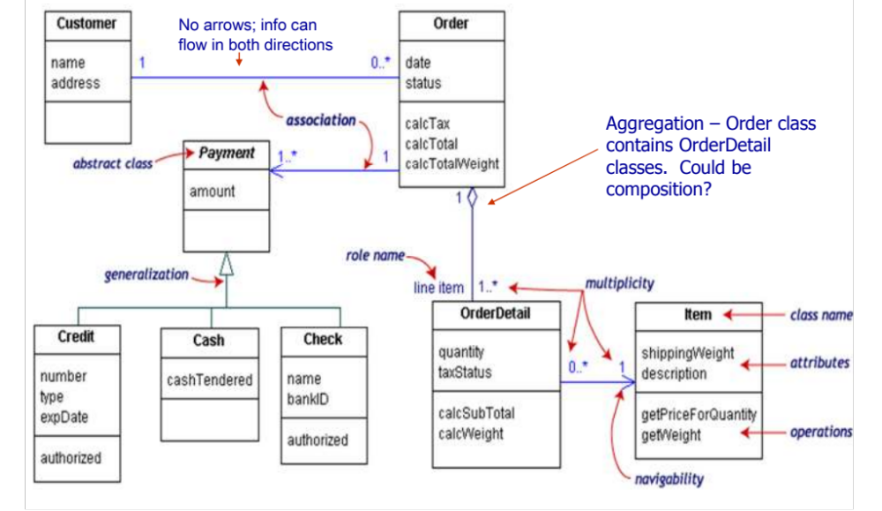

Slide 24
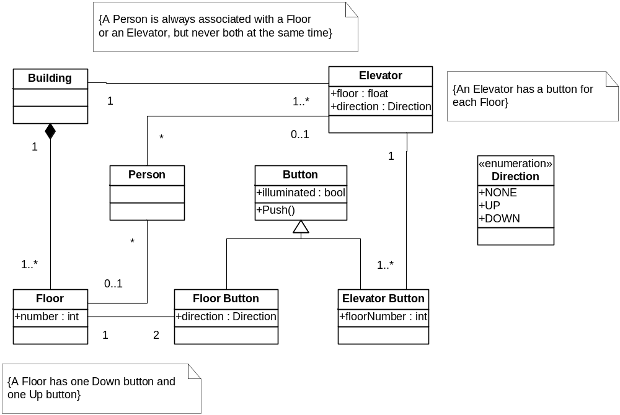
Class Diagram
Example

Slide 25
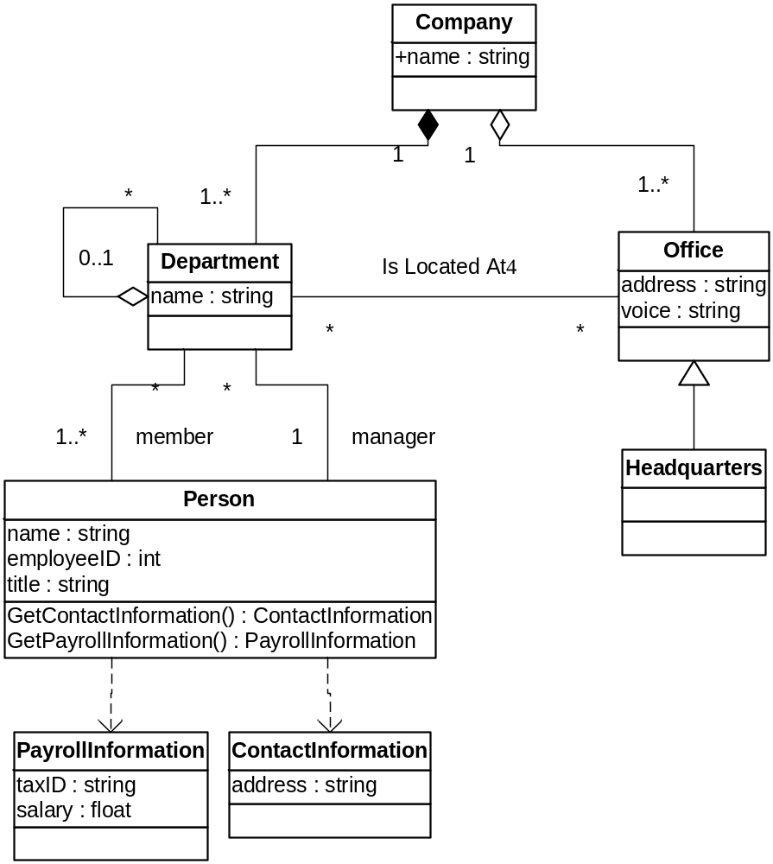
Class Diagram
Example
Source: Booch et. al., The UML User Guide

