Slide 1
Software Architecture

Slide 2
Objectives
Understand what software architecture is and why we need it
Understand the basic concepts and benefits of layered software architecture
Be able to create a layered architecture with classes in appropriate layers
Be able to represent a layered architecture in a UML package diagram

Slide 3
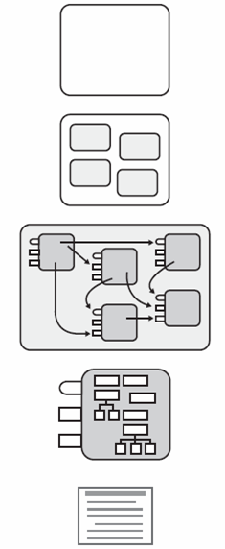
Design Levels
System
Sub-Systems
High-Level Design
Packages
Classes
Low-Level Design
Methods

Slide 4
Architecture Definitions
Software Architecture: the large-scale organization of software into packages, subsystems, and layers.
How different parts of a software system fit together to provide the functionality and satisfy the requirements of a system
The big, high-level decisions about how a system will be structured
The stuff you can’t afford to get wrong
Layer: a very coarse-grained grouping of classes, packages, or subsystems that has cohesive responsibility for a major aspect of the system.

Slide 5
Software Architect
Very experienced engineers
Often seen as the culminating role for an engineer
Responsible for developing the system’s architecture

Slide 6
What the Architecture Defines
The major subsystems
Subsystems are major areas of functionality
Complex subsystems may be decomposed into smaller subsystems
Responsibilities of each subsystem
Dependencies between subsystems
Interfaces between subsystems
Communication patterns between subsystems
Implementation technologies
Operating systems, languages, UI, networking, database, etc.
Physical System Deployment
System topology
What kinds of machines will be needed?
How will they be connected?
Mapping of logical software components onto physical hardware

Slide 7
Implementing the Architecture
Once the overall architecture has been defined, different teams or individuals can design subsystems in parallel
Defining good interfaces between subsystems is critical
Interfaces should be as simple as possible
Give subsystem designers maximum freedom
Limit the ripple effects of changes to subsystems

Slide 8
Layered Architecture
Hierarchical organization of a logical architecture
Higher layers depend on (call on services of) lower layers
Lower layers do not depend on higher layers
Very useful and common way to handle high-level design of software systems

Slide 9
Layered Architecture: Scenario I
Request at Layer N travels down through each successive layer, finally reaching Layer 1
The top-level request results in a tree of requests that travel down through the layers (each request at Layer J is translated into multiple requests to Layer J-1)
Results from below are combined to produce a higher-level result that is passed to the layer above
Example: Network Protocol Stack (i.e. TCP/IP)

Slide 10
Layered Architecture: Scenario II
Request at Layer N travels down through successive layers until it reaches Layer J, which can satisfy the request without the help of Layer J-1
Layer J may cache previous results
Layer J may pre-fetches or pre-computes results

Slide 11
Layered Architecture: Scenario III
Events generated at Layer 1 travel up through successive layers, finally reaching Layer N
Examples
Interrupt generated by device driver
Asynchronous I/O operation completes
Signal received from OS
Event may stop before reaching Layer N if it can be handled by some intermediate layer
Multiple events at Layer J may be combined into a single higher-level event which is sent to Layer J+1

Slide 12
Relaxed vs. Strict Layered Architecture
Strict Layered Architecture: a layer may only have dependencies on the layer directly below it.
Common in network protocol stacks
Relaxed Layered Architecture: a layer may have dependencies on any layer below it.
Common in business systems
Scenarios I – III are strict layered architectures

Slide 13
Example: Networking Protocol Stacks

Slide 14
Example: Virtual Machines - VMware

Slide 15
Example: Virtual Machines - Java

Slide 16
Common Layers in Layered Architecture
User Interface /
Com. Endpoints
Use Cases / Business Logic
dependencies
more application-specific
Domain Model / Entities
Frameworks, Libraries, Databases, etc.
Operating System
Hardware

Slide 17
Common Layers in Layered Architecture
User Interface / Communication Endpoints
Code that directly interfaces with external users or systems
Example: User interface for bank loan officers, very specific to this application for loan officers
Uses Cases / Business Logic / Application Logic
Code that implements the actual features of the application using the Domain Models / Entities
Example: Class that analyzes the likelihood a customer will default on a bank loan, specific to this application for loan officers
Domain Models / Entities
Code that models the core data and algorithms of the domain
Reusable in any application in the same domain
Example: Customer class that stores data and simple algorithms for bank customers, reusable in any bank application

Slide 18
Example: CS 240 Family Map Server
HTTP Handlers
Services
dependencies
more application-specific
Models
Java library, SQLite, GSON
Operating System
Hardware

Slide 19
Example: CS 240 Family Map Client
Android U.I.
Logic in Activities / Fragments
dependencies
more application-specific
Models
Java library, Android library, GSON
Android
Hardware

Slide 20
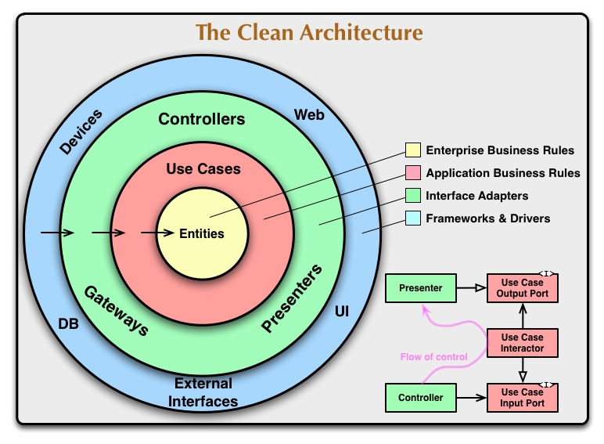
A different perspective

Slide 21
UML Architecture Diagrams
High-Level
Component Diagrams
Package Diagrams
Low-Level
Class Diagrams

Slide 22
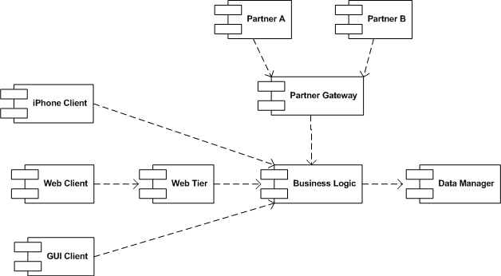
UML Component Diagram
UML Component Diagrams can be used to show subsystems and dependencies between them

Slide 23
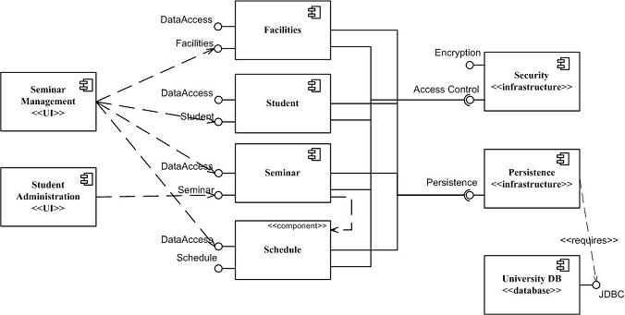
UML Component Diagram (cont.)

Slide 24
UML Package Diagram

Slide 25
Implementation
Determine the number of layers (i.e., abstraction levels)
Name the layers and assign responsibilities to them
Define the interface for each layer
Error handling strategy
Part of a layer's interface is the set of errors it might return
The errors returned by a layer should match its level of abstraction
Errors received from the layer below should be mapped into higher-level errors that are appropriate for the layer above
Low-level errors should not be allowed to "leak out" and become visible to high-level layers

Slide 26
Benefits of Layered Architecture
Separation of concerns across layers
Reduces coupling: “a measure of how strongly one element is connected to, has knowledge of, or depends on other elements”
Improves cohesion: “a measure of how functionally related the operations of a software element are”
Increases reuse potential (some layers are reusable by multiple applications)
Increases clarity
Related complexity is encapsulated and decomposable

Slide 27
Benefits of Layered Architecture (continued)
Some layers can be replaced with new implementations
Lower layers contain reusable functions
Some layers can be distributed (placed on different servers)
Development by teams is aided because of the logical segmentation

Slide 28
Disadvantages of Layered Architecture
Efficiency
Overhead involved in moving between layers may reduce efficiency
Dependency
Dependencies between layers can cause problems when a layer needs to be modified
Layer(s) above and below may be affected (more layers potentially affected by a relaxed layered architecture)

