Slide 1
State Design Pattern

Slide 2
State Design Pattern
Behavioral Pattern
Allows object to alter its behavior when internal state changes
Uses Polymorphism to define different behaviors for different states
Implementation of Replace conditional with Polymorphism

Slide 3
When to use STATE pattern ?
State pattern is useful when there is an object that can be in one of several states, with different behavior in each state.
To simplify operations that have large conditional statements that depend on the object’s state.
if (myself = happy) then
{
eatIceCream();
….
}
else if (myself = sad) then
{
goToPub();
….
}
else if (myself = ecstatic) then
{
….

Slide 4
Example
PersonState
Person
state variable
doSomething()
doSomething()
mad
angry
happy
doSomething()
Client
doSomething()
doSomething()
doSomething()

Slide 5
State Structure
Allow a object to alter its behavior when its internal state changes.

Slide 6
// Not good: unwieldy "case" statement
class CeilingFanPullChain
{
private int m_current_state;
public CeilingFanPullChain()
{
m_current_state = 0;
}
public void pull()
{
if (m_current_state == 0)
{
m_current_state = 1;
System.out.println(" low speed");
}
else if (m_current_state == 1)
{
m_current_state = 2;
System.out.println(" medium speed");
}
else if (m_current_state == 2)
{
m_current_state = 3;
System.out.println(" high speed");
}
else
{
m_current_state = 0;
System.out.println(" turning off");
}
}
}
public class StateDemo
{
public static void main(String[] args)
{
CeilingFanPullChain chain = new CeilingFanPullChain();
while (true)
{
System.out.print("Press ");
get_line();
chain.pull();
}
}
static String get_line()
{
BufferedReader in = new BufferedReader(
new InputStreamReader(System.in)) ;
String line = null;
try
{
line = in.readLine();
}
catch (IOException ex)
{
ex.printStackTrace();
}
return line;
}
}

Slide 7
interface State
{
void pull(CeilingFanPullChain wrapper);
}
class Off implements State
{
public void pull(CeilingFanPullChain wrapper)
{
wrapper.set_state(new Low());
System.out.println(" low speed");
}
}
class Low implements State
{
public void pull(CeilingFanPullChain wrapper)
{
wrapper.set_state(new Medium());
System.out.println(" medium speed");
}
}
class Medium implements State
{
public void pull(CeilingFanPullChain wrapper)
{
wrapper.set_state(new High());
System.out.println(" high speed");
}
}
class High implements State
{
public void pull(CeilingFanPullChain wrapper)
{
wrapper.set_state(new Off());
System.out.println(" turning off");
}
}
class CeilingFanPullChain
{
private State m_current_state;
public CeilingFanPullChain()
{
m_current_state = new Off();
}
public void set_state(State s)
{
m_current_state = s;
}
public void pull()
{
m_current_state.pull(this);
}
}

Slide 8
public class StateDemo
{
public static void main(String[] args)
{
CeilingFanPullChain chain = new CeilingFanPullChain();
while (true)
{
System.out.print("Press ");
get_line();
chain.pull();
}
}
static String get_line()
{
BufferedReader in = new BufferedReader(new InputStreamReader(System.in))
;
String line = null;
try
{
line = in.readLine();
}
catch (IOException ex)
{
ex.printStackTrace();
}
return line;
}
}

Slide 9
State Design Pattern

Slide 10
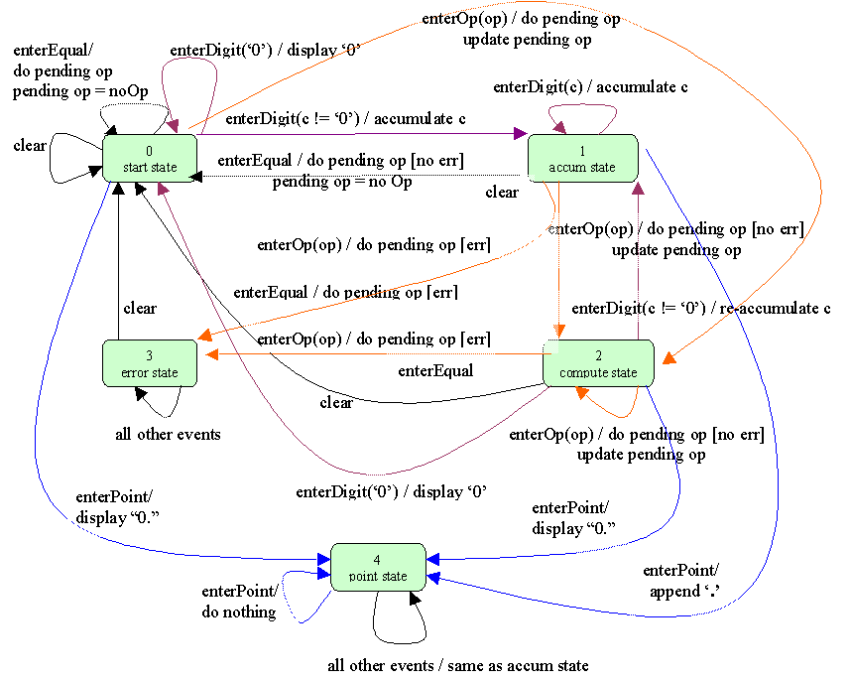

Slide 11
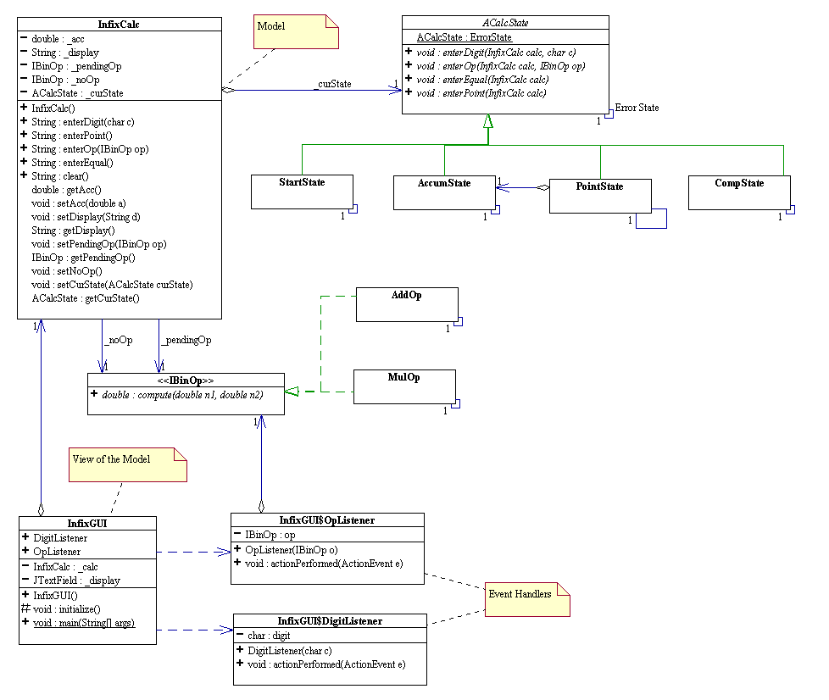

Slide 12
Alarm Clock State Machine
Clock Data: time, alarmTime
Clock Inputs: setTime(), setAlarmTime(), alarmOn(), alarmOff(), snooze()

