Slide 1

9th International Conference on Micro-Electronics, Electromagnetics and Telecommunications
Paper ID : 186
Paper Title: Detection of Cardiovascular Disease by ECG Images Using LSTM
Authors: S. Rajesh, Meeniga Nandini, Medagam Rahithya, P.Naga Lokesh
Presenter: Meeniga Nandini
Date: 20-12-2024

Slide 2
Abstract
Through the analysis of electrocardiogram (ECG) images, this study explores the application of machine learning and deep learning techniques for the early identification of cardiovascular illnesses. We evaluate the efficacy of conventional algorithms and cutting-edge deep learning techniques using a variety of datasets, preprocessing techniques, and feature extraction approaches model like the LSTM. While robustness is ensured by validation on separate datasets, the application of transfer learning improves model generalization. A focus on interpretability seeks to promote clinical acceptance, which is essential for incorporating new techniques into standard medical procedures. Overall, this study shows how these methods have the potential to transform the diagnosis of cardiovascular disease, allowing for prompt interventions and ultimately leading to better patient outcomes. Additionally, by permitting preemptive therapies, this interdisciplinary approach holds promise for revolutionizing cardiovascular healthcare.
Keywords:Cardiovascular disease, Diagnosis, Machine learning, Deep learning, Electrocardiogram (ECG),LSTM

Slide 3
Presentation Outline
Introduction
Related Work
Proposed Methodology
3.1 Preprocessing the ECG signal
3.2 Feature Extraction
3.3 LSTM Algorithm
4. Results
5. Conclusion
6. References

Slide 4
Introduction
This study aims to combine deep learning and machine learning methods for the early identification of cardiovascular disorders by electrocardiogram (ECG) picture processing, providing a novel means of advancing medical science. By means of the incorporation of varied. It aims to perform a complete comparison examination of the diagnostic efficacy between conventional methods and state-of-the-art deep learning models, notably Long Short-Term Memory (LSTM) network, using datasets, preprocessing procedures, and feature extraction techniques. This project establishes the foundation for a comprehensive study of cardiovascular health analytics with the goal of expanding the limits of existing diagnostic capabilities.
The proposed methods are validated on various datasets to ensure that they work reliably in different settings. The research’s emphasis on the potential to transform the diagnosis of cardiovascular illness highlights its dedication to facilitating prompt interventions and ultimately enhancing patient out- comes, so influencing the trajectory of cardiovascular health- care in the future.

Slide 5
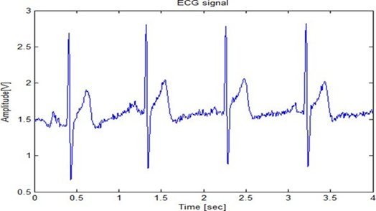
Introduction
A. ECG signal
The electrical activity of the heart is displayed on an ECG signal. Doctors can see if the heart is beating correctly because to the waves it produces. Through the use of these waves, cardiac issues can be identified
Fig. 1. ECG Signal with PQRST Dimensions

Slide 6
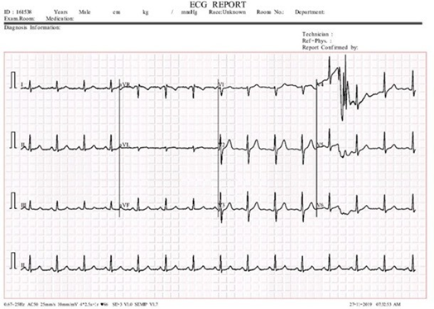
Introduction
B. Abnormal ECG Signal
Abnormal ECG signals include various cardiac anomalies such as arrhythmias, ischemia, and conduction disorders. Unusual P or T waves, aberrant QRS length or shape, and extended PR or QT intervals are examples of anomalies that can be seen in an abnormal ECG signal. It may be a sign of an electrolyte imbalance, myocardial infarction, ischemia, or arrhythmias. Abnormal wave shapes or ST elevation/depression are common anomalies. For a proper diagnosis and course of therapy, these variations call for additional medical assessment.
Fig. 2. Abnormal ECG Signal

Slide 7
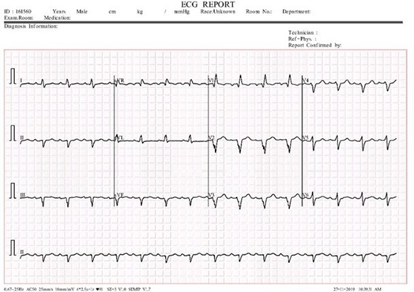
Introduction
C. Normal ECG signal
Normal ECG signals exhibit regular patterns representing healthy cardiac activity. P waves represent atrial depolarization, QRS complexes represent ventricular depolarization, and T waves represent ventricular repolarization in a typical ECG signal. The QRS length should be ¡ 0.12 seconds, and the PR interval should be 0.12-0.20 seconds. The normal range for heart rate is 60–100 bpm. Any differences might point to irregularities in the heart.
Fig. 3. Normal ECG signal

Slide 8
2. RELATED WORK
The study by Abubaker and Babayi builds on previous research that used conventional approaches for cardiovascular disease identification, by employing machine learning and deep learning to advance ECG image interpretation. By combining deep learning techniques and sophisticated algorithms, their strategy outperforms conventional methods and simpler models in terms of accuracy.
Ullah and colleagues improve the identification of cardiovascular illness by fine-tuning feature selection in machine learning models. By using more relevant feature sets to improve accuracy, this work advances earlier techniques.

Slide 9
2. RELATED WORK
By incorporating cutting-edge device getting to know techniques, Gupta et al. (2019) gift MIFH, a system intelligence framework for diagnosing heart ailment that improves on previous procedures. Compared to conventional models, their technique increases diagnostic performance and accuracy. Ahmad and Polat recommend a coronary heart sickness prediction version utilizing a jellyfish optimization algorithm combined with gadget studying. This method enhances prediction accuracy and performance, building on previous optimization and system getting to know techniques for scientific diagnostics.
Ullah et al. (2022) use more advantageous characteristic selection techniques to provide an powerful machine mastering model for early and correct cardiac disorder prediction. Their technique improves on previous models by using using superior feature optimization to boom prediction accuracy and early detection skills.

Slide 10
2. RELATED WORK
Sailasya and Kumari (2021) investigate the fulfillment of device studying classification methods in stroke prediction. Their research compares numerous models’ efficaciousness for you to improve forecast accuracy and dependability

Slide 11
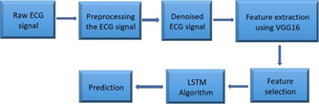
3. Proposed Methodology
Fig.5 Proposed Methodology

Slide 12
3. Proposed Methodology
The first step is to get the raw ECG data, which depicts the heart’s electrical activity. Noised ECG signals are created by filtering raw signals to remove artifacts, baseline drift, and noise. The VGG16 convolutional neural network is used to extract excessive-degree features from denoised ECG data. The most relevant skills for categorizing and characterizing cardiac events are identified using feature selection procedures. The chosen properties were loaded into an LSTM algorithm, which is a type of recurrent neural network capable of processing sequential data. The LSTM model simplifies the process of accurately forecasting cardiovascular events by finding temporal correlations and patterns in ECG data. Finally, the trained LSTM model is used for prediction tasks, offering valuable insights on heart health and supporting medical decision-making.
Raw ECG data often show a waveform representing the heart’s electrical activity over time. These indicators, with three separate waveforms (P wave, QRS complex, and T wave), mimic the atria and ventricles’ depolarization and repolarization processes. Raw data, including waveforms, intervals, and amplitudes, is vital for diagnosing cardiac problems such as ischemia, myocardial infarctions, and arrhythmias. Accurate interpretation of raw ECG signals is necessary for clinically assessing and treating heart-related diseases.

Slide 13
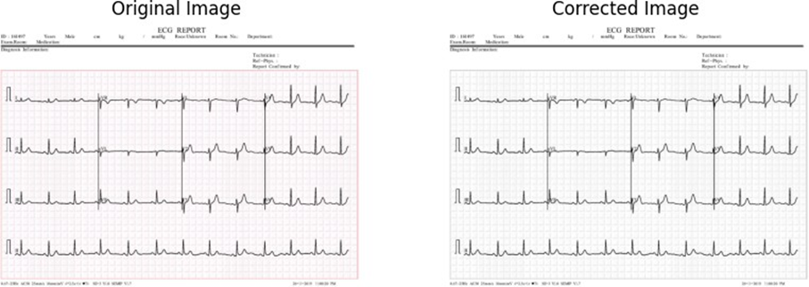
3. Proposed Methodology
3.1 Preprocessing the ECG signal
The collected ECG images vary in size, contrast, and sharpness levels. Filtering removes baseline float and noise from the dataset, ensuring signal clarity and standardization. Separating signals into heartbeats or intervals simplifies feature extraction. To provide consistency, normalization standardizes signal amplitudes across recordings.
Fig. 6 Original and adjusted ECG signal pictures

Slide 14
3. Proposed Methodology
Using Wavelet Transform to remove noise from ECG data involves breaking down the sign into frequency components, identifying patterns in the noise at different scales, and filtering out particular noise while preserving significant ECG characteristics.Noise distortions such as baseline drift and muscle interference can be minimized by thresholding wavelet coefficients and reconstructing the signal.Wavelet denoising is a versatile approach for improving the quality of ECG recordings, allowing for accurate diagnosis and analysis of inclinical conditions.

Slide 15
3. Proposed Methodology
3.2 Feature Extraction
VGG16 function extraction uses a pretrained model trained on the ImageNet dataset to extract high-level functions from images. Load VGG16 without its pinnacle class layers and select an output from an advanced convolutional layer for analysis. The photo is loaded, scaled to 224 pixels, turned into an array, and preprocessed to meet VGG16’s entry conditions. The version extracts characteristic maps from preprocessed photographs. If necessary, these function mappings can be flattened to form a one-dimensional function vector. VGG16’s powerful feature extraction capabilities may be used for many tasks such as object recognition, image classification, clustering, and more.
Using VGG16 for ECG sign function extraction is useful because it uses the pretrained version’s convolutional layers to extract complex, hierarchical capabilities from ECG recordings. This method enhances accuracy in identifying cardiovascular problems, decreases the need for large labeled datasets, and increases generalization to new data. VGG16 automates characteristic extraction, making the evaluation process more efficient and effective in diagnosing coronary heart problems.

Slide 16
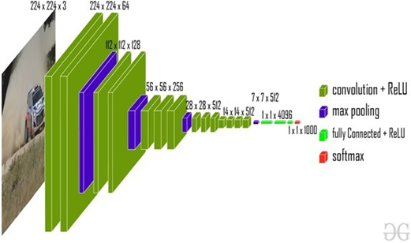
3. Proposed Methodology
Fig. 7. VGG16 Architecture

Slide 17
3. Proposed Methodology
3.3 LSTM Algorithm
LSTM, a recurrent neural network, is used to diagnose cardiovascular diseases by analyzing sequential data such as ECG signals. It excels at capturing long-term dependencies, which are crucial for understanding the context of cardiac rhythm abnormalities. LSTM networks are trained on annotated ECG datasets to accurately discriminate between normal and abnormal cardiac rhythms. This assists clinicians in early identification and diagnosis of many cardiovascular diseases. LSTM’s ability to process temporal data makes it a valuable tool for improving diagnostic abilities and patient outcomes in cardiovascular healthcare. LSTM networks may detect patterns and spatial relationships in photos by considering them as sequential recordings during image processing.

Slide 18
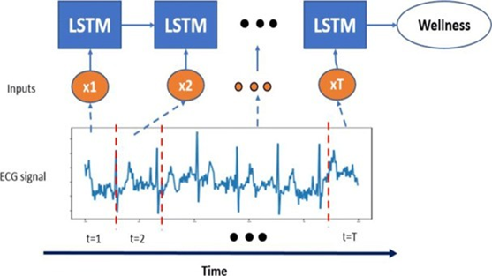
3. Proposed Methodology
LSTM, a recurrent neural network, is used to identify cardiovascular disorders by processing sequential data such as ECG signals. It captures long-term dependencies, which are critical for recognizing heart rhythm problems. LSTMs are trained on ECG datasets to differentiate between normal and abnormal rhythms, which aids in early analysis. Their capacity to process temporal information improves diagnostic skills in healthcare. Furthermore, in image processing, LSTMs can detect spatial patterns by considering images as sequences, which aids with tasks such as classification and segmentation by determining relationships throughout an image.
Fig. 8. LSTM Architecture

Slide 19

4. RESULTS
Fig. 9 : Results

Slide 20
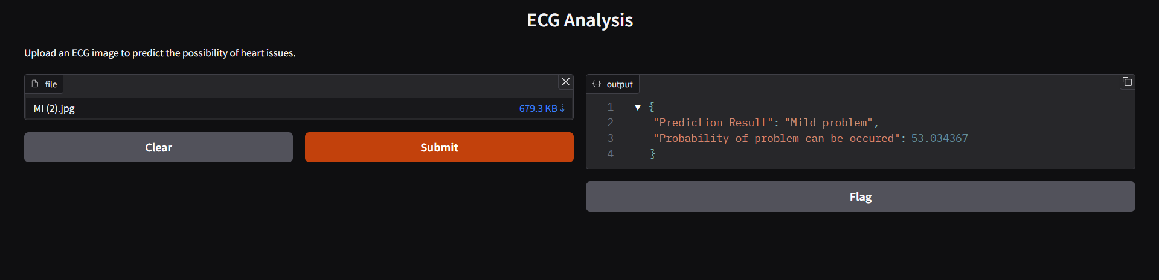
4. RESULTS
Fig. 10 : Results

Slide 21
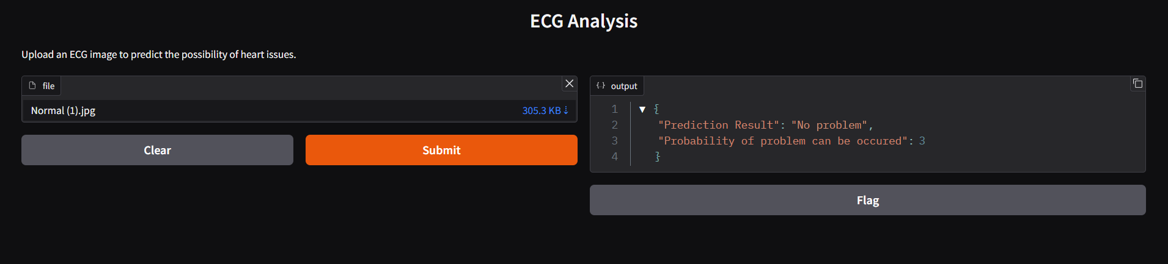
4. RESULTS
Fig. 11 : Results

Slide 22
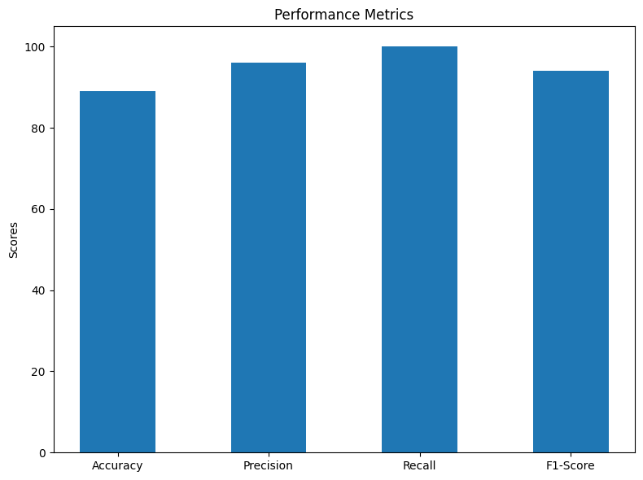
4. RESULTS
Fig. 12 : Performance Graph

Slide 23
5. CONCLUSION
This study offers analysis of feature extraction techniques, diverse datasets, preprocessing methodologies, and electrocardiogram (ECG) images. It also carries out a thorough comparative analysis to evaluate the diagnostic efficacy of both state-of-the-art deep learning models, such as the Long Short-Term Memory (LSTM) network, and traditional algorithms. This comparative analysis lays the groundwork for a deeper examination of cardiovascular health analytics with the goal of pushing the envelope of present diagnostic capabilities and opening new avenues for future developments in medical diagnostics. As we move forward, the validation procedure is essential to guaranteeing the dependability and strength of the suggested approaches. The work tackles the requirement for consistent performance across diverse situations by means of validation on discrete datasets that reflect different illness presentations.

Slide 24
6. References
Abubaker, M. B., Babayi˘git, B. (2022). Detection of cardiovascular diseases in ECG images using machine learning and deep learning methods. IEEE Transactions on Artificial Intelligence, 4(2), 373-382.
Ullah, T., Ullah, S. I., Ullah, K., Ishaq, M., Khan, A., Ghadi, Y. Y., Algarni, A. (2024). Machine Learning-Based Cardiovascular Disease Detection Using Optimal Feature Selection. IEEE Access.
Henein, M. Y., Vancheri, S., Longo, G., Vancheri, F. (2022). The role of inflammation in cardiovascular disease. International journal of molecular sciences, 23(21), 12906.
Ullah, X. Chen, K. Rajab, M. Al Reshan, A. Shaikh, M. Hassan, M. Rizwan,and M. D´avidekov´a, “An efficient machine learning model based on improved features selections for early and accurate heart disease predication,” Computational Intelligence and Neuroscience, vol. 2022, pp. 1–12, 07 2022
G. Sailasya and G. Kumari, “Analyzing the performance of stroke prediction using ml classification algorithms,” International Journal of Advanced Computer Science and Applications, vol. 12, 01 2021.
Garg, B. Sharma, and R. Khan, “Heart disease prediction using machine learning techniques,” IOP Conference Series: Materials Science and Engineering,vol. 1022, p. 012046, jan 2021.
Townsend, N., Kazakiewicz, D., Lucy Wright, F., Timmis, A., Huculeci, R., Torbica, A., ... Vardas, P. (2022). Epidemiology of cardiovascular disease in Europe. Nature Reviews Cardiology, 19(2), 133-143.

Slide 25
6. References
Jankowski, J., Floege, J., Fliser, D., Bo¨hm, M., Marx, N. (2021). Cardiovascular disease in chronic kidney disease: pathophysiological insights and therapeutic options. Circulation, 143(11), 1157-1172.
Timmis, A., Vardas, P., Townsend, N., Torbica, A., Katus, H., De Smedt, D., ... Achenbach, S. (2022). European Society of Cardiology: cardiovascular disease statistics 2021. European heart journal, 43(8), 716-799.
Hill, M. A., Yang, Y., Zhang, L., Sun, Z., Jia, G., Parrish, A. R., Sowers, J. R. (2021). Insulin resistance, cardiovascular stiffening and cardiovascular disease. Metabolism, 119, 154766.
11. Matsushita, K., Ballew, S. H., Wang, A. Y. M., Kalyesubula, R., Schaeffner, E., Agarwal, R. (2022). Epidemiology and risk of cardiovascular disease in populations with chronic kidney disease. Nature Reviews Nephrology, 18(11), 696-707.
Vogel, B., Acevedo, M., Appelman, Y., Merz, C. N. B., Chieffo, A., Figtree, G. A., ... Mehran, R. (2021). The Lancet women and cardiovascular disease Commission: reducing the global burden by 2030. The Lancet, 397(10292), 2385-2438.
Joshi, A., Rienks, M., Theofilatos, K., Mayr, M. (2021). Systems biology in cardiovascular disease: a multiomics approach. Nature Reviews Cardiology, 18(5), 313-330.

