Slide 1
CRYPTOGRAPHY: WHY and HOW?
Carl Gibbons
Computer Information Technology
https://byui-cit.github.io/gibbonsc/
Notes:
Thank you for attending this lecture.

Slide 2
1. CRYPTOGRAPHY SOLVES WHAT PROBLEMS?
WHY?
-··· -·-- ··- ··
Notes:
Let me start with “Why?”
My degrees are in mathematics. A mentor once suggested to me that an aspiring scholar in pursuit a science degree should practice reframing “why” questions into “what” questions. Her recommendation was intended to make study topics more scientifically objective. Let “arts” degree holders and seekers ponder and think deeply about “why” questions.
I appreciated this insight, and I have tried to make it a habit. I’m guilty of using prejudicial and divisive language to distinguish “hard sciences” (math, physics, biology, chemistry) from “soft subjects” (arts, humanities, social studies.) Her suggestion helps to humble me and remind me to respect scholars that pursue the “arts” paths that I did not choose.
Here’s an easy “why to what” reframing: instead of “why study cryptography,” instead ask “what problem does it solve?”

Slide 3
What do I get by learning these things?
Notes:
My mentor also recommended that more effective results come from pondering “what” before “how” questions, such as “what problem does a technology solve” rather than “how does a technology work.” In the discipline called Systems Analysis and Design, a methodology called “waterfall” follows this practice: analysis and requirements gathering happen before design and implementation.
There’s a record of a conversation between the ancient Greek mathematician Euclid and one of his students. The student asked, “What do I get by learning these things?” In other words, how will I use the math you’re teaching in real life?

Slide 4
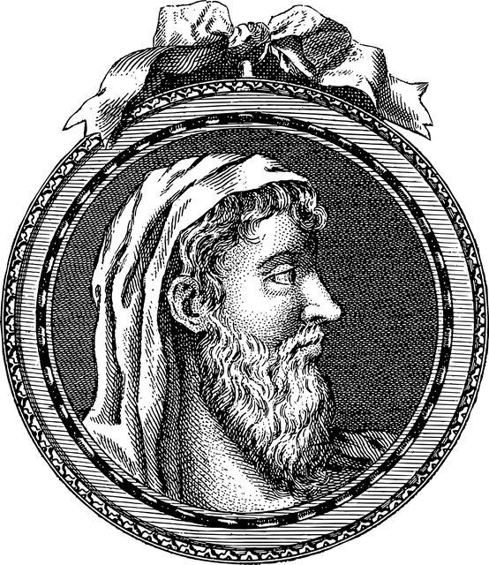
What do I get by learning these things?
Give him threepence, since he must make a gain out of what he learns.
- Stobaeus, Extracts
Notes:
I have always appreciated Euclid’s condescending reply to the student’s servant: “Give him a tiny amount of money, since he must make gain out of what he learns.” I agree with Euclid: truth and beauty are reason enough to study.
Nevertheless, I will suffer through a brief “what is this good for” question before spending time on the “how does it work” topics that I find so much more beautiful and satisfying.

Slide 5
Cybersecurity Model
Confidentiality
Integrity
Availability
Each of these principles depends on Authorization.
Notes:
A fundamental model in Cybersecurity scholarship has become known as the CIA triad, a cute pun on the United States Central Intelligence Agency.
Confidentiality: an authorized party can obtain and view information. An unauthorized party cannot.
Integrity: an authorized party can modify/create/erase information. An unauthorized party cannot.
Availability: an authorized party can access and process information in a timely manner.

Slide 6
Cybersecurity Model
Confidentiality read (privacy)
Integrity write (reliability)
Availability use
Each of these principles depends on Authorization.
Notes:
The primary uses of Cryptography are to promote a couple of intellectual property controls:
Privacy – to keep unathorized users from reading your private content.
Reliability – to keep unauthorized users from modifying or tampering with your private content.

Slide 7
Other uses for cryptography
Authentication
Nonrepudiation
Obfuscation
Digital Signatures
Third-party trust
Notes:
Cryptography handles other problems, too. It’s used in authentication challenges: “are you really whom you say you are, and not an impostor?” This includes cognitive “what you know” challenges, such as “what’s the password?”, and tangible “show me what you have” challenges such as certificates and tokens. Cryptograhy can also provide nonrepudation services – “after something occurs, you won’t be able to plausibly deny that it occurred.” Cryptography makes obfuscation easier, by which I mean, just make information harder to obtain, without regard to authorization. Cryptography is also a component of Digital Signatures and Third-party trust – instead of shaking someone’s hand or scribbling something on a dotted line, a party can be a witness to a transaction using electronic means.

Slide 8
2.
HOW DOES CRYPTOGRAPHY SOLVE PROBLEMS?
HOW?
-··· -·-- ··- ··
Notes:
How does cryptography solve these problems?

Slide 9
Data at rest / data in transit
Encrypt:
Transform plaintext into ciphertext
Decrypt:
Transform ciphertext back into plaintext
Privacy (Confidentiality)
Authorized sender and receivers view useful or understandable information.
Unauthorized receivers only see nonsense or gibberish.
Notes:
For privacy, legible data called “plaintext” is “encrypted” into obscured or obfuscated noise called “ciphertext.” In a successful cryptosystem, only authorized readers can “decrypt” the ciphertext to recover the original plaintext. Unauthorized interceptors only observe noise. This can be done for data in long-term storage (disks, tapes, etc.) – “data at rest” – and also for data communicated over cables, fibers, or radio transmissions – “data in transit.”

Slide 10
Data at rest / data in transit
Hash:
A result of a mathematical operation that transforms a message into a short “digest” token of the message.
Reliability (Integrity)
Evidence that information is communicated unmolested,
or
evidence that an unauthorized communicator has tampered with the contents.
Authentication
Evidence to distinguish a genuine agent from an impostor.
Notes:
For message reliability, a “hash” digest of the message may be computed and stored or transmitted alongside the message. The message recipient may recompute the digest and compare the result to the provided hash. If they match, the message must have retained its integrity; if not, the recipient knows the message has been altered.
Passwords should be hashed. Rather than save a copy of someone’s password, which risks confidentiality of that password, store a hash instead. When the user provides a password, calculate the hash and compare with the stored hash to judge the user’s authentic identity. Hashes may also be used with with tokens used for authentication, such as certificates.

Slide 11
Trust architecture
Nonrepudiation
Evidence that a message was successfully delivered despite a sender’s claim otherwise,
or
evidence that the sender is geniunie, despite a recipient’s claim otherwise.
Digital Signature
An artifact that combines authentication and message integrity mechanisms.
Third-party verification
Engage a guarantor, or distributed witnesses, to affirm trust mechanisms.
PKI (public key infrastructure) enables these digital trust mechanisms at large scale.
Notes:
With the advent of public key cryptography about half a century ago, electronic nonrepudiation capability became feasible. A digital token used to identify and authenticate a sender is used both to hash a message, and also to encrypt that hash into a “digital signature. The receiver also hashes the message, then decrypts the signature – if the results match, the sender’s identity is verified.
A public key infrastructure (PKI) is a scalable business and network arrangement in which parties may generate digital certificates, have them signed by a certificate authority (a sort of electronic “notary”) and then use signed certificates to conduct private, reliable, authentic transactions that can’t be repudiated.

Slide 12
3.
HOW DO ENCRYPTION, DECRYPTION, and HASHES HAPPEN?
HOW?
-··· -·-- ··- ··
Notes:
Now for the stuff I find delightful: How does cryptography happen?

Slide 13
STANDARD ENCODING
Not Cryptography
Notes:
First, let’s review some preliminary data science explanations.

Slide 14


Decimal
0
1
2
3
4
5
6
7
8
9
Notes:
With eight fingers and two thumbs on each hand (ten digits), I learned to count using the decimal system.

Slide 15


Hexadecimal
0
1
2
3
4
5
6
7
8
9
a (10)
b (11)
c (12)
d (13)
e (14)
f (15)
Notes:
For digital technologies, its often easier to pretend to have seven fingers and a thumb on each hand, and count using sixteen numerals. The convention is to use letters a through f for the extra six digits – in traditional decimal, these would be the numbers ten through fifteen.

Slide 16
Hexadecimal
0000 ↔ 0
0001 ↔ 1
0010 ↔ 2
0011 ↔ 3
0100 ↔ 4
0101 ↔ 5
0110 ↔ 6
0111 ↔ 7
1000 ↔ 8
1001 ↔ 9
1010 ↔ a
1011 ↔ b
1100 ↔ c
1101 ↔ d
1110 ↔ e
1111 ↔ f
Notes:
Hexadecimal numerals make it more convenient to work with binary bits – zeroes and ones – by grouping them into four bit nibbles. Fundamentally, a binary representation is how data is stored or transmitted by electronic computers, but humans like me find it difficult to work with long boring sequences of zeroes and ones. Hexadecimal numerals are more compact and a little easier to work with.

Slide 17
ASCII/Unicode
33/21: ! | 46/2e: . | 65/41: A | 78/4e: N | 97/61: a | 110/6e: n
34/22: “ | 47/2f: / | 66/42: B | 79/4f: O | 98/62: b | 111/6f: o
35/23: # | 48/30: 0 | 67/43: C | 80/50: P | 99/63: c | 112/70: p
36/24: $ | 49/31: 1 | 68/44: D | 81/51: Q | 100/64: d | 113/71: q
37/25: % | 50/32: 2 | 69/45: E | 82/52: R | 101/65: e | 114/72: r
38/26: & | 51/33: 3 | 70/46: F | 83/53: S | 102/66: f | 115/73: s
39/27: ‘ | 52/34: 4 | 71/47: G | 84/54: T | 103/67: g | 116/74: t
40/28: ( | 53/35: 5 | 72/48: H | 85/55: U | 104/68: h | 117/75: u
41/29: ) | 54/36: 6 | 73/49: I | 86/56: V | 105/69: I | 118/76: v
42/2a: * | 55/37: 7 | 74/4a: J | 87/57: W | 106/6a: j | 119/77: w
43/2b: + | 56/38: 8 | 75/4b: K | 88/58: X | 107/6b: k | 120/78: x
44/2c: , | 57/39: 9 | 76/4c: L | 89/59: Y | 108/6c: l | 121/79: y
45/2d: - | 58/3a: : | 77/4d: M | 90/5a: Z | 109/6d: m | 122/7a: z
Notes:
Most information we use is text or prose, rather than numbers. Our society in general has adopted a standard way to represent text and other glyphs as unique patterns of seven or eight binary bits. A portion of “American Standard Code for Information Interchange” (ASCII) is shown here, with both decimal and hexadecimal representations of the binary patterns assigned to each key of a typical twentieth-century American typewriter. (Today, we use a more inclusive standard called Unicode, which uses up to sixteen binary bits to uniquely represent every symbol in every written human language.)

Slide 18
Plaintext → Cleartext → Plaintext
ASCII/Unicode
Sender → Receiver
Spencer Kimball
Spencer Kimball
53 70 65 6e 63 65 72
4b 69 6d 62 61 6c 6c
S p e n c e r K i m b a l l
53 70 65 6e 63 65 72
4b 69 6d 62 61 6c 6c
5370656e636572 4b696d62616c6c
Notes:
Today’s computer networks use this code to communicate. Here’s a model showing how the message “Spencer Kimball” is transmitted over a computer network. The bit patterns (shown here as hexadecimal instead of binary) are sent as signals to another computer. The receiver’s computer processes those signals into characters that the receiver can understand.
Although a code is used to communicate, this isn’t considered cryptography, because the message is sent in “cleartext.” This means that any third party that intercepts these signals may also easily decode and understand the message.

Slide 19
SYMMETRIC ENCRYPTION
Confidentiality
Notes:
Now let’s observe some historic and contemporary examples of encryption, and how they’re used to keep private messages confidential.
A crpytographic scheme is called “symmetric” if both the sender and receiver of a message use the same secret “key” to encrypt/decrypt a message.

Slide 20
SUBSTITUTION
symbol replacement
Notes:
A common way to encrypt a message is to use a substitution cipher – a systematic way to replace characters in a message with some other characters.

Slide 21
Plaintext → Ciphertext → Plaintext
Pig Pen
Spencer Kimball
spencer
kimball
Spencer Kimball
Notes:
A method known as “pig pen” replaces characters with certain geometric shapes, and has been used for centuries to encrypt private messages. An interceptor that receives the strange geometric shapes cannot understand the message without the secret key used for encryption and decryption.

Slide 22
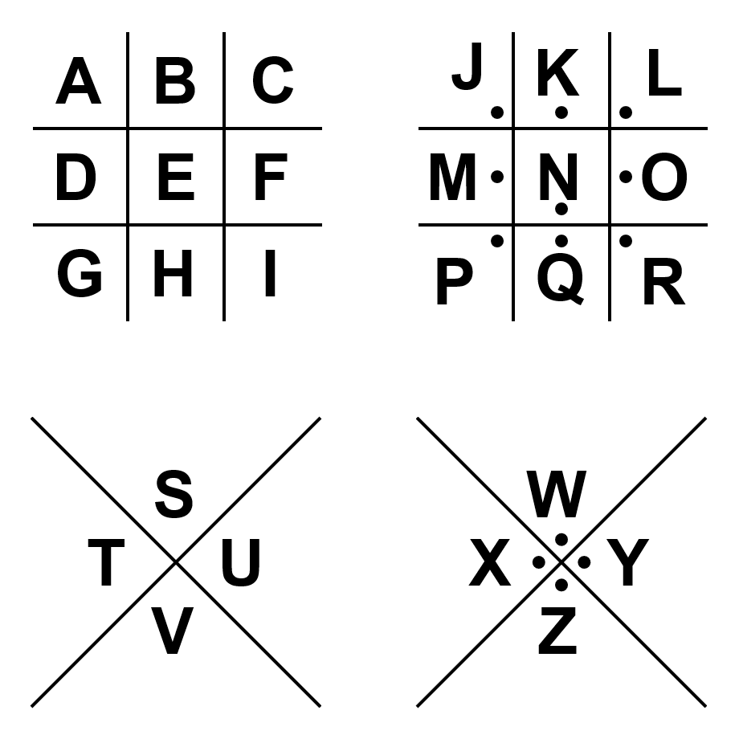
Plaintext → Ciphertext → Plaintext
Pig Pen
key: (diagram)
Encrypt
Decrypt
Spencer Kimball
spencer
kimball
Spencer Kimball
Notes:
In this example, the key is represented by a diagram. Authorized communicators must use this diagram when they need to communicate something in secret. It’s pretty easy to learn and remember how to recreate the diagram, so it was a convenient and popular cipher.
We call this a symmetric cipher because both the sender and receiver use the same key (the same diagram) to encrypt and decrypt.

Slide 23
Plaintext → Ciphertext → Plaintext
rot13 (Caesar)
Spencer Kimball
Fcrapre Xvzonyy
Spencer Kimball
53 70 65 6e 63 65 72
4b 69 6d 62 61 6c 6c
46 63 72 61 70 72 65
58 76 7a 6f 6e 79 79
53 70 65 6e 63 65 72
4b 69 6d 62 61 6c 6c
Notes:
Another ancient cipher takes advantage of memorized “alphabetic order.” This is a “Caesar cipher,” which uses the alphabet inscribed on two rings. The key is to know how to line up both rings against each other, and then substitute letters on one ring with letters on the other.

Slide 24
Plaintext → Ciphertext → Plaintext
ABCDEFGHIJKLM
NOPQRSTUVWXYZ
rot13 (Caesar)
key: 13
Spencer Kimball
Fcrapre Xvzonyy
Spencer Kimball
53 70 65 6e 63 65 72
4b 69 6d 62 61 6c 6c
Encrypt
46 63 72 61 70 72 65
58 76 7a 6f 6e 79 79
53 70 65 6e 63 65 72
4b 69 6d 62 61 6c 6c
Decrypt
Notes:
This particular Caesar cipher is also named “rot13,” for “rotate by thirteen letters.” With one of the rings rotated exactly halfway through the 26-letter alphabet, encryption and decryption are perfectly symmetrical.

Slide 25
Binary substitution with Exclusive-Or (XOR)
0 XOR 0 → 0
0 XOR 1 → 1
1 XOR 0 → 1
1 XOR 1 → 0
Notes:
At the binary, or “bit” level, there is just one substitution cipher. It either leaves a bit changed (1 substituted for 0, 0 substituted for 1) or unchanged (0 remains 0, 1 remains 1). A “logical” operation called “exclusive or” encapsulates all four possibilities.

Slide 26
Binary substitution with Exclusive-Or (XOR)
XOR | 0 | 1
0 | 0 | 1
1 | 1 | 0
0 XOR 0 → 0
0 XOR 1 → 1
1 XOR 0 → 1
1 XOR 1 → 0
Notes:
Here’s the “exclusive or” operation represented in a two-row by two-column table, in the same manner as a multiplication table.

Slide 27
Binary substitution with Exclusive-Or (XOR)
XOR | 0 | 1
0 | 0 | 1
1 | 1 | 0
Example:
Plaintext: | p | 70 ≡ 0111 0000
Key: | K | 4b ≡ 0100 1011
Ciphertext: | ; | 3b ≡ 0011 1011
0 XOR 0 → 0
0 XOR 1 → 1
1 XOR 0 → 1
1 XOR 1 → 0
p
;
p
Notes:
Here’s an example of “exclusive or” used as a binary substitution cipher with the ASCII or Unicode bit patterns of a single character message with a single character secret “key.” For corresponding bits in the message “lowercase p” and the key ‘capital K’, if the bits are the same, the ciphertext gets a “zero” bit, and if the bits are different, the ciphertext gets a “one” bit. The resulting ciphertext happens to be the bit pattern for the semicolon character.
Decryption happens the same way: if a ciphertext bit and symmetric key bit are the same, the plaintext gets a “zero” bit; if different, the plaintext gets a “1” bit.

Slide 28
PERMUTATION
symbol rearrangement
Notes:
Okay, those are three elementary examples of substitution ciphers. There’s another way to encrypt a message: instead of substituting symbols for other symbols, just scramble existing symbols into a different linear order.

Slide 29
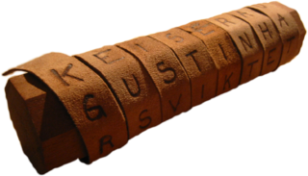
Plaintext → Ciphertext → Plaintext
scytale
Spencer Kimball
Sebprae
Klnilcm
Spencer Kimball
Notes:
A “scytale” is a rod or dowel, with a belt or other strip of material wrapped around it in a helix or spiral. In this example, the dowel’s circumference is five characters around, and the belt is long enough to go around the dowel three times; then the message “Spencer Kimball” is inscribed on the belt, in the direction of the scytale’s dowel.

Slide 30
Plaintext → Ciphertext → Plaintext
scytale
key: 5
Encrypt
Decrypt
Spencer Kimball
Sebprae
Klnilcm
Spencer Kimball
Notes:
The recipient must possess an identically sized dowel and wrap the belt around it to decipher the message. The symmetric “key” is the circumference of the dowel.

Slide 31
Plaintext → Ciphertext → Plaintext
shuffle
Spencer Kimball
crneSep
albmKli
Spencer Kimball
53 70 65 6e 63 65 72
4b 69 6d 62 61 6c 6c
63 72 6e 65 53 65 70
61 6c 62 6d 4b 79 69
53 70 65 6e 63 65 72
4b 69 6d 62 61 6c 6c
Notes:
There are other ways to shuffle a message. In this permutation cipher, letters are exchanged in a pattern known by both sender and receiver.

Slide 32
Plaintext → Ciphertext → Plaintext
shuffle
key: (15)(27)(34)
Spencer Kimball
crneSep
albmKli
Spencer Kimball
53 70 65 6e 63 65 72
4b 69 6d 62 61 6c 6c
Encrypt
63 72 6e 65 53 65 70
61 6c 62 6d 4b 79 69
Decrypt
53 70 65 6e 63 65 72
4b 69 6d 62 61 6c 6c
Notes:
In this example, the permutation for each seven-letter word is as follows: “exchange position 1 with position 5, 2 with 7, 3 with 4, and leave position 6 alone.”

Slide 33
COMBINED SUBSTITUTION/ PERMUTATION
contemporary encryption
Notes:
Today, every robust symmetric cryptography algorithm employs a series of both substitution and permutation operations.

Slide 34
Plaintext → Ciphertext
AES (Rijndael)
Spencer Kimball
Vf].?±¸Ð
ØßPÆ\ÍÚÒ
Ciphertext → Plaintext
Vf].?±¸Ð
ØßPÆ\ÍÚÒ
Spencer Kimball
Notes:
Today’s “state of the art” is known as Advanced Encryption Standard, based on an algorithm originally called “Rijndael” by its Dutch inventors.

Slide 35
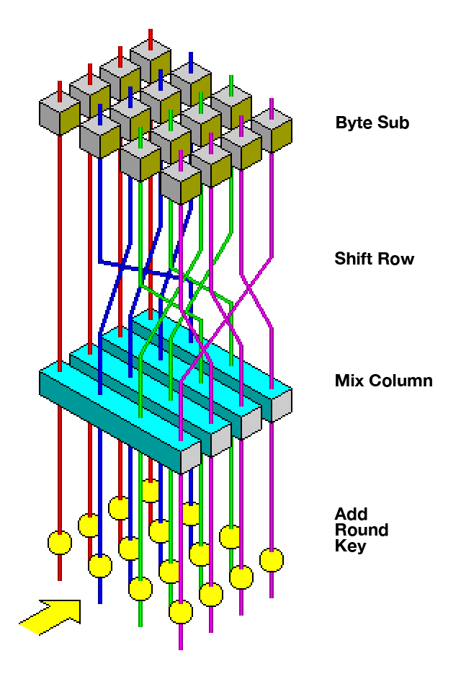
Plaintext → Ciphertext
AES
Spencer Kimball
Vf].?±¸Ð
ØßPÆ\ÍÚÒ
Encrypt
Ciphertext → Plaintext
Vf].?±¸Ð
ØßPÆ\ÍÚÒ
Decrypt
Spencer Kimball
Image credit: Jon Savard
Notes:
Rijndael transforms data in rounds of four steps: a symbol substitution step using the shared secret key called “ByteSub”, two permutation shufflers called “ShiftRow” and “MixColumn,” and an exclusive-or substitution step involving variations of the shared secret key called “AddRoundKey.” Depending on the implementation, these four-step “rounds” are repeated about a dozen times to produce the ciphertext.
The recipient decrypts using the same key, with the rounds performed in reverse order: AddRoundKey, (un)MixColumn, (un)ShiftRow, then ByteSub. repeated about a dozen times. (I’ve left out a few details, but this is essentially how most of our encryption works on the Internet today.)
AES has been analyzed and studied for decades. It remains very difficult to find any patterns in the ciphertext “noise” that it produces. At this time, it is very unlikely that a motivated interceptor would be able to discern either the secret shared key or original plaintext message.

Slide 36
ASYMMETRIC ENCRYPTION
Confidentiality, and more
Notes:
About fifty years ago, new algorithms were discovered that can be used to encrypt and decrypt messages, without the hassle of maintaining a shared secret key between communicants. The first of these to be widely used was called RSA, the initials of its inventors.

Slide 37
Plaintext → Ciphertext → Plaintext
RSA
public key
private key
5
377
5
Notes:
A message’s recipient publishes one of a pair of keys – that’s right, the encryption key is not secret! A sender encrypts a message using that public key, and transmits the ciphertext message. No interceptor may recover the original plaintext, because the public key cannot be used to decrypt the message. Only the recipient’s private key (which must be kept secret) can decrypt the message back into plaintext.

Slide 38
Plaintext → Ciphertext → Plaintext
RSA (mod 589)
Keys: 7, 463
public key:
7 (mod 589)
private key:
463 (mod 589)
5
377
5
5⁷ ≡ 377 (mod 589)
377⁴⁶³ ≡ 5 (mod 589)
Notes:
The RSA algorithm relies on two mathematical operations: exponent (raising to a power) and remainder (the “modulus” operation: it’s the same as division, but instead of finding the quotient, the result is rather the remainder left over). In this simplified example, the “public” key is the divisor 589 and an exponent 7. The plaintext must be interpreted as a number, in this case, five. The sender raises five to the seventh power (that is, multiplies 5 by itself seven times) and divides by 589. The ciphertext is the remainder after division: 377.
The “private” key is a carefully calculated exponent, in this case, 463. To decrypt, the recipient multiplies 377 by itself 463 times (hopefully using a computer to do this and not using pencils and papers) and divides the result by 589. The remainder will be the original plaintext, 5.
This algorithm doesn’t work with just any exponents and divisors – they must be carefully selected, because the arithmetic depends on properties of prime numbers to work properly. This example used numbers of somewhat small magnitude, and wouldn’t be considered very secure, but if RSA is used with divisors and private exponents that are hundreds of digits long, it’s very difficult for a ciphertext interceptor to figure out the private key or plaintext message.

Slide 39
Other asymmetric algorithms
Diffie-Hellman
ECC (Elliptic Curve Cryptography)
… a few others
Notes:
Several other public/private key algorithms have been discovered, studied, and successfully implemented, such as Diffie-Hellman, Elliptic Curve Cryptography, and a few others.
Exponentiation and division can be expensive computer operations, measured by compute time and electricity or energy consumed. Elliptic Curves are growing more popular in cryptography. With them, ciphertexts can be generated and decrypted with addition and multiplication operations, which can be done with significantly less time and electricity. Furthermore, elliptic curve algorithms used with smaller magnitude keys, only dozens of digits long instead of hundreds, have shown to be just as resistant to ciphertext interceptors’ attacks or analysis.

Slide 40
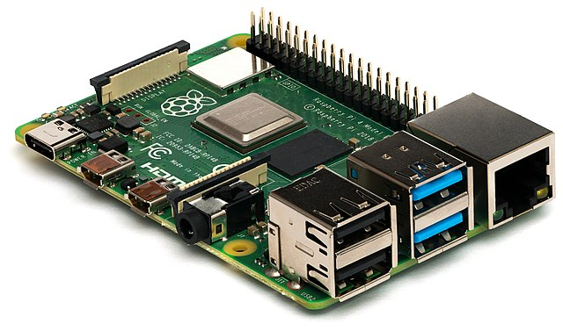
Other asymmetric algorithms
Diffie-Hellman
ECC (Elliptic Curve Cryptography)
… a few others
Notes:
In my opinion, long term general IT market trends seem to favor technologies that consume less power, so that battery power sources last longer. Innovations such as “Internet-of-things” (IoT) devices are taking advantage of (and contributing to) this trend. I predict that ECC variants will soon become our most widely used public/private key encryption methods.

Slide 41
Asymmetric vs Symmetric
Asymmetric Pro:
Reduced key distribution danger.
Asymmetric Con:
Computationally intensive.
Symmetric Pro:
Computationally efficient.
Symmetric Con:
Danger of key interception.
Notes:
Currently, we take advantage of both symmetric and asymmetric algorithms. A typical communication starts by creating, at that moment, a random symmetric key, intended to be used for efficient AES encryption. Then that symmetric key is encrypted and delivered to the recipient using an asymmetric (public key) method, such as RSA or ECC. Asymmetric encryption takes a little more time and effort, but since a symmetric key is a pretty small message, the overhead isn’t very onerous. Then with the new random key securely shared with the recipient, AES is subsequently used to very efficiently encrypt the rest of the message to be delivered.

Slide 42
(one-way trapdoor functions)
HASHES
Integrity
Notes:
The third major category of popular cryptographic algorithms are called hashes. Let’s start with the simplest of all possible hashes – one binary bit.

Slide 43
Plaintext → Hash
Parity bit
Spencer Kimball
Spencer Kimbell
53 70 65 6e 63 65 72
4b 69 6d 62 61 6c 6c
1
53 70 65 6e 63 65 72
4b 69 6d 62 65 6c 6c
0
Notes:
“Parity” is a count of how many binary bits in a message are set to 1. If there are an odd number of “1” bits in the message, the resulting hash is one, but if there are an even number of “1” bits in the message, the result is zero.
Parity will detect variations in a message about 50% of the time. For example, suppose Spencer Kimball’s last name is misspelled with an e. The Unicode binary pattern for the letter a contains three “1” bits. The pattern for e has four “1” bits. That change of just one bit is enough for the “parity” hash algorithm to calculate a different one-bit signature of the original message.

Slide 44
Plaintext → Hash
Parity bit
”hash collision”
Spencer Kimball
Spencer Kimbull
53 70 65 6e 63 65 72
4b 69 6d 62 61 6c 6c
1
53 70 65 6e 63 65 72
4b 69 6d 62 75 6c 6c
1
Notes:
This simplest of all hash algorithms only detects message alterations 50% of the time, though. The binary pattern for u is 01110101, which has five binary bits set to 1, so Kimball misspelled with a u still has odd parity, and the alteration produces the same hash. This phenomenon is called a “hash collision.” Parity can be useful in other ways, but it’s way too short and simple to be an effective test for message integrity assurance.

Slide 45
Plaintext → Hash
CRC-16
Spencer Kimball
Spenser Kimball
53 70 65 6e 63 65 72
4b 69 6d 62 61 6c 6c
9126
53 70 65 6e 73 65 72
4b 69 6d 62 65 6c 6c
5172
Notes:
“Cyclic-redundancy-check” is another efficient and easily implemented bit counter. This example produces a sixteen-bit result. A change of just one bit in the plaintext message (the first name is misspelled with an s instead of a c) produces a very different digest signature. This is good enough to detect non-maliciously induced message alterations, such as bits getting changed by natural interference, perhaps by stray cosmic rays, or a speck of dust on an optical disc. But an attacker determined to vandalize the message can still easily figure out how to change the contents enough to produce a CRC hash collision.

Slide 46
Plaintext → Hash
SHA2-256
Spencer Kimball
53 70 65 6e 63 65 72
4b 69 6d 62 61 6c 6c
17d510292a8b8f29ca3176c9961d1ecd6d996f0a139053d0f6c0dc05da1e43ee
Spender Kimball
53 70 65 6e 64 65 72
4b 69 6d 62 61 6c 6c
e187afbae2dab2b86891c1132b76100e2480619724e933ffa2c15cad1d38b0aa
Notes:
The state-of-the-art in hash algorithms have been named “SHA,” for “secure hash algorithm.” This example shows a version of SHA that digests messages into signature strings that are 256 bits long (64 hexadecimal digits).
Again, in this example just one bit is changed in the original message – the first name is misspelled with a d instead of a c. The differences between the resulting hashes are very diffuse. Current versions of SHA are very collision-resistant, meaning it’s almost impossible for a determined adversary to alter the message in such a way as to preserve the original hash result.

Slide 47
SYMMETRIC, ASYMMETRIC, HASHES
COMBINE:
Notes:
To illustrate all of these algorithms in action, let’s look at an encrypted web site connection and certificate for www.Amazon.com.

Slide 48
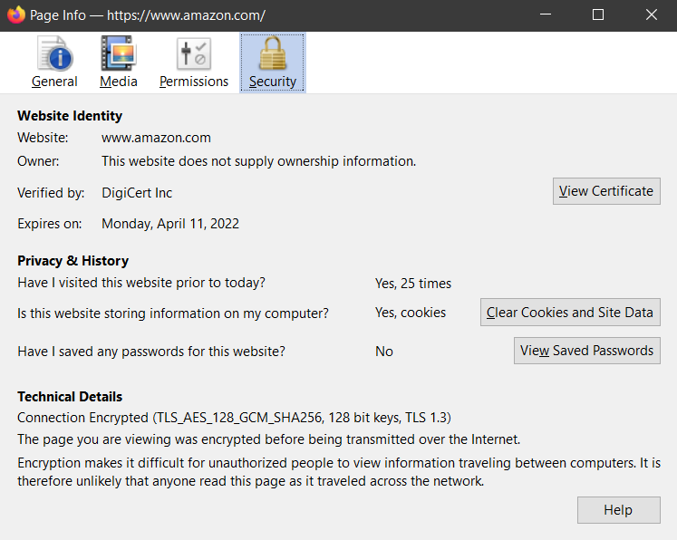
Notes:
The Firefox browser shows that my connection to www.Amazon.com is using AES_128_GCM for symmetric encryption and SHA-256 for integrity hashes. The third-party authority that vouches for this certificate is DigiCert Inc.
There’s also a button that lets me view Amazon’s digital certificate.

Slide 49
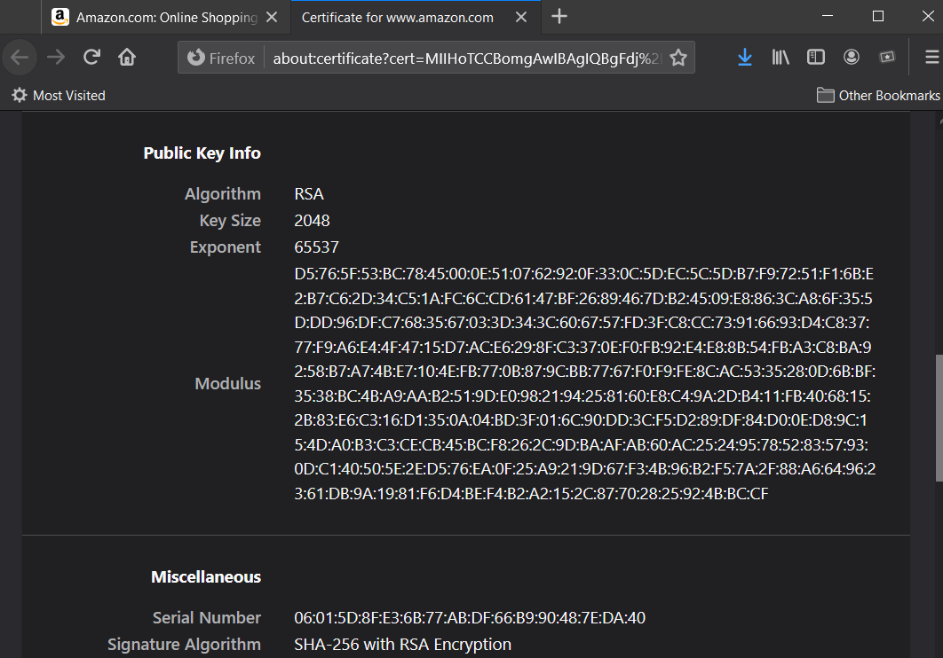
Notes:
When I view the details of the www.amazon.com certificate, I see that it uses RSA for its asymmetric encryption algorithm, and I can see its public key. Its exponent is 65537, and its divisor is such a big number that 512 hexadecimal digits are required to show all of it.

Slide 50
4.
HOW DOES CRYPTOGRAPHY AFFECT OUR LIVES?
HOW?
-··· -·-- ··- ··
Notes:
How else does cryptography affect our lives?

Slide 51
Cryptograpy
Private/reliable remote transactions
Intellectual property and licensing
Digital watermarks
Cryptocurrency, block-chain ledgers, non-fungible tokens
Notes:
In addition to online shopping, here are just a few more applications that feature cryptographic algorithms among their ingredients:
Other remote transactions, such as donations or items shared on social media sites.
DRM assertions of limited rights to use and enjoy intellectual property, including text, audio, video, and interactive content.
Digital identifying markers that are kept in digital copies of documents and media.
Experiments that leverage “block-chains” of cryptographically signed digital records to implement alternative financial investment vehicles.

Slide 52
DISCUSSION
Thanks!
Notes:
What else would you like to talk about?

Slide 53
CREDITS, CITATIONS, LICENSE
Tip-of-the-hat to BYU-I’s CyberSecurity Association (official student society): https://byuicsa.org/
Presentation template
https://www.slidescarnival.com/
Pigpen diagram
Wrixon, Fred B. (1998). Codes, Ciphers, and other Cryptic & Clandestine Communication. Black Dog & Leventhal Publishers, Inc. ISBN 1-57912-040-7. pp 182-183.
Ciphertext engines
https://icyberchef.com/
Portrait of Euclid
Gordon Johnson, courtesy of Pixabay
Pigpen typeface
https://fontmeme.com/fonts/pigpen-cipher-font/
Hand, scytale, AES, and Raspberry Pi images
https://commons.wikimedia.org/
License: CC BY-SA 3.0
Notes:
I was pleased to use others’ resources while preparing for this lecture. Thanks.

Slide 54
CRYPTOGRAPHY: WHY and HOW?
Carl Gibbons
Computer Information Technology
https://byui-cit.github.io/gibbonsc/
Notes:
Thank you for attending this lecture.

Slide 55

Free templates for all your presentation needs
For PowerPoint and Google Slides
100% free for personal or commercial use
Ready to use, professional and customizable
Blow your audience away with attractive visuals

