Slide 1
CIT 361/CYBER 360: Advanced Scripting
5.1: The Windows Registry

Slide 2
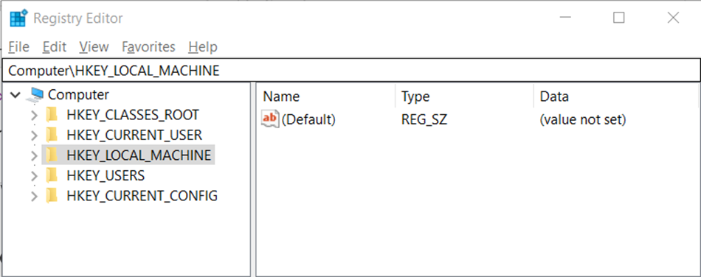
Hives, Keys, and Registry Entries
Hives: collections of registered configurations
Keys: nodes in a hive’s tree structure
Entries: properties (names and values) placed in a key.

Slide 3
Using PowerShell to browse the Registry
Get-PSDrives
Set-Location HKLM: Get-ChildItem
One of the registry keys in HKEY_LOCAL_MACHINE is named Security, which requires elevated privilege, and produces an exception message. To suppress this error output:
Get-ChildItem –ErrorAction SilentlyContinue
To get the registry entries inside a key:
Get-ItemProperty -Path HKLM:\Software\Microsoft\Windows\CurrentVersion\Run

Slide 4
Security Concerns
Attackers may query the registry to learn more about a workstation or server.
What applications are registered?
What security options are configured?
Is it a virtual machine, or a honeypot or sandbox?
Are any credentials (logins/passwords) stored in the registry?
Attackers may also exploit the registry to maintain persistent access to a compromised host:
HKLM:\Software\Microsoft\Windows\CurrentVersion\Run
HKLM:\Software\Microsoft\Windows\CurrentVersion\RunOnce
HKCU:\Software\Microsoft\Windows\CurrentVersion\Run
HKCU:\Software\Microsoft\Windows\CurrentVersion\RunOnce

Slide 5
Exercise
Your first exercise this week helps you practice with Windows Registry operations.

