Slide 1
CYBER 360: Advanced Scripting
9.2: Authoring Modules

Slide 2
Module Terminology
Module Member: a function, variable, or alias defined inside a module script. Using Export-ModuleMember, a module can control which of its members are made available
Module Manifest: a data file (it’s actually a PowerShell script with a very limited subset of allowed syntax) that contains information about the module and how it should be loaded.
Module Type: either script, binary, cim, or manifest. Different PowerShell module types are implemented differently.
Nested Module: If a module requires some other module as a prerequisite, it can call Import-Module to load it, or it can add it to the NestedModules element of its module manifest. The top-level module in a tree of nested modules is called the Root module.
PowerShell in Action, 3e, p274

Slide 3
Writing a PowerShell module
A module is just a PowerShell script, but it has a .psm1 file extension instead of a .ps1 extension. Use Import-Module or using module to load a module.
By default, all functions are exported, but script-scoped variables aren’t. You may use Export-ModuleMember to control which members are exported, but once you use it, only those listed module members are made available (exported).
Example:
Export-ModuleMember –Function *-count –Variable increment

Slide 4
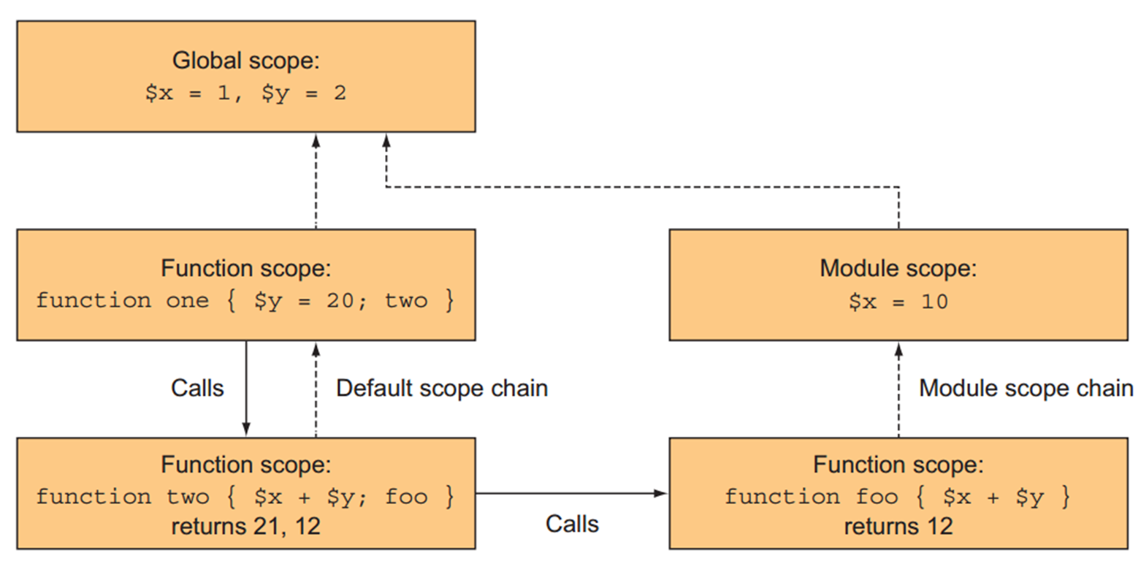
About Scopes in Modules
PowerShell in Action, 3e, p302

Slide 5
Nested Modules
When Import-Module is used from within a module, the imported module becomes a nested module.
By default, a nested module’s imported functions are only visible from within the module that imported it. Instead of downloading and installing a module, you can download only (don’t install) with the Save-Module cmdlet.
The module author can override this behavior with a –Scope parameter. Examples:
Import-Module <module name> -Scope global
Import-Module <module name> -Scope local
If Import-Module is called from within a module’s function, its imported members are only available in that function!

Slide 6
Exercise
For your second exercise this week, you will create a custom module that improves upon PowerShell’s Invoke-WebRequest cmdlet. You will also experiment with script-level scope for a variable in the module, and experiment with exporting module members.

