Slide 1
CIT 361/CYBER 360: Advanced Scripting
4.4: Windows Events and Linux/Unix syslogs

Slide 2
Events and Logs
Windows uses structured data objects to represent audit records and to log system events.
Linux/Unix uses syslog text string data for event logging.
Two codes are associated with each syslog:
Facility (a service or software associated with the logged message)
Examples: kern, user, mail, auth, news, cron, ftp, ntp, local0-local7)
Severity (one of eight “levels of pain” associated with the logged message)
7: debug
6: information
5: notice
4: warning
3: error
2: critical
1: alert
0: panic
There is a logger command that generates new syslog messages. Useful in scripts.

Slide 3
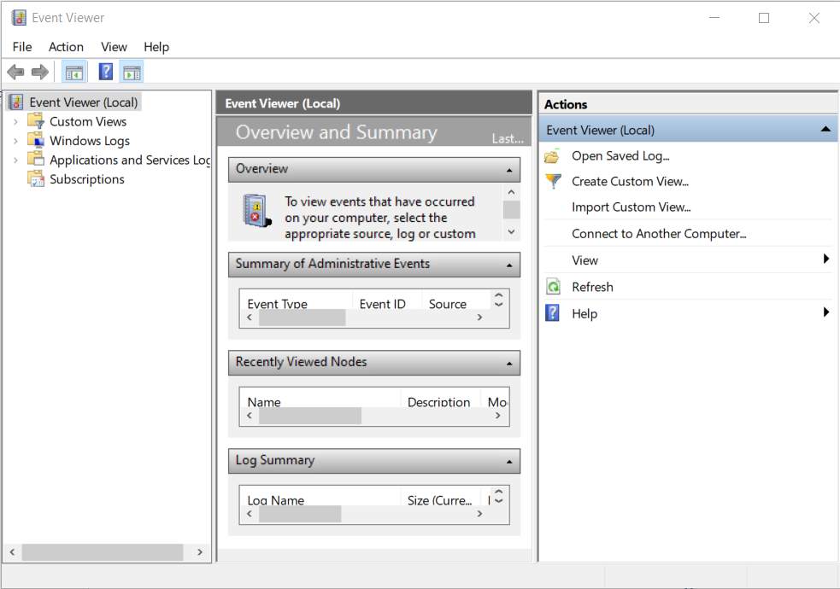
Windows Event Viewer app

Slide 4
Legacy CLI command wevtutil
wevtutil /?
Help documentation
A few of its subcommands:
el | enum-logs # lists names of all of the event logs
gl | get-log # shows log configuration settings
sl | set-log # changes log configuration settings
qe | query-events # fetch the actual event logs themselves
gli | get-log-info # show status of an event log and its associated event file
cl | clear-log # back up events from a log, then empty it to prepare for fresh events

Slide 5
Navigate Windows Events using PowerShell Core
Get-WinEvent
Read or fetch event objects and log providers
New-WinEvent
Create and append a new event object to an event log
These two commands also work in Windows PowerShell (Desktop).
(There were other *-EventLog cmdlets in Windows PowerShell, but those have been deprecated.)

Slide 6
Event IDs
Associated with every event object is an Event ID number.
System administrators and security practitioners learn over time to identify particular Event IDs that may be relevant to their investigations.
Textbook chapter 4 suggests several to start with:
400: The engine state changed from none to available # PowerShell versions
800: The pipeline execution details for the command line # PowerShell cmdlets
4104: Creating ScriptBlock Text # Can occur when ScriptBlockLogging is enabled
40961: The PowerShell console is starting up # monitor for users opening PowerShell
6: Creating a WSMan session # Occurs when a PowerShell remoting session happens
… and many more

Slide 7
EventList
Third-party module invented and maintained by the textbook author
Download and install the EventList module from PowerShellGallery.com:
Install-Module EventList
To open its Graphical User Interface utility:
Open-EventListGUI
Expects you to have rudimentary awareness of Security baselines and Mitre ATT&CK frameworks.
Then you can use it to automatically generate lists of additional Windows Event IDs that you may collect and use, together with a SIEM or with other security baseline tools, to help you with security audits and monitoring tasks.

Slide 8
Exercise
Your next exercise this week helps you practice with Windows Events and Linux/Unix syslogs.

