Slide 1
CIT 361/CYBER 360: Advanced Scripting
2.1: Variables

Slide 2
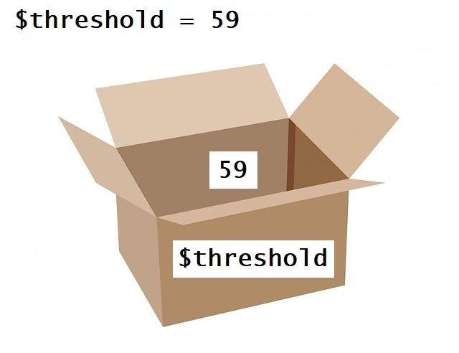
A Variable is a Named Data Container
In PowerShell, all variable names begin with a $ (dollar symbol).
The = (equal sign) is the variable assignment operator. For clarity, think of this operator as “gets the value” rather than “equals.”
So in this example, the variable $threshold gets the value 59.
“Named Data Container” metaphor:
59: the value inside the container
$threshold: the label written on the outside of the container

Slide 3
Loosely Typed vs. Constrained Type
The value of a PowerShell variable can be any object of any class:
$x = -4
$x.GetType().FullName # returns System.Int32
$x = Get-Date
$x.GetType().FullName # returns System.DateTime
Optionally, if you need to constrain the type of a variable, prefix its assignment operation with a square bracketed type name:
[int]$x = 7
$x = "seven" # throws an error
$x = Get-Date # throws an error
[DateTime]$x = Get-Date # recreates the variable, different type constraint

Slide 4
Multiple valued type: array
An array with multiple values is created with the , (comma) operator:
$a = -1, "two", (Get-Date) # two commas to create a three-element array
$single = ,3 # unary comma operator creates an array with just one element
$a.GetType().FullName # returns System.Object[]
You can tell it’s an array by the square brackets in the type name, but because it’s loosely typed, you can’t determine this way what data type might be in any of its elements.
To access an element, use a square-bracketed index suffix after the variable name:
$a[0] # returns -1
$a[1] # returns two
$a[2].GetType().Name # returns DateTime
The number between the square brackets is an offset count from the first element: the first is at index 0, the second at index 1, the third at index 2, etc.
Expect more facts about PowerShell arrays later…

Slide 5
Multiple valued type: hash table
A hash table is like an array but is indexed using names (or ‘keys’) instead of offset numbers.
$h = @{ Id = 2; Item="Robin" } # creates a two-element array
$h.GetType().FullName # returns System.Collections.Hashtable
To access an element, use a square-bracketed name suffix after the variable’s name:
$h["Id"] # returns 2
$h["Item"] # returns Robin
$h["Id"].GetType().Name # returns Int32
$h["Item"].GetType().Name # returns String
In this example the name between the square brackets is a string, so it must be quoted.
The value at a hash table’s name may be accessed like an encapsulated object’s property:
$h.Id # returns 2
$h.Item # returns Robin
Expect more facts about PowerShell hash tables later…

Slide 6
Automatic variables (1)
Boolean constants:
$true # returns True
$false # returns False
Unassigned or empty value:
$null # doesn’t return any output.
$null.GetType() # throws an error. (Object doesn’t exist; can’t invoke method)
The value in $? holds success or failure of the previous command or expression:
$null
$? # returns True, because previous command evaluated successfully without error
$null.GetType()
$? #returns False, because previous command threw an error

Slide 7
Automatic variables (2)
Automatic iterator variable $_:
Useful in pipelines, where the objects output by one command become the input to a subsequent command. Example:
3, 2, 1 | Foreach-Object {Write-Output "Countdown: $_"}
Outputs:
Countdown: 3
Countdown: 2
Countdown: 1
In this example, an array of three integer objects is passed through the pipe. The Foreach-Object command executes a script block in a loop, once for each object in the pipeline. The automatic variable $_ is the implied “loop variable” used in the script.
There are many other automatic variables, more than we can cover here:
Get-Help about_Automatic_Variables
Expect frequent fun with Foreach-Object commands later…

Slide 8
List variables using PSDrives
Get-ChildItem Variable:
Returns names (without the dollar sign prefix) and values of every variable.
Includes automatic variables as well as the variables you have assigned.
If a variable has been assigned, it will show up in this list.
If a variable isn’t in this list, an attempt to retrieve its value will return $null.
To remove a variable $x that you have assigned:
Remove-Variable x # (Note: omit the dollar prefix)
Get-ChildItem Env:
Returns names and values of environment variables.
Example: get the value of the Path environment variable, converted to an array:
$env:Path –split ';'
If you’re curious for more:
Get-Help about_Variables
Get-Help about_Environment_Variables

Slide 9
Scopes: security for variables
At the PowerShell command line, variables have global scope.
When you start writing scripts, there will be situations for which we don’t want a script to change the value of a globally available variable. You can limit a variable to a more restricted script scope, which the script can modify it as necessary while it’s running, but still leave the global variables unmolested.
In-class exercise: Get-VariableScope.ps1 script.
If you’re curious for more:
Get-Help about_Scopes

Slide 10
Exercise
This unit’s first exercise is a short drill manipulating variables.

