Slide 1
CIT 361/CYBER 360: Advanced Scripting
5.2: User Rights

Slide 2
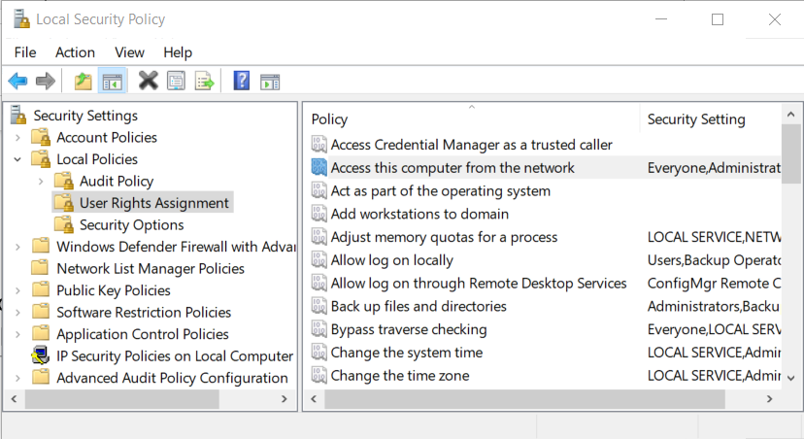
Local Security Policy management console

Slide 3
Principle of Least Privilege - operation
If a user needs a privilege to perform a work task, then grant the user that privilege.
If a user doesn’t need a privilege to perform a task, then don’t grant the privilege.
If a user needed and was previously granted a privilege, but the associated task is completed and they don’t now need the privilege, then remove the privilege that was granted.

Slide 4
Principle of Least Privilege - complexity
Privilege management (access management) is difficult to maintain.
User dimension: more users → many complex varieties of granted privileges.
Solutions include group-policy access controls, role-based access controls.
Privilege dimension: more privilege granularities → complex privilege relationships.
Solutions include rule-based access controls, attribute-based access controls.

Slide 5
Principle of Least Privilege - governance
Strive to balance security and convenience.
Security governance in an agile enterprise requires rapid access management adjustments.
Continually assess the need for any friction introduced or removed by access management.
Track metrics that are relevant to the business.
How quickly can a user be authenticated and authorized to be granted a necessary privilege?
After a user no longer requires a privilege, how quickly is the situation verified and the privilege revoked?

Slide 6
secedit.exe
Legacy Command Prompt utility for working with security settings
The following command creates a configuration text file that contains key-value pairs.
The keys represent various security privileges.
The values at each key are lists of security identifiers (SIDs) of the local users and groups which are granted each privilege.
secedit /export /areas USER_RIGHTS /cfg C:\Temp\secedit.txt
Add another switch option /mergedpolicy to the command above to get domain-managed settings along with the locally configured users and groups.
The following PowerShell commands translate the security identifier *S-1-5-19 into the friendlier name of its user or group:
$s=New-Object System.Security.Principal.SecurityIdentifier('S-1-5-19')
$s.Translate([System.Security.Principal.NTAccount]).Value

Slide 7
Exercise
Your next exercise this week explores:
User Rights settings in the Local Security management console
secedit.exe.

