Slide 1
CYBER 360: Advanced Scripting
9.1: Modules In-Depth

Slide 2
Review: PowerShell modules
Recall from your chapter 2 study:
PowerShell cmdlets and functions may be organized into Modules.
Filesystem locations where PowerShell expects to find modules: $Env:PSModulePath
PowerShell Gallery: https://www.powershellgallery.com/
Cmdlets for finding and installing new modules:
Find-Module, Install-Module
Cmdlets for working with installed modules:
Get-Module, Get-Command –Module <module name>, Remove-Module

Slide 3
Cmdlets for authoring PowerShell modules
Cmdlets to granularly specify cmdlets, functions, aliases, and/or variables that will be made available:
Export-ModuleMember
Cmdlets for working with module manifest (.psd1) files:
New-Module
New-ModuleManifest
Update-ModuleManifest
Test-ModuleManifest

Slide 4
Modules can include PowerShell classes (to provide new custom data types)
If a module provides new classes, use
using module <module name>
to load the module. (If it just provides cmdlets, functions, aliases, and/or variables, you may use the Import-Module cmdlet instead.)
A module is automatically loaded when:
A cmdlet from that module is run,
Get-Command is used to find or learn about a module’s commands, or
Get-Help is used to get more info about a cmdlet in a module.

Slide 5
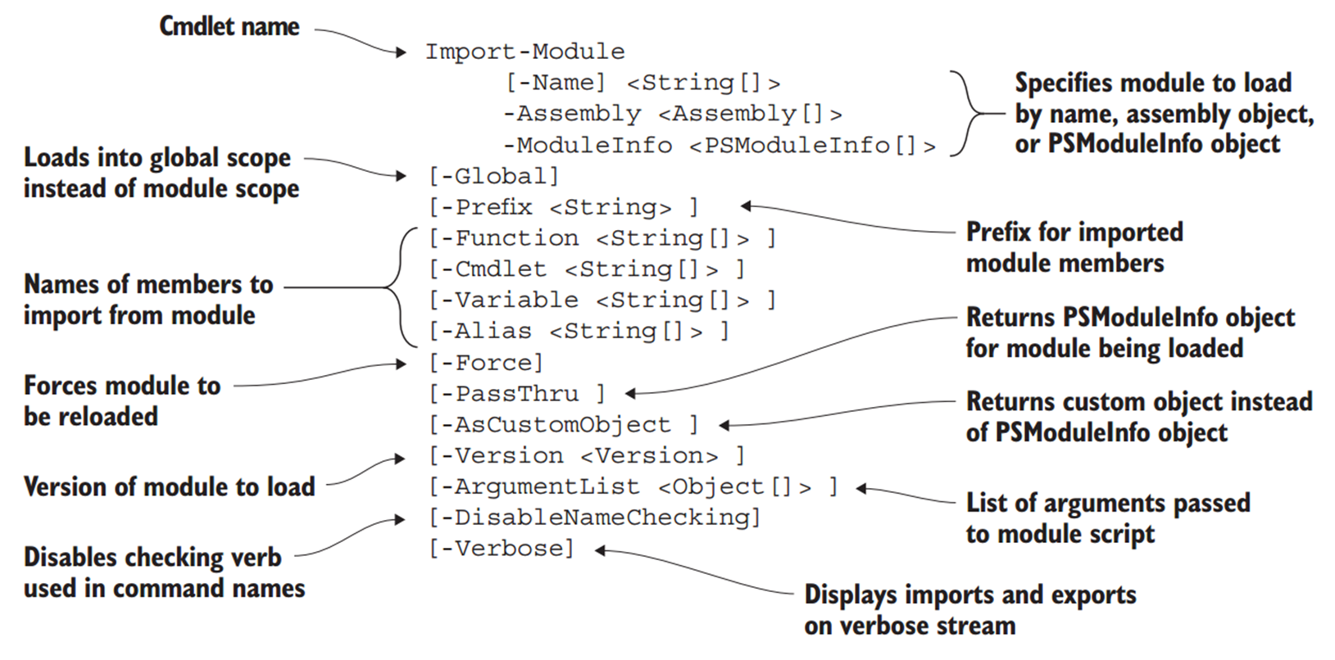
All about Import-Module
PowerShell in Action, 3e, p280

Slide 6
More module cmdlets
Instead of downloading and installing a module, you can download only (don’t install) with the Save-Module cmdlet.
You can register and use additional module repositories.
Get-PSRepository
Register-PSRepository
You can publish your own modules in your own repositories:
Publish-Module

Slide 7
Exercise
For your first exercise this week, you will explore module cmdlets in depth, install and use modules from the PowerShell gallery, import a custom module, and register a new repository.

