Slide 2
Create blocks by sorting
Unordered Student IQ’s
101
98
100
110
95
93
86
102
Ordered Student IQ’s
110
102
101
100
98
95
93
86
Ordered Student IQ’s
110
102
101
100
98
95
93
86
Randomly Assign Condition Within Block
New
Control
Control
New
Control
New
New
Control
Block 1
Block 1
Block 2
Block 2
Block 3
Block 3
Block 4
Block 4

Slide 3
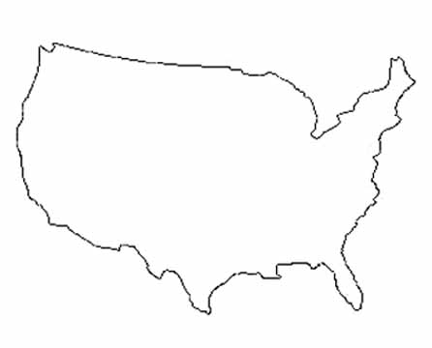
Seed varieties of A, B, and C
A | C | B
B | C | A
Field 1
Field 3
B | A | C
A | B | C
Field 7
B | C | A
Field 4
Field 2
C | A | B
A | B | C
Field 6
Each field is a block
Field 5
This Photo by Unknown Author is licensed under CC BY-NC-ND

Slide 4
Peter
Aaron
Ella
Yung
Alaina
Nikola
Etc.
oscillating
by hand
ultra sonic
sonic
by hand
sonic
oscillating
ultra sonic
by hand
ultra sonic
sonic
oscillating
sonic
ultra sonic
oscillating
by hand
ultra sonic
oscillating
by hand
sonic
oscillating
sonic
by hand
ultr sonic
Period 1
Etc.
Period 2
Etc.
Period 3
Etc.
Period 4
Etc.

