Slide 1
House Price Prediction IBM Data Science Professional Coursera Eddie Park

Slide 2
Contents
1. Dataset
2. Methodology
3. Result
4. Conclusion & Discussion

Slide 3
Dataset & Methodology
Dataset is imported from Kaggle competition of House Price Prediction.
Dataset contains 80 features
The purpose of the competition is to predict values of SalePrice column in the test data set using other features.
To predict the value, we are going to use multiple regression model with customized number of features.

Slide 4
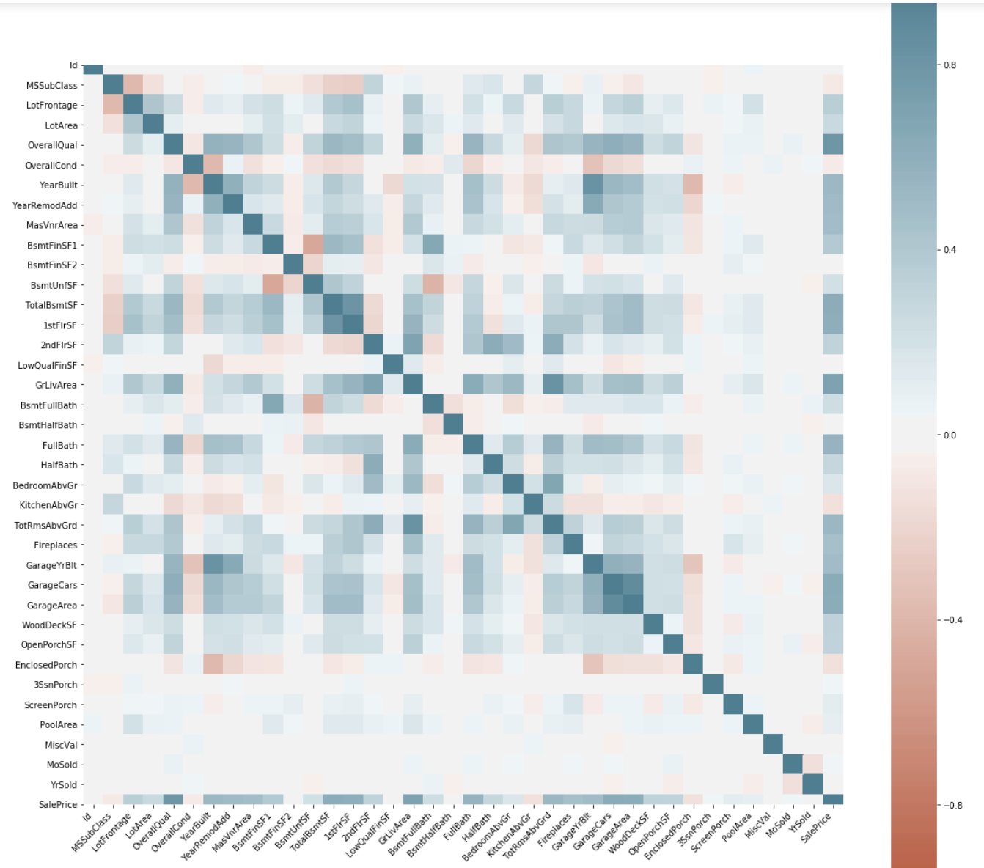
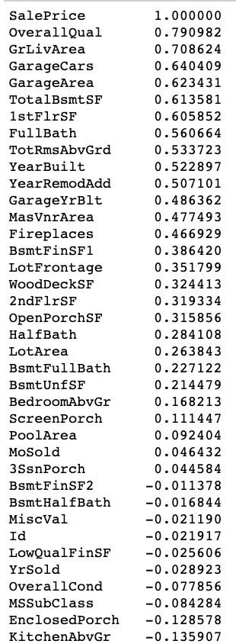
Correlation Heatmap & value

Slide 5
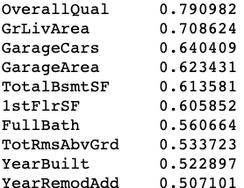

Using Top 10 Most Correlated Features
Yields a decent R squared value
0.81 R2-score means our regression model can explain 81% of the variance around the mean.

Slide 6
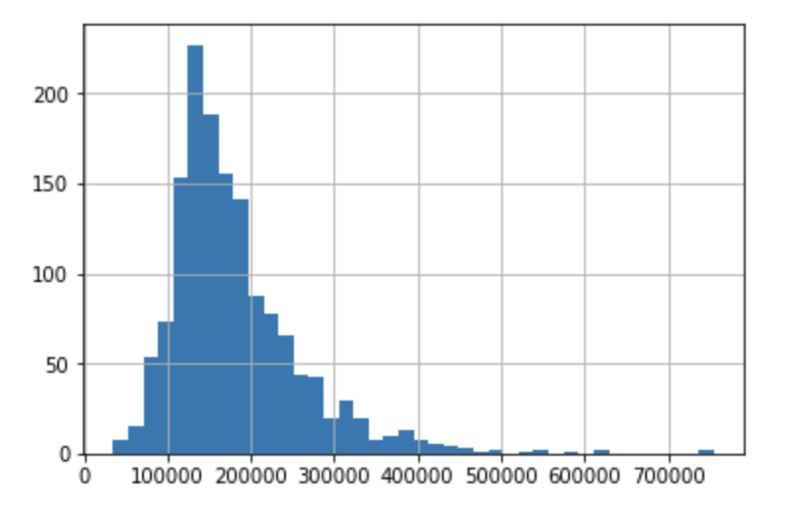
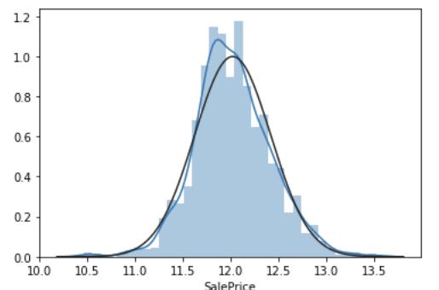
Skewness of SalePrice value

Slide 7
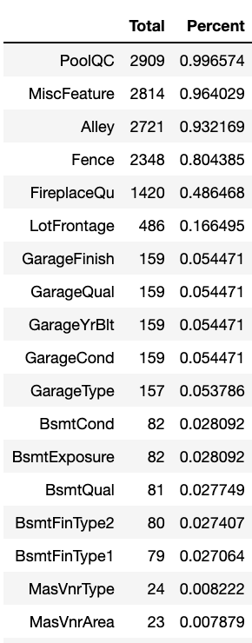
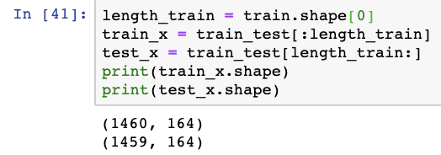

For Simplicity, Dropped Columns with Missing Values
After dropping columns with missing values and using pandas.get_dummies function, number of features increased from 80 to 163.

Slide 8
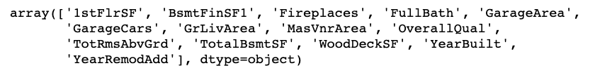

Using Top 16 Most Correlated Features
Same R-squared value with top 10 most correlated features model
But this mode produces better result in Kaggle competition
We can conclude that additional 5 features make a meaningful contribution in predicting sale price of a house
Notes:
No good becomes a free good

Slide 9
Conclusion & Discussion
Regression mode with top 16 most correlated features produced the best performance
We can improve the performance of our model by excluding outliers
Adding categorical features only makes the model more complex and overfitted
Simple model sometimes produce the best result
Other advanced machine learning model like XGBoost might produce a better result
Notes:
No good becomes a free good

