Slide 1
Image Compare Tool
GUI Visual Guide Byung Geun (BG) Jun | March 2026

Slide 2
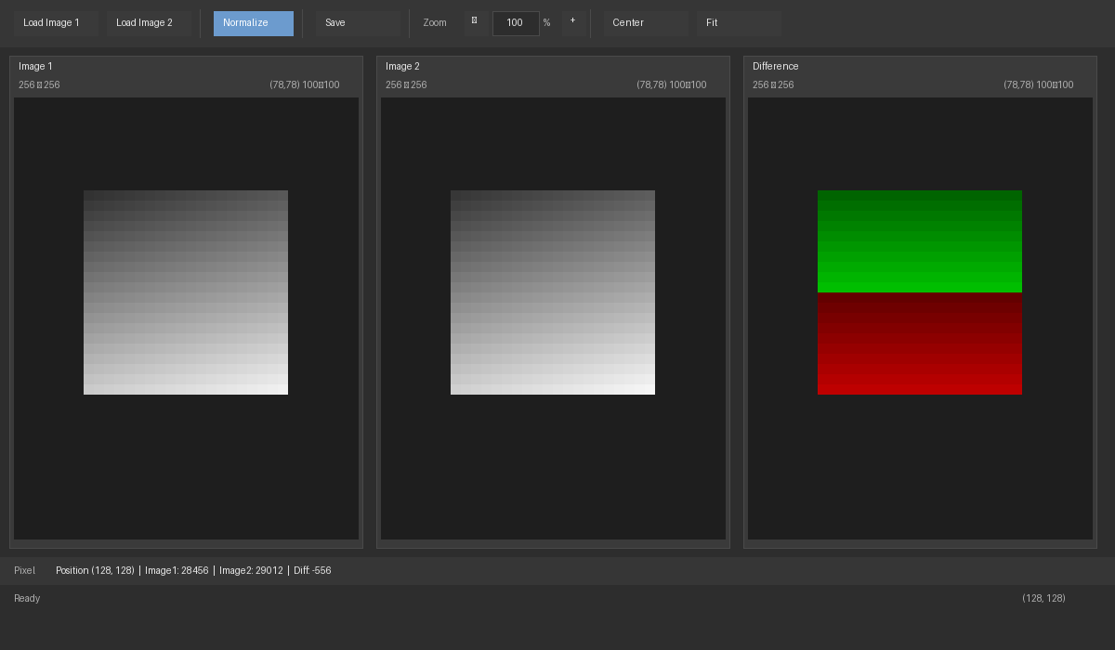
Main Interface Overview
Three-panel view with Control Panel, Image Panels, and Status Bars

Slide 3
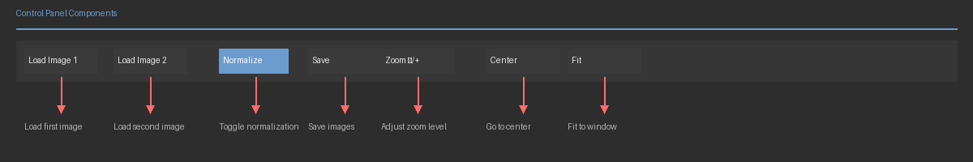
Control Panel Components
All controls for image loading, normalization, saving, and navigation

Slide 4
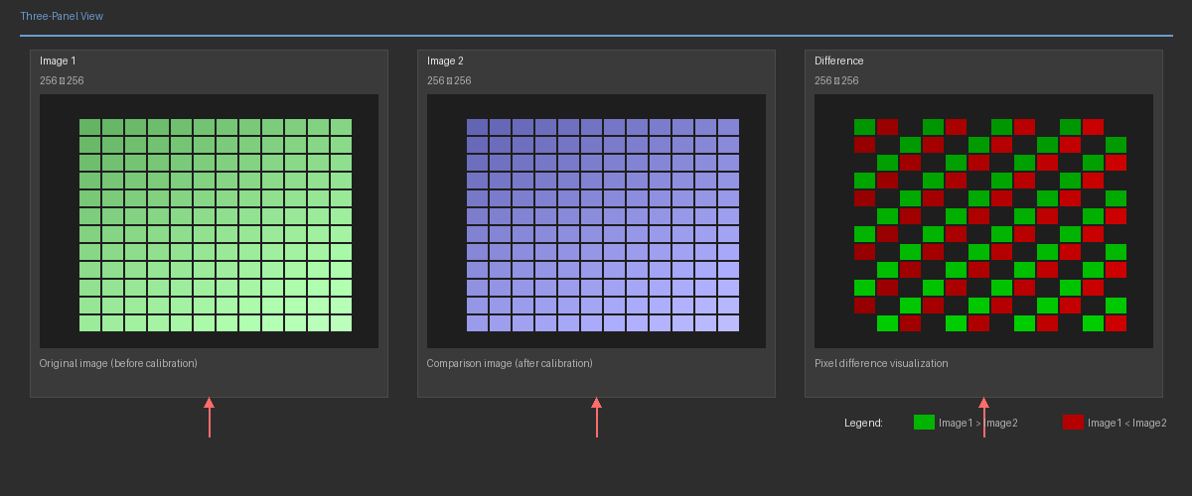
Three-Panel Image View
Left: Image 1 | Center: Image 2 | Right: Difference visualization

Slide 5
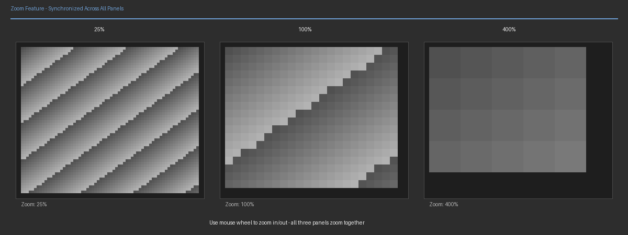
Synchronized Zoom Feature
All three panels zoom together - use mouse wheel or +/- buttons

Slide 6
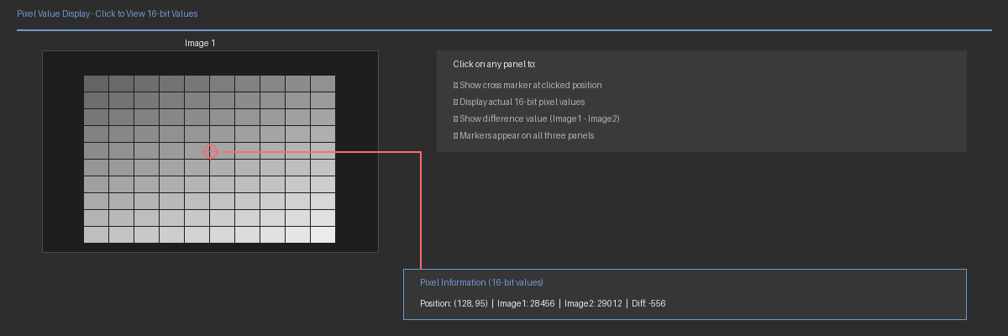
Pixel Value Display
Click on any panel to view actual 16-bit pixel values

Slide 7
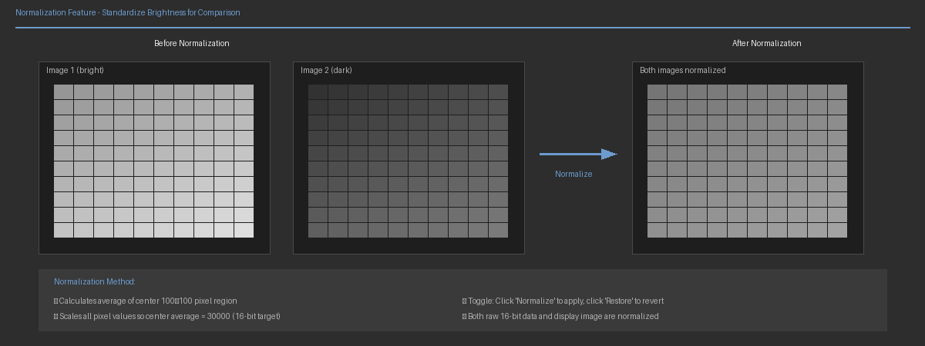
Image Normalization
Standardize brightness based on center 100×100 region average

Slide 8
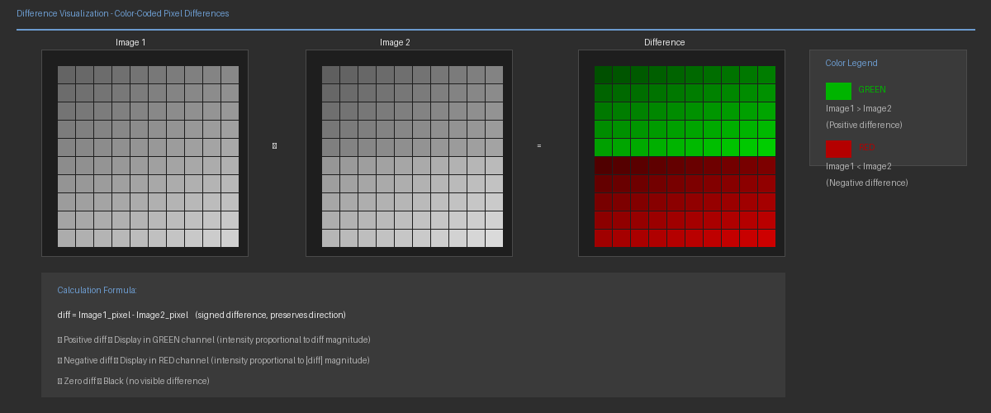
Difference Visualization
Color-coded difference: GREEN = Image1 > Image2, RED = Image1 < Image2

Slide 9
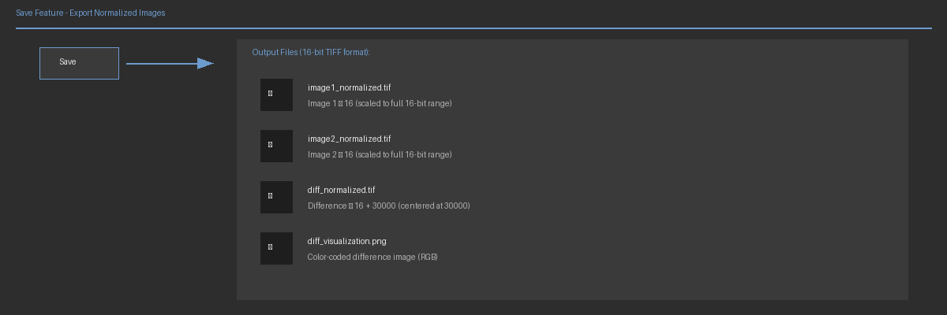
Save Feature
Export normalized images as 16-bit TIFF files

Slide 10
Thank You
Questions & Discussion Contact: byungpaul@meta.com

