Slide 1
mysql

Slide 2
Show databases
1 use DB명
2. show tables;
3. desc 테이블명 (테이블구조
4. select * from 테이블명
5. insert into 테이블(필드,,) valuse 값
6. update 테이블 set 필드1=변경값 where 조건;
7. delete from 테이블 where 조건;

Slide 3
Update member join set userPw=‘1111’, userHobbys=‘야구, 축구’ where userId=‘m1’; 수정
From member join where userId=‘m1’ 확인
Drop databases member / member db를 삭제/

Slide 4
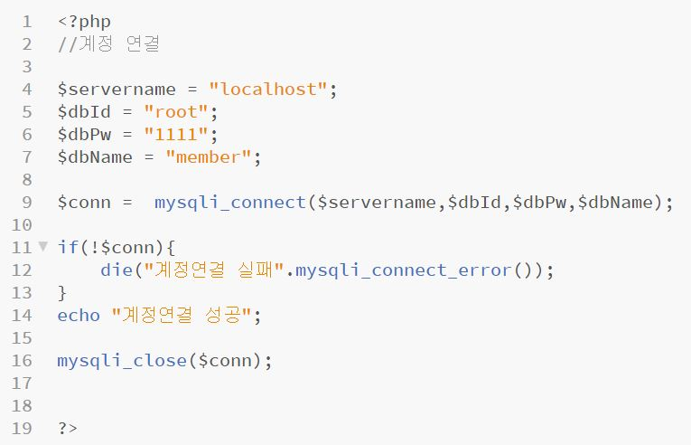
연결하고 반드시 mysqli_close() 시켜준다.

Slide 5
$conn=new mysqli(“호스트 이름”, “계정아이디”, “계정비밀번호”, “db명”);

Slide 6
실습
1. 회원가입(join.php)
2. joinOk.php <<>> dbConnect.php(db연결)
3. 정상적회원가입 login.php
joinOk.php loginOk.php
Index.php join.php login.php<<
db 생성 member3
테이블 joinMember

Slide 7
CREATE SCHEMA `member3` DEFAULT CHARACTER SET utf8 ;
CREATE TABLE `joinmember` ( `userId` varchar(100) NOT NULL, `userPw` varchar(100) NOT NULL, `userGender` varchar(45) NOT NULL, `userHobbys` varchar(200) NOT NULL, `userPhone` varchar(200) NOT NULL, PRIMARY KEY (`userId`)) ENGINE=InnoDB DEFAULT CHARSET=utf8

