Slide 1
IoTDataViewer
App by –
Anshul rawat
Akshay arora
Sumit kumar

Slide 2
ACCOUNT CREATION
User can signup in two ways – Providing his own API_KEY during signup or Not providing the key and using API_KEY provided by us
If he provides his own API_KEY then during signup all of his created channels are fetched and stored in our database.
If he uses our API_KEY then our account is multiplexed and a new user account is created . This user can create channels under our account and is given access to only his/her added channels
Our database ( on firebase ) stores information of users like name phone number ,email ,password and API_KEY
It also stores the channels created or added by a particular user
USER IS VERIFIED USING 4 DIGIT OTP

Slide 3
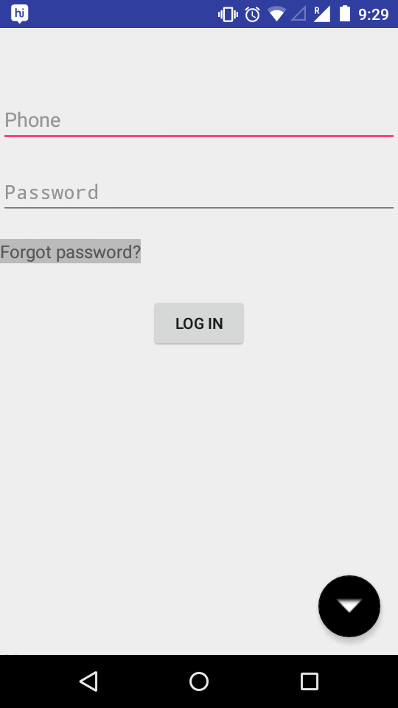
LOGIN SCREEN

Slide 4
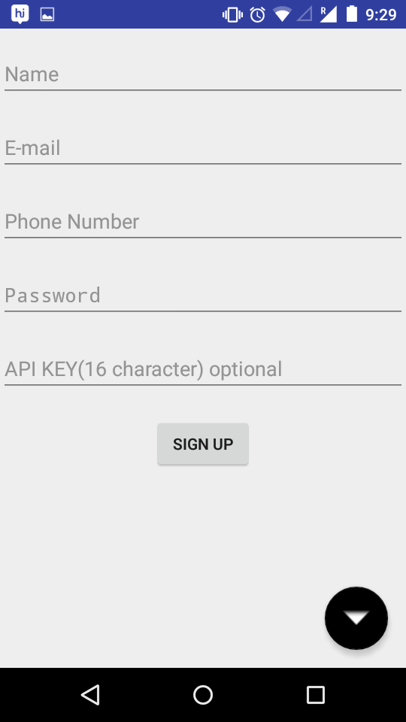
SIGNUP SCREEN

Slide 5
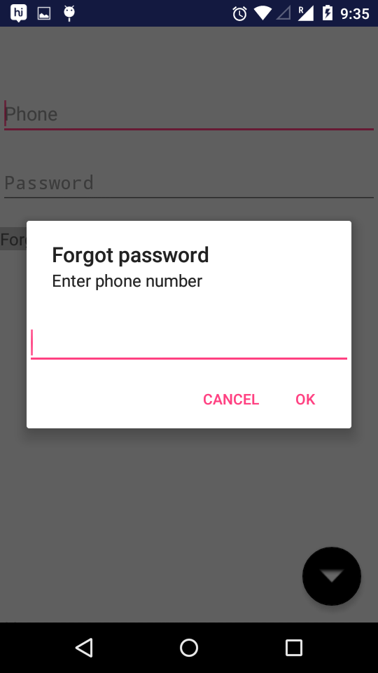
FORGOT PASSWORD

Slide 6
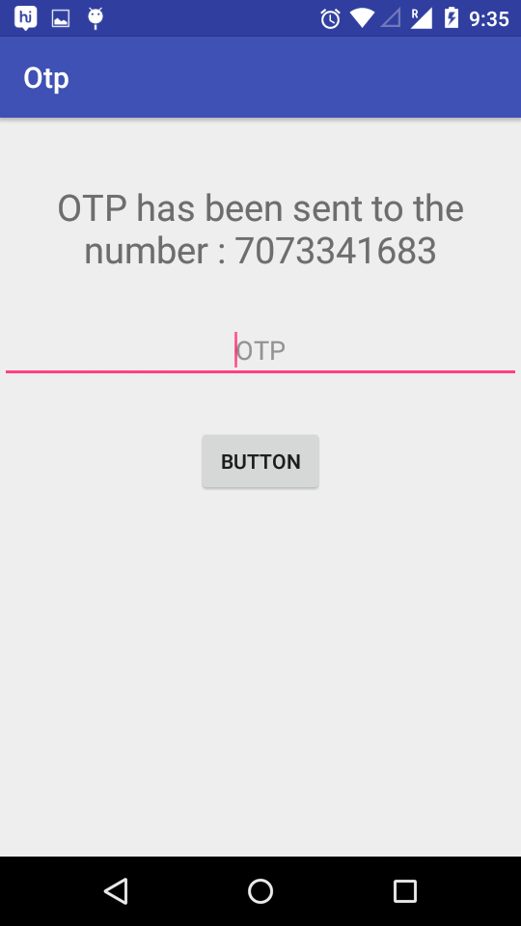
OTP VERIFICATION

Slide 7
MAIN SCREEN
Channel ID added by the user are shown in different CARDS
User can create new channels
User can add new public channels to his channel’s list
User can delete a channel by long press on card ( a popup menu confirms the delete operation )
User can single click on a card to see it’s details

Slide 8
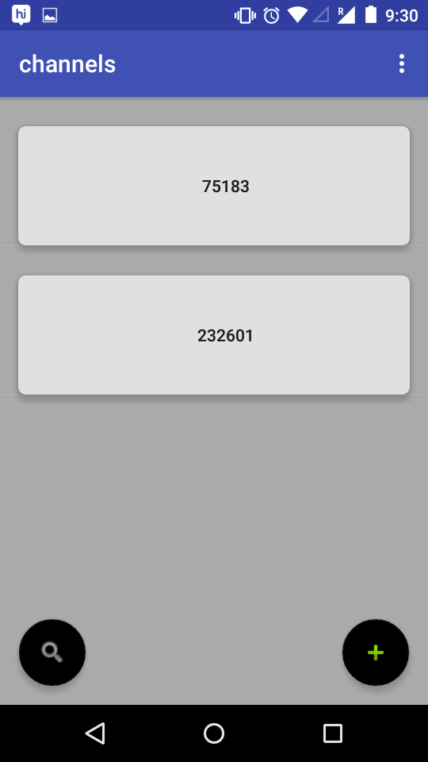
MAIN SCREEN

Slide 9
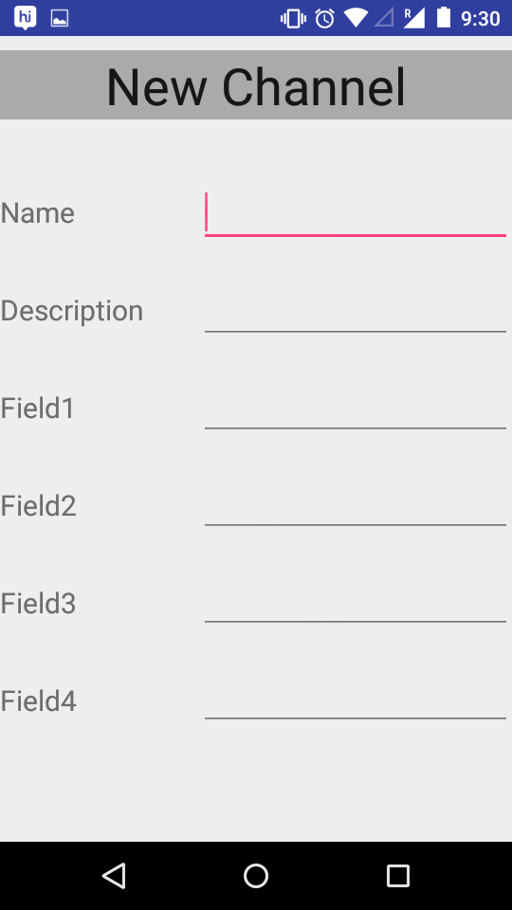
CREATE CHANNEL

Slide 10
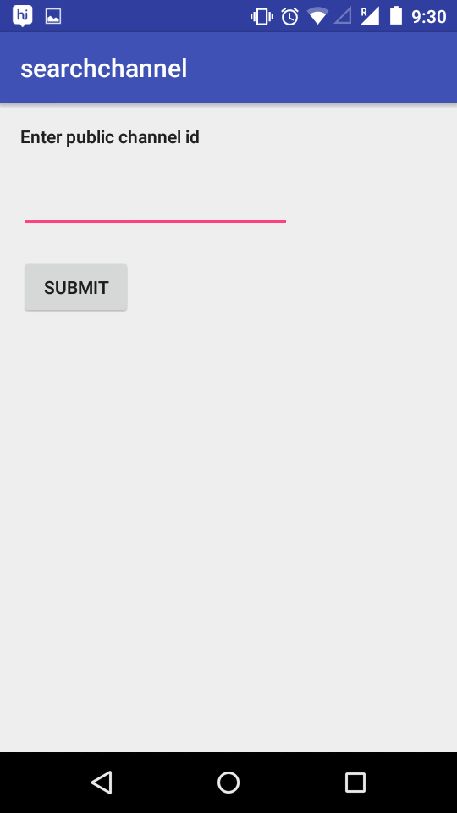
SEARCH PUBLIC CHANNEL

Slide 11
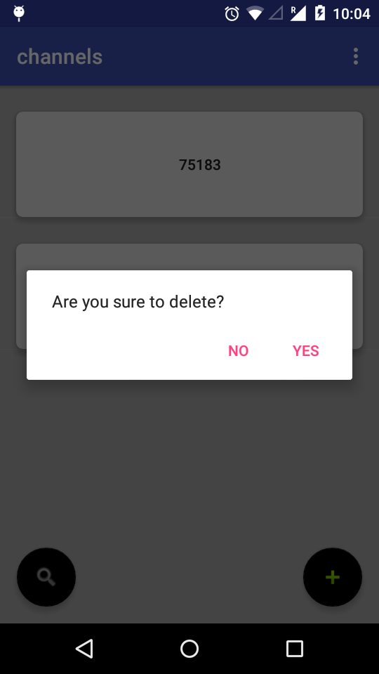
Delete Channel

Slide 12
Channel Details
Details like channel id , channel name , description
Cards of fields are displayed below the description
Field details can be seen by clicking on the specific field
Channel can be updated from the update channel button by bottom right of screen

Slide 13
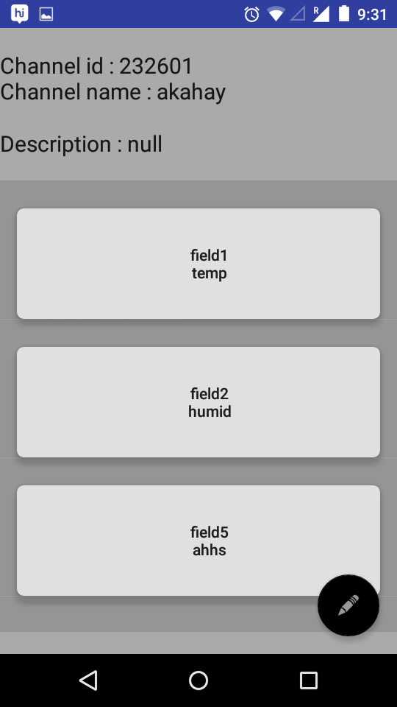
CHANNEL DETAILS

Slide 14
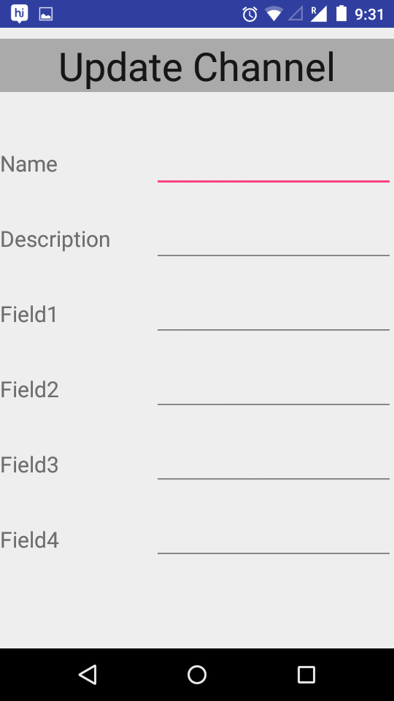
UPDATE CHANNEL

Slide 15
Field details
Two latest values from a given field are displayed : recent one on top
The chart related to the field is shown below
Frequency of data fetch can be set using drop down menu provided
Threshold value for the field can be set for sending notifications alerts every time the value in field is exceeded ( Even if the app is not running )

Slide 16
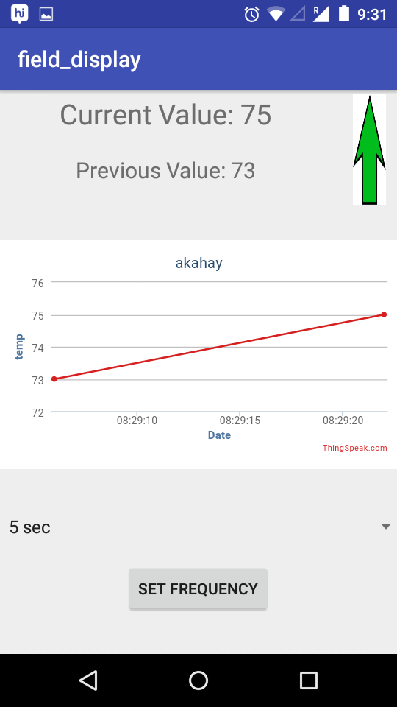
FIELD DETAILS

Slide 17
Push Notification
Push Notification on exceeding threshold value for a field
Used polling technique implemented in python to fetch data from thingspeak.com , compare it with threshold values, and sending push notification to specific android devices through firebase cloud messaging service
Threshold values for specific field can be set from the field details menu
This value is stored in a firebase database and fetched

Slide 18
Other Features
If user has logged in once , he is not required to login again the next time he opens the app
Logout button is provided
User can change password
User can enable disable notifications
While fetching data from internet a loading screen disables all features

Slide 19
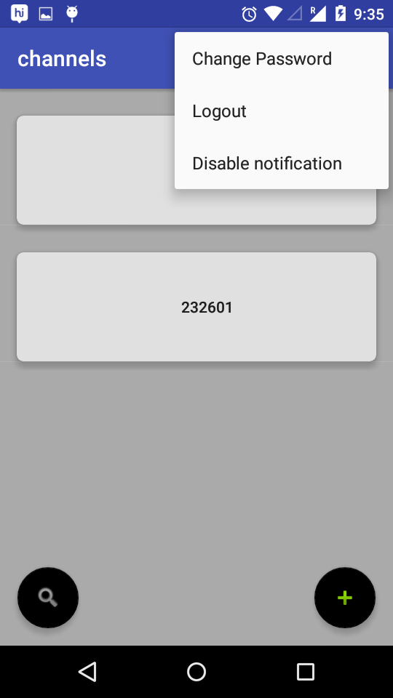
Other Features

Slide 20
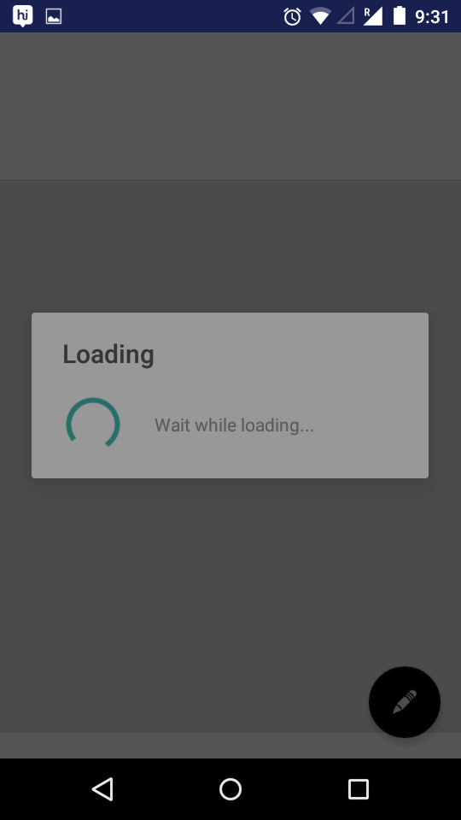
Other Features

Slide 21
THANK YOU

