Slide 1
starphone

Slide 2
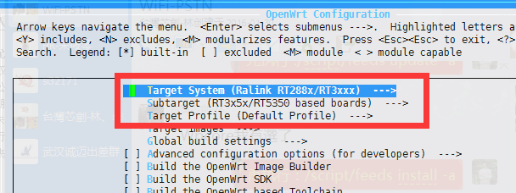
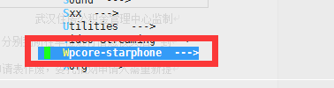
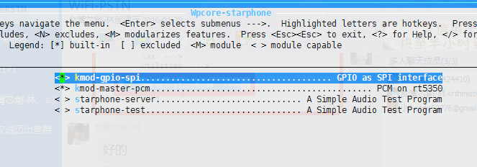
下载代码方式
git clone https://github.com/byxlk/openwrt-rt5350.git git checkout innodev-tech.com ./script/feeds update -a ./script/feeds install -a
make menuconfig make V=99

Slide 3
Mobile phone
main
WIFI
Network Communication
Openwrt RT5350F
Modem Application Interface
PCM
SPI
INT
RESET
AUDIO Drvier
Pcm
CTRL Driver
SPI/INT/Reset
Si3050 + Si3019
Si3050 Hardware
TIP
RING
Phone switch

