Slide 1
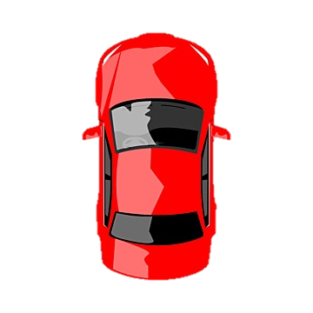
3
4
2
7
5
1
7
6

Slide 2
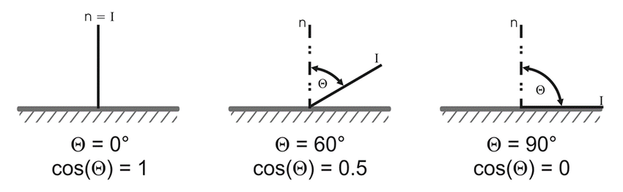
Software Flowchart
Phone
Video feed
Colour Mask
Output: 3 sets of np.array
Who: Jack lord
Perspective Transform
3 sets of np.array
Bryce
Via IP Webcam app
Car
Laptop
Car Control
Steers the car
Jack Zhang
UART Thread
String
Jack Zhang
Path Planner
(direction, speed)
everyone
Via Bluetooth Serial Connection
Python queue
3 sets: blue, yellow and purple
Np.array: Python Numpy arrays. Size NX2, where N is the number of points marking the outline of the colour region. The first column is the x- and second is the y-coordinates of each point.
Direction: Integer in degrees (positive for turning left). direction the path planner tells the car to drive in (Θ in the diagram on the right)
Speed: integer between 0 and 255. The maximum PWM value written to the motors on the car.
Python queue: each element is a string in the format: “/ <direction> <speed>”
Forward

Slide 3
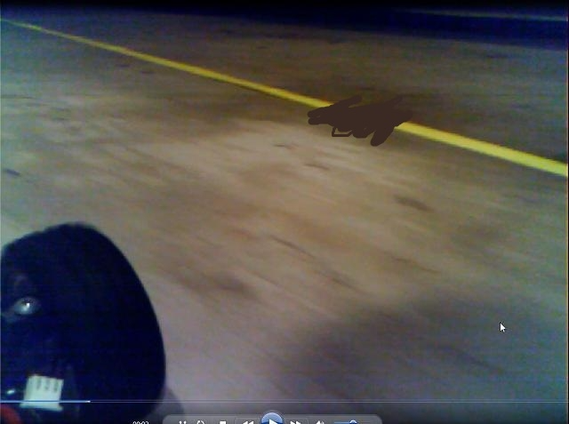
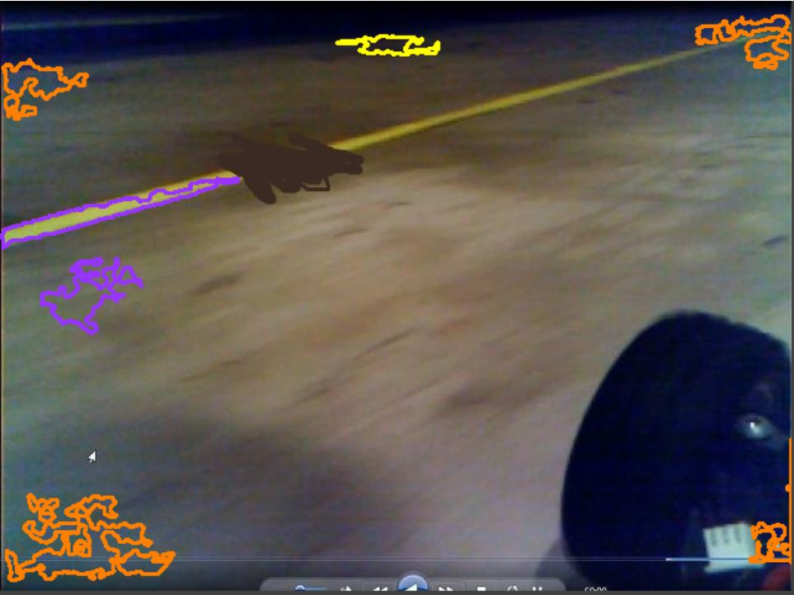
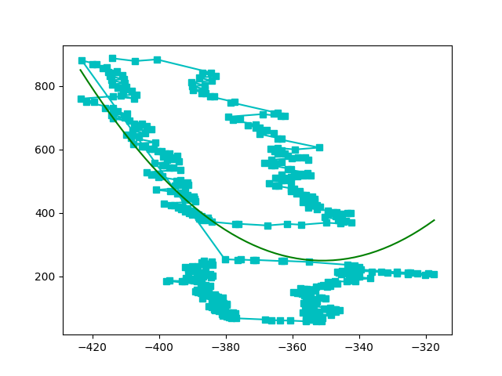
GUI Layout
Raw Video Feed (from Ib)
Outlines from colour masking (from Jack L)
The /example_code colour masking is bad, so this is the only correct outline marking the yellow line. LOL.
After perspective transform (from Bryce)
Empty space, just in case we need to add something else
The gap is the black scribble from the video to simulate imperfect camera capture of the yellow line.
Ignore the green line
The arrow indicate the direction the path planner tells the car to drive in. Its length represents the speed. Car is at the base of the arrow. Needs text annotation showing direction and speed in PWM. Negative degree is turn right, and positive degree is turn left.
-30 deg
PWM: 200

